Slide 1
The Role of DNA Evidence in Criminal defenses cases: the case of People v. Castro
professor jim n. mayua
Grace-Juliana Liwanga

Slide 2
aGenda
I. Introduction
A. Historical Background
B. People v. Castro
C. Significant of the issue
II. Legal Basis
Federal
Georgia
III. Definitions of concept
IV. Analysis of Data
V. Problems with DNA Evidence
VI. Conclusion and Recommendations

Slide 3
Why the issue of DNA evidence is significant
DNA is a powerful investigative tool because, with the exception of identical twins, no two people have the same DNA.
DNA evidence collected from a crime scene can be linked to a suspect or can eliminate a suspect from suspicion.

Slide 4
Why the issue of DNA evidence is significant
DNA evidence is playing a larger role than ever before in criminal cases:
to convict the guilty and
to exonerate those wrongly accused or convicted.
However, DNA evidence is not INFAILLIBLE
DNA EVIDENCE IS NOT ALWAYS EFFECTIVE

Slide 5
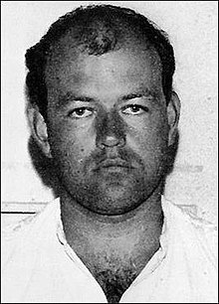
I. Introduction 1. Historical background
Colin Pitchfork
Colin Pitchfork was found guilty of raping and murdering and he was the first person in the world to be convicted using DNA fingerprinting technology
Practical use of DNA typing first came into existence in 1985 through the pioneering efforts of Dr. Alec Jeffreys of the University of Leicester in England.

Slide 6
I. Introduction
1. Historical background
Since the advent of DNA typing, United States courts have addressed DNA identification evidence in both civil and criminal matters.
The technique has gained popularity at an exponential rate from its introduction in the United States in 1987 until now.
Defense attorneys were unable to combat the evidence effectively or find scientists to testify against it.
The first that seriously challenged a DNA profile admissibility was
People v. Castro

Slide 7
II. People v. Castro (N.Y. Sup. Ct. 1989)
FACTS
The defendant stands accused of two counts of murder in the second degree, it being alleged that on February 5, 1987 he stabbed to death 20-year-old Vilma Ponce, who was 7 months pregnant at the time, and her 2-year-old daughter.

Slide 8
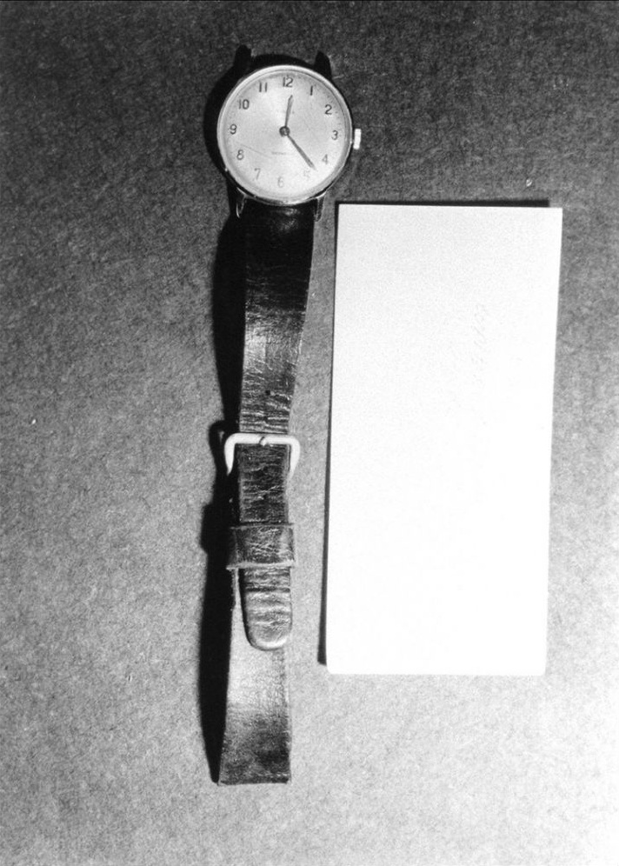
People v. Castro (N.Y. Sup. Ct. 1989)
FACTS
A wristwatch worn by the defendant at the time of his arrest was seized. What appeared to be bloodstains on the watch were noted by the detectives. The defendant stated that the blood was his own.

Slide 9
People v. Castro (N.Y. Sup. Ct. 1989)
ANALYSIS
To determine the admissibility of the DNA evidence.
The court launched a three-pronged analysis:
(1) is the theory generally accepted,
(2) are the procedures capable of producing reliable results, and
(3) did the laboratory perform the accepted techniques?
“The most comprehensive and extensive legal examination of DNA forensic tests held to date in the United States.",

Slide 10
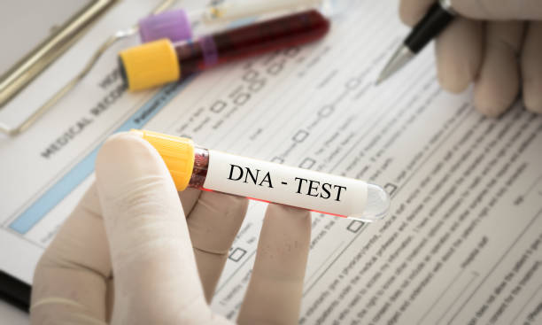
People v. Castro (N.Y. Sup. Ct. 1989)
RULING
The ruled that because the evidence revealed that the testing laboratory failed to comply with established testing procedures, the results were inherently unreliable and were inadmissible as a matter of law.

Slide 11
II. Legal basis
A. FEDERAL
(a) Statute
(A)The Attorney General may, as prescribed by the Attorney General in regulation, collect DNA samples from individuals who are arrested, facing charges, or convicted or from non-United States persons who are detained under the authority of the United States.
(b) Case law
The general-acceptance standard was first articulated in an influential 1923 federal case, Frye v United States, 293 F. 1013 (DC Cir. 1923).

Slide 12
Frye v United
James Alphonso Frye was an alleged murderer. The key legal issue in Frye v. United States was whether the systolic blood pressure deception test, as a scientific method for detecting deception, had gained enough acceptance among scientific experts in the relevant fields to be admissible as expert testimony in a court of law.

Slide 13
II. Legal basis
(b) Case law
Frye v. United States established one of the most influential rules of evidence in the history of American law.
In jurisdictions that follow Frye, the proponent of the scientific evidence must establish that the underlying theory and methodology are generally accepted within the relevant portions of the scientific community.

Slide 14
(B) Ga. Code § 35-3-160
(b) (1) A sample of deoxyribonucleic acid (DNA) shall be collected by oral swab or other noninvasive procedure from any individual: (A) Who has been convicted of a felony and is currently incarcerated in a detention facility, serving a probation sentence, or serving under the jurisdiction of the State Board of Pardons ...

Slide 15
DNA Evidence definition and function
DNA, or Deoxyribonucleic Acid, is the genetic material that uniquely identifies each person (except identical twins). It has become an indispensable tool in forensic science, primarily used to identify or exclude individuals from crime scenes.
DNA is generally used to solve crimes in one of two ways. In cases where a suspect is identified, a sample of that person’s DNA can be compared to evidence from the crime scene. The results of this comparison may help establish whether the suspect committed the crime.
In cases where a suspect has not yet been identified, biological evidence from the crime scene can be analyzed and compared to offender profiles in DNA databases to help identify the perpetrator. Crime scene evidence can also be linked to other crime scenes through the use of DNA databases.

Slide 16
Supporting Cases: The Innocence Project & Golden State Killer
Innocence Project The Innocence Project has been instrumental in overturning wrongful convictions, using DNA evidence to exonerate over 375 individuals. These cases demonstrate the strength of DNA in revealing the truth and correcting past injustices.
Golden State Killer The case of the Golden State Killer is a prime example of how DNA can solve cold cases. Using familial DNA searches, investigators were able to identify and capture Joseph James DeAngelo, decades after his crimes were committed.

Slide 17
Key Details of the Golden State Killer Case:
Key Details of the Golden State Killer Case:
Criminal Activity (1974–1986):
DeAngelo committed crimes across different regions in California and was known by several aliases based on the locations and the nature of his crimes:
Visalia Ransacker: In the mid-1970s, he began with a string of burglaries in Visalia, California.
East Area Rapist: In the late 1970s, he sexually assaulted numerous women in their homes, mainly in the Sacramento area.
Original Night Stalker: In the early 1980s, he committed a series of murders in Southern California, often targeting couples.
Modus Operandi:
DeAngelo was known for stalking his victims, often studying their routines before breaking into their homes. His crimes were methodical, and he would sometimes tie up his victims, taunting them while prolonging the attacks. In the cases involving couples, he would sometimes restrain the male partner and subject the female to sexual assault.

Slide 18
Analysis of Data
ADMISSIBILITY OF NOVEL SCIENTIFIC TECHNIQUES
Courts use two distinct approaches to determine the admissibility of novel scientific evidence.
(a) General acceptance
(b) General "relevancy" test

Slide 19
Iv. Analysis of data
ADMISSIBILITY OF NOVEL SCIENTIFIC TECHNIQUES
a) General acceptance
IS USED BY The majority of jurisdictions , the approach WAS ADOPTED SINCE 1923 case of Frye v. United States. When considering the admissibility of any evidence produced through new scientific procedures, a Frye jurisdiction requires that the procedures gain "general acceptance" within the appropriate scientific community.

Slide 20
Analysis of data
Attacks upon DNA typing usually focus on the "general acceptance" portion of the Frye test.
Because this technique finds its roots in molecular biology, chemistry, and population genetics,
THEREFORE, a court may have difficulty determining the appropriate scientific field before reaching the "general acceptance" question.

Slide 21
Analysis of data
(b) General acceptance relevancy test
Jurisdictions that do not adopt the Frye test apply a general "relevancy" test reflected in the Federal Rules of Evidence.
Under the federal rules, scientific evidence is treated as expert testimony; admissibility is conditioned on the qualification of the expert and the probative value of the evidence.

Slide 22
Interpreting DNA Test Results
Three types of results can occur in DNA testing:
inclusion, exclusion, and inconclusive.
It is important that victim service providers understand the meaning of these terms and be able to explain their implications.

Slide 23
Interpreting DNA Test Results
(a) Inclusion.
When the DNA profile of a victim or suspect is consistent with the DNA profile from the crime scene evidence, the individual is “included” as the possible source of that evidence.
However, the strength of inclusion depends upon the number of loci (locations on the DNA strand) examined and how common or rare the resulting DNA profile is in the general population.

Slide 24
Interpreting DNA Test Results
(b) Exclusion.
When the DNA profile from a victim or suspect is inconsistent with the DNA profile generated from the crime scene evidence, the individual is “excluded” as the donor of the evidence.
However, exclusion does not imply innocence. In a rape case, for example, a perpetrator wearing a condom could be excluded as a suspect because no semen was found at the crime scene, but evidence found elsewhere at the crime scene may include that same person as a suspect.

Slide 25
Interpreting DNA Test Results
(c)Inconclusive.
Inconclusive results indicate that DNA testing could neither include nor exclude an individual as the source of biological evidence.
Inconclusive results can occur for many reasons: for example, the quality or quantity of DNA may be insufficient to produce interpretable results, or the evidentiary sample may contain a mixture of DNA from several individuals (e.g., a sample taken from a victim of a gang rape).

Slide 26
Strengths and Weaknesses of DNA Evidence
Strengths
High Accuracy: DNA provides precise identification of suspects, making it one of the most reliable forms of evidence.
Solving Cold Cases: DNA can be preserved and tested years later, helping to solve previously unsolved crimes.
Weaknesses
Contamination Risk: DNA samples are highly sensitive to contamination, which can lead to incorrect results.
Human Error: Mistakes in lab procedures or mishandling can undermine the reliability of DNA evidence.

Slide 27
V. problems with dna evidence in court
Environmental factors such as heat, sunlight, bacteria and mold can destroy DNA evidence.
Identical twins share identical DNA.
DNA from close relatives is more similar than DNA from unrelated persons.
DNA cannot be used to determine WHEN the suspect was at the crime scene.

Slide 28
V. problems with dna evidence in court
One common challenge to the admissibility of DNA evidence involves the chain of custody—the documentation and handling of evidence from collection to analysis.
Defense attorneys may question whether DNA samples were properly preserved and handled to prevent contamination or tampering.

Slide 29
VI. Conclusion and Recommendations
Key Takeaways DNA evidence has proven to be a powerful tool in both solving crimes and exonerating the wrongfully convicted. However, it must be handled with care to ensure accuracy.
Recommendations
Improved Lab Protocols: Stricter forensic lab standards to prevent contamination and human error.
Juror Education: Ensure jurors understand both the strengths and limitations of DNA evidence.
As technology advances, DNA will continue to be a central component of criminal investigations, but legal safeguards must evolve alongside it.

Slide 30
THANK YOU!

