Slide 1
The Problem with Prison Overcrowding
Areyona Hurt
University of North Georgia

Slide 2
What Is Prison Crowding?
Prison overcrowding occurs when the number of prisoners exceeds the prison capacity.
Remains one of the most prominent problems within U.S. prisons with most prisons operating at 150% to 200%
Poses multiple legal, financial, and moral problems
Caused by a number of factors

Slide 3
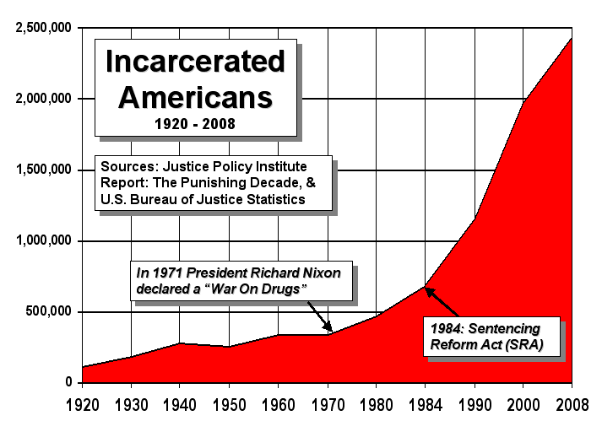
The Start of the Problem

Slide 4
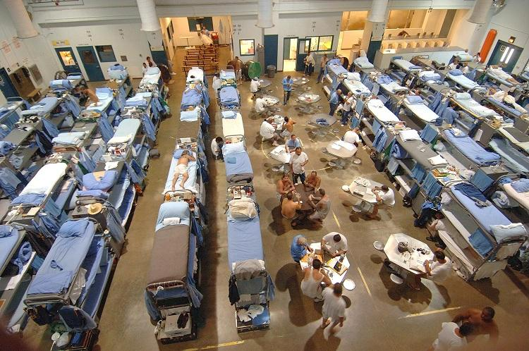
The Causes
Continued increase in the number of offenders sent to prison
Convicted inmates serving a greater portion of their sentences in prison
Aggressive "tough on crime" approach by legislature and criminal justice system

Slide 5
Results of Prison Overcrowding
Inmates often experience:
A lack of medical care
Increased violence within other inmates
A decline of mental health
A decline in physical health
There is a significant increase in the turnover rate among prison staff

Slide 6
Possible Solutions to Combat Prison Overcrowding
Prison Expansion Model
Community Corrections Model
Electronic Monitoring

