Slide 1
The challenge of prosecuting and preventing cybercrime: the case of United States v. Samuel Ogochi
Jim Nzonguma Mayua, Associate Professor, Albany State University
Arlexis Farmer, Student Albany State University
Mar’kaya Artist, Student Albany State University
Fall 2024

Slide 2
Agenda
Significance of the topic
Relevant cases
A. United States v. Samuel Ogoshi
B. United States v. GonzaleZ
III. Understanding Cybercrime
IV. Legal Basis
A. International law
B. Federal law
C. Georgia law
V. Problems related to the prosecution of cybercrime
VI.CONCLUSION AND RECOMMENDATIONS

Slide 3
Significance of the topic
Cybercrime has many impacts including monetary loss, emotional trauma, and reputation damage. When dealing with international cybercrimes it is unsure where it will be prosecuted and who will handle the case.
Computers, networks, and devices are increasingly becoming normal to use but the crimes are becoming harder to recognize

Slide 4
Significance of the topic
If it were measured as a country, then cybercrime — which is predicted to inflict damages totaling $9.5 trillion USD globally in 2024, according to Cybersecurity Ventures —
It would be the world’s third-largest economy after the U.S. and China, surpassing the wealth of entire nations.

Slide 5
Significance of the topic
One of the main impacts seems to be financial. “According to FBI reports, Secretary Mayorkas of the Department of Homeland Security highlighted losses related to cybercrime exceeding $4.1 billion in 2020” (Proofpoint, n.d.).
Georgia ranked among the states that experienced the most cybercrime losses, which cost the state roughly $300 million in 2023. (The Center Square)

Slide 6
Significance of the topic

Slide 7
Significance of the topic
Twenty percent of minors who are cyber bullied consider suicide, while ten percent actually attempt to take their own lives, resulting in approximately 4,500 deaths per year (Murray).

Slide 8
Significance of the topic
How track down sophisticated users who commit unlawful acts on the Internet while hiding their identities
Part of the struggle to combat cyber crime is that we don't know what we don't know.
Cross-border attacks make cybercrime difficult for law enforcement to deal with, constrained as they are by national boundaries.

Slide 9
Significance of the topic
Constitutionally, crimes must be prosecuted in the states and districts in which they were committed.
However, cybercrime has complicated the venue inquiry.

Slide 10
United States v. Samuel Ogoshi
Jordan John DeMay (June 7, 2004 – March 25, 2022), a 17-year-old high school student from Marquette, Michigan, was found dead in his bed at his father's home on the morning of March 25, 2022. He had died from a self-inflicted gunshot wound about four hours before his body was discovered.

Slide 11
United States v. Samuel Ogoshi
After their son's death, John and Jennifer learned that he had been a victim of sextortion. A group of men from Nigeria had posed a young woman on Instagram using the handle dani.robertss. As Dani, they convinced Jordan to send explicit photos of himself to them. After receiving the photos, they threatened to make them public if Jordan did not pay them.
Sextortion: a form of blackmail where someone threatens to share a nude
or sexual image or video of you unless you give in to their demands

Slide 12
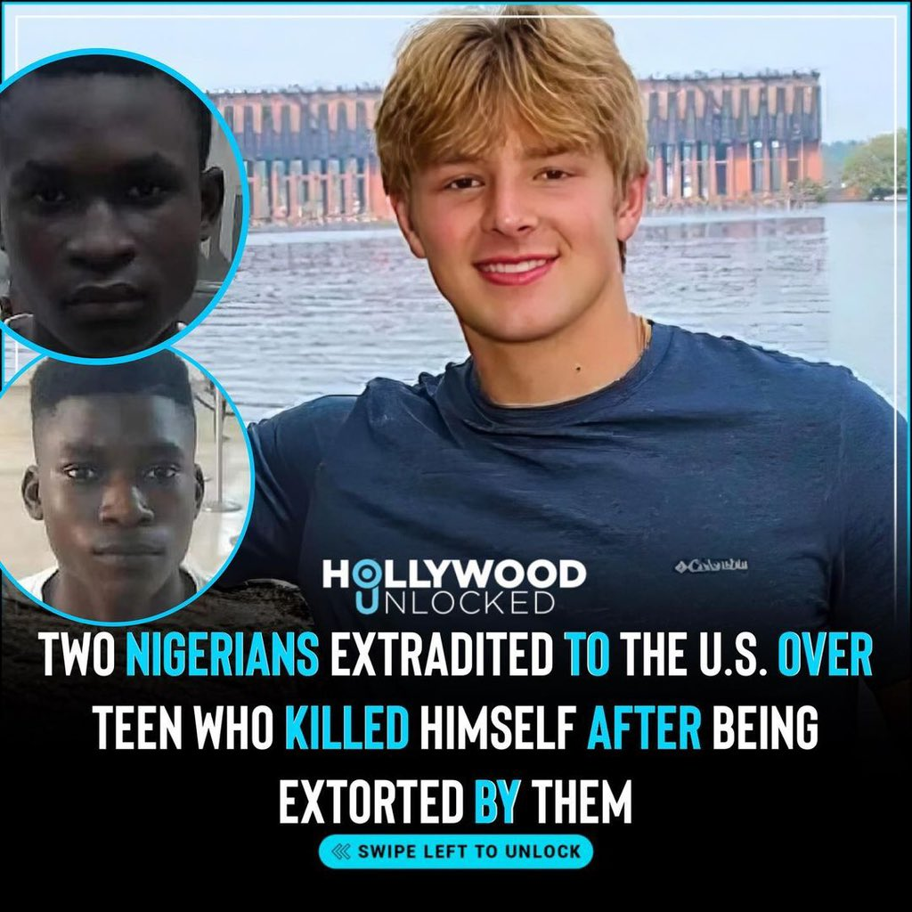
United States v. Samuel Ogoshi
When Jordan was unable to pay the $1000 they demanded, he messaged that he would commit suicide because of them. The brothers responded: "Good. Do that fast...Or I’ll make you do it...I swear to God."
His parents decided to go public to help raise awareness and garner support for the extradition of those involved.

Slide 13
United States v. Samuel Ogoshi
Legal proceedings
In May 2023, indictments were issued against Samuel and Samson Ogoshi, brothers from Lagos, Nigeria. They were arrested by Nigerian police in January 2023. On July 20, 2023, a judge ordered that they be turned over to the United States and on August 3, 2023, the Solicitor-General of Nigeria signed the surrender order. The men involved, Samuel Ogoshi (22), Samson Ogoshi (20), and Ezekiel Ejeham Robert (19), were extradited from Nigeria to face criminal charges in the United States for their role in DeMay's death.

Slide 14
United States v. Samuel Ogoshi
The Ogoshi brothers pled guilty to sexually extorting teenage boys and young men in April 2024. U.S. attorney for the Western District of Michigan Mark Totten stated: “[The] guilty pleas represent an extraordinary success in the prosecution of international sextortion. These convictions will send a message to criminals in Nigeria and every corner of the globe: working with our partners both here and overseas, we can find you and we can bring you to justice.

Slide 15
United States v. Samuel Ogoshi
Charges
All three men are charged with conspiracy to sexually exploit minors, which carries a mandatory sentence of 15 years in prison, conspiracy to distribute child pornography, which carries a minimum sentence of 5 years in prison, and conspiracy to commit stalking through the internet, which has no minimum sentence but a maximum sentence of 5 years. Samuel Ogoshi is additionally charged with Sexual Exploitation and Attempted Sexual Exploitation of a Minor Resulting in Death, which carried a mandatory sentence of 30 years in prison with the possibility of a life sentence.
On September 4, 2024, both Samuel and Samson Ogoshi were sentenced 17.5 years in prison. The third defendant, Ezekiel Robert, is currently appealing his extradition.

Slide 16
United States v. GonzaleZ
He was accused of being the mastermind of a group of hackers called the ShadowCrew group, which trafficked 1.5 million in stolen credit and ATM card numbers.
He was said to have masterminded the hacking of TJX Companies, in which 45.6 million credit and debit card numbers were stolen over an 18-month period ending in 2007, topping the 2005 breach of 40 million records at CardSystems Solutions.

Slide 17
United States v. GonzaleZ
Co-defendants
Gonzalez had multiple US co-defendants for the Dave & Buster's and TJX thefts. The main ones were charged and sentenced as follows:
Stephen Watt was charged with providing a data theft tool in an identity theft case. He was sentenced to two years in prison and 3 years of supervised release. He was also ordered by the court to pay back $250,000 in restitution.[
Damon Patrick Toey pleaded guilty to wire fraud, credit card fraud, and aggravated identity theft and received a five-year sentence.[
Christopher Scott pleaded guilty to conspiracy, unauthorized access to computer systems, access device fraud and identity theft. He was sentenced to seven years.

Slide 18
United States v. GonzaleZ
On March 25, 2010, U.S. District Judge Patti Saris sentenced Gonzalez to 20 years in prison for hacking into and stealing information from TJX, Office Max, the Dave & Busters restaurant chain, Barnes & Noble and a string of other companies. The next day, U.S. District Court Judge Douglas P. Woodlock sentenced him to 20 years in connection with the Heartland Payment Systems case. The sentences were ordered to run concurrently, meaning that Gonzalez will serve a total of 20 years for both cases.
Gonzalez (inmate number: 25702-050) served his 20-year sentence at the FMC Lexington, a medical facility. He was released on September 19, 2023.

Slide 19
Definition of the concept
Cybercrime, the use of a computer as an instrument to further illegal ends, such as committing fraud trafficking in child pornography and intellectual property, stealing identities, or violating privacy (Dennis, 2024).
Forms of cybercrime
Cybercrime takes many forms, and it is therefore difficult to fight.

Slide 20
Definition of the concept
Common forms of cybercrime include:
phishing: using fake email messages to get personal information from internet users;
misusing personal information (identity theft);
hacking: shutting down or misusing websites or computer networks;
spreading hate and inciting terrorism;
distributing child pornography;
grooming: making sexual advances to minors.

Slide 21
Definition of the concept
Nowadays, all digital devices (including computers, tablets, and smartphones) are connected to the internet. In theory, cyber criminals could bring a large part of the Netherlands to a halt. The government rightly takes cybercrime very seriously, and we are working hard to fight it.

Slide 22
Impact of cybercrime
Impact of Cyber Crime over Society
Conceptually, crime is a dynamic and relative phenomenon and subjected to the relative sociopolitical & economical changes occurring in existing system of society. Therefore, neither all-time suitable comprehensive definition encompassing all aspects of ‘crime’ is possible at any moment of time nor can a single definition be made applicable to different society
Impact of Cyber Crime over Teenager
These days a worst fear in teenager’s eyes is Cyber Bullying. Cyber Bullying is a fear when person receives threats, negative comments or negative pictures or comments from other person. United States v. Ogoshi

Slide 23
Legal basis
International Laws
International Laws on Federal Laws The Convention on Cybercrime, primarily known as the Council of Europe Convention on Cybercrime, targets cyber-attacks done solely through technology. The Convention came about in 2001 but came into force on July 1, 2004. Over two decades later, it is still the most useful international agreement on cybercrime.

Slide 24
Legal basis
Federal
The Computer Fraud and Abuse Act (“CFAA”), codified at Title 18, United States Code, Section 1030, is an important law for prosecutors to address cyber-based crimes.
The CFAA prohibits intentionally accessing a computer without authorization or more than authorization but fails to define what “without authorization” means

Slide 25
Legal basis
Georgia Law
(h)Criminal Penalties.(1) Any person convicted of the crime of computer theft, computer trespass, computer invasion of privacy, or computer forgery shall be fined not more than $50,000.00 or imprisoned not more than 15 years, or both.
(2) Any person convicted of computer password disclosure shall be fined not more than $5,000.00 or incarcerated for a period not to exceed one year, or both

Slide 26
Problems to prosecute cybercrime
Cybercrime is almost always a cross-border event, with criminals targeting victims in foreign countries to reduce the risk of arrest. Cross-border attacks make cybercrime difficult for law enforcement to deal with, constrained as they are by national boundaries.

Slide 27
Problems to prosecute cybercrime
Most of the time, the person committing the crime is located outside of the country (or at least outside the legal jurisdiction of the court and prosecutors seeking the conviction)
It’s hard enough to successfully prosecute a cyber criminal if they originate in the same jurisdiction as the victim.
In United States v. Samuel Ogoshi, the third defendant, Ezekiel Robert, is currently appealing his extradition.

Slide 28
Conclusion
We must take action to combat Cybercrime through increased awareness and preventative measures.
The government still has an important role to play, but most of the prevention needs to be done by commercial entities producing software and those with the ability to stop fraud. Relying on consumer education programs will only affect a percentage of possible victims. The others need to be automatically protected through measures that

Slide 29
Recommendations
“Cyber criminals have the battlefield advantage: it's easier to attack than to defend, as defending requires more effort and resources. Therefore, the public and private sectors must act together to develop collective cyber threat intelligence and detection sharing, security and technology and coordinated incident response mechanisms.
By joining forces and creating concrete channels for collaboration, we can make a decisive shift in the fight against cybercrime."

Slide 30
recommendations
“The most effective way to fight cybercrime is to come together. Each sector, business and organization has different insights into the threat ecosystem, skillsets to disrupt malicious infrastructure and abilities to hold criminals accountable.

Slide 31
The lack of harmonized national cybercrime laws, international standardization of evidentiary requirements (both in terms of admissibility in a court of law, and in terms of international state responsibility), mutual legal assistance on cybercrime matters, and timely collection, preservation, and sharing of digital .

Slide 32
Thank you!

