Slide 1
Reducing Recruiting Issues in Law Enforcement: A survey of Georgia Cadets
Butch Beach, D.P.A., Professor, Point University
Rudy K. Prine, Ph.D, Professor, Valdosta State University
Michael Wilkie, D.P.A., Georgia Association of Chiefs of Police

Slide 2
History of Police Recruiting Issues
PERF has documented recruiting issues since the 1990s
Throughout the 21st Century (2000s) police officer recruitment has been a concern for police agencies (Butterfield, 2001)
Recruitment and retention of officers is an increasing challenge for police agencies (Rand, 2009)
Chiefs across the nation have placed officer recruitment and retention as the second most pressing issue for them. Exceeded only by funding (Wilson, et.al., 2010)
Identifying sources of the recruiting challenge remains problematic, in part, because the symptoms vary greatly by jurisdiction.

Slide 3
History of Police Recruiting Issues
However, some of those issues seem to be consistent over time.
External to Policing
Economic conditions
Social conditions
Work-life changes, et.al.
Greater number of recruits have problems such as obesity, substance abuse, etc.
Younger generation is less interested in the regimented style

Slide 4
History of Police Recruiting Issues
Internal to Policing
Lack of Training Opportunities
Lack of Competitive Compensation Packages
Salary
Retirement
Insurance

Slide 5
History of Police Recruiting Issues
The recruitment issues seem to growing more difficult.
There is greater negative coverage of the media
There remains the recruiting of minorities; being representative
Additionally, there are now difficulties with recruiting due to generational gaps.
These generation differences present problems through:
Generational preferences
Conceptions of work
Career changes

Slide 6
History of Police Recruiting Issues
Ellen Scrivner (2006) of the John Jay College of Criminal Justice noted that “the police candidate of the 1970s and 1980s were identified as “responsibility absorbers” with prior military experience, who were educated through their departments to follow a “reactive” policing cycle of respond, control, and return to service. By contrast, the candidates of today are more likely to need a stronger focus on strategic thinking and problems-solving skills, an ability to collaborate with the community, and a greater capacity to use technology and problem-solving skills often acquired through a college education before joining the department.”

Slide 7
History of Police Recruiting Issues
Desirable Labor Base
Firefighters
Local Law enforcement
Clean criminal record
Little to no drug use
Willing to work outdoors and in dangerous environments
Healthy and physically fit
H.S. diploma or better
Average to high intelligence
Federal Agencies
Private Contractors
Military

Slide 8
History of Police Recruiting Issues
The final challenge may be the hiring process itself:
How long does the applicant have to wait for a decision?
How rigorous is the application process?
Is the application available online?

Slide 9
Recruiting to Retention
Theory of evolutionary police officer retention
Begins with recruiting; getting the right people in the pipeline
Selection process; getting the right people in the seats
Keeping the right people; ethical, moral, disciplined officers.
Retention is an intentional act
Continued professional development
Continued maintenance; salary increases; working environment
Promotional opportunities

Slide 10
Generational Challenges
Baby Boomers: 25% (1946-1964)
Most of the Boomers are retirement age of 55 or over
Generation X: 33% (1965-1980)
Currently the majority of leadership; Some became eligible at 55 in 2020
Generation Y: 35% (1981-2000)
Some GenY have 20 years of service and are leading agencies; they comprise the near-term leadership
Generation Z: 5% (2001-2020)
These are most of our recruits (earliest date of 1996= 28 years of age)

Slide 11
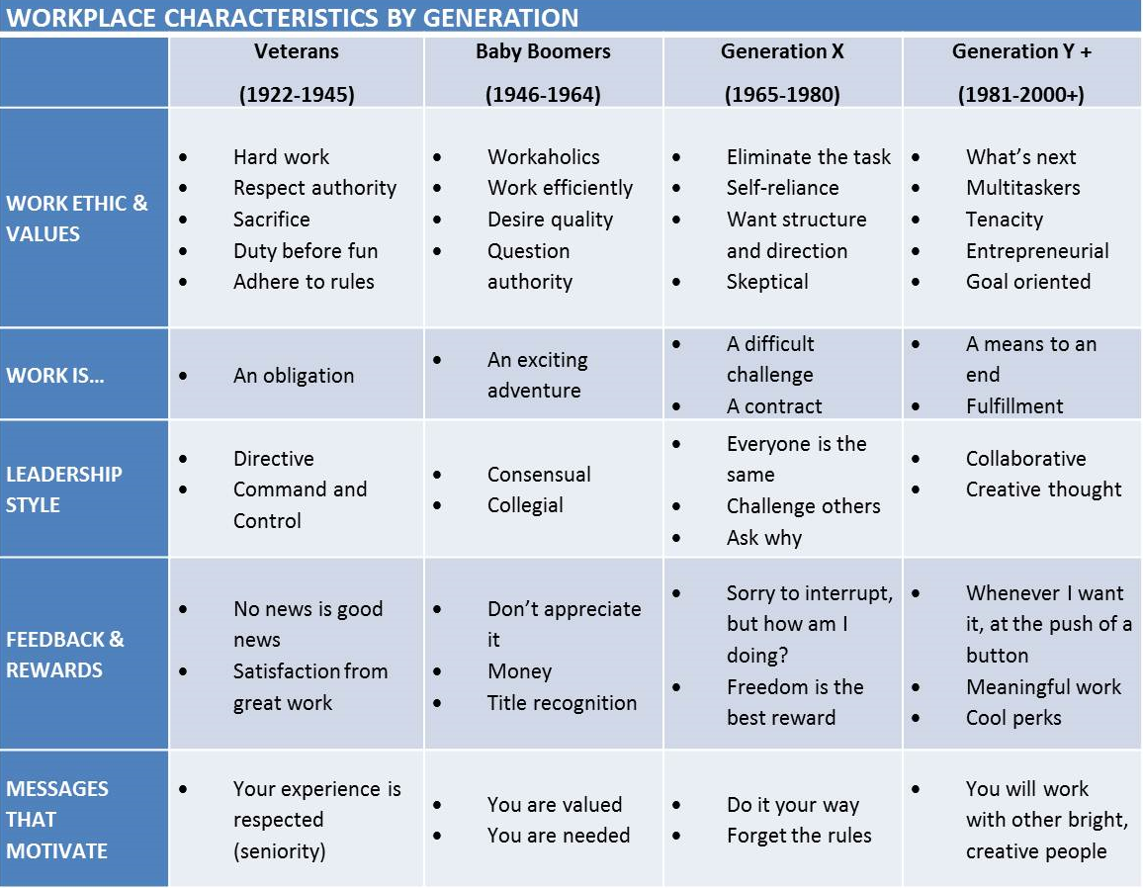
Generational Workplace Characteristics

Slide 12
Who are Generation Z?
Research says that Gen Z may be defined as the generation born between the mid-1990s and the mid-2000s.
What are the traits of Gen Z in the workplace?
Preference for traditional communication
Desire to work individually
Mobile-first habits
Motivated by stability
Naturally competitive

Slide 13
Who are Generation Z?
What does Gen Z look for in an employer?
Collaborative environment
Updated technology and digital workplace tools
Development opportunities
Flexible hours
Work that makes a positive impact on the community
Companies that value authenticity.

Slide 14
Who are Generation Z?
How do you attract Gen Z employees?
Offer flexible hours
Offer industry related training
Provide the opportunity for growth
Provide the latest technology and software
Show that your company cares about the community and their employees

Slide 15
Who are Generation Z?
What benefits do Gen Z look for when applying for a job?
Competitive pay
Paid time off
Health and wellness benefits
Cafeteria plans
Flexibility
Financial management assistance

Slide 16
What does this mean?
Law enforcement is still recruiting as though there has been little to no change in the population being recruited.
Very little research on strategic recruiting; but most agencies are failing to take notice to what has been done.
The question becomes what is attractive to available applicants in your jurisdiction.
Why do prospective officers select any particular agency over another?

Slide 17
Recruiting in the state of Georgia
Beach, Prine, and Wilkie conducted a statewide study to identify why prospective officers chose a particular agency.

Slide 18
Recruiting in the state of Georgia
In 2024 a questionnaire was distributed to basic training cadets in the state training system of GPSTC.
Of the 579 distributed 515 surveys were completed entirely, for a return rate of 89%.
The study reveals some basic insight to the preferences of those officers currently being recruited to become law enforcement officers.

Slide 19
Survey Results
Gender
Male 77%
Female 23%
Race or Ethnicity
White 55%
Black 31%
Asian 01%
Hispanic/Latino 08%
Pacific Islander 01%
American Indian 00%
Bi-racial 04%
**rounding process accounts for the total being less than 100%

Slide 20
Survey Results
Age
21-25 46%
26-30 23%
31-35 16%
36-45 13%
46-55 02%
Over 55 01%
Education
High School or GED 37%
Some college 30%
Associate Degree 11%
Bachelors Degree 19%
Masters Degree 01%
Post-graduate Degree 01%
*63% education beyond H.S. or GED

Slide 21
Survey Results
Military Service
Yes 20%
No 75%
Reserve/National Guard 05%
Sponsoring Agency
Municipal PD 51%
County PD 11%
Sheriff’s Office 29%
State Agency 09%

Slide 22
Survey Results
Agency Size
1-10 04%
11-20 15%
21-50 23%
51-100 17%
101-150 09%
151-200 08%
Greater than 200 17%
Unknown by respondent 07%
Previous Interactions with Police
Relative or Close friend 45%
Minor Traffic Violations 30%
Officer aided a Victim 01%
Officer Assistance 05%
No previous contact 13%

Slide 23
Survey Results
Overall Experiences with Police
Very Positive 35%
Mostly Positive 44%
Neutral 19%
Negative 01%
Very Negative 00%
Effect of Prior Interactions
Very Important 41%
Somewhat Important 23%
Neutral 23%
Not Important 08%
Not Important at all 05%

Slide 24
Regarding your choice of agency, rank the factors in terms of their importance; 1 not all important to 5 Very Important
The agencies reputation in the community.
1 0%
2 7%
3 25%
4 20%
5 48%
Proximity to where I live
1 6%
2 4%
3 24%
4 30%
5 37%

Slide 25
Regarding your choice of agency, rank the factors in terms of their importance; 1 not at all important to 5 Very Important
Professional actions of their personnel 4.64
Professional appearance of their personnel 4.49
The Agency’s reputation in the community 4.47
The personal attention I received 3.81
Proximity to where I live 3.75
Professional, Informative website 3.56
Professional, Informative Social Media 3.38
Salary and benefits were comparable 3.37
Word of mouth, personal interaction 3.30
A ride along experience 3.24
They had the best recruiting video 2.21
They were the first agency to hire me 2.05
Local advertising 1.87
On-line job sites (zip recruiter, etc.) 1.58

Slide 26
Regarding your choice of agency, rank the factors in terms of their importance; 1 not all important to 5 Very Important
Professional appearance of their personnel
1 0%
2 0%
3 19%
4 24%
5 57%
Professional Actions of their Personnel
1 0%
2 0%
3 18%
4 23%
5 60%

Slide 27
Regarding your choice of agency, rank the factors in terms of their importance; 1 not all important to 5 Very Important
A ride along experience
1 15
2 22
3 7
4 22
5 35
Professional, informative social media
1 13
2 11
3 43
4 12
5 21

Slide 28
Regarding your choice of agency, rank the factors in terms of their importance; 1 not all important to 5 Very Important
Professional, Informative Website
1 5
2 11
3 41
4 14
5 29
They had the best recruiting video
1 28
2 30
3 28
4 9
5 4

Slide 29
Regarding your choice of agency, rank the factors in terms of their importance; 1 not all important to 5 Very Important
The personal attention I received
1 3
2 9
3 19
4 26
5 43
They were the first agency to hire me
1 15
2 25
3 25
4 15
5 20

Slide 30
Regarding your choice of agency, rank the factors in terms of their importance; 1 not all important to 5 Very Important
Salary and benefits were comparable
1 6
2 21
3 26
4 19
5 29
On-line job sites; Zip Recruiter, etc.
1 18
2 38
3 15
4 12
5 18

Slide 31
Regarding your choice of agency, rank the factors in terms of their importance; 1 not all important to 5 Very Important
Local advertising
1 40
2 25
3 12
4 9
5 14
Word of mouth; personal interaction
1 5
2 10
3 16
4 31
5 38

Slide 32
Top Ten
Professional actions of their personnel
Professional appearance of their personnel
Word of mouth; personal interaction
The personal attention I received
The agency’s reputation in the community
Proximity of where I live
Ride along experience
Salary and benefits were comparable
Professional, informative website
Professional, informative social media
They were the first agency to hire me
On-line job sites like Zip Recruiter, etc
Local advertising
They had the best recruiting video
Professional actions of their personnel
Professional appearance of their personnel
The Agency’s reputation in the community
The personal attention I received
Proximity to where I live
Professional, Informative website
Professional, Informative Social Media
Salary and benefits were comparable
Word of mouth, personal interaction
A ride along experience
They had the best recruiting video
They were the first agency to hire me
Local advertising
On-line job sites (zip recruiter, etc)

Slide 33
How long have you seriously considered a career in law enforcement?
Since High School 31%
After my time in college 11%
After my time in the military 12%
All my life 29%
This is a recent decision 16%

Slide 34
What were your most important expectations from your agency of choice
Professionalism and high standards 4.62
Supportive of me and my career goals 4.60
Make a difference in the community 4.60
Family atmosphere, close to peers 4.31
Fun, excitement rather than the routine 3.97

Slide 35
Which Best Describes Your Current View of Law Enforcement
A calling I plan to follow 49%
Make a difference, help others 23%
A professional field 20%
It is a steady job 03%
A job until a better one is available 03%
Other 02%

Slide 36
How satisfied were you with the overall application and selection process
Very satisfied 77%
Somewhat satisfied 22%
Not satisfied 01%

Slide 37
How important are Pay and Benefits?
Very Important 48%
Important but not the deciding factor 43%
Fair in comparison to other agencies 06%
Acceptable until better opportunity 03%

Slide 38
Many Agencies are offering signing bonuses, even for applicants who are not yet certified. Which best reflects your opinion on these bonuses?
Very important 30%
Somewhat important 24%
A consideration, but not deciding factor 41%
It is not a consideration at all 05%

Slide 39
When asked what can administrators do to improve the chances of attracting quality applicants, they said:
Department job/career fairs 4.29
Community Outreach Programs 4.26
Department website easy to navigate 4.20
Ride along programs 4.02
Citizen police academies 3.40
Facebook advertising 3.06
Roadside Billboards 2.83
Social media 2.49

Slide 40
Professionalism
How does one define professionalism?
What does GenZ expect from an organization and its leaders?

Slide 41
Leadership Expectations of Gen Z
Gen Z values honesty, integrity, fairness, altruism, and care for values as key dimensions of leadership.
They expect leaders to consistently demonstrate moral behaviors, both personally and professionally
A leader’s personality, particularly their integrity, moral development, and moral identity, is crucial in shaping perceptions of this generation.
Ethical leadership is critical in predicting Gen Z employee’s productivity, satisfaction, turnover, voice behaviors, and innovative behaviors.
Lim, A.T. (2024).Ethical Leadership in the eyes of GenZ: A literature review.
FIRM A Journal of Management Studies, 9(1), 83-96.

Slide 42
Leadership Expectations of Gen Z
A 2020 study found that Gen Z employees expect support and understanding from supervisors and the they reject the traditional idea of a “Boss” telling them what to do and expect a more informed, collegiate, and facilitated process
A 2021 study found that Gen Z employees “want a positive, communicative leader who provides mentorship and other developmental opportunities from ambitious team members”
This generation are less interested in a long-term career IF it does not fit with their values and are not in a hurry either to take leadership positions or be tied into a particular job role as an “identity”. Further, this study found that this generation want to know and be aligned with the purpose of tasks and roles and expect to be developed professionally.
A 2022 study found that generational expectations of leaders is significantly informed by macro-cultural factors. Gen Z employees from collectivist culture with high power distance, long term orientation and high uncertainty avoidance have higher expectations of their future leaders.
Wilkinson, D.J. (2024). OR Research Briefing. Ethical Leadership Expectations of New Entrants into Employment (Gen Z). Oxford-Review.org/September 8, 2024

Slide 43
Professional Culture
How is it developed?
Leaders develop and consistently maintain ethical principles such as honesty, integrity, altruism, and fairness
How is it maintained?
Make principled decisions that prioritize the well-being of employees and the organization
Actively promote and model ethical behavior to create a strong ethical culture.
A strong ethical culture; Attracts ethical people, satisfies ethical people, retains ethical people

Slide 44
Questions or Comments

