Slide 2
“Pruning Branches That Could Have Flourished." Multidisciplinary Perspectives and Strategies for Safeguarding our Schools and Neighborhoods from Gun Violence"

Slide 3
GunViolenceOpen2024.mp4

Slide 4
Welcome
We are a team of dedicated professionals
focused on addressing the complex
issue of gun violence in our schools and communities.

Slide 5
Meet Our Team
Dr. Anthony Owusu-Ansah
Dr. Bettie Stafford
Dr. Vonda Hubbard
Dr. Kizzie Donaldson-Richard
“Unfortunately, Professor Brandon Henry is unable to join us today due to a family emergency. He played a crucial role in our team, contributing the data which focused on community outreached and youth engagement to reduce gun violence, and we extend our thoughts and support to professor Henry and his family during this time. We look forward to having him with us again soon.”

Slide 6
Our Mission
"To create safer schools and stronger communities by
implementing multidisciplinary strategies and promoting positive change.“

Slide 7
Statistics On Gun Violence For Georgia

Slide 8
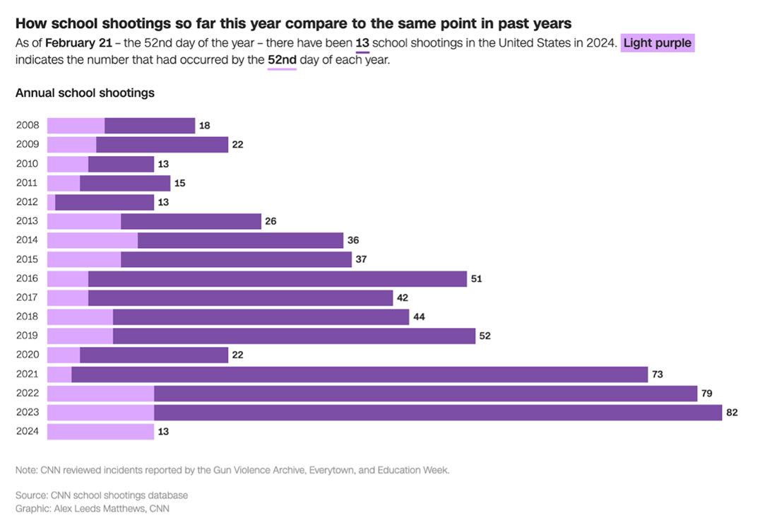
Data on Gun Violence

Slide 9
Gun Violence Archive

Slide 10
Literature on Gun Violence in South Georgia
The literature on gun violence in South Georgia shows significant public health challenges and disparities that are heavily influenced by demographic and social factors.
Firearm-related injuries and fatalities in Georgia have escalated over recent years, with a notable increase in both homicides and suicides involving firearms.
A study by Danner et al. (2020) emphasizes that the state’s average annual firearm injury rate is 31.5 per 100,000 people.
This research also reveals that firearm suicides have the highest fatality rate, which is six times higher than other forms of gun-related violence (Danner et al., 2020).

Slide 11
Literature on Gun Violence in South Georgia
In terms of geographical impact, Southern Georgia has seen elevated levels of gun-related crimes, particularly in rural areas where access to mental health services and gun safety education is limited.
According to the Educational Fund to Stop Gun Violence (EFSGV), the state ranks 17th in the United States for overall firearm mortality rate, with 14.8 deaths per 100,000 individuals.
This underscores the need for targeted interventions and policy reforms to reduce the prevalence of firearm suicides and homicides in these communities (EFSGV, 2020).
To effectively address gun violence in South Georgia, a multifaceted approach that involves public health strategies, community-based interventions, and enhanced research into the causes and prevention of gun violence is required (Danner et al., 2020; EFSGV, 2020).

Slide 12
Student Survey Results
10 questions
8 Likert scale questions
2 open-ended questions
181 responses

Slide 13
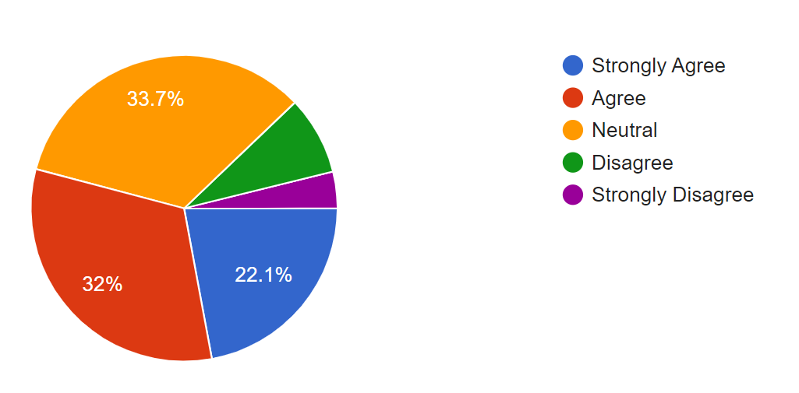
*I feel safe from gun violence when I am at school.
Student Survey Results

Slide 14
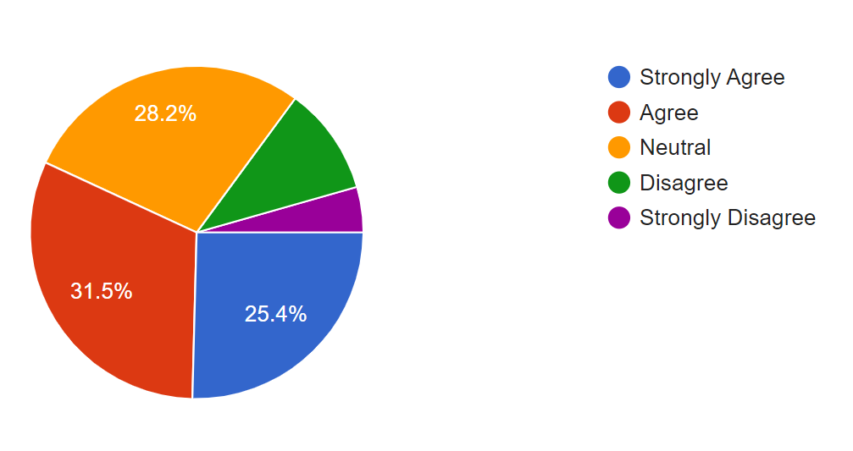
My school has effective measures in place to prevent gun violence.
Student Survey Results

Slide 15
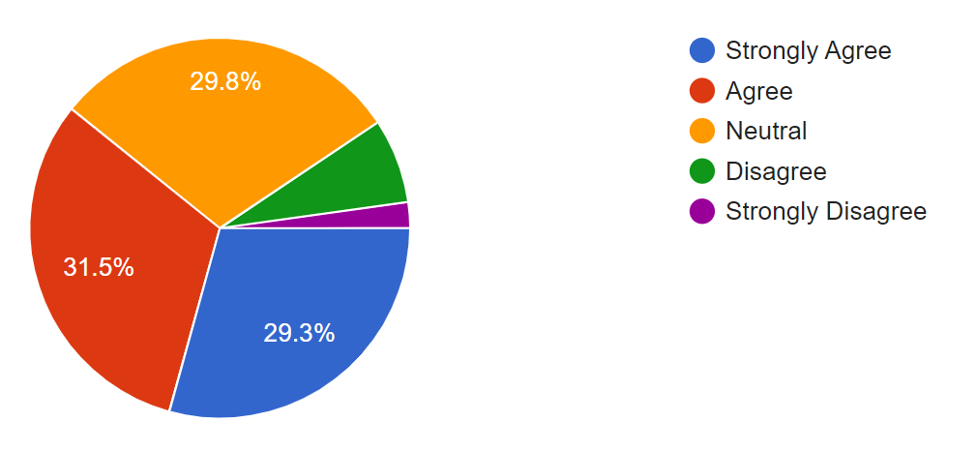
The presence of security personnel (e.g., guards, resource officers) makes me feel safer at school.
Student Survey Results

Slide 16
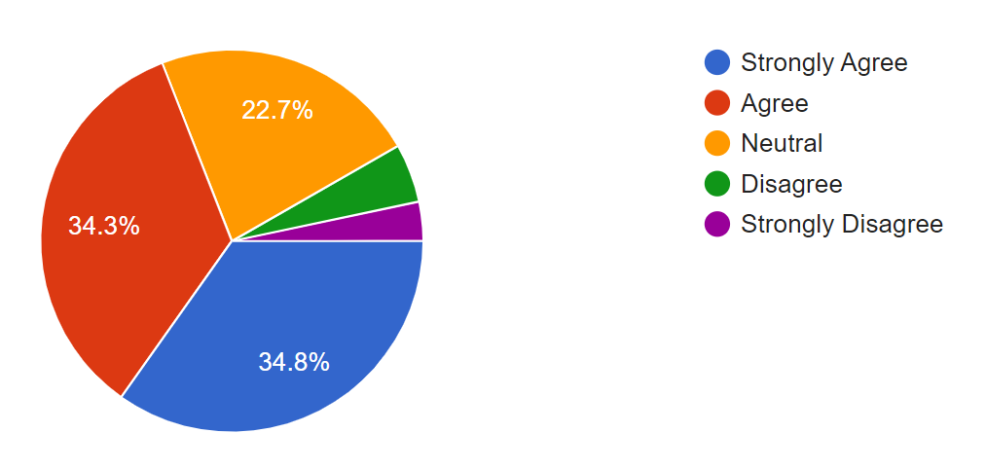
I believe gun violence in the community influences the safety of my school.
Student Survey Results

Slide 17
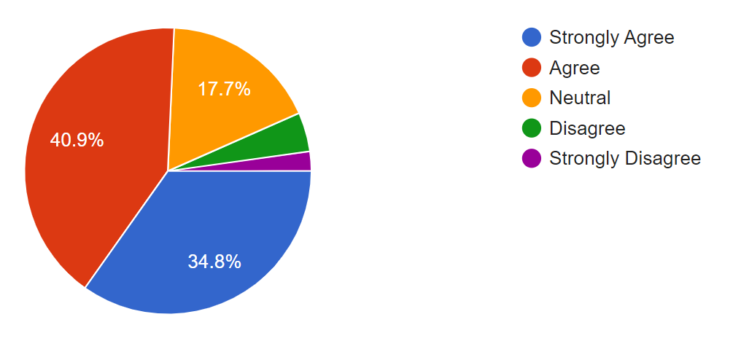
My school offers sufficient mental health resources for students who feel unsafe or anxious about gun violence.
Student Survey Results

Slide 18
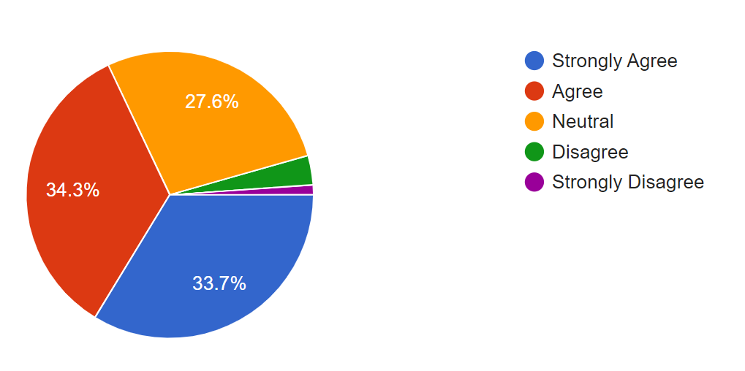
I trust my teachers and school staff to handle a potential threat of gun violence effectively.
Student Survey Results

Slide 19
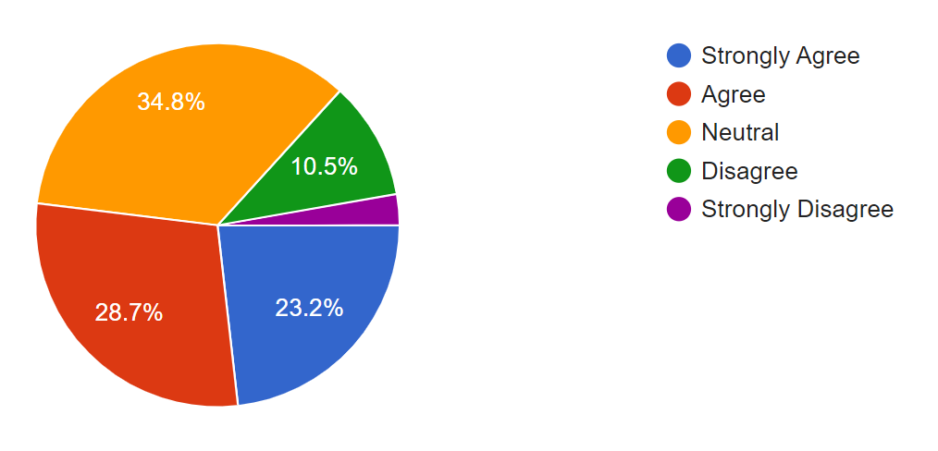
I feel that student voices are heard when it comes to decisions about school safety.
Student Survey Results

Slide 20
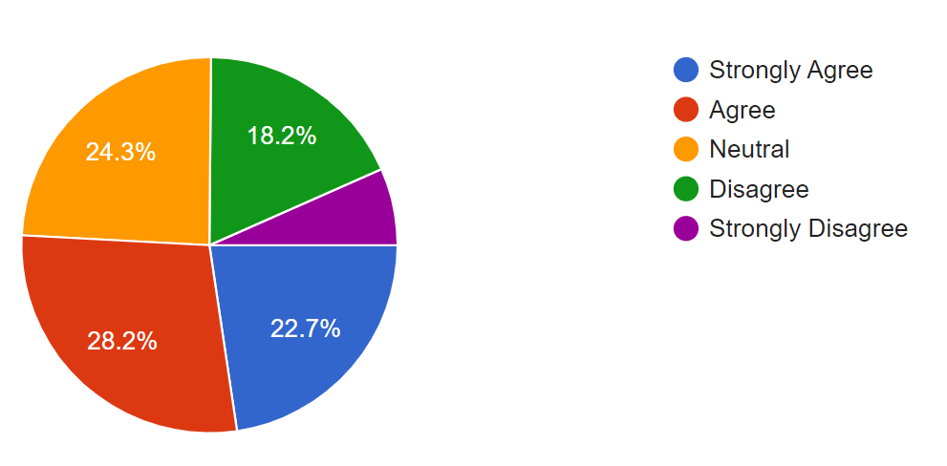
Gun violence in my neighborhood affects how I feel about going to school.
Student Survey Results

Slide 21
Steps the school could take to make students feel safer from gun violence…
Student Survey
Responses
More visible security and metal detectors
Every building on campus should not be so easily accessible to the public.
Random people come in all of the time and it makes me feel so unsafe. Literally can come into our buildings with ill intent.
I think that metal detectors should be put in place and be restrictive on who and who can’t come on school property.
I feel as though the school could provide students with plans on what to do to keep themselves safe.

Slide 22
Steps the school could take to make students feel safer from gun violence…cont’d.
I think that my school should implement active shooter drills scheduled at least once a semester that include the faculty, staff, and students.
This will ensure that students feel more secure because they will have some knowledge of what to do in an emergency situation.
Listen to the students more about who is carrying and implement more weapon detectors and cameras.
Cameras should be everywhere. The only privacy you should have is in your room.
Student Survey
Responses

Slide 23
“Being an aspiring teacher in an era where gun violence is high, makes me sad to think about. The recent shooting is a sad sight to see because kids go to school to learn. This just makes me realize we have to be more vigilant and promote anti-gun violence.” --Aspiring Teacher
“I feel a bit worried for not only myself but my future students. It is scary to think a place such as a school would be targeted as a place to pursue gun violence. It is even scarier to think it could potentially be one of the students sitting in my classroom.”
--Aspiring Teacher
“Gun violence in the profession I’m in personally frightens me. I think about the drills that are put in place in case of an intruder. I ponder on what if it doesn’t work like it’s supposed to. What if I’m not able to protect someone’s child fast enough? What if I don’t make it back to my own home? It’s just a really scary thing to think about.”
---Aspiring Teacher
“I feel that gun violence is something that happens too often in our country. It saddens me that gun violence takes place in schools and in general.”
--Aspiring Teacher
Aspiring Teacher
Responses

Slide 24
Faculty and Staff Survey Results
10 questions
8 Likert scale questions
2 open-ended questions
85 responses

Slide 25
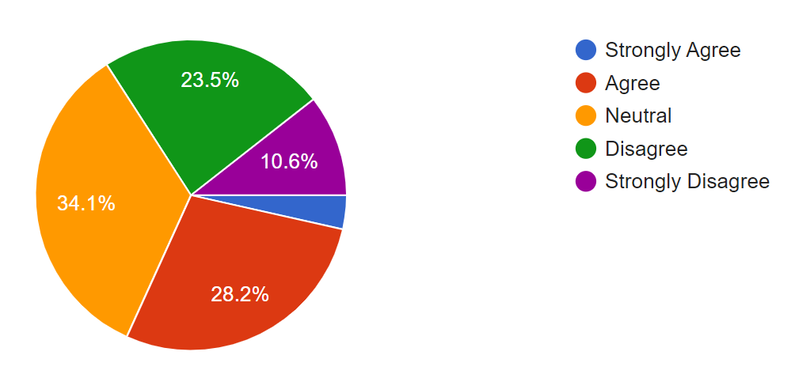
Faculty Survey I feel confident that my school is adequately prepared to handle potential gun violence incidents

Slide 26
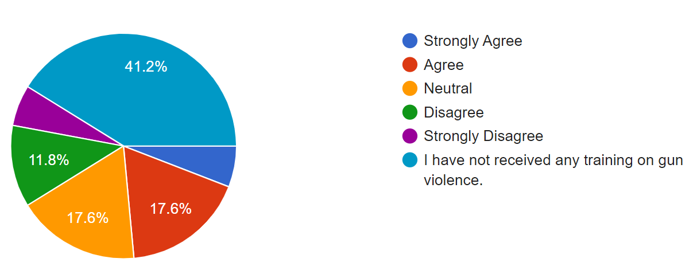
Faculty Survey The training I have received prepares me to respond appropriately in the event of gun violence.

Slide 27
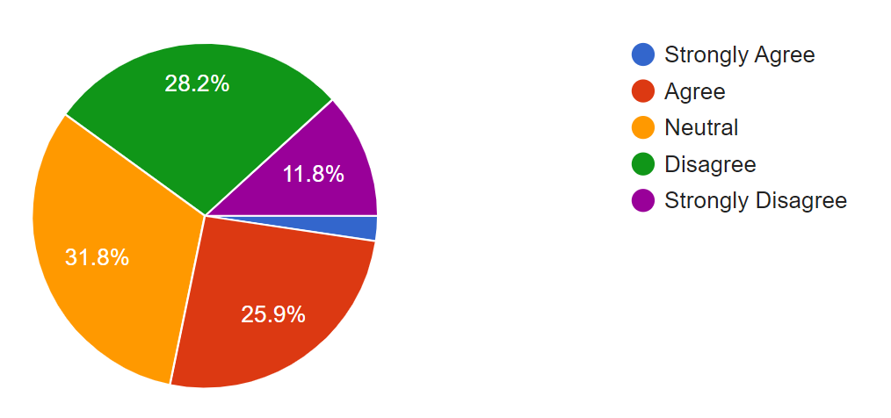
I believe my school’s security measures are sufficient to prevent gun violence.

Slide 28
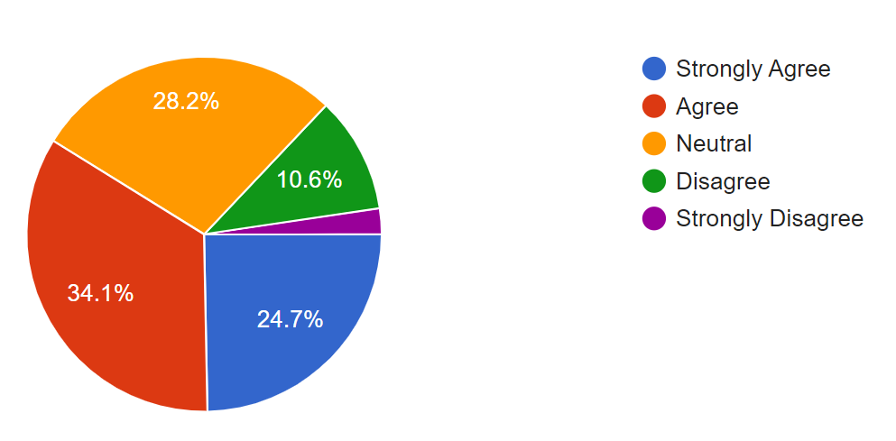
I am concerned about the potential for gun violence in my school.

Slide 29
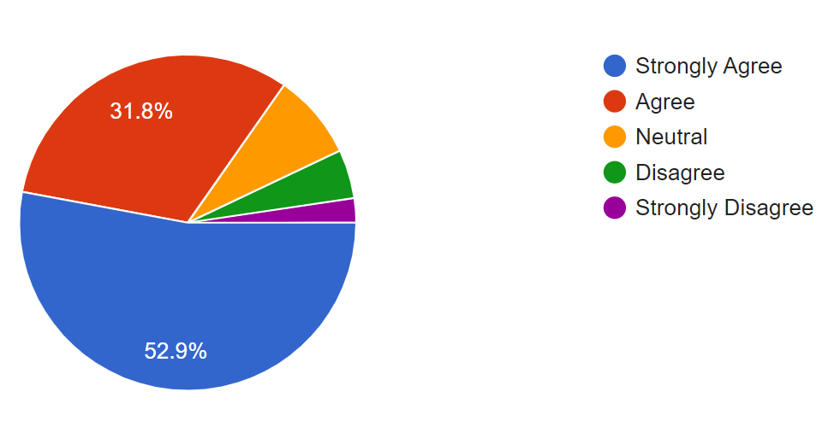
I feel that collaboration between teachers, administrators, and local authorities can reduce the risk of gun violence in schools.

Slide 30
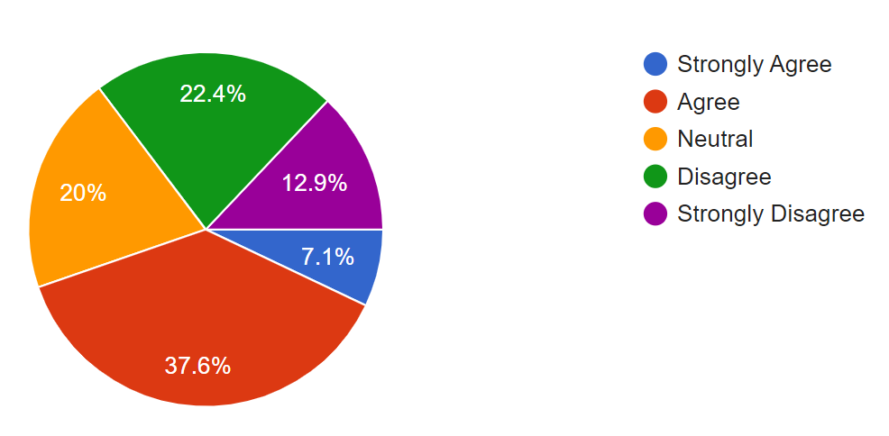
I have access to the resources I need to help students who are anxious or traumatized by gun violence.

Slide 31
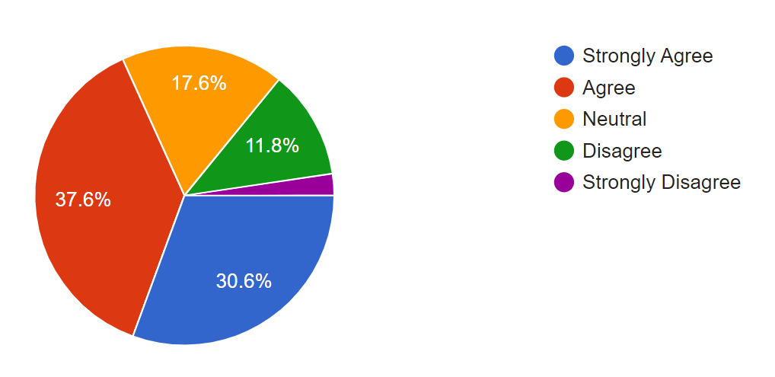
I believe there is a connection between gun violence in the community and the safety of my school.

Slide 32
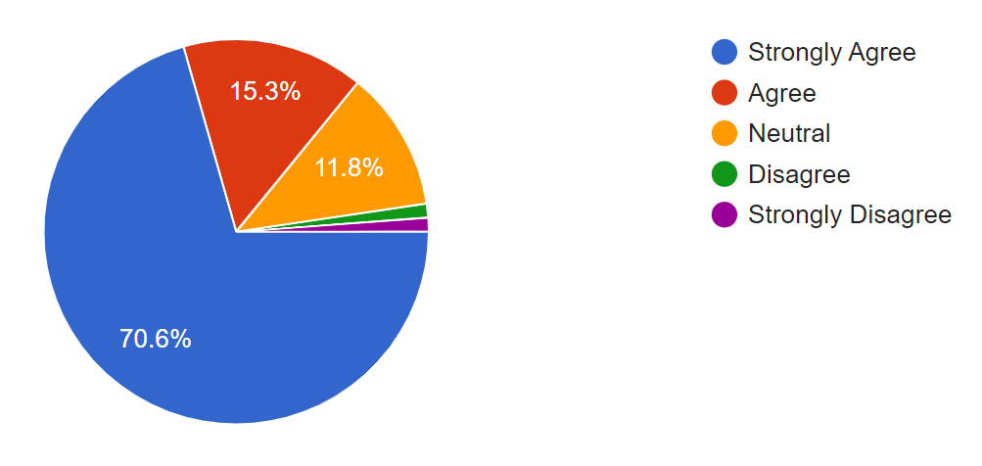
I feel that more can be done at the local or federal level to protect schools from gun violence.

Slide 33
What could be done within schools to prevent gun violence…
More training on gun violence and the seriousness of it as a real threat as the mentality is will not happen here. Also, kids are almost immune to it like it is a joke and they are waiting for it to happen or a threat to happen - not taken seriously.
Gun legislation on the federal and state level. Community centered approaches to reducing guns in the community.
To ensure preventative measures are continuously and consistently practiced by exercising a zero tolerance policy on guns on campus.

Slide 34
What could be done within schools to prevent gun violence…cont’d.
Gun violence is just a symptom. We need to treat the root cause of the violence, through more efforts to normalize that it's OK to seek help, its OK to get therapy, its OK to feel your feelings, and work on teaching people healthier ways to deal.
Better screening and security measures, access to mental/behavioral support for students, faculty, and staff; and crisis response resources on campus.
Secure funding to better equip our facilities with cameras, hire security personnel to be more present, upgrade the IT infrastructure, develop a strong crisis management playbook, have an effective gun violence communication strategy, and be intentional about making student well-being a priority.

Slide 35
Parents Survey Results
10 questions
8 Likert scale questions
2 open-ended questions
9 responses

Slide 36
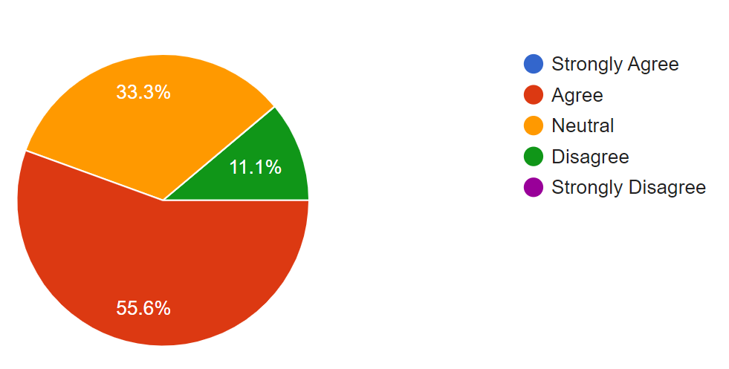
Parents Survey I feel confident that my child’s school has effective safety measures in place to prevent gun violence.

Slide 37
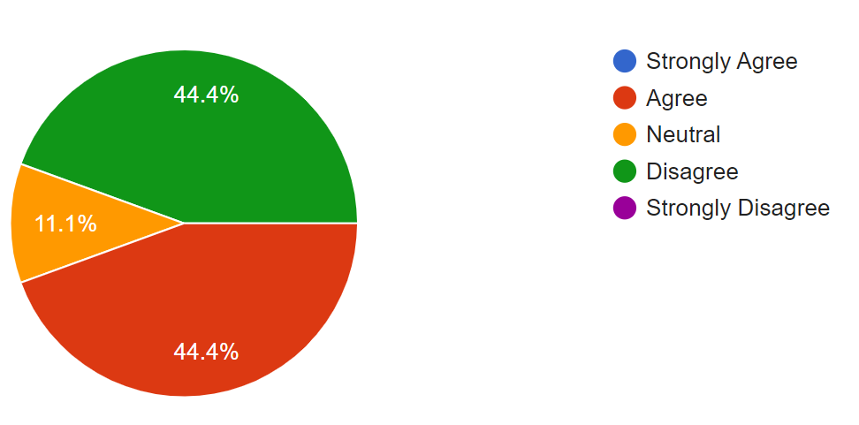
I am satisfied with the communication between the school and parents regarding safety protocols for gun violence.

Slide 38
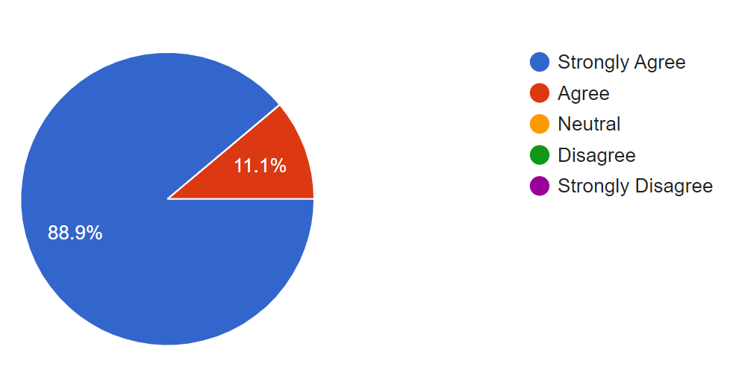
I believe that schools need additional support from law enforcement to prevent gun violence.

Slide 39
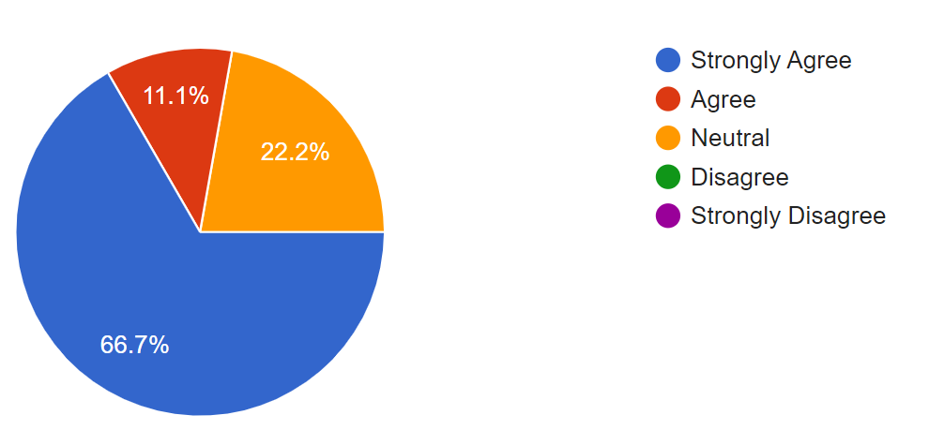
Gun violence in the community affects how safe I feel sending my child to school.

Slide 40
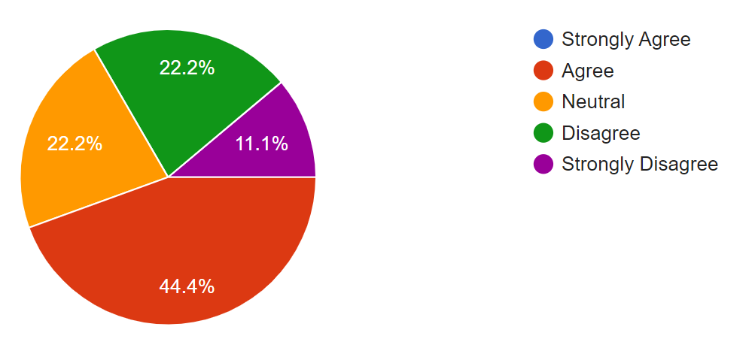
I trust my child’s school to handle a potential gun violence threat effectively.

Slide 41
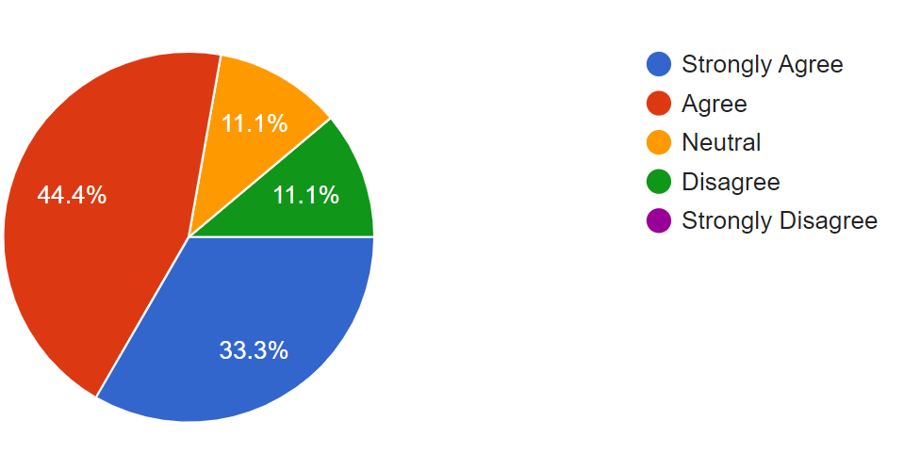
I am concerned about the long-term psychological effects of gun violence on children.

Slide 42
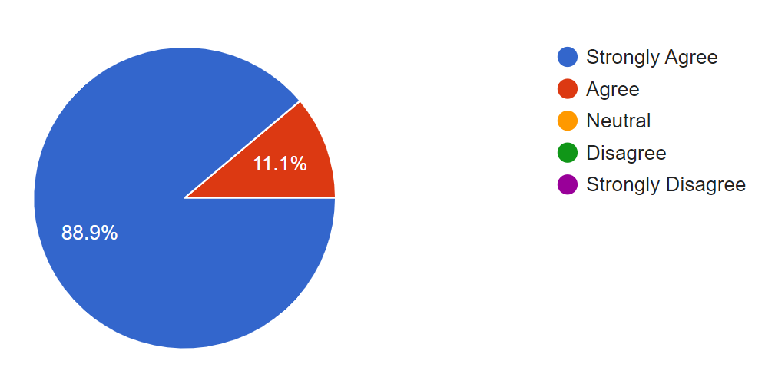
I believe gun violence prevention efforts should involve schools, parents, and the local community working together.

Slide 43
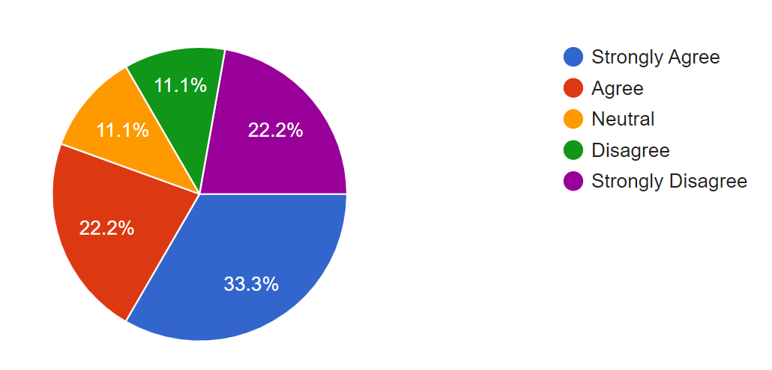
I feel that current gun control policies are insufficient to protect schools and neighborhoods from gun violence.

Slide 44
Steps that should be taken by schools and communities to improve safety from gun violence…
Start by holding stakeholders meetings to get input and communicate current policies.
Schools being a little more vigilant in terms of checking bags before entry.
The school systems should conduct more education based efforts not only to students, but teachers and parents as well. In addition, better security at access points in all schools should be employed. Finally, all students and faculty should be mandated to take a course involving Active Shooter trainings.

Slide 45
Steps that should be taken by schools and communities to improve safety from gun violence…cont’d.
I feel that school should in place a random check (at least twice) on lockers throughout the month.
Schools and communities should be more transparent about the number of guns on campus and how gun-related cases have been handled.
Schools and local law enforcement agencies need to work closely and train together.

Slide 46
Law Enforcement Officers Survey Results
27 questions
6 Demographic
21 Likert scale
1 open-ended
33 responses

Slide 47
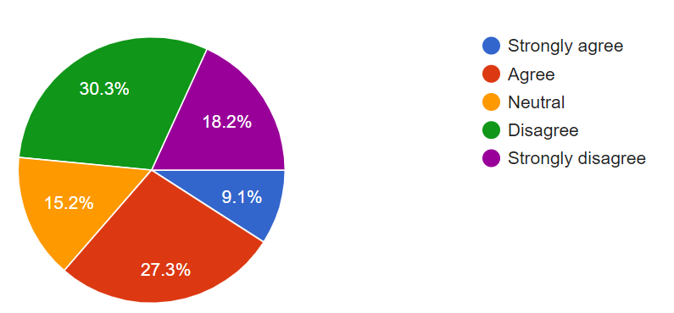
I have responded to incidents of gun violence in schools.

Slide 48
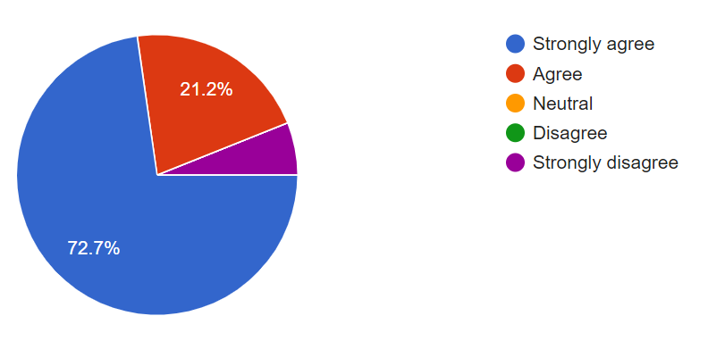
I have responded to gun violence in residential neighborhoods.

Slide 49
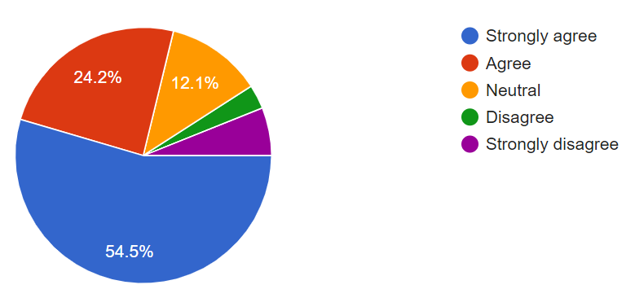
Gun violence incidents in neighborhoods occur frequently in my jurisdiction.

Slide 50
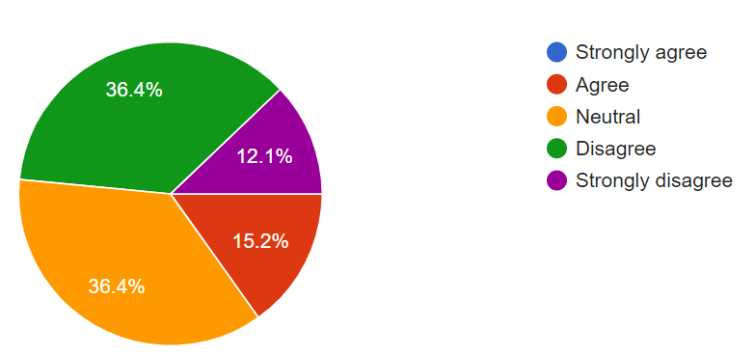
Gun violence is a significant issue in schools in my jurisdiction.

Slide 51
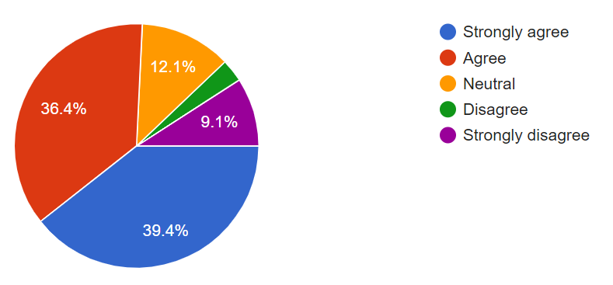
Access to firearms is a major contributor to gun violence in schools.

Slide 52
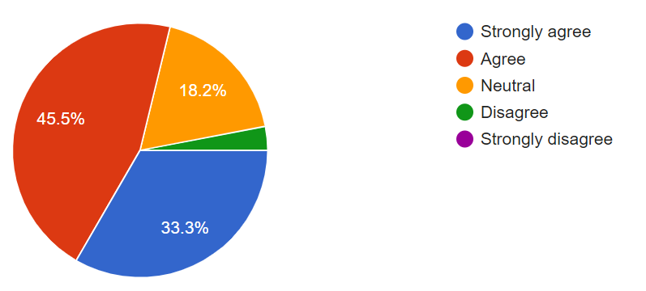
Mental health issues among students contribute to school gun violence.

Slide 53
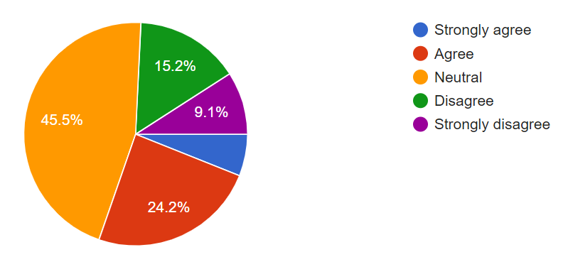
Current school safety measures are effective in preventing gun violence.

Slide 54
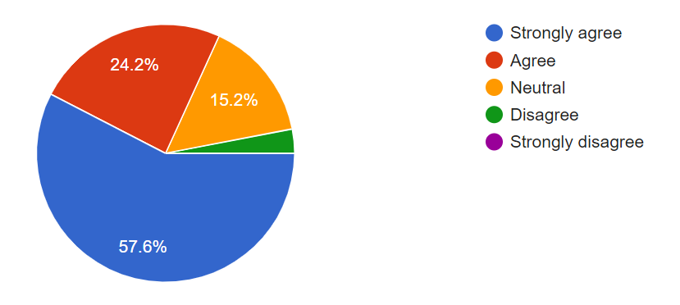
Gun violence is a significant issue in neighborhoods in my jurisdiction.

Slide 55
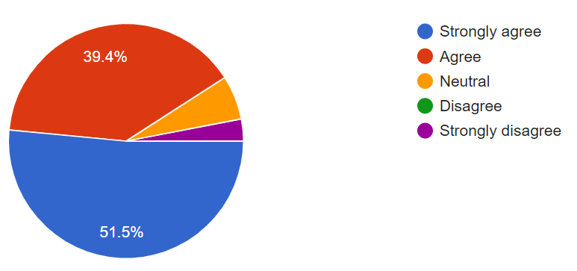
Gang activity is a primary cause of gun violence in neighborhoods.

Slide 56
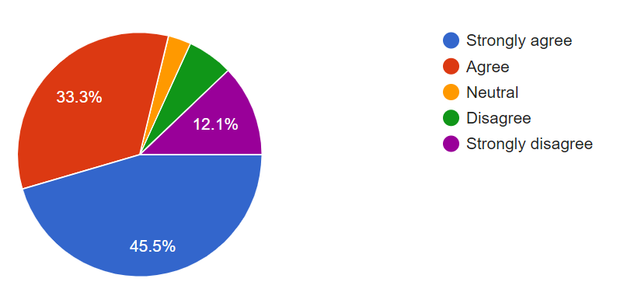
Easy access to firearms contributes to gun violence in neighborhoods.

Slide 57
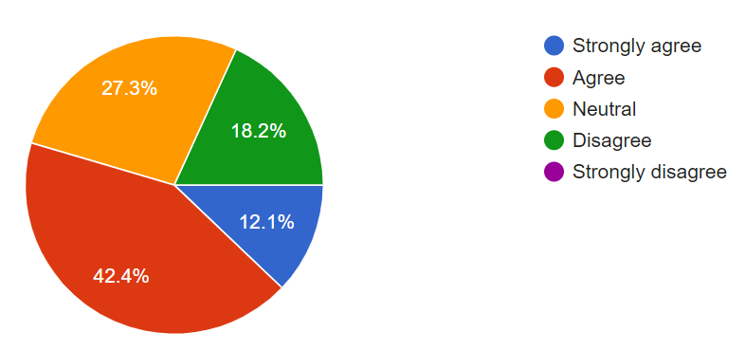
Domestic disputes frequently lead to gun violence in residential areas.

Slide 58
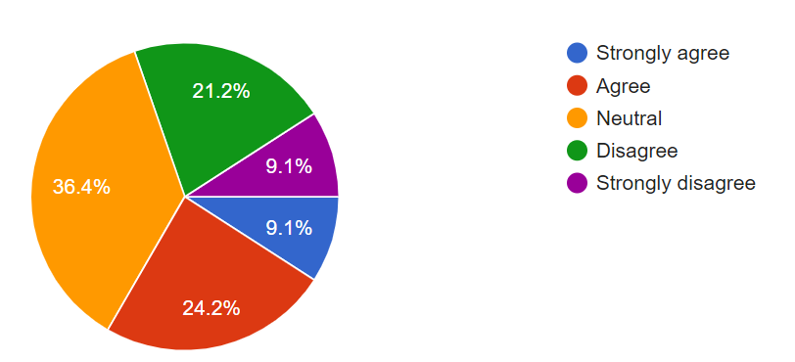
Current policing strategies are effective in reducing gun violence in neighborhoods.

Slide 59
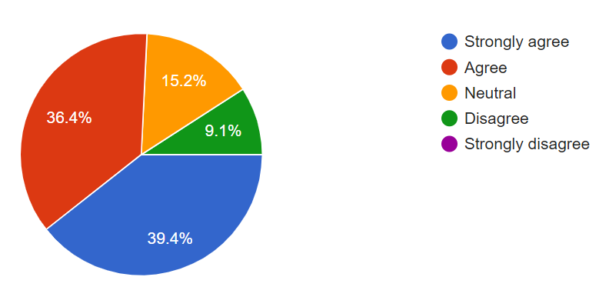
I feel well-prepared to respond to incidents of gun violence in schools.

Slide 60
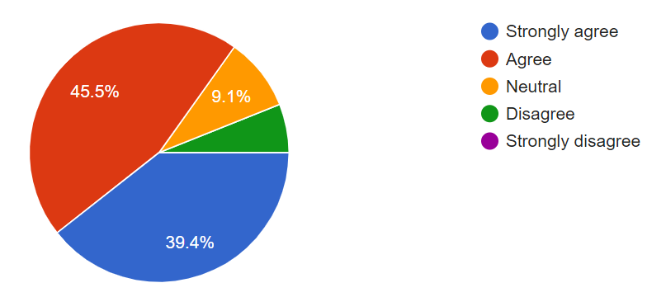
I feel well-prepared to respond to incidents of gun violence in neighborhoods.

Slide 61
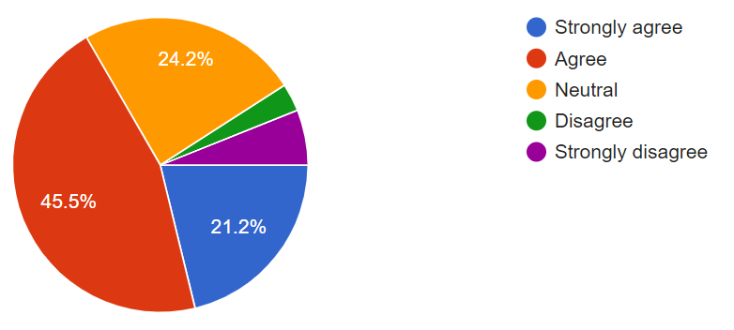
I have received sufficient training to handle gun violence in schools.

Slide 62
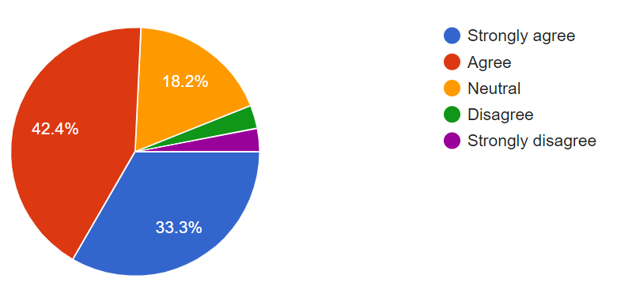
I have received sufficient training to handle gun violence in neighborhoods.

Slide 63
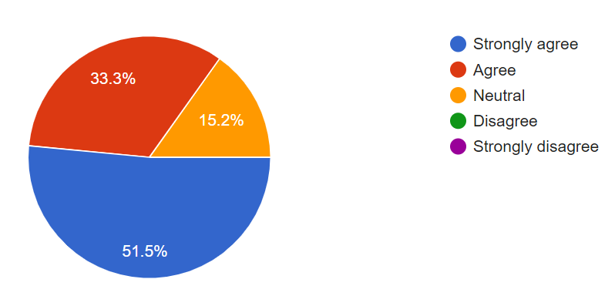
Additional training is needed for law enforcement to better handle gun violence situations.

Slide 64
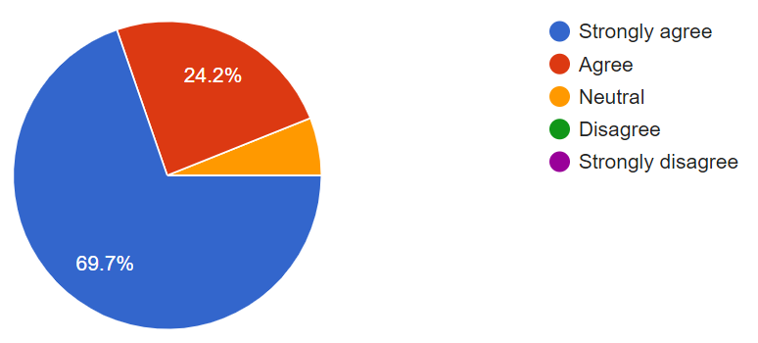
Community involvement is crucial in preventing gun violence in schools.

Slide 65
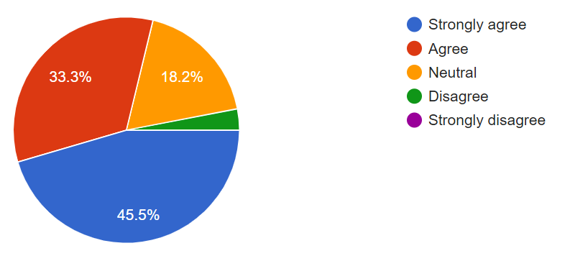
Strengthening mental health services would reduce gun violence in schools and neighborhoods.

Slide 66
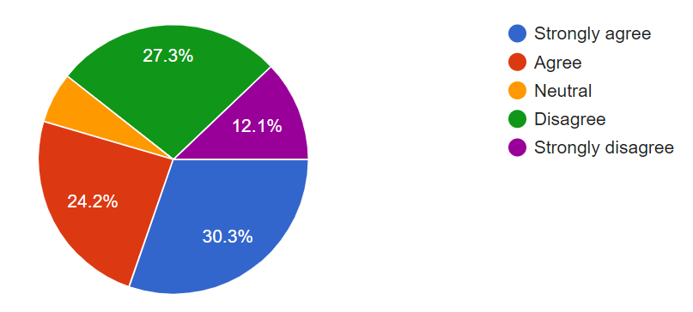
Stricter regulations on firearm access would help reduce gun violence.

Slide 67
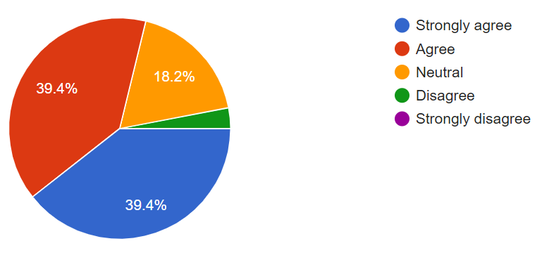
Improving collaboration between law enforcement and schools will reduce school-based violence.

Slide 68
Suggestions for Addressing Gun Violence in Schools and Neighborhoods
Accountability is the issue, whether it be at home, police , school administrators or social works. Every entity needs to take ownership and accountability.
More training for law enforcement.
Being more attentive to children.
Constant communications between all parties involved is a start. Town hall meetings consisting of parents, students, law enforcement and other social behavior entities to collaborate and stay abreast of trends in law enforcement and behavior of students who may have reason to inflict harm on themselves or others.

Slide 69
Suggestions for Addressing Gun Violence in Schools and Neighborhoods
I don’t believe access to guns is the cause of gun violence. Many who commit these crimes did not have legal access to weapons already but found a way to access one. I believe mental health and a lack of discipline in children is the biggest issue.
Police and community involvement within schools and neighborhoods will reduce gun violence.
There was no mention about recidivism rates or court proceedings. Criminals are getting out on bond after bond, after bond. Catch and release program.

Slide 70
Conclusion
"Together, we aim to safeguard our schools and neighborhoods. Stay tuned for our upcoming presentations and discussions."

Slide 71
References
•Danner, O. K., Hudak, L., Bayakly, R., Koplan, C., Kelly, A., Nieb, S. L., & Heron, S. L. (2020). Redefining Our Understanding of The Impact of Firearm-Related Injury in the State of Georgia: A White Paper by the Violence Prevention Task Force of IPRCE. Journal of the Georgia Public Health Association, 8(1), 90-100. Retrieved from Georgia Southern University Digital Commons ​
Solutions | Center for Gun Violence Solutions (jhu.edu)​
The recommended form of citation for this website is Everytown for Gun Safety Support Fund, “Everytown Gun Law Rankings,” accessed [September 30, 2024], https://everytownresearch.org/rankings/.

Slide 72
Questions and Comments !!!!

Slide 73
How did we do?

