Slide 1
Mugshot Photos: Media, Police, and Stigmatization Tom Hochschild & Lorna Alvarez-Rivera Valdosta State University

Slide 6
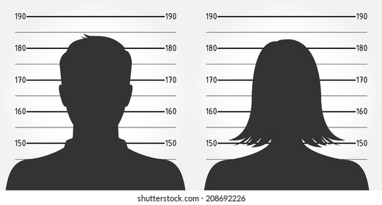
Typical Characteristics of Mugshot Photo
One of the worst days of person’s life
Disoriented, angry, or sad look on face
Disheveled hair
May be wearing jumpsuit
Media may use standardized framing

Slide 7
Why do police release mugshot photos?
Public record
Evidence of police effectiveness
Specific deterrence
General deterrence

Slide 8
Why do media outlets publish mugshots?
Increase sales, clicks, or advertising revenue.
Demonstrate concern for community.

Slide 9
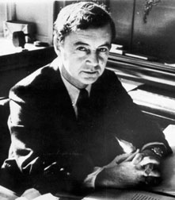
Erving Goffman
Aspect of an individual or group perceived as discrediting by others.
People who acquire a stigma have “spoiled identities.”
Stigmatized individuals and groups lose full social acceptance.

Slide 10
Three Types of Stigma
1) Deviations in Personal Traits
drug addict
thief
criminal record
unhygienic
mental illness
promiscuous
spouse/child abuser
cheater
lazy
gambling addict
disfluent (stutterer)

Slide 11
2) Group Traits
sexual orientation
race/ethnicity
social class
family reputation
occupation
gender
age group
university affiliation
regional background
political affiliation
vegetarianism

Slide 12
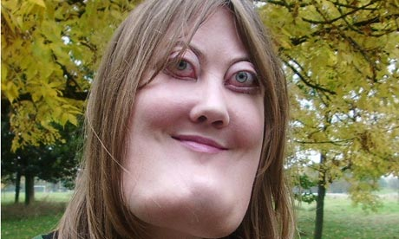
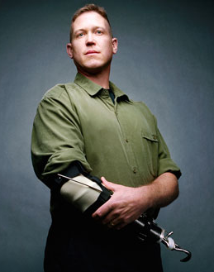
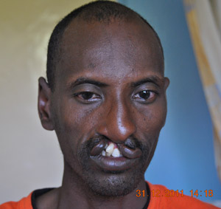
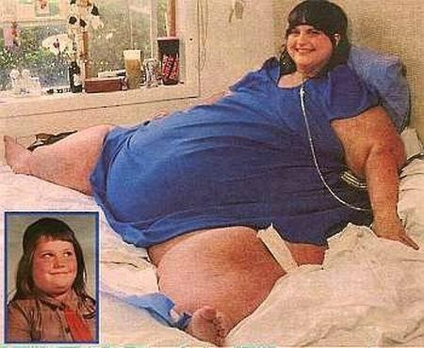
3) External Physical Deviations
cherubism
cleft lip
prosthetic limb
morbid obesity

Slide 13
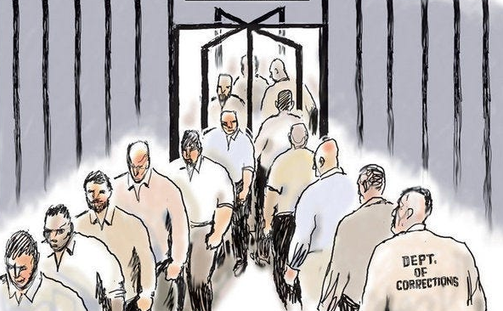
Benefits of Releasing Mugshot Photos?
Specific Deterrence?
Mugshot already on file.
U.S. recidivism rates are around 75% after 5 years.

Slide 14
Benefits of Releasing Mugshot Photos?
General Deterrence?

Slide 15
What’s the harm when mugshot photos are made public?
Damages person’s reputation.
Can stigmatize and harm people within same group. (e.g., family, employer, school, race/ethnicity, neighborhood, sexuality)
Damages person’s relationships with family, friends, employer or school.
Causes mental and emotional turmoil for person.
Makes it difficult for person to maintain or find intimate partner relationship.
Hinders person’s ability to maintain or find employment.
Makes it difficult for person to acquire loans or financial aid.
Can lead to extortion.

Slide 16
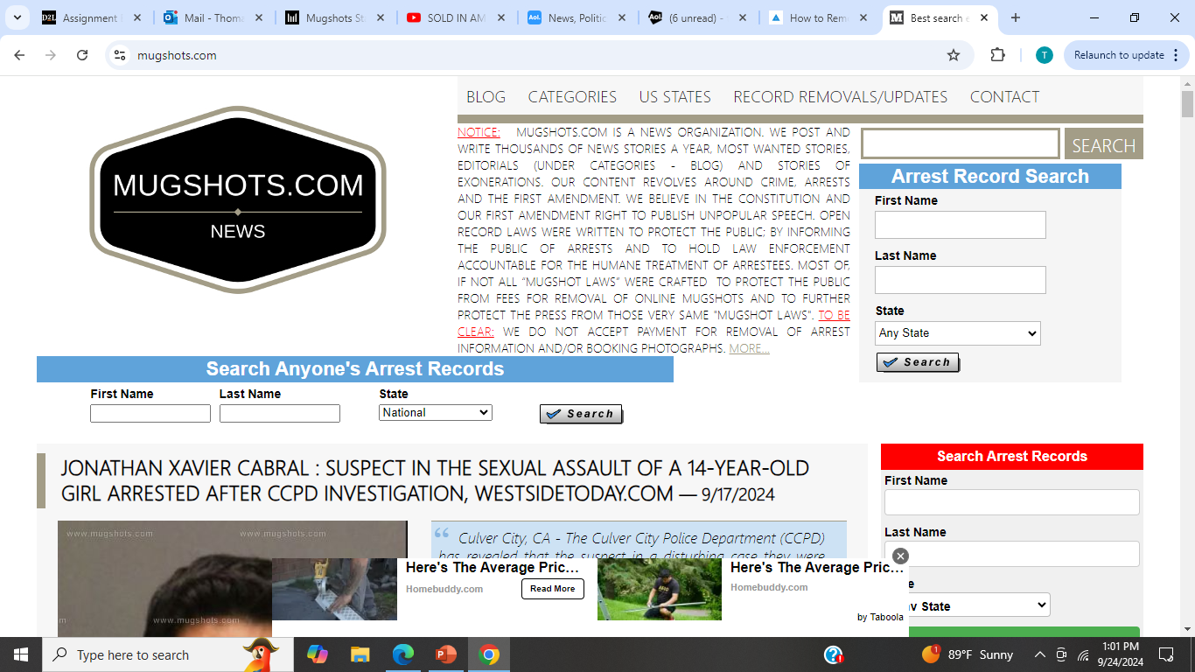

Slide 17
There are no federal laws regulating use of mugshots, but some states have restrictions

Slide 18
Some police departments have stopped posting mugshots

Slide 19
Juvenile Offenders Receive Mugshots Based On:

Slide 20
Some media outlets have stopped using mugshots

Slide 21
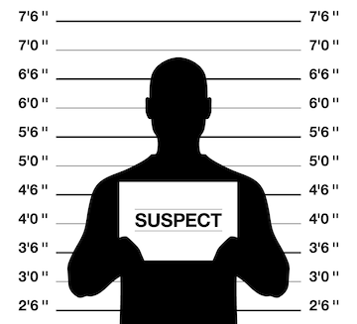
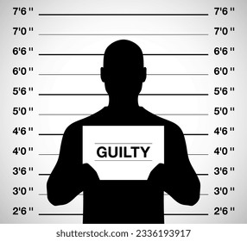
Should mugshot photos be released by police?
Pre-Verdict
Post-Verdict
√
?
x
VIOLENT
CERTAINTY?
VIOLENT
TERM?
x
x
NOT
NON-VIOLENT
NON-VIOLENT

Slide 22
Mugshot Photos: Media, Police, and Stigmatization Tom Hochschild & Lorna Alvarez-Rivera Valdosta State University

Slide 24
Georgia Mugshot Law (HB 6051)
Applies to all mugshot photos taken within the state.
Exemptions include ongoing investigations and public threats

Slide 25
De-sociologizing Crime Stories
Appear Current
Appear to be Concerned About Crime
Increase circulation or clicks

