Slide 1
Higher Education in Prison: Making the Case for GA Faculty and Schools to Participate
Tiffany A. Parsons & Abigail Kolb

Slide 2
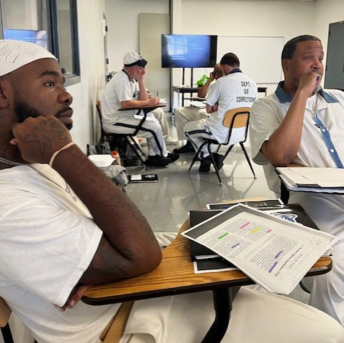
Why?: The Need for HEP in GA
Michael: sophomore at UWG.
@ 16, sentenced to life (30 yrs.)
Background: parental addiction, homeless (motels)
Gang involvement by 10: love/support & necessities
School: dropped out in middle
Education: taught himself to read and write in prison, earned his GED, currently has a 4.0 GPA and co-authored a paper under review

Slide 3
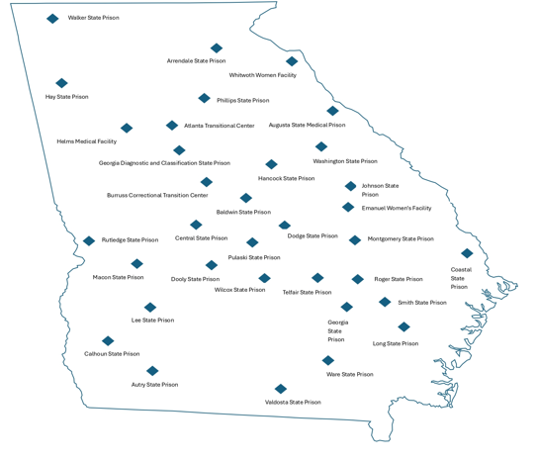
95,000 Georgians are behind bars
8th most populous state;
4th highest incarcerated population (DOJ 2024).
incarcerates approx. 881 per 100,000 people.
47,000 are in GA State Prisons while 1,500 are in juvenile facilities.
An additional 356,000 Georgians are under supervision (GDC 2023; PPI 2023).
Recidivism rate of 30% (GDC 2023).

Slide 4
Individuals who committed crimes related to survival and economy (property crimes) are by far the most likely to recidivate.
GA's poverty rate: 12%
The unfortunate reality is that our prisons house a disproportionate number of Georgia’s poor.
More than half (57%) of incarcerated men ages 27-42 earned $22,500 or less annually prior to incarceration.
Incarcerated people have a median household income of approximately 41% less than non-incarcerated people of similar ages (PPI 2015).

Slide 5
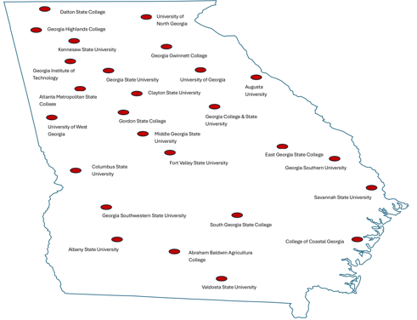
University System of GA & Faculty
Most incarcerated persons - no access to quality education or good jobs prior to incarceration (PPI 2021).
Rectify both AND simultaneously
Reduce the state-wide problem of over incarceration and recidivism,
Develop an untapped pool of talent for GA’s workforce,
Building stronger communities across the state in which returning men and women have improved employment prospects as well as a likelihood of higher annual and lifetime earnings.

Slide 6
Added Benefit: Stronger GA Families
The overwhelming majority of incarcerated Georgians are men (GDC).
Most incarcerated adults, men and women, are parents (Miller 2021).
Upon their release, families will have mothers, fathers, and spouses who can financially contribute to their households and be physically and emotionally present (Mangual, Wilcox, Cannon, and Price 2023).

Slide 7
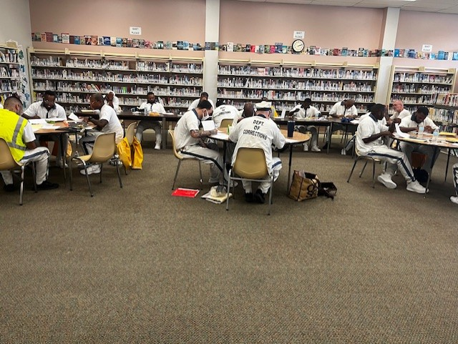
Why HEP?
Nationwide, opportunity-based programs, hard skills training and technical education, show little to no impact on recidivism (MacKenzie 2006), but
earning a bachelor’s degree while incarcerated reduces recidivism to 6% (RAND 2018; Vera 2019).
There is currently one USG institution offering a bachelor’s degree in prison and only one institution in the state having earned SACSCOC PEP approval: The University of West GA.

Slide 8
Non-Special Mission State Prisons
Name | Location | Capacity | Men/Women/Youth
Baldwin State Prison | Hardwick | 981 | Men
Burruss Correctional Training Center | Forsyth | 708 | Men & Youth
Calhoun State Prison | Morgan | 1639 | Men
Central State Prison | Macon | 1153 | Men
Coastal State Prison | Garden City | 1389 | Men
Dodge State Prison | Chester | 1236 | Men
Dooly State Prison | Unadilla | 1702 | Men
Emanuel Women's Facility | Swainsboro | 415 | Women
Hancock State Prison | Sparta | 1201 | Men
Hays State Prison | Trion | 1100 | Men
Jimmy Autry State Prison | Pelham | 1712 | Men
Johnson State Prison | Wrightsville | 1612 | Men
Lee State Prison | Leesburg | 762 | Men
Long Unit | Ludowici | 212 | Men
Macon State Prison | Oglethorpe | 1762 | Men
Montgomery State Prison | Mount Vernon | 418 | Men
Phillips State Prison | Buford | 925 | Men
Pulaski State Prison | Hawkinsville | 1211 | Women
Rogers State Prison | Reidsville | 1391 | Men
Rutledge State Prison | Columbus | 640 | Men
Smith State Prison | Glennville | 1570 | Men
Telfair State Prison | Helena | 1410 | Men
Valdosta State Prison & Annex | Valdosta | 1184 | Men
Walker State Prison | Rock Spring | 444 | Men
Ware State Prison | Waycross | 1492 | Men
Washington State Prison | Davisboro | 1346 | Men
Whitworth Women's Facility | Hartwell | 442 | Women
Wilcox State Prison | Abbeville | 1840 | Men

Slide 9
Private Prisons
Name | Location | Capacity | Men/Women/Youth
Coffee Correctional Facility | Nicholls | 2628 | Men
Jenkins Correctional Facility | Millen | 1150 | Men
Riverbend Correctional Facility | Milledgeville | 1500 | Men
Wheeler Correctional Facility | Alamo | 2695 | Men

Slide 10
County Facilities
Name | Location | Capacity | Men/Women/Youth
Athens-Clarke County Correctional | Athens | 112 | Men
Bulloch County Correctional | Statesboro | 160 | Men
Carroll County Correctional Institute | Carrollton | 246 | Men
Clayton County Prison | Lovejoy | 242 | Men
Colquitt County Prison | Moultrie | 190 | Men
Coweta County Prison | Newnan | 232 | Men
Decatur County Prison | Bainbridge | 135 | Men
Effingham County Prison | Springfield | 192 | Men
Floyd County Prison | Rome | 424 | Men
Gwinnett County Prison | Lawrenceville | 158 | Men
Hall County Correctional Institution | Gainesville | 200 | Men
Harris County Prison | Hamilton | 150 | Men
Jackson County Correctional | Jefferson | 150 | Men
Jefferson County Correctional | Louisville | 140 | Men
Mitchell County Correctional | Camilla | 135 | Men
Muscogee County Prison | Columbus | 576 | Men
Richmond County Correctional | Augusta | 230 | Men
Screven County Prison | Sylvania | 148 | Men
Spalding County Correctional | Griffin | 384 | Men
Sumter County Correctional | Americus | 350 | Men
Terrell County Correctional Institute | Dawson | 140 | Men
In addition:
19 Regional Youth Detention Centers and 6 Youth Development Camps
There are a significant number of youth in custody who have graduated from high school or earned their GEDs and are eligible to attend college while incarcerated.
Currently, eCampus serves a handful of young students in custody each semester.

Slide 11
USG Institutions
GA Prisons

Slide 12
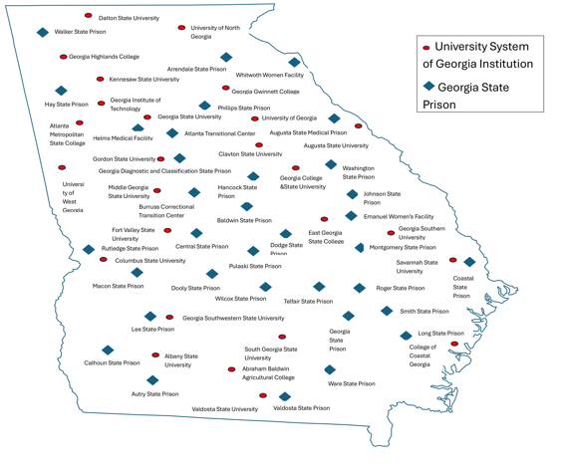
Both: USG & GDC

Slide 13
Together, we can offer HEP programs in every state prison thereby
Reducing crime and the prison population,
Enhancing GA’s workforce,
improving GA families, and
making better GA communities.

Slide 14
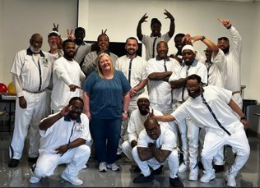
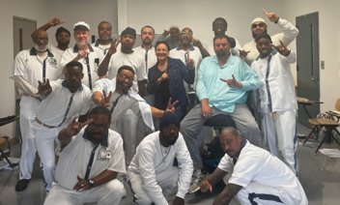
HOW?
USG Institutions - independent PEP (Gordan State)
USG Institutions - joining a centralized USG PEP
USG faculty - faculty sharing in PEP

Slide 15
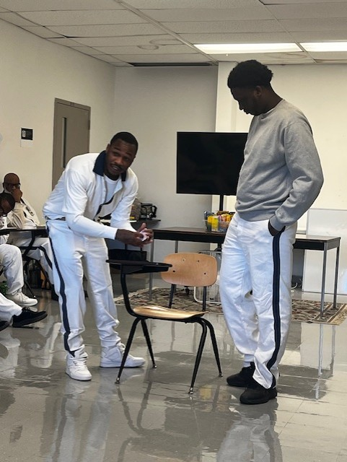
Teachers: The Hardest Job You'll LOVE Doing
"college has changed the life of every single person in this class."
"in this short amount of time [college] has given us a new outlook on life, outside these walls and inside."
"I want to thank you for seeing something in me even when I do not see it myself."

Slide 16
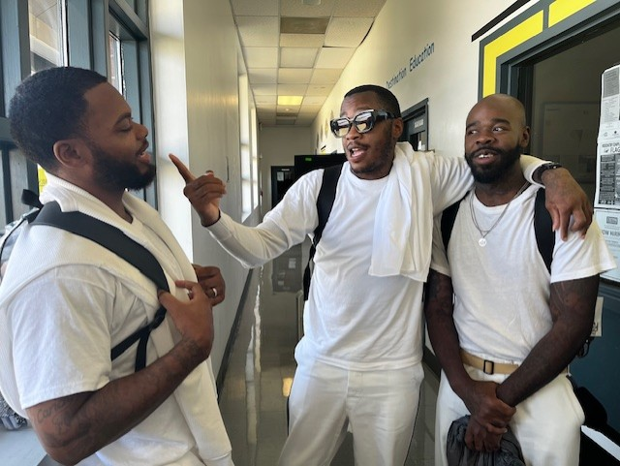
"I wanna make the world see that with just a little humanity and concern that some can become not only reformed people but bring something to the world that will make history."

Slide 17
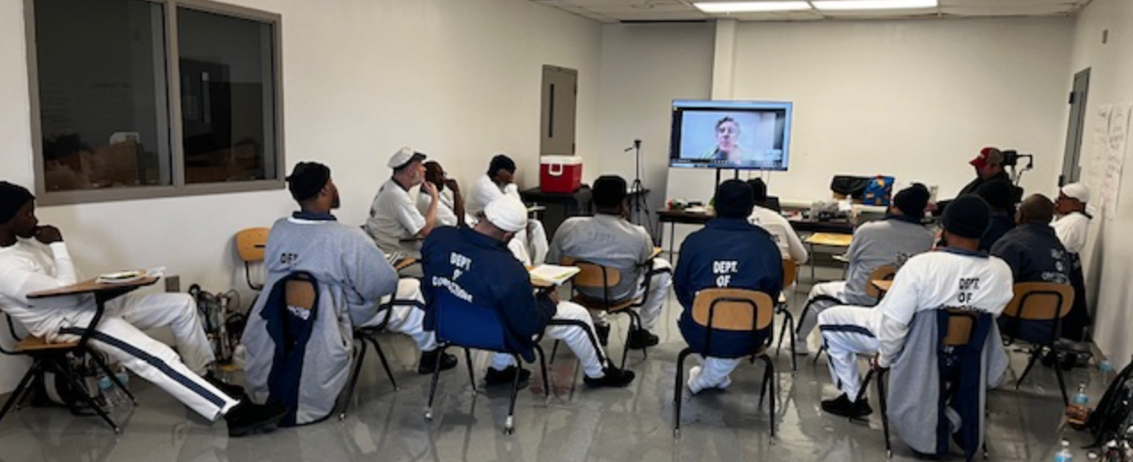
tparsons@ westga.edu
Improve GA
Change lives
Support a HEP program
Start a HEP program
Teach in a HEP program

