Slide 1

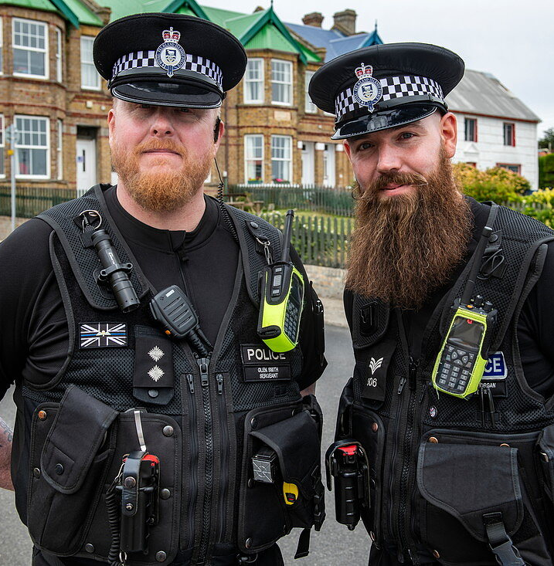
Front line supervision
The lynchpin of effective policing
Dr Johannes P. Oosthuizen
University of North Georgia

Slide 2
Main project: Research methodology
Community Policing
62 shifts
Patrol Sergeants
105 shifts
CID
32 shifts
1800 activities
10 interviews
700 activities
18 interviews
4071 activities
33 interviews
12 observers
51 observers
40 observers

Slide 3
This project: patrol sergeants
Average operational experience of 14 years
25% had spent several years in the same station
75% moved to their station within the last 12-18 months.
The views expressed come from experienced officers who knew the problems and difficulties of their station well.

Slide 4


















police ranks
UK (England & Wales) |  | USA (NYPD)
Constable |  | Police Officer and detective
Sergeant |  | Sergeant
Inspector |  | Lieutenant
Chief Inspector |  | Captain
Superintendent |  | Deputy Inspector
Chief Superintendent |  | Inspector
Assistant Chief Constable |  | Deputy Chief
Deputy Chief Constable |  | Assistant Chief
 |  | Bureau Chief
Chief Constable |  | Chief of department

Slide 5
Sui Generis
When it comes to the performance of operational police officers, there is no one as important as the first-line supervisor.
First-line supervisors who meet the demanding standards and expectations are a rare exception, or sui generis, in a class by themselves (Green, Lynch, & Lynch, 2014).
Green, K., Lynch, E., & Lynch, R. (2014). The Police Manager (7th ed.). California: Routledge.

Slide 6
Managerial awareness
The first-line supervisor leadership role is critical for the stability and future of any police service.
It is crucial that sergeants realise they are a critical part of the management team and, as such, are responsible for maintaining policy and procedure (Waters, 2004).
Waters, M. (2004, July 1). The Leadership Role of the First Line Supervisor in Police Operations. The Florida Police Chief Magazine , p. 1

Slide 7
Process v product
Forces strive to select the best candidates but then something happens with the process when they don't nurture or develop the potential they have identified in their officers.
Part of this attitude comes from our results-oriented society and organisations tend to confuse process with product (Green, Lynch, & Lynch, 2014).
Green, K., Lynch, E., & Lynch, R. (2014). The Police Manager (7th ed.). California: Routledge.

Slide 8

Performance and trust

Slide 9
Medium Performance High Trust
High Performance
Low Trust
High Trust
High Performance
Low Performance
Low Trust
Low Performance
High Trust
PERFORMANCE
TRUST
Sinek, S (2023). Simon Sinek’s Optimism Company. What the Navy Seals can Teach Businesses about Team Building. Accessible from https://simonsinek.com/stories/what-the-navy-seals-can-teach-businesses-about-team-building/

Slide 10
The hamster wheel
Hesitant – so risk and liability increases
Supervisors withdraw from proactive supervision
Passive observers and good bureaucrats
Lack the skills to train rookie supervisors
Lacking experience & qualifications

Slide 11
Straddling the fence
First-line supervisors stand with each foot in a different world: management and operations.
Any failure to acknowledge and to support this role can and will frustrate senior officers in their ability to achieve divisional and force objectives, simply because they are limited by the quality of those first-line supervisors.

Slide 12
Policy implementors
Chief
Senior Management Team
Inspector
Sergeant
Police Officer
Frustrated police [officers and staff] can lead to negative productivity (Baker, 2000).
Baker, T. (2000). Effective Police Leadership. New York: Looseleaf Law Publications.

Slide 13
College of Policing: Effective supervision
Guidelines for chief officers (2022)
Culture and capacity
Capability
Organizational support & processes
College of Policing. (2022). Effective Supervision: Guidelines. Obtained from https://assets.college.police.uk/s3fs-public/2022-04/Effective-supervision-guidelines.pdf

Slide 14

College of Policing: Effective supervision
Guidelines for supervisors (2022)
Acting as a role model
Building effective relationships
Communicating effectively
Demonstrating fairness and respect
Supporting wellbeing
Supporting the delivery of good service
Supporting professional discretion in decision making

Slide 15

3 Golden rules
Rule Number 1: Supervisory training should start on the first day on the job.
Rule Number 2: First-line supervisors need the support from their supervisors—the Inspectors.
Rule Number 3: There is little preparation for the highly critical, low- and high-frequency events.
Notes:
Rule no. 1 notes: Every officer picks up a supervisory style through different means and at the end of a number of years of acting or temporary rank and having then been successful at a promotion board, the absence of extensive support and training for their new position will cause the newly-promoted officer to draw upon their experiences with other supervisors and adopt the style in which they observed other supervisors handle their responsibilities. These new supervisors will be guided by the manner in which they were treated or ignored and during this delicate transition, in which the sergeant now occupies both the operational and managerial worlds, a lack of training and support will be crucial to their success.
Rule No. 2 notes - First-line supervisors can often fail to receive the support they need from their supervisors—the Inspectors. Without that support and despite their best efforts, it becomes far too easy to fall back into the old, more comfortable and non-challenging pattern.
Rule No. 3 Notes - There is often little preparation for the highly critical, low- and high-frequency events that really test a supervisor's mettle (such as missing persons, domestic abuse incidents, reports of ASB), yet they demand the best in supervisors or officers to handle them with professional poise according to the highest standards. If policies are important, especially those relating to the high-risk/critical tasks, training must be provided in those policies for supervisors. According to Green, Lynch & Lynch (2014), one rule is: “Never ask a supervisor to enforce a high risk/critical task policy unless he or she has first been trained in the application of that policy”

Slide 16

What does the observational data tell us about the challenges facing front line supervision?

Slide 17
Urban sergeant: late shift activity
Sergeant Activity | Minutes taken
Briefing | 10
Volume Crime briefing | 15
One to One meeting | 10
Allocating jobs via AWA | 30
Sick Officer paperwork | 10
Task from Probation Service | 15
Interview for Deep Dive Exercise | 20
Missing person enquiries | 30
Updating C2 Inspector | 5
E-Mail admin | 10
Discussion with colleagues | 10
RTC enquiries | 10
Case direction | 50
Case direction | 5
Case direction | 30
Assisting CSI with body retrieval tent | 95
Dinner | 15
E-mails | 10
Case direction | 5
Paperwork | 55
Handover | 10
Missing person enquiries | 20
Crime allocation | 45
Admin | 40
Total of 24 activities Average time per activity = 25 minutes | 610
70% are office based
Out of the 10-hour shift, this amounts to 4 hours and 50 minutes (50% of the shift).
Meal breaks are limited (15min per shift)
Missing person/crime enquiries take up 17% of their time, amounting to 1 hour and 45 min.

Slide 18
Rural sergeant: early shift activity
Sergeant activity | Minutes taken
Crime enquiries | 35
Checking incidents | 40
Briefing | 10
Checking incidents | 40
Briefing | 20
Briefing | 15
Paperwork | 45
Attend incident | 15
Paperwork | 80
Hire vehicles check | 35
General supervision | 15
Incident at Bridport | 95
Crime Enquiries | 30
Property enquiries | 30
Staff supervision | 10
Workload checks | 20
Crime enquiries | 30
Hand over to Sergeant | 30
Total of 18 activities Average time per activity = 33 minutes | 595
61% are office based
Out of the 10-hour shift, this amounts to 4 hours (50% of the shift)
There are few external taskings (1hour 5min per shift)
Meal breaks were not recorded
Missing person /crime enquiries take up 34% of their time, amounting to 3 hours and 25 min.

Slide 19
Time spent in police stations
 | WEEKDAYS |  | WEEKENDS
 | Sergeant | PCs | Sergeants | PCs
Time spent in station | 76.3% | 50.6% | 57.0% | 40.8%
Time spent out of station | 23.7% | 49.4% | 43.0% | 59.2%
Total | 100% | 100% | 100% | 100%

Slide 20
Activity analysis for patrol sergeants

Slide 21

Qualitative results

Slide 22
The burden of bureaucracy
“ Patrol Sergeant job changed from operational to administrative (90% admin: 10% operational)” (Sgt 3)
“ Over a period of seven years the responsibility of being a Sergeant has changed incredibly. The job now is a ‘manager of process’ rather than people” (Sgt 7)

Slide 23
Demand changes things
“ Public demands increasing, resources decreasing but [we are] working smarter.”(Sgt 8)
“ We cannot do proactive work” (Sgt 1)
“ [We are] now more realistic about the crimes that will be investigated properly and those that won’t.” (Sgt 2)
“[I] Feel as if we were always just one incident away from having our strength entirely wiped out.” (Sgt 9)

Slide 24

THE BEEHIVE EFFECT

Slide 25

understanding bureaucracy

Slide 26
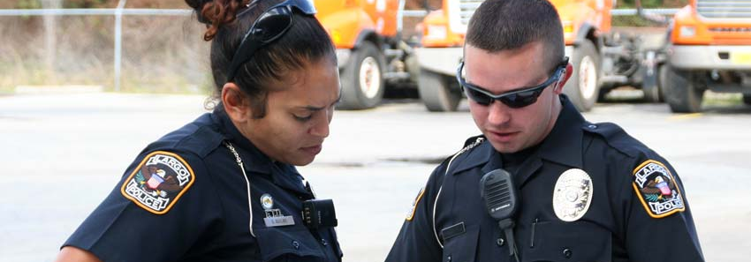
Field training programs

Slide 27

Any questions
Johannes.oosthuizen@ung.edu

