Slide 1
From Darkness to Light: A Qualitative Analysis of the Efficacy of Bluestar® on Ceramic Tiles
CJ Giordiano | Madison Harner | Dr. Jon Hager | Dr. Stu Batchelder | University of North Georgia

Slide 3
How would Bluestar® be able to detect bloodstains on ceramic tiles that have been cleaned with multiple different cleaners?
Notes:
This is the question that your experiment answers

Slide 4
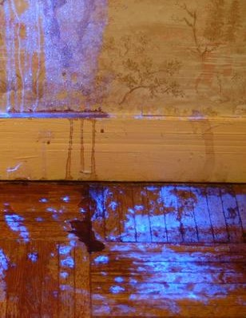
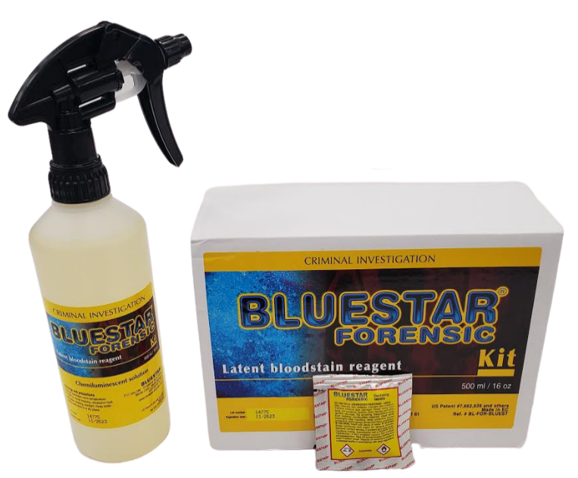
What is Bluestar®?
Bluestar® is similar to luminol and it has a bioluminescent reaction to blood and will glow in the dark when blood is detected.

Slide 5
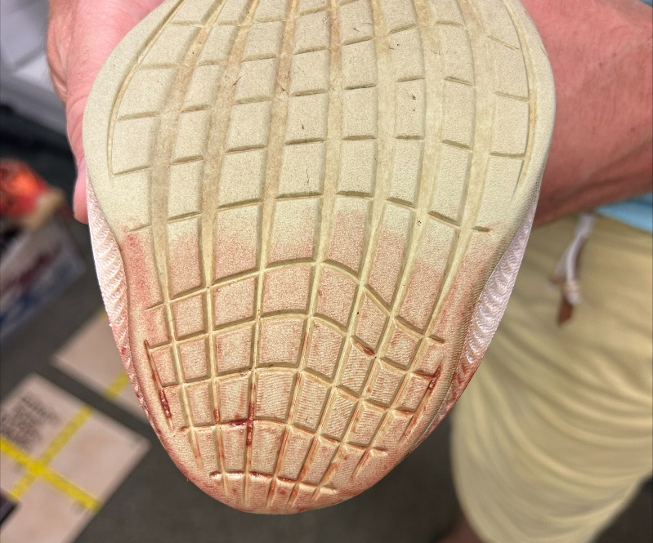
Project Overview
We used a shoe to make bloodstains on ceramic tiles and let them dry at different intervals before cleaning: 2 days, 4 days, and 6 days.
We used three different cleaning solutions: Vinegar and water, Baking soda and water with a vinegar rinse, and hydrogen peroxide and water.

Slide 6
Previous Research
Most other research done prior to this has used luminol to detect bloodstains rather than Bluestar®.
Other research also used more chemical based cleaners, such as bleach and dish soap, rather than more natural cleaning products.
Prior research has tested different surfaces such as concrete and drywall
This research has shown that porous surfaces absorb blood and react more than non-porous surfaces. It also showed that certain chemical cleaners cause a false positive reaction.
Because of this, we decided to use ceramic tiles and non-chemical based cleaners for our research.
Notes:
Summarize your research in three to five points.

Slide 7
Variables
Controlled variables
Independent variables
Dependent variable
Ceramic tiles
Type of cleaner
How each bloodstain reacted to the Bluestar® after each different cleaner on different days
Kind of blood
Amount of blood
How many sprays of cleaner
Amount of time passed between blood application and cleaning

Slide 8
Materials
Materials | Quantity
Ceramic tiles | 3
Skylark Brand of sliced, skinned, and deveined calf liver | 1 package
Size 10 Nike Zoom Fly 3 shoe (right) | 1
Smart Way brand distilled white vinegar with 4% acidity | 1 bottle, 2 fl. oz for mixture
Arm and Hammer Fridge and Freezer baking soda | 29 grams
Kroger brand hydrogen peroxide | 2 fl. oz
Warm tap water | 6.75 fl. oz
Bluestar® tablets | 2
Spray bottles | 4
Sharpie | 1
Roll of tape | 1

Slide 9
Procedure
Step 1
Create the bloodstain once on each section of every tile and allow them to dry.
Step 2
Use each cleaner to clean their respective section
Step 3
Use the Bluestar® after to detect blood residue.
Step 4
Repeat for each tile on each expected day and record results.
Notes:
List all of the steps used in completing your experiment.
Remember to number your steps.

Slide 10
Data/Observations
 | 2-day old blood | 4-day old blood | 6-day old blood
Vinegar with warm water | - | + | +
Baking soda with warm water and vinegar rinse | - | + | +
Hydrogen peroxide | + | + | +

Slide 11
2-Day Old Blood Results
Vinegar and warm water
Baking soda and water with a vinegar rinse
Hydrogen peroxide and warm water

Slide 12
4-Day Old Blood Results
Vinegar and warm water
Baking soda and water with a vinegar rinse
Hydrogen peroxide and warm water

Slide 13
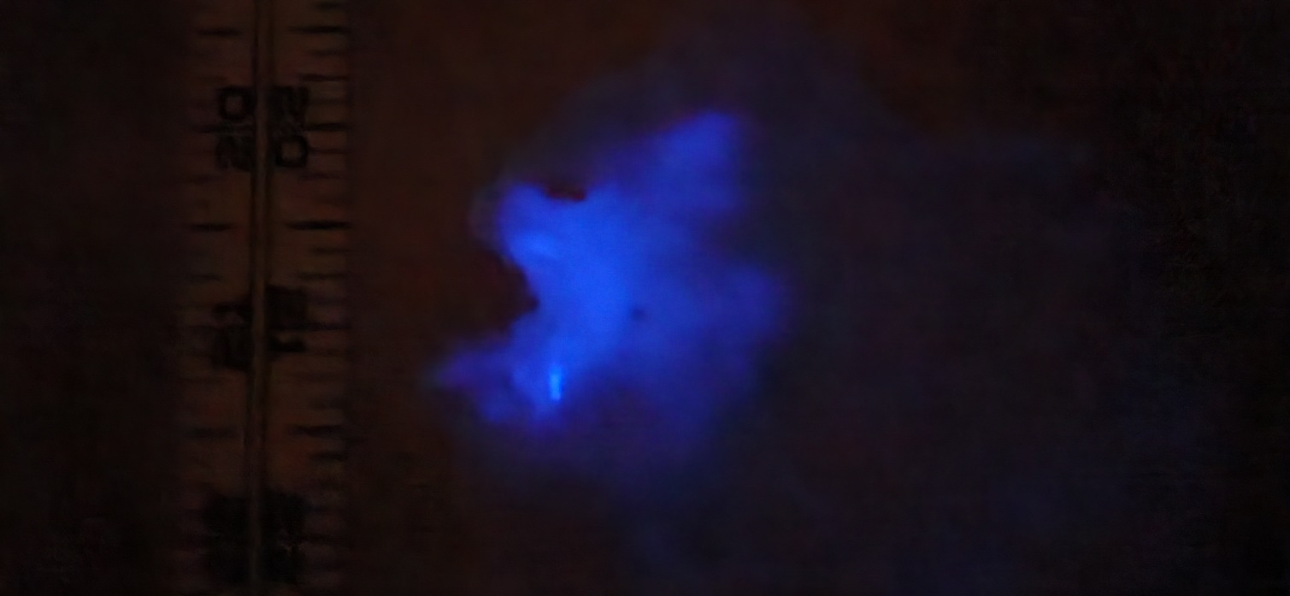
6-Day Old Blood Results
Vinegar and warm water
Baking soda and water with a vinegar rinse
Hydrogen peroxide and warm water

Slide 14
Conclusion
The purpose of this study was to determine if blood would be able to be detected even after using different cleaning agents that would potentially disrupt the reaction in Bluestar®.
We found that the older the blood sample was, the more reactions occurred.
Reactions occurred in all of the cleaning attempts on 4- and 6- day old blood samples
This leads us to the conclusion that Bluestar® may be better at detecting older blood samples and detectives may need to use Bluestar® a few days after the crime occurred to detect the blood.
Visualization of the bloodstains

Slide 15
References
Adams, J. L., Rancourt, E. D., & Christensen, A. M. (2019). The effect of household oxidizing cleaners on chemiluminescence of blood using Bluestar®. Journal of Forensic Sciences, 64(3), 869–872. MEDLINE with Full Text. https://doi.org/10.1111/1556-4029.13914
Bluestar® Forensic. (2021). The chemistry of Bluestar® Forensic. https://www.bluestar-forensic.com/the-chemistry-of-bluestar-forensic/
Cavanaugh, G. (2021). How to get away with murder: The effectiveness of blood detectors on surfaces cleaned of blood. Undergraduate Theses and Capstone Projects. https://digitalshowcase.lynchburg.edu/utcp/196
Creamer, J. I., Quickenden, T. I., Crichton, L. B., Robertson, P., & Ruhayel, R. A. (2005). Attempted cleaning of bloodstains and its effect on the forensic luminol test. Luminescence : The Journal of Biological and Chemical Luminescence, 20(6), 411–413. MEDLINE with Full Text. https://doi.org/10.1002/bio.865
Gabriel, J., & Marquez, G. (2021). Effectiveness of various cleaning agents at removing detectable traces of blood. Boston University Libraries OpenBU. https://open.bu.edu/handle/2144/42150?show=full
Indalecio-Céspedes, C. R., Hernández-Romero, D., Legaz, I., Sánchez Rodríguez, M. F., & Osuna, E. (2021). Occult bloodstains detection in crime scene analysis. Forensic Chemistry, 26, 100368. https://doi.org/10.1016/j.forc.2021.100368

Slide 16
References
Lupica, R. (2017). Comparing two alternate light sources with Bluestar Forensic: Locating blood in a manipulated crime scene. Journal of Forensic Identification, 67(2), 190–204. Complementary Index.
Meunier, O., Fersing, T., Burger, S., & Santasouk, J. (2022). Biocleaning in operating theatres: Validation of cleaning techniques by revealing residual traces of blood. Journal of Hospital Infection, 121, 32–38. CINAHL Complete. https://doi.org/10.1016/j.jhin.2021.11.023
Stojanović, I. (2019). Detection of bloodstains on cotton fabric after washing. Acta Medica Medianae, 58(1), 24–27. https://doi.org/10.5633/amm.2019.0104
Streeting, C. A., Chaseling, J., Krosch, M. N., & Wright, K. (2020, June 29). A comparison of ABAcard® Hematrace® and RSIDTM-blood tests on dried, diluted bloodstains treated with leucocrystal violet or luminol. Taylor & Francis Online. https://www.tandfonline.com/doi/full/10.1080/00450618.2020.1781256
Wykoff, A. (2020). Qualitative analysis of luminol efficacy on bleach-cleaned and paint-concealed blood. Themis: Research Journal of Justice Studies and Forensic Science, 8(1). https://doi.org/10.31979/THEMIS.2020.0801

