Slide 1
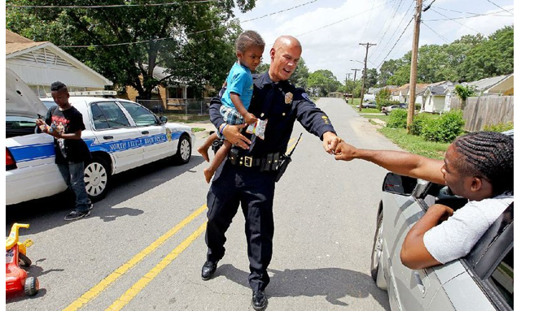
Achieving Social Justice When Policing the Community An Un Biased Approach : Recognizing and Re-Thinking Aggression Implications, Impact and Solutions
Presented by Dr. I.L Page
Albany State University

Slide 2
Presentation Objectives
Identify and understand the importance of community policing.
What is micro aggression
How to recognize micro aggression as a threat to community policing.
Identify key distinct forms of micro aggression.
Examples of some common occurrences.
How we can begin the healing process between law enforcement and community resident.

Slide 3
What is Community Policing
The building of a supportive relationship between community residents and law enforcement undergirded by mutual respect
A strategy that emphasizes building relationships between police officers and members of the community. This strategy seeks a collaborate effort to solved problems with the help of the people.
Engage law enforcement and community leaders in devising new ways to reduce crime while building public trust.
Collaborative partnerships between the law enforcement agency and the community to develop solutions to problems and increase relationships

Slide 4
Goal of Community Policing
Improve
Improve the relationship between community residents and police officers.
Build
Build trust that is undergirded by fairness and respect
Maintain
Maintain public safety by working with community members to identify and solve problems

Slide 5
The Issue of Concern

Slide 6
Perspectives leading to Distrust
Community Perspective
Police officers have a negative view of the community and people
They over-react and mis handle situations when marginalized citizens are involved.
They are racist.
They abuse their power and authority.
Law Enforcement Perspective
Community residents do not care about their community, they will tolerate drugs use and crime.
Community residents are automatically aggressive when confronted by law enforcement.

Slide 7
What is Micro Aggression
It is subtle behavior meant to go unnoticed
A statement, action, or incident regarded as an instance of indirect, subtle, or unintentional discrimination against members of a marginalized group such as a racial or ethnic minority.
Indirect, subtle, or unintentional discrimination against members of a marginalized group.
The everyday slights, indignities, put downs and insults that people of color, women, LGBTQ+ populations or those who are marginalized, experience in their day-to-day interactions with people.

Slide 8
Three Distinctions
Micro aggressions occur in three distinct ways:
Micro assaults, Micro insults, and
Micro invalidations
Micro assaults: are conscious, deliberate forms of discriminatory practice that are intended to harm, and most closely resemble traditional forms of discrimination.
Micro insults: Verbal and nonverbal communications that subtly convey rudeness and insensitivity and demean a person's racial heritage or identity.
Micro invalidations: is when a person's comment invalidates or undermines the experiences of a certain group of people.

Slide 9
Root of Micro Aggression
Racism
the view that certain racial or ethnic groups are biologically inferior and practices involving their domination and exploitation are therefore justified.
the belief that different races possess distinct characteristics, abilities, or qualities, especially as to distinguish them as inferior or superior to one another.

Slide 10
Two Factors that Influence Racism
Prejudice
An irrational attitude toward a race or group of people based on your biases and their membership to a certain group.
Any rigid and irrational generalization about an entire category of people.
Discrimination
A behavior of unequal treatment towards people because of their membership to a particular race or group of people.
Unequal treatment of various categories of people.

Slide 11
It is ……………
It is a mind set (that can be unconscious or conscious) of what we think about a certain group of people
Institutionalized in the legal system, the political system, education system, housing industry etc.…

Slide 13
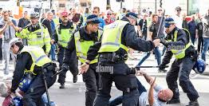
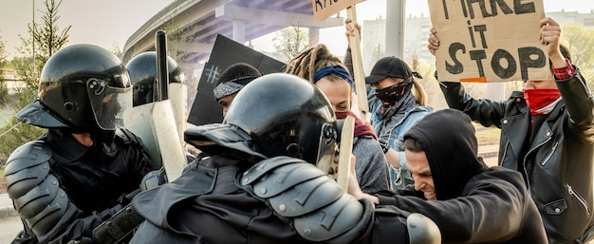
Some negative examples
excessive use of force when dealing with marginalized populations
racial profiling-- a person of color stopped because she/he is driving a luxury car
lack of trust resulting in an aggressive or threatening tone
community members not reporting crimes due to fear of police biased behavior

Slide 14
Examples continue
Stop-and frisk practices. Intrusive searches of individuals without reasonable cause.
lack of cultural sensitivity, and a perception that police are more likely to target certain demographics; often stemming from historical issues and systemic inequalities, leading to a breakdown in communication and cooperation between law enforcement and the community they serve.

Slide 15
Why Should Society be Concerned about Community Policing and Community Relationships
Avoid violent encounters between law enforcement members and community residents.
Lack of trust.
Injustice- violation of another person’s rights or what is morally right. To treat unfairly, to deny fair treatment to someone.
Public safety is at risk for both groups.
Social Justice is at risk

Slide 16
Achieving Social Justice

Slide 17
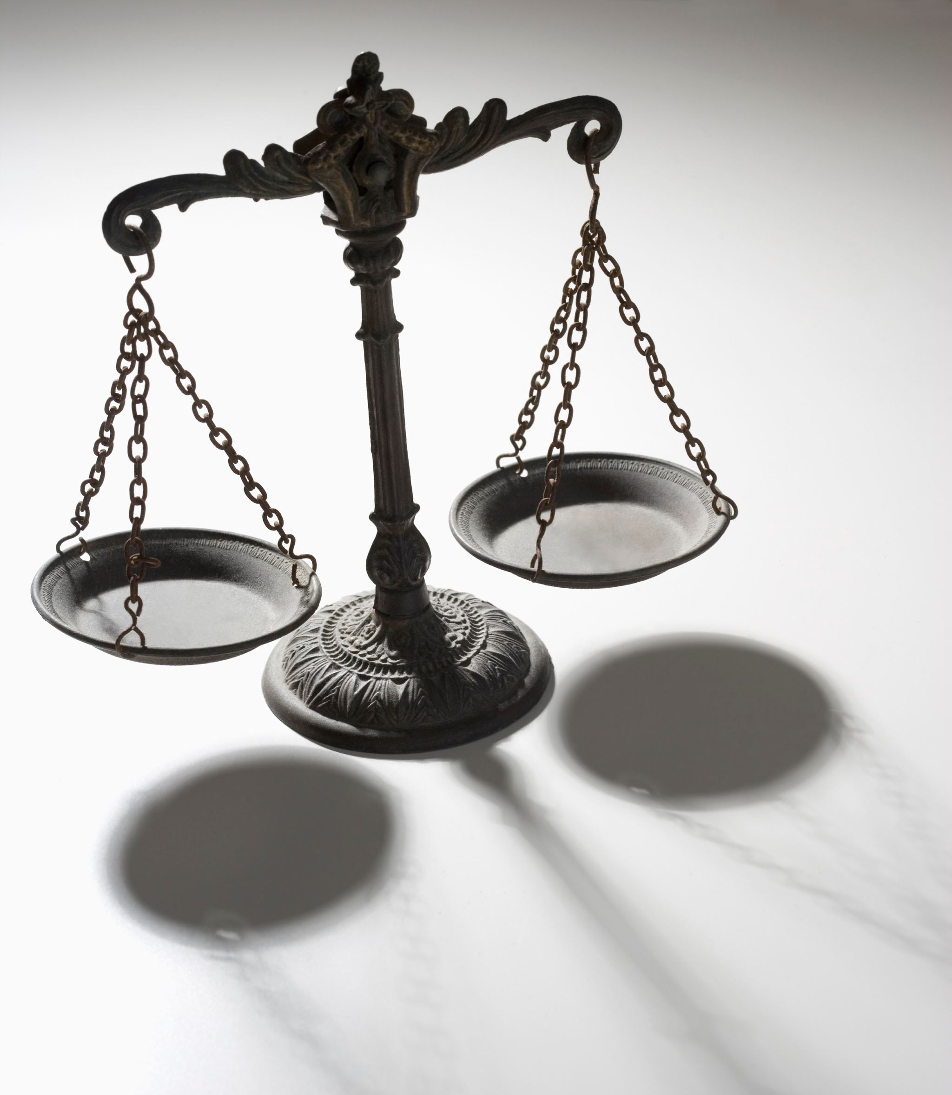
What is Social Justice
The standards we use to judge social justice may vary depending upon the situation, it may help to think of social justice in three ways:
Distributive justice refers to fair outcomes, such as human rights pay distributions. Many people believe that there is much less distributive justice for women and minority group members because they earn far less than white males for doing the same work.
Procedural justice refers to the fairness in how decisions are made. Examples might be ways to resolve conflicts or to determine allocations of resources. Many people believe that a small group of people run America.
Retributive Justice refers to fair punishment and how severe it should be. If you consider sentencing outcomes between white and black felons, you will find that black felons serve longer jail sentences for committing the same crimes and with the same prior criminal records.

Slide 18
Social Justice
The major issues that define social justice are as follows:
Dignity of people. The foundation of social justice is the belief in the inherent dignity of all people.
Common good and community: how we organize our society--- in economics and politics, in law and policy--- directly affects human dignity and the capacity of individuals to grow in the community.
The moral test for a society is how it treats its most vulnerable and poor members.
Rights and responsibilities: human dignity can be protected, and a healthy community can be achieved only if human rights are protected, and responsibilities are met.

Slide 19
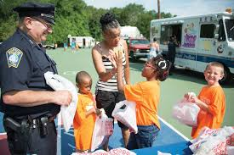
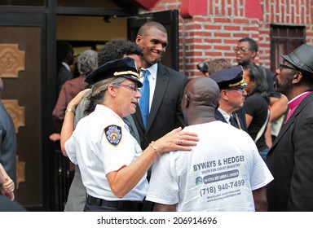
Some Common Understandings
Community residents must not view law enforcement members as a threat
Law enforcement members must not view community residents as a threat
Mutual respect must be a part of every interaction

Slide 20
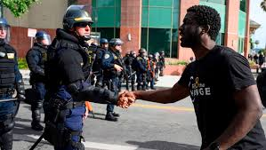
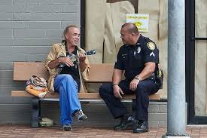
Some Solutions
Self examination of our personal biases
Recognized and accept that racial, class and gender inequality exists
Understand and respect people’s differences and rights
On going cultural competency training for law enforcement members .
Law enforcement monthly meetings with community agencies such as neighborhood associations, civil rights associations, churches, etc.. Community churches sponsor Law Enforcement Day
Law enforcement members are invited to community events
Commit to attending two cultural events outside of your racial identity each year

Slide 21
Some Solutions
Recognized and accept that racial, class and gender inequality exists
Understand and respect people’s differences and rights
On going cultural competency training for law enforcement members .
Transparency of all interactions. Body cameras on at all times.
Law enforcement members are invited to community events

Slide 23
References
Banks, B. M. Microaggression directed at Black college women: The
moderating role of racial identity and self-control depletion.
Hall. Daniel., J.D, Ed.D. 2023, Criminal Law and Procedure 8th ed. Cengage Publishing.
How can we fix the relationship between police and the community?
https://www.reddit.com/r/liberalgunowners/comments/1f1l3t9/how_can_
we_fix_the_relationship_between_police/
https://fastercapital.com/topics/promoting-community-policing.html
Hudson, David., Building Trust Between Communities and Local Police. December 1, 2014.
whitehouse.gov
Nadal, K. Psychologist, 62, 271-286
Sue, D.W. Capodilupo, C. M., Torino, G.C., Bucceri, J. M., Holder, A.M.,
Sage Publishing., 2011.
The Reverend Dr. Willard W C Ashley, Sr. Presentation Titled, Racialized Aggression

Slide 24
References
Also Known as Micro Aggression, September 8, 2020.
https://youtu.be/mgvjnxr6OCE
https://youtu.be/e4N50b76cZc
Van Wormer, Katherine, Kaplan, Laura, and Juby, Cindy. 2012. Second edition.
Confronting Oppression, restoring Justice: From Policy Analysis to social Action.
Wikipedia, Micro Aggression meaning and ways.

