Slide 1


AI in Academia:
Maximizing efficiency
and impact
PRESENTED BY:
DR. JASON ARMSTRONG,
ALBANY STATE UNIVERSITY
AND
MS. LEATHA CYPRIAN, M.S.C.J., J.D.,
COLUMBUS TECHNICAL COLLEGE

Slide 2


HAVE YOU USED AI?
Notes:
https://www.menti.com/alt592mjzn9v

Slide 3

TODAY'S AGENDA:
  Intro to AI
  Live Demonstration
  Question and Answers

Slide 4

WHAT IS AI?
  Artificial Intelligence
  Generative AI
  Large Language Model (LLM)
Notes:
Ask ChatGPT, what is generative AI?
https://chatgpt.com/share/50428524-8487-4cfb-853f-01161c9e5ad2

Slide 5
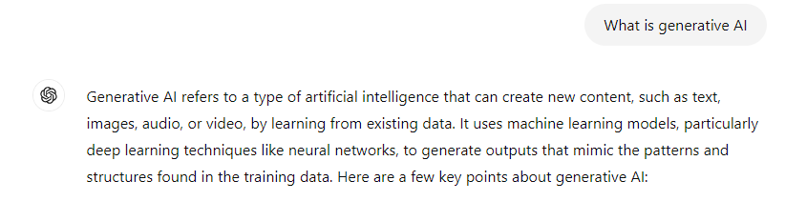
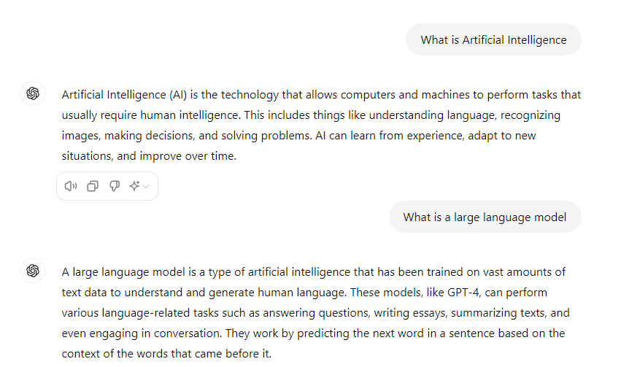
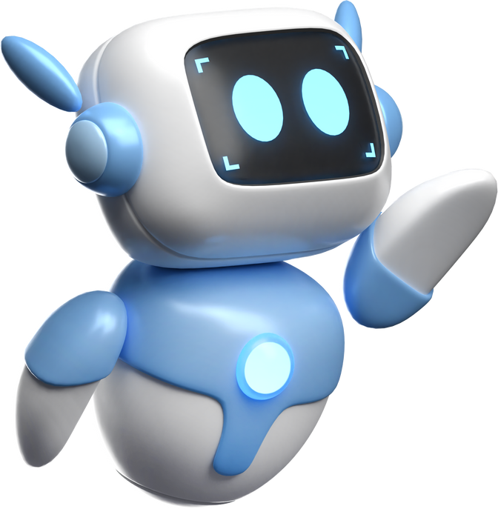
SAMPLE RESPONSES
Notes:
Ask ChatGPT, what is generative AI?
https://chatgpt.com/share/50428524-8487-4cfb-853f-01161c9e5ad2

Slide 6






AI PROGRAMS
  ChatGPT
  Co-Pilot
  Gemini
  Claude
  Poe
  InVideo
  Perplexity

Slide 7

WHAT IS A PROMPT?
  Prompt engineering
    Simple
    Complex
Notes:
What is a prompt?
A prompt is a piece of text or an instruction given to a language model to guide its response or generate specific content. It acts as a starting point or context for the model to produce relevant and coherent outputs. For example, asking a question or giving a sentence to complete can be a prompt for the AI to provide an answer or continuation.

Slide 8

SIMPLE
COMPLEX
Create a syllabus for a college English course.
Create a detailed syllabus for a college English course focused on American literature. The syllabus should include a course overview, weekly reading assignments, key themes and learning objectives, a list of major texts including novels, poems, and short stories, assessment methods such as essays, tests, and class participation, and a grading rubric. Include specific dates for assignments and exams, and plan for a mix of lectures, group discussions, and multimedia resources

Slide 9

THE COMPONENTS OF A GREAT PROMPT
  Clear Objective
  Specific Details
  Scope and Limitations
  Format and Structure
  Audience and Context
  Tone and Style
Notes:
What is a prompt?
A prompt is a piece of text or an instruction given to a language model to guide its response or generate specific content. It acts as a starting point or context for the model to produce relevant and coherent outputs. For example, asking a question or giving a sentence to complete can be a prompt for the AI to provide an answer or continuation.

Slide 10

BENEFITS OF AI
  Work/Life Balance
  Teaching Assistant
  Research Assistant
  Personal Assistant

Slide 11

TOOL 1:
Vocabulary Words and Quiz using ChatGPT
live
demo

Slide 12
TOOL 2:
Rubric using ChatPGT
live
demo

Slide 13
TOOL 3:
Course outline for 15 week course
live
demo

Slide 14
TOOL 4:
Discussion and essay prompts
live
demo

Slide 15
TOOL 5:
Invideo Demonstration
live
demo

Slide 16
TOOL 6:
Case Study generation
live
demo

Slide 17




Any Questions??

Slide 18












ATT
2:00 PM Wed Aug 7
98%

