Slide 1
Undocumented Immigration and Crime In the US
Isabelle Cosby
University of North Georgia

Slide 2
PURPOSE
The U. S. border - Mexico
Heavy influx of undocumented immigrants
Honest vocations or to further a criminal enterprise?
Accelerating crime-rates – influx drug
Statistically significant relationship between the influx of undocumented immigrants and the crime rates.
Concludes with information on better protect the nation’s borders

Slide 3
How are Drugs Moved Into the US?
Heavy presence in Southern border states
Massive amounts of illicit drugs
10% of marijuana produced smuggled through the Tohono O’odham
Use commercial trucks, private and rental vehicles
Compartments are put into the vehicle
Individuals will smuggle drugs on foot

Slide 4
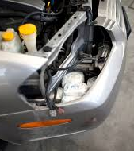
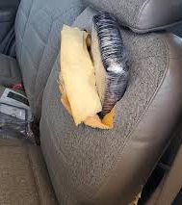
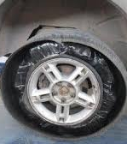
Visual Examples
Cars are taken apart
X-ray machines
Density pockets

Slide 5
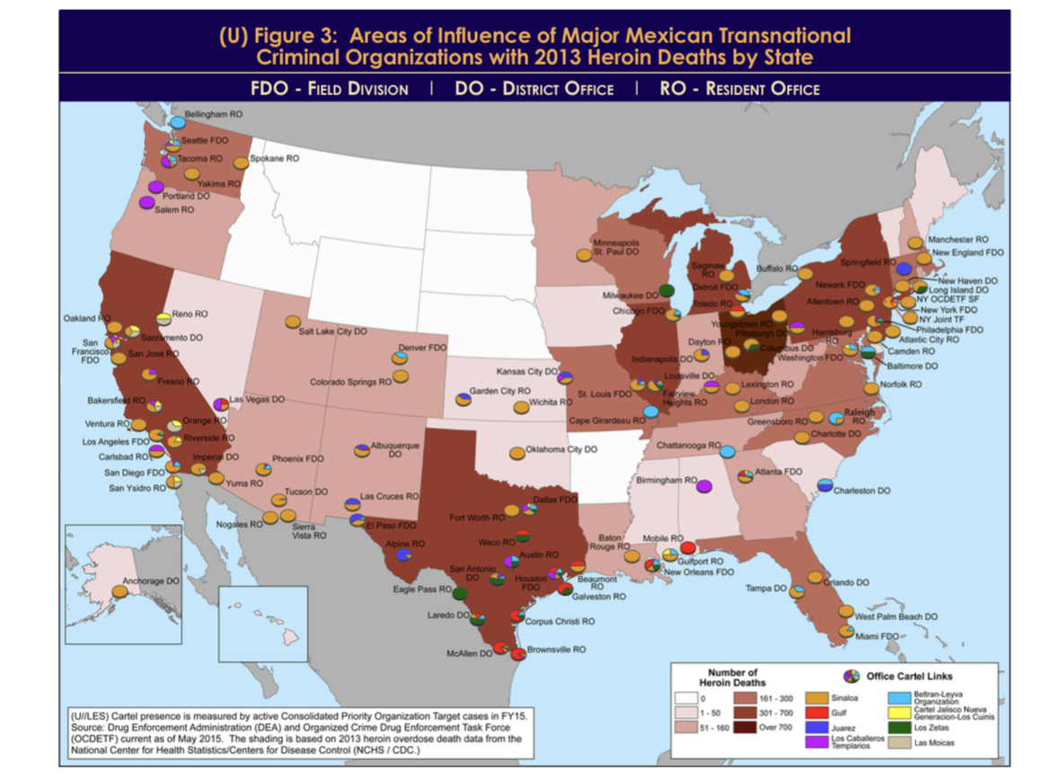
What Drug Cartels?
Sinaloa Cartel
Los Zetas
The Gulf Cartel

Slide 6
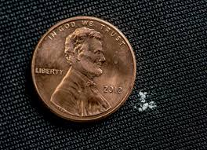
Arizona Example Drug Trafficking
4.5 million fentanyl pills
66,000 grams of fentanyl powder
33,000,000 people potentially
138 kilograms of cocaine
3100 pounds of methamphetamine
35 kilos of heroine
Trafficked by the Sinaloa cartel

Slide 7
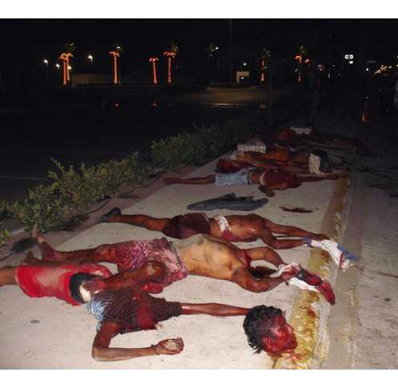
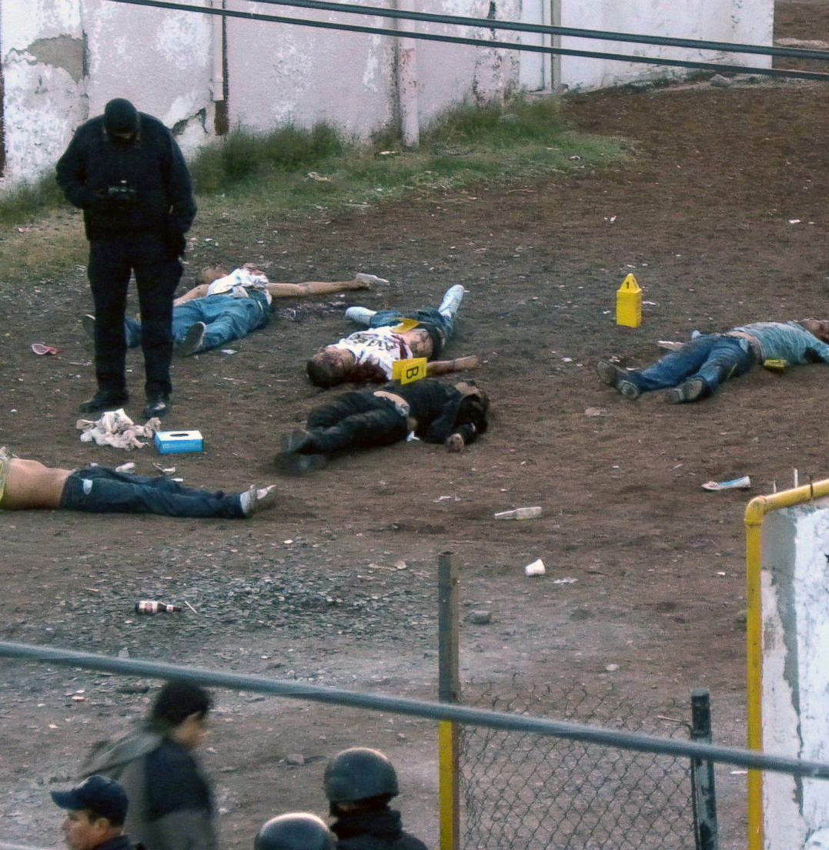
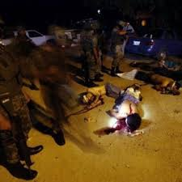
Violence beyond drugs
Juarez Mexico
Linked to cartel violence
Most dangerous cities in the world
Borders El Paso Texas

Slide 8
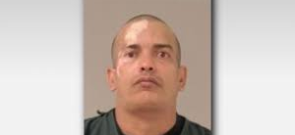
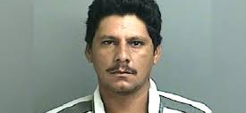
How does this affect the Innocent?
64% of federal arrests = non-citizens
7% of population
Safety threat to citizens and legal immigrants
Example – Alexis Sacorit
Example- francisco Oropeza
Harmed innocent people

Slide 9
What should be done?
Link between criminal activity amongst drug cartels
Threat to National security
Border precautions
Shutting down the POE
Adding more agents to the unsecured areas
The public should know!

Slide 10
References
(U) United States: Areas of influence of major Mexican ... - dea.gov. Drug Enforcement Agency Intelligence Report . (2015, July). https://www.dea.gov/sites/default/files/2018-07/dir06515.pdf
Davis, H. (2023, June 20). Increased illegal immigration brings increased crime: Almost 2/3 of federal arrests involve noncitizens. The Heritage Foundation. https://www.heritage.org/crime-and-justice/commentary/increased-illegal-immigration-brings-increased-crime-almost-23-federal
Gunden, M. (2023, June 17). Fentanyl, crime, and Arizona’s southern border: August 2022. Common Sense Institute Arizona. https://commonsenseinstituteaz.org/fentanyl-crime-and-arizonas-southern-border-august-2022/
Justice , D. of. (2010, February). U.S. Southwest Border Smuggling and Violence. (U) U.S. southwest border smuggling and violence - national drug threat assessment 2010 (unclassified). https://www.justice.gov/archive/ndic/pubs38/38661/swb.htm
Justice , D. of. (2023, April 14). Justice Department announces charges against Sinaloa Cartel’s global operation. Office of Public Affairs | Justice Department Announces Charges Against Sinaloa Cartel’s Global Operation | United States Department of Justice. https://www.justice.gov/opa/pr/justice-department-announces-charges-against-sinaloa-cartel-s-global-operation
Underwood , J. (2023, February). Dea, Arizona attorney General & Tempe Police announce 150+ subjects charged & massive quantities of narcotics seized. DEA. https://www.dea.gov/press-releases/2023/02/23/dea-arizona-attorney-general-tempe-police-announce-150-subjects-charged#:~:text=To%20date%2C%20over%20150%20individuals,and%20over%20%242%20million%20dollars.

