Slide 1
No-knock warrant: Human life versus evidence protection
Jim Nzonguma Mayua
Associate Professor
Albany State Universty
Fall 2023

Slide 2
Agenda
I. INTRODUCTION
Historical Background
Why No-Knock warrant was established
II. Legal basis
A. Federal regarding no-knock
B. Georgia law regarding no-knock
3. MAIN ARGUMENT
3. RESEARCH QUESTION
4. ANALYSE OF DATA
Arguments of proponents of no-knock warrant
Arguments of opponents of no-knock warrant
5. CONCLUSION AND RECOMMENDATIONS

Slide 3
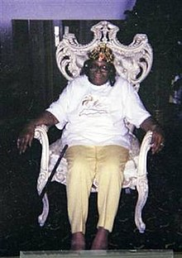
Killing of Kathryn Johnston On November 21, 2006, Kathryn Johnston, a 92-year-old African American woman, was killed by undercover police officers at her home in Atlanta, Georgia.

Slide 4
Killing of Kathryn Johnston
Kathryn Johnston (June 26, 1914 – November 21, 2006)^{[1]} was an elderly woman from Atlanta, Georgia who was killed by undercover police officers in her home on Neal Street in northwest Atlanta on November 21, 2006, where she had lived for 17 years. Three officers had entered her home in what was later described as a 'botched' drug raid. Officers cut off burglar bars and broke down her door using a no-knock warrant. Police said Johnston fired at them and they fired in response; she fired one shot out the door over the officers' heads and they fired 39 shots, five or six of which hit her.
One of the officers planted marijuana in Johnston's house after the shooting. Later investigations found that the paperwork stating that drugs were present at Johnston's house, which had been the basis for the raid, had been falsified. The officers later admitted to having lied when they submitted cocaine as evidence claiming that they had bought it at Johnston's house. Three officers were tried for manslaughter and other charges surrounding falsification, convicted, and sentenced to ten, six, and five years, respectively

Slide 5
KILLING OF Bounkham Phonesavanh (BABY BOU BOU )
Police executed a no-knock raid at 2:25 am on May 28, 2014, with a SWAT team breaching a door with a ram and throwing a flash-bang stun grenade into a room containing a 19-month-old child. The grenade exploded inside the infant's playpen, igniting the playpen and his pillow, causing "blast burn injuries to the face and chest; a complex laceration of the nose, upper lip and face; 20% of the right upper lip missing; the external nose being separated from the underlying bone; and a large avulsion burn injury to the chest with a resulting left pulmonary contusion and sepsis . The search yielded no drugs, no drug dealer and no weapons; the drug dealer was arrested the next day without the use of flash-bang grenades. (Atlanta, Ga).

Slide 6
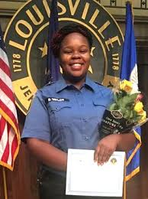
Killing of breona taylor
‘On March 13, 2020, Louisville Metro Police Department officers shot and killed Breonna Taylor in her apartment after being fired upon by Kenneth Walker, Breonna Taylor's boyfriend, while executing a search warrant shortly after midnight. Although the police had received court approval for a "noknock" entry, they did knock and announce themselves prior to breaking down the door, according to Kentucky Attorney General Daniel Cameron. However, Walker claims that he only heard banging on the door and no announcement.Walker fired the first shot; Walker said he fired his gun due to not knowing the intruders were police.

Slide 7
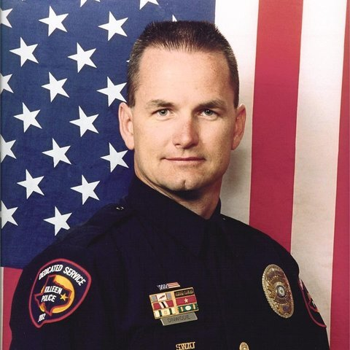
Killing of Det. Charles D. Dinwiddie,
May 11, 2014. Texas
According to guy the thought someone was trying to break in and started shooting. Police said that guy shot 4 police officers that included the death of Charles Dinwiddie. Police never found drugs in the apartment.

Slide 8
Killing of Special Agent Laura Schwartzenberger
1977 - 2021
On February 2, 2021, Special Agent Laura Schwartzenberger was executing a search warrant at a suspect’s home in Sunrise, Florida. The suspect opened fire on agents as they tried to breach the door. Schwartzenberger was mortally wounded, along with Special Agent Daniel Alfin.
Schwartzenberger was born on July 29, 1977 in Pueblo, Colorado. She joined the FBI in December 2005.

Slide 9
Killing of Daniel Alfin
1985 - 2021
On February 2, 2021, Special Agent Daniel Alfin was executing a search warrant at a suspect’s home in Sunrise, Florida. The suspect opened fire on the team of agents as they tried to breach the door. Alfin was mortally wounded, along with Special Agent Laura Schwartzenberger.
Alfin was born on January 17, 1985 in Manhasset, New York. He joined the FBI in April 2009.

Slide 10
Why the issue of no-knock warrant is significant
Drug offenses are not capital offenses, but a substantial number of citizens and officers lose their lives over no-knock warrants served for drugs.
Reform is important

Slide 11
I. Introduction
What are “no-knock” warrants and why are they used?
A no-knock warrant is a warrant issued by a judge that allows law enforcement to enter a property without immediate prior notification of the residents, such as by knocking or ringing a doorbell.
The increased use of no-knock warrants is a product of the country’s “war on drugs,” a series of federal and local policies aimed at cracking down on recreational drug use. President Richard Nixon launched the campaign in the 1970s, but it gained momentum in the 1980s under President Ronald Reagan.

Slide 12
I. Introduction
Use of no-knock warrants has increased substantially over time. By one estimate, there were 1,500 annually in the early 1980s whereas by 2010 there were 60,000–70,000 no-knock or quick-knock raids conducted by local police annually, the majority of which were looking for marijuana

Slide 13
ii. Legal basis
Federal law regarding no-knock
1. Jurisprudences
A. Ker v. California, 374 U.S. 23, 83 S.Ct. 1623 (1963)
ISSUE:
1) Did the warrantless entry by the deputies, without a warrant and without knocking and announcing their intent to enter, for the purpose of making a narcotics arrest, make the evidence inadmissible?
2) Were the subsequent searches of the apartment lawful?
HOLDING:
1) No
2) Yes
The 1963 Supreme Court ruling Ker v. California set a precedent in favor of forcible police entries involving narcotics out of concern that evidence could be destroyed.

Slide 14
ii. Legal basis
Federal law regarding no-knock
1. Jurisprudences
b. Wilson v. Arkansas, 514 U.S. 927 (1995)
The U.S. Supreme Court acknowledged that the fourth amendment incorporates the common law requirement that police officers entering a residence must knock on the door and their identity and purpose before attempting forcible entry to execute a search warrant.
However, the Supreme Court also recognized that not every entry must be preceded by an announcement and that the fourth amendment’s flexible requirement of reasonableness should not be read to mandate a rigid rule of announcement that ignores countervailing law enforcement interests

Slide 15
ii. Legal basis
b. Wilson v. Arkansas, 514 U.S. 927 (1995)
The Wilson decision left it to the lower courts to determine the circumstances under which an unannounced entry is reasonable under the Fourth Amendment and “simply [held] that although a search or seizure of a dwelling might be constitutionally defective if police officers enter without prior announcement, law enforcement interests may also establish the reasonableness of an unannounced entry.”

Slide 16
ii. Legal basis
d. In Richards v. Wisconsin, 520 U.S. 385 (1997),
The Supreme Court went on to hold that, in order to justify a “no-knock” entry, the police must have a reasonable suspicion that knocking and announcing their presence, under the particular circumstances, would be dangerous or futile, or that it would inhibit the effective investigation of the crime by, for example, allowing the destruction of evidence.
The Court noted that, “[t]his standard – as opposed to a probable-cause requirement – strikes the appropriate balance between the legitimate law enforcement concerns at issue in the execution of search warrants and the individual privacy interests affected by no-knock entries.”

Slide 17
ii. Legal basis
FEDERAL LAW REGARDING NO-KNOCK WARRANTS
Federal statute regarding no-knock warrants
18 U.S.C. § 3109 provides that an officer may break open any outer or inner door or window of a house, or any part of a house, or anything therein, to execute a search warrant, if, after notice of his authority and purpose, he is refused admittance or when necessary to liberate himself or a person aiding him in the execution of the warrant.

Slide 18
ii. Legal basis
Federal statute regarding no-knock warrants
Federal agents are generally required to “knock and announce” their identity, authority and purpose, and demand to enter before entry is made to execute a warrant in a private dwelling. However, there are some circumstances where unannounced entries are authorized. The new policy generally limits the use of “no knock” entries in connection with the execution of a warrant to situations where an agent has reasonable grounds to believe that knocking and announcing the agent’s presence would create an imminent threat of physical violence to the agent and/or another person.

Slide 19
ii. Legal basis
Although a federal statute previously authorized no-knock warrants for certain drug searches in the Comprehensive Drug Abuse Prevention and Control Act of 1970, Congress repealed that provision in 1974.
The “no-knock” experience lasted four years and demonstrated the inevitability of many of the dangers foreseen in 1970. During the four-year period when “no-knock” warrants were issued, horror stories were legion. Over one hundred newspaper articles, reproduced in the Congressional Record, described a repeated scenario: terrified citizens, thinking themselves targets of burglary or more frightening acts, discovered that they were instead being searched by law enforcement officers who had entered their homes without notice.

Slide 20
ii. Legal basis
B. Current law in Georgia regarding no-knock warrants
O.C.G.A. § 17-5-27 states that:
All necessary and reasonable force may be used to effect an entry into any building or property or part thereof to execute a search warrant if, after verbal notice or an attempt in good faith to give verbal notice by the officer directed to execute the same of his authority and purpose: (1) He is refused admittance; (2) The person or persons within the building or property or part thereof refuse to acknowledge and answer the verbal notice or the presence of the person or persons therein is unknown to the officer; or (3) The building or property or part thereof is not then occupied by any person.

Slide 21
ii. Legal basis
B. Current law in Georgia regarding no-knock warrants
However, as the Court of Appeals of Georgia has noted, “where the State demonstrates a reasonable suspicion that knocking and announcing the officers’ presence would be dangerous or futile under the particular circumstances, or that it would hinder the effective investigation of the crime by, for example, allowing the destruction of evidence, a no-knock entry may be authorized.” Furthermore, “…the standard for establishing the reasonable suspicion necessary to justify a no-knock entry, as opposed to the standard for establishing probable cause, is not high.

Slide 22
Iv. Research question
How does the no-knock warrant balance between priority of life and the need to protect evidence?
Does the no-knock warrant serve the government legitimate purpose?

Slide 23
Main argument
Our society needs to place the lives of its people above the acquisition of drug evidence.

Slide 24
4. ANALYSE OF DATA
A. arguments of proponents of no-knock warrant
Prevent suspects from fleeing,
Help preserve evidence, and/or
Protect the safety of innocent parties or officers,

Slide 25
4. ANALYSE OF DATA
B. Controversy about no-knock warrant
There have been cases where burglars have robbed homes by pretending to be officers with a no-knock warrant.
There have been many cases where armed homeowners, believing that they are being invaded, have shot at officers, resulting in deaths on both sides.
The act of entering someone's home by surprise, often late at night or early in the morning, creates a risk of violence, especially given the prevalence of gun ownership in United States.
While it is legal to shoot a homeowner's dog when an officer fears for their life, there have been numerous high-profile cases in which family pets lacking the size, strength, or demeanor to attack officers have been shot.

Slide 26
5. Statistics about no-knock warrant
A. No-knock warrant does not serve the government legitimate goal
There are no statistics showing that no-knock warrant tactic has decreased the drug offenses.
We analyzed the highest drug use by state , we found that the top ten are states that use No-knock warrant (New Mexico, West Virginia, DC, Louisiana, Colorado, Missouri, Arkansas, Nevada, Oklahoma, Michigan).
20,000 no-knock raids executed in the U.S. each year.

Slide 27
5. Statistics about no-knock warrant
B. Innocent people killed
We see about 8 to 10 cases per year where a completely innocent person is killed among these raids.
C. People who have some drugs in the house
We another 20 or 30 where someone who, may have had some drugs in the house is killed
From 2010 through 2016, at least 81 civilians and 13 officers died during SWAT raids,
including 31 civilians and eight officers during execution of no-knock warrants.

Slide 28
No-knock warrants may be issued in every state except
Oregon (prohibited by state law),
Florida (prohibited by a 1994 state supreme court decision),
Virginia (prohibited through legislation passed in 2020), and
Tennessee (prohibited through legislation passed in 2021).
Connecticut,

Slide 29
When can he use
officers may lawfully conduct searches and seizures in the case of emergent exigent circumstances.
reserving them for only the most dangerous and urgent situations.

Slide 30
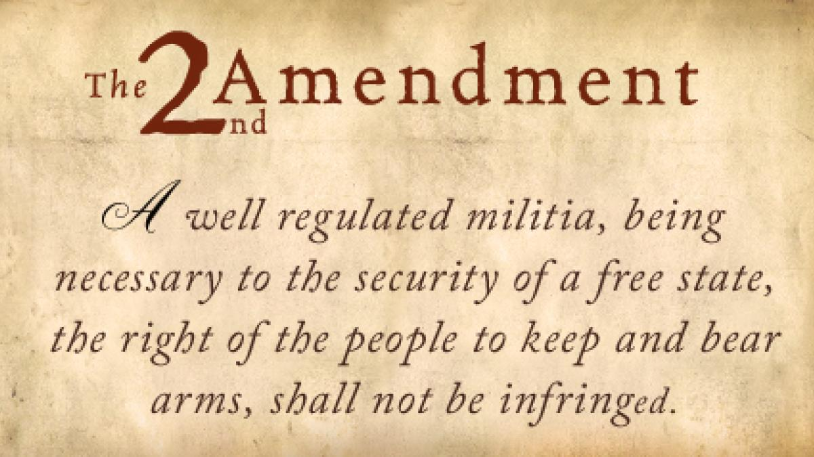
Conclusions and recommendations
There are several other considerations law enforcement leaders need to evaluate that directly impact the risks created during dynamic no-knock raids in contemporary times:
The proliferation of guns in households across the country.
In 2020 and 2021, Americans bought over 42 million guns.
Residents awakened from their sleep by the sounds of someone breaking into their home could reasonably reach for their legally owned firearms to defend themselves, leading to tragic consequences for occupants and officer

Slide 31
Conclusions and recommendations
No-knock conflicts with the right to self-defense, your-ground laws, and the castle doctrine.
The common law principle of “castle doctrine” says that individuals have the right to use reasonable force, including deadly force, to protect themselves against an intruder in their home.
Georgia Law on the Use of Force in Defense of Self or Others
Official Code of Georgia Annotated (O.C.G.A.) §16-3-21 outlines this defense and when it is accepted and when it is not.
When people feel threatened or even see another being threatened, sometimes the reaction is to use force to defend and occasionally, deadly force.
Essentially, two elements that must be present before the use of deadly force is justified:
The danger to either himself or a third person must be imminent; and
He must reasonably believe that such force is necessary to prevent death or great bodily injury to self or a third person.

Slide 32
Conclusions and recommendations
The risk of a mistake-of-fact shooting.
The facts of Kathryn Johnston, BABY BOU BOU cases serve as an example of this type of risk.
The search yielded no drugs, no drug dealer and no weapons

Slide 33
Conclusions and recommendations
Technology advances and warning systems.
The shooting of two FBI agents, Special agents (Laura Schwartzenberger and Daniel Alfin) in Florida in 2021 is an example of this issue.
The target of the warrant was allegedly warned of their approach by a doorbell camera. This warning allowed him to fire at the agents through his door with a high-powered rifle
Insufficient information about the residence and its occupants.
Many civil cases have arisen from raids on the wrong address, or the correct address but the targets had moved out, or lack of information on the presence of children in the residence, leading to flashbangs being deployed in and around young children

Slide 34
Conclusions and recommendations
Failure to properly supervise specialty narcotics units and warrant applications.
The unfortunate truth is some specialty units become so consumed by their mission that they believe the ends justify the means.
This can lead to overaggressive tactics and warrant services. It also can lead to officers lying or exaggerating information on warrant applications, as allegedly happened in the Breonna Taylor incident.

Slide 35
Conclusions and recommendations
Failure to adhere to a proper Priority of Life.
This is probably the most important consideration, and everything discussed in this article so far is relevant to it.
The National Tactical Officers Association (NTOA) has long established safety priorities: 1. Hostages/victims 2. Innocent bystanders 3. Public safety personnel (police, EMS, fire) 4. Suspect(s) 5. Drugs/evidence (Controlling objective) Using these safety priorities, the NTOA has taken the position for some time now that no-knock warrants no longer make sense, especially when the objective is the preservation of evidence.
I strongly agree with this position. Most no-knock warrants for drugs essentially place the preservation of evidence over the safety of anyone else — including police officers.

Slide 36
Thank you

