Slide 1
Mobile Eye Witness: Cellebrite Forensics in Law Enforcement
Hope Kellum, Bryson R. Payne
hlkell2583@ung.edu, bryson.payne@ung.edu

Slide 2
What is Digital Forensics?
Defined as “a branch of forensic science that focuses on identifying, acquiring, processing, analyzing, and reporting on data stored electronically”
What is it used for?

Slide 3
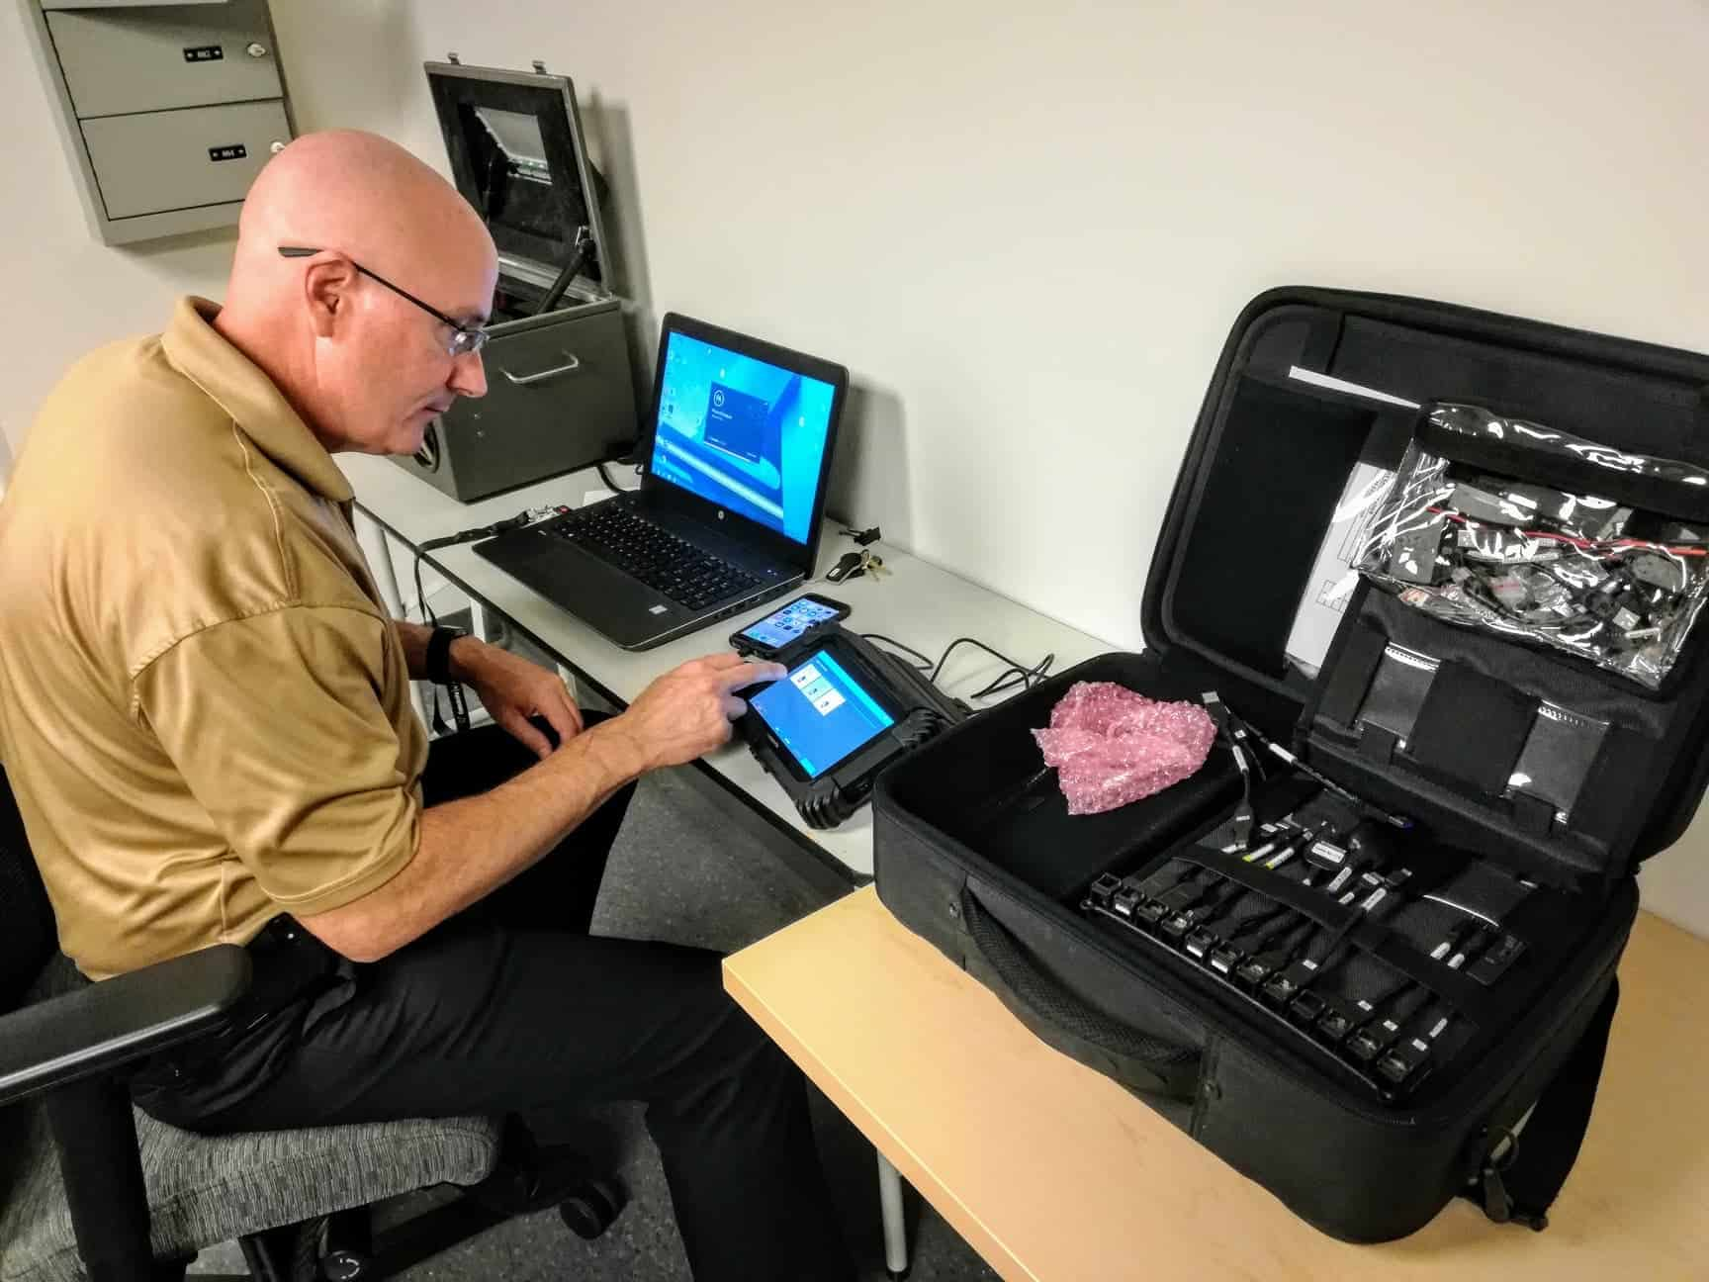
Why Does Law Enforcement Need it?
Evidence Collection
Solving Crimes

Slide 4
Cellebrite Background
Cellebrite is a software company made in Israel in 1999 by Avi Yablonka, Yaron Baratz, and Yuval Aflalo.
Digital Forensics Tool
UFED

Slide 5
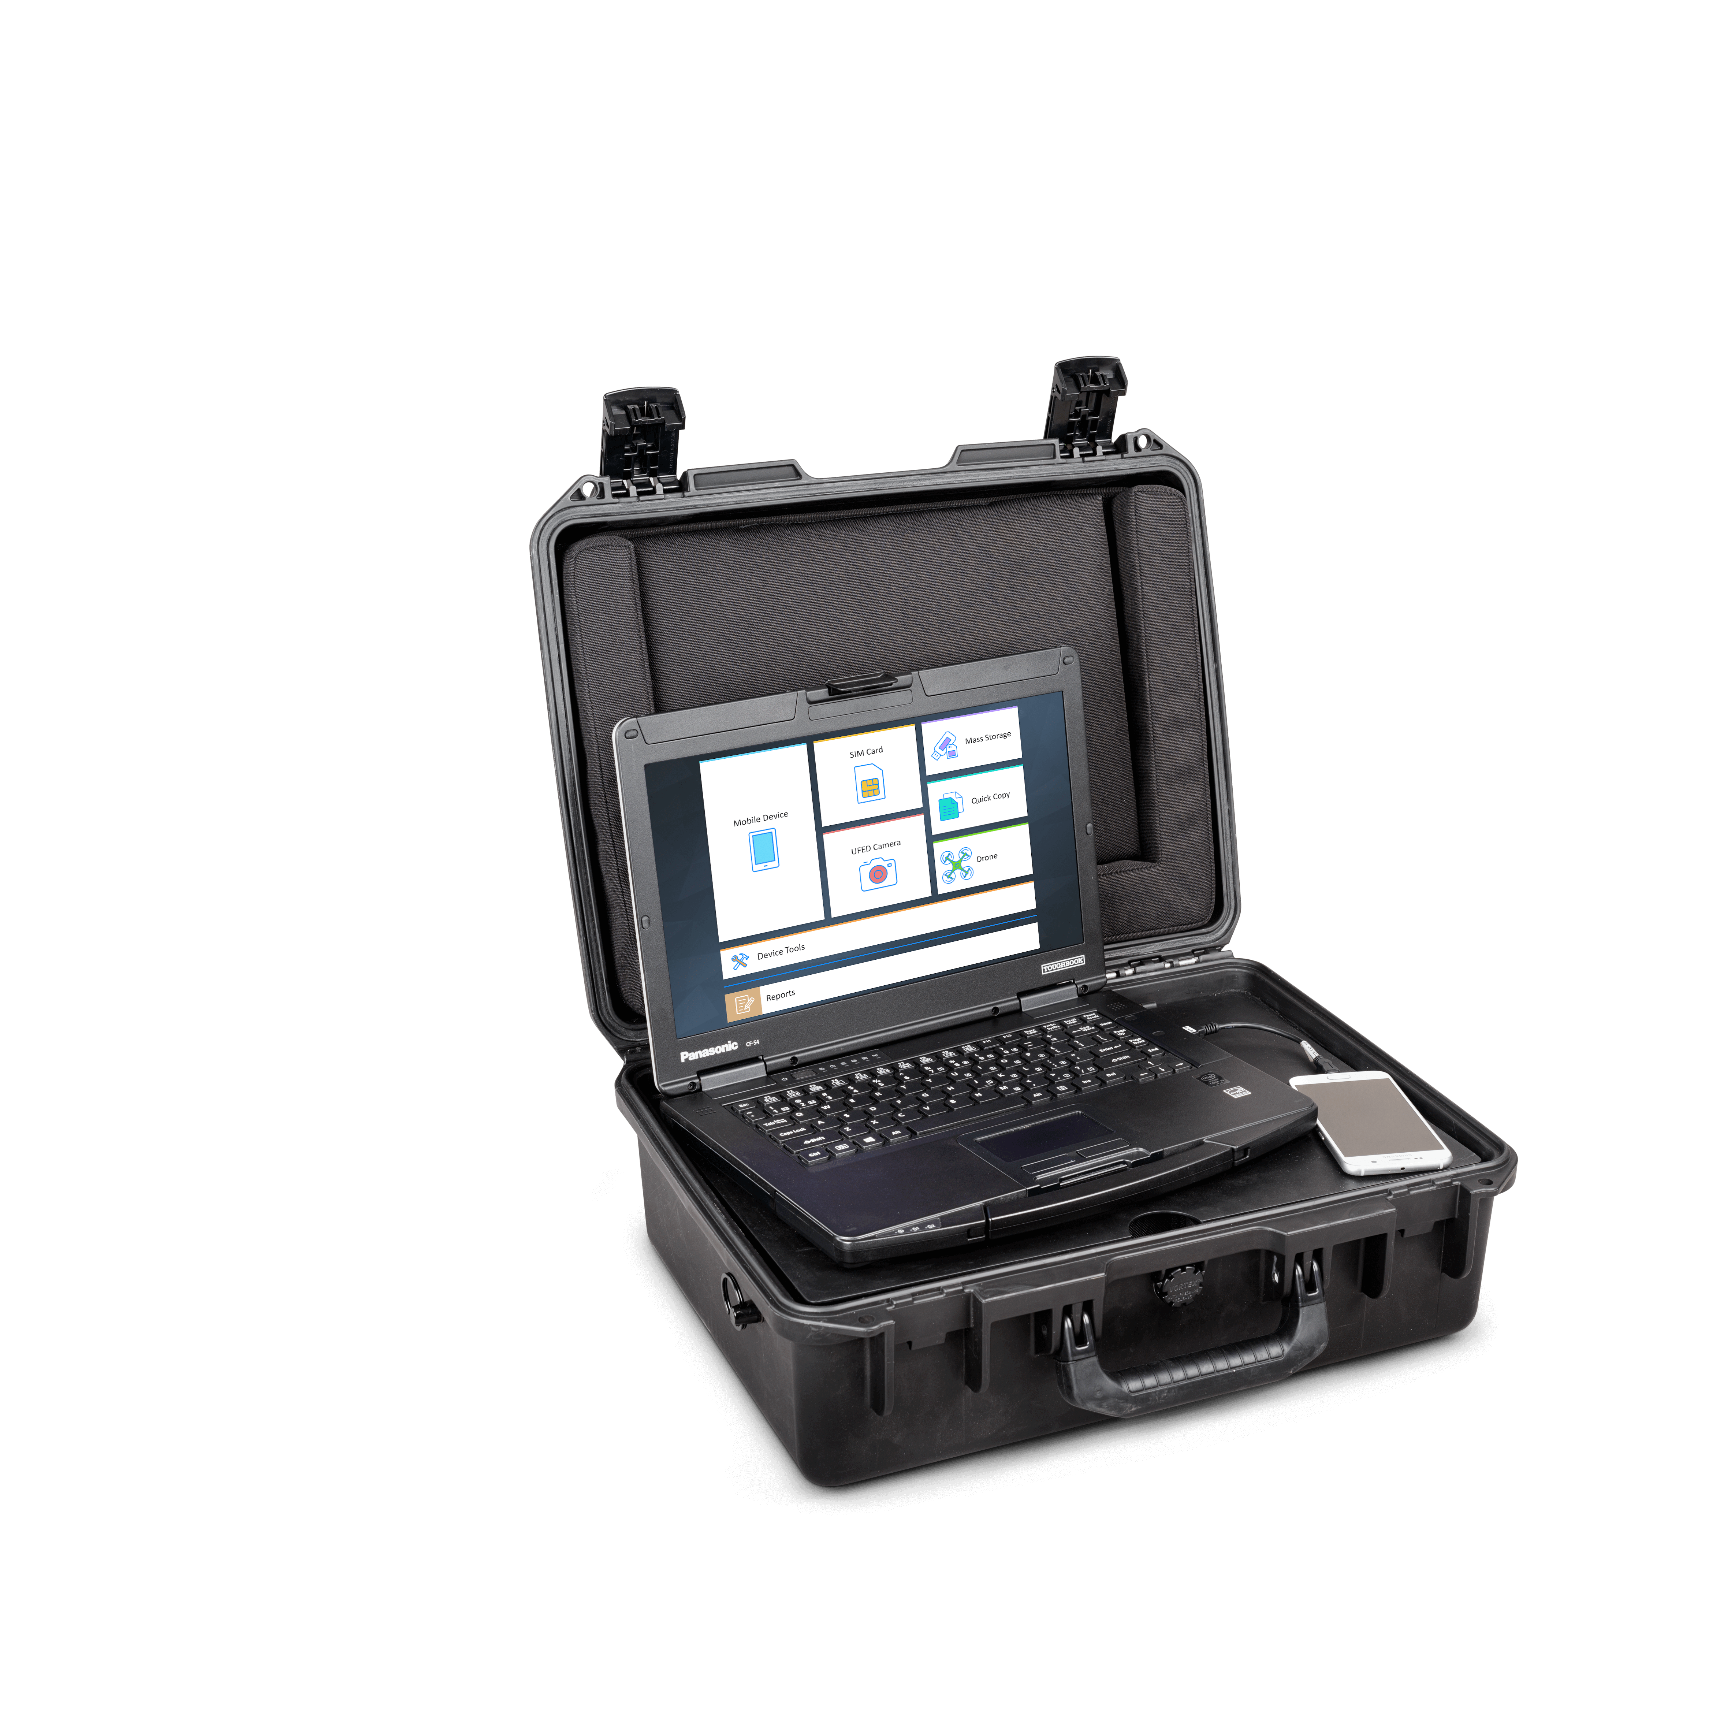
How does Cellebrite Work?
UFED’s: UFED touch, UFED 4PC, UFED Ruggedized Laptop
Extraction Types: Logical, File System, Physical

Slide 6
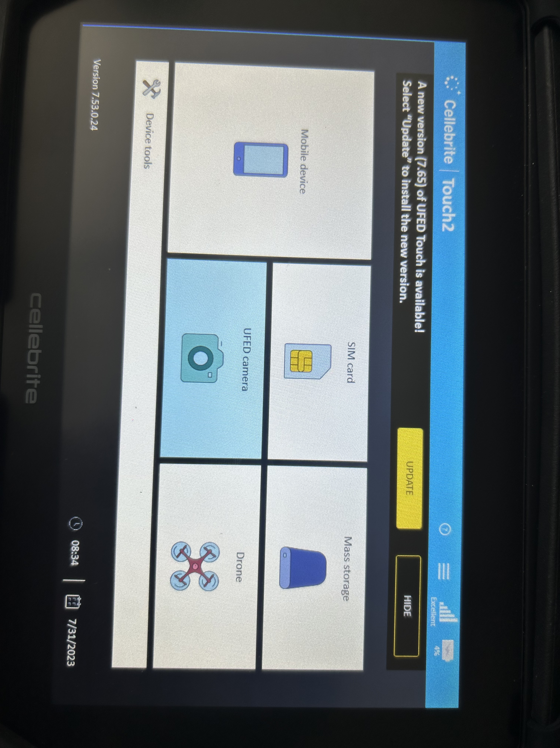
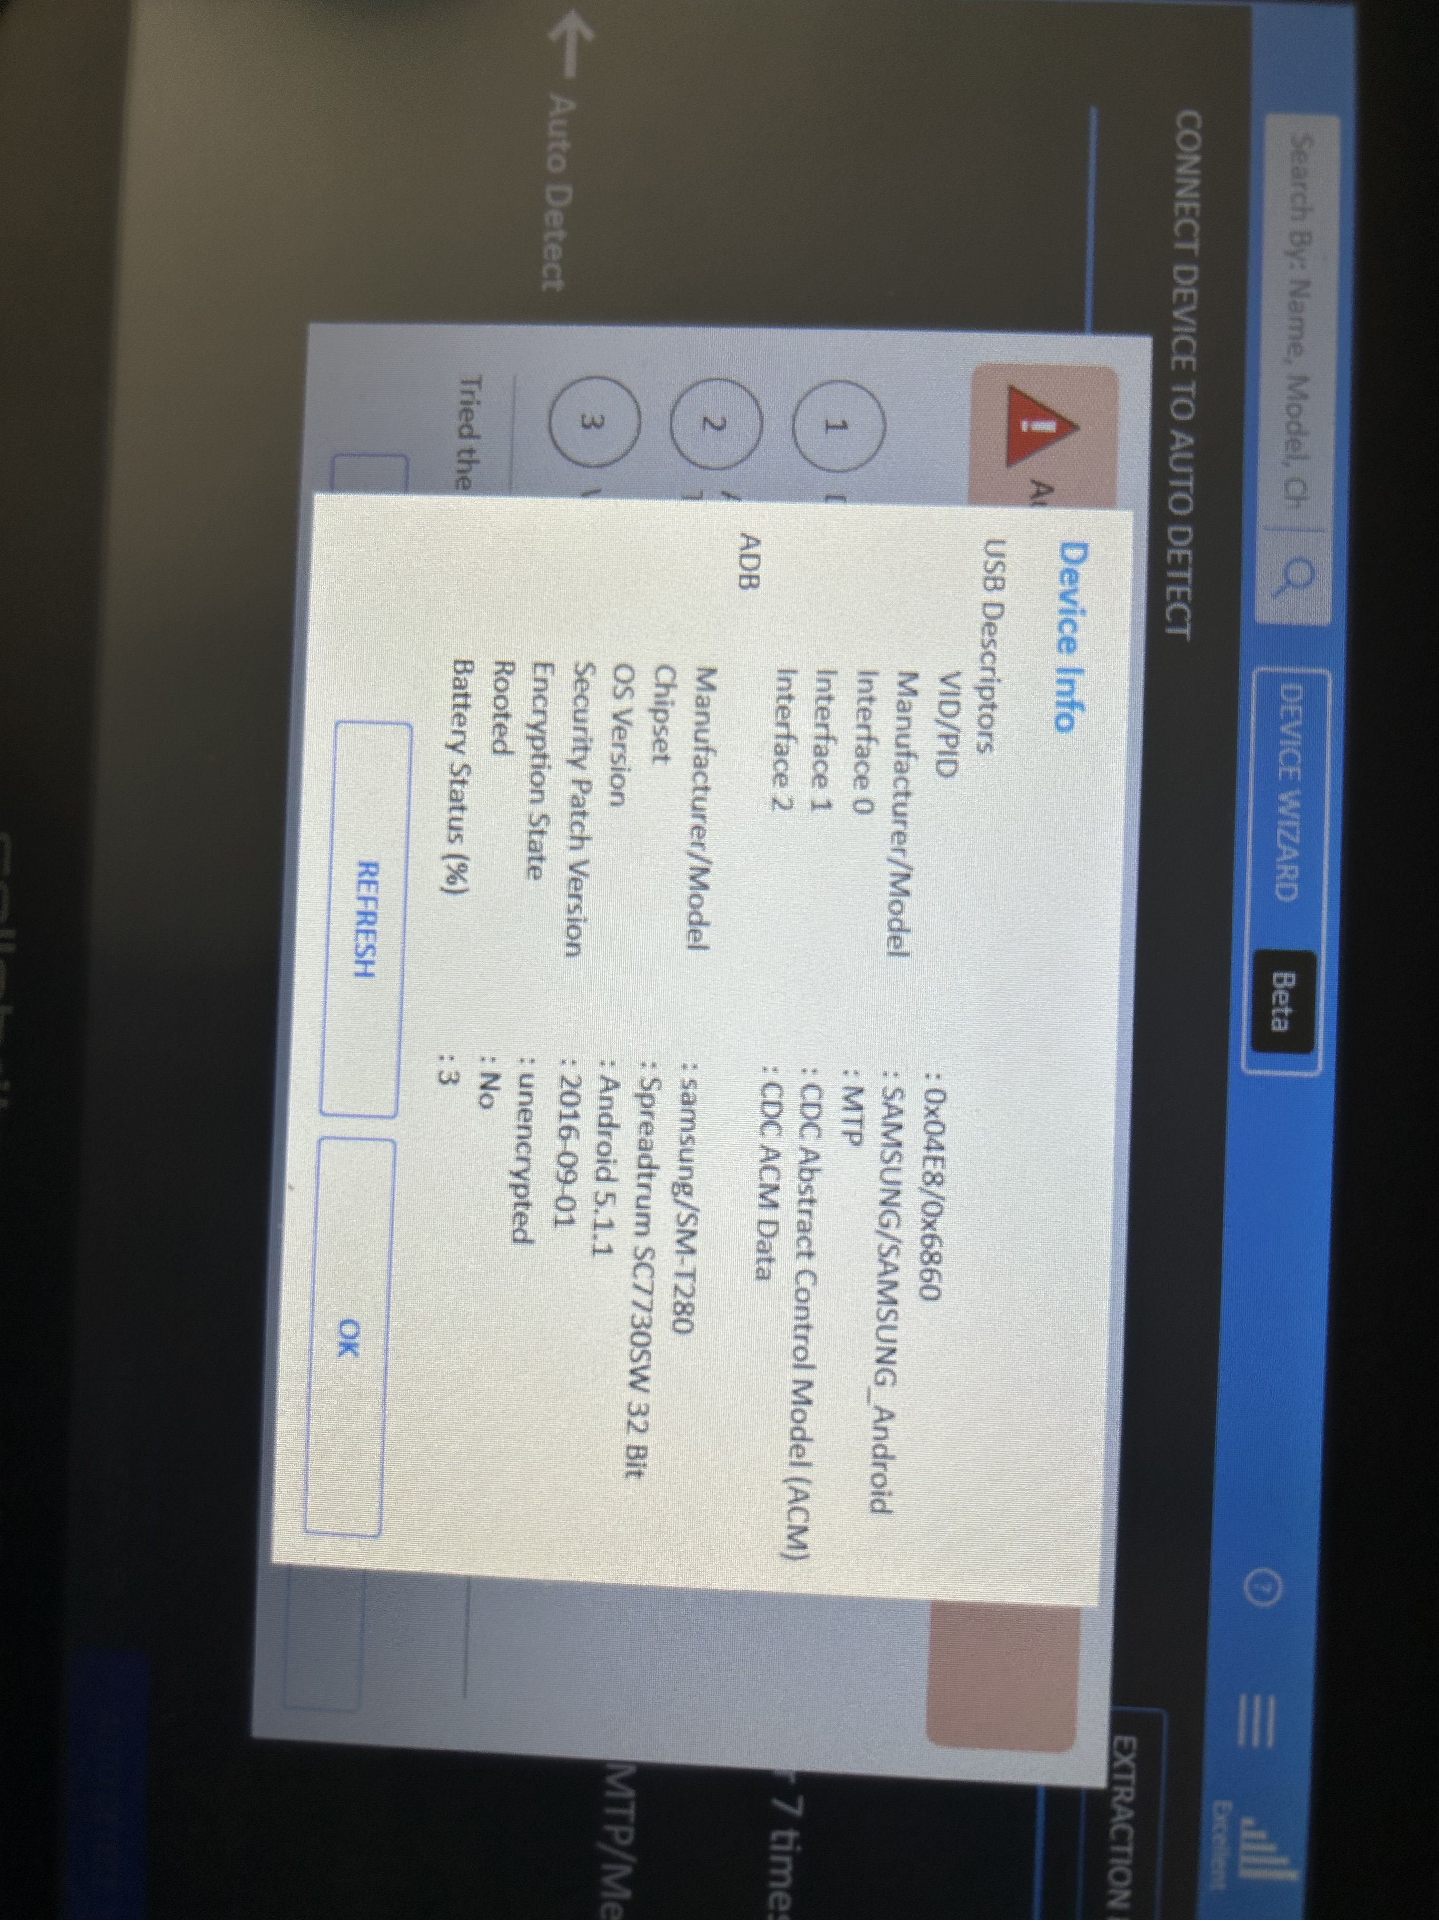
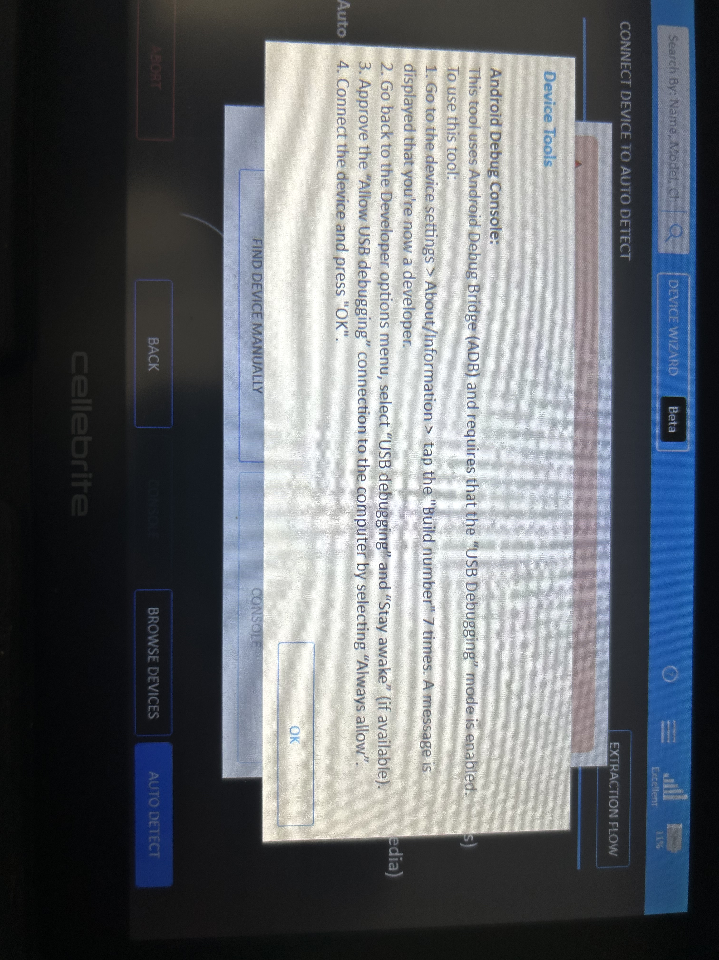
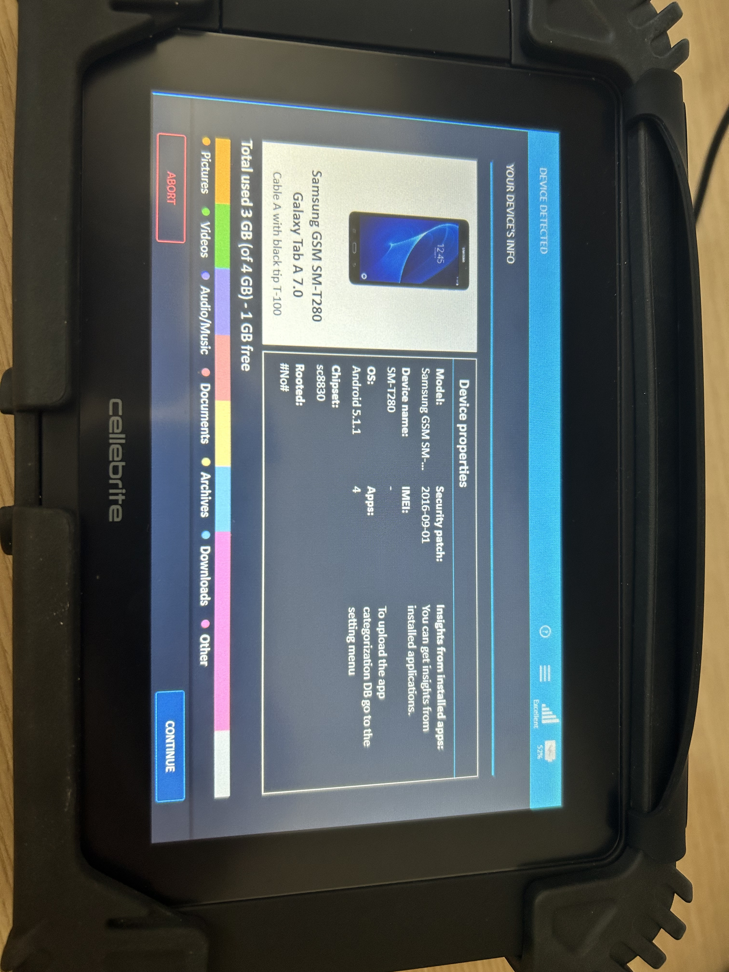

Slide 7
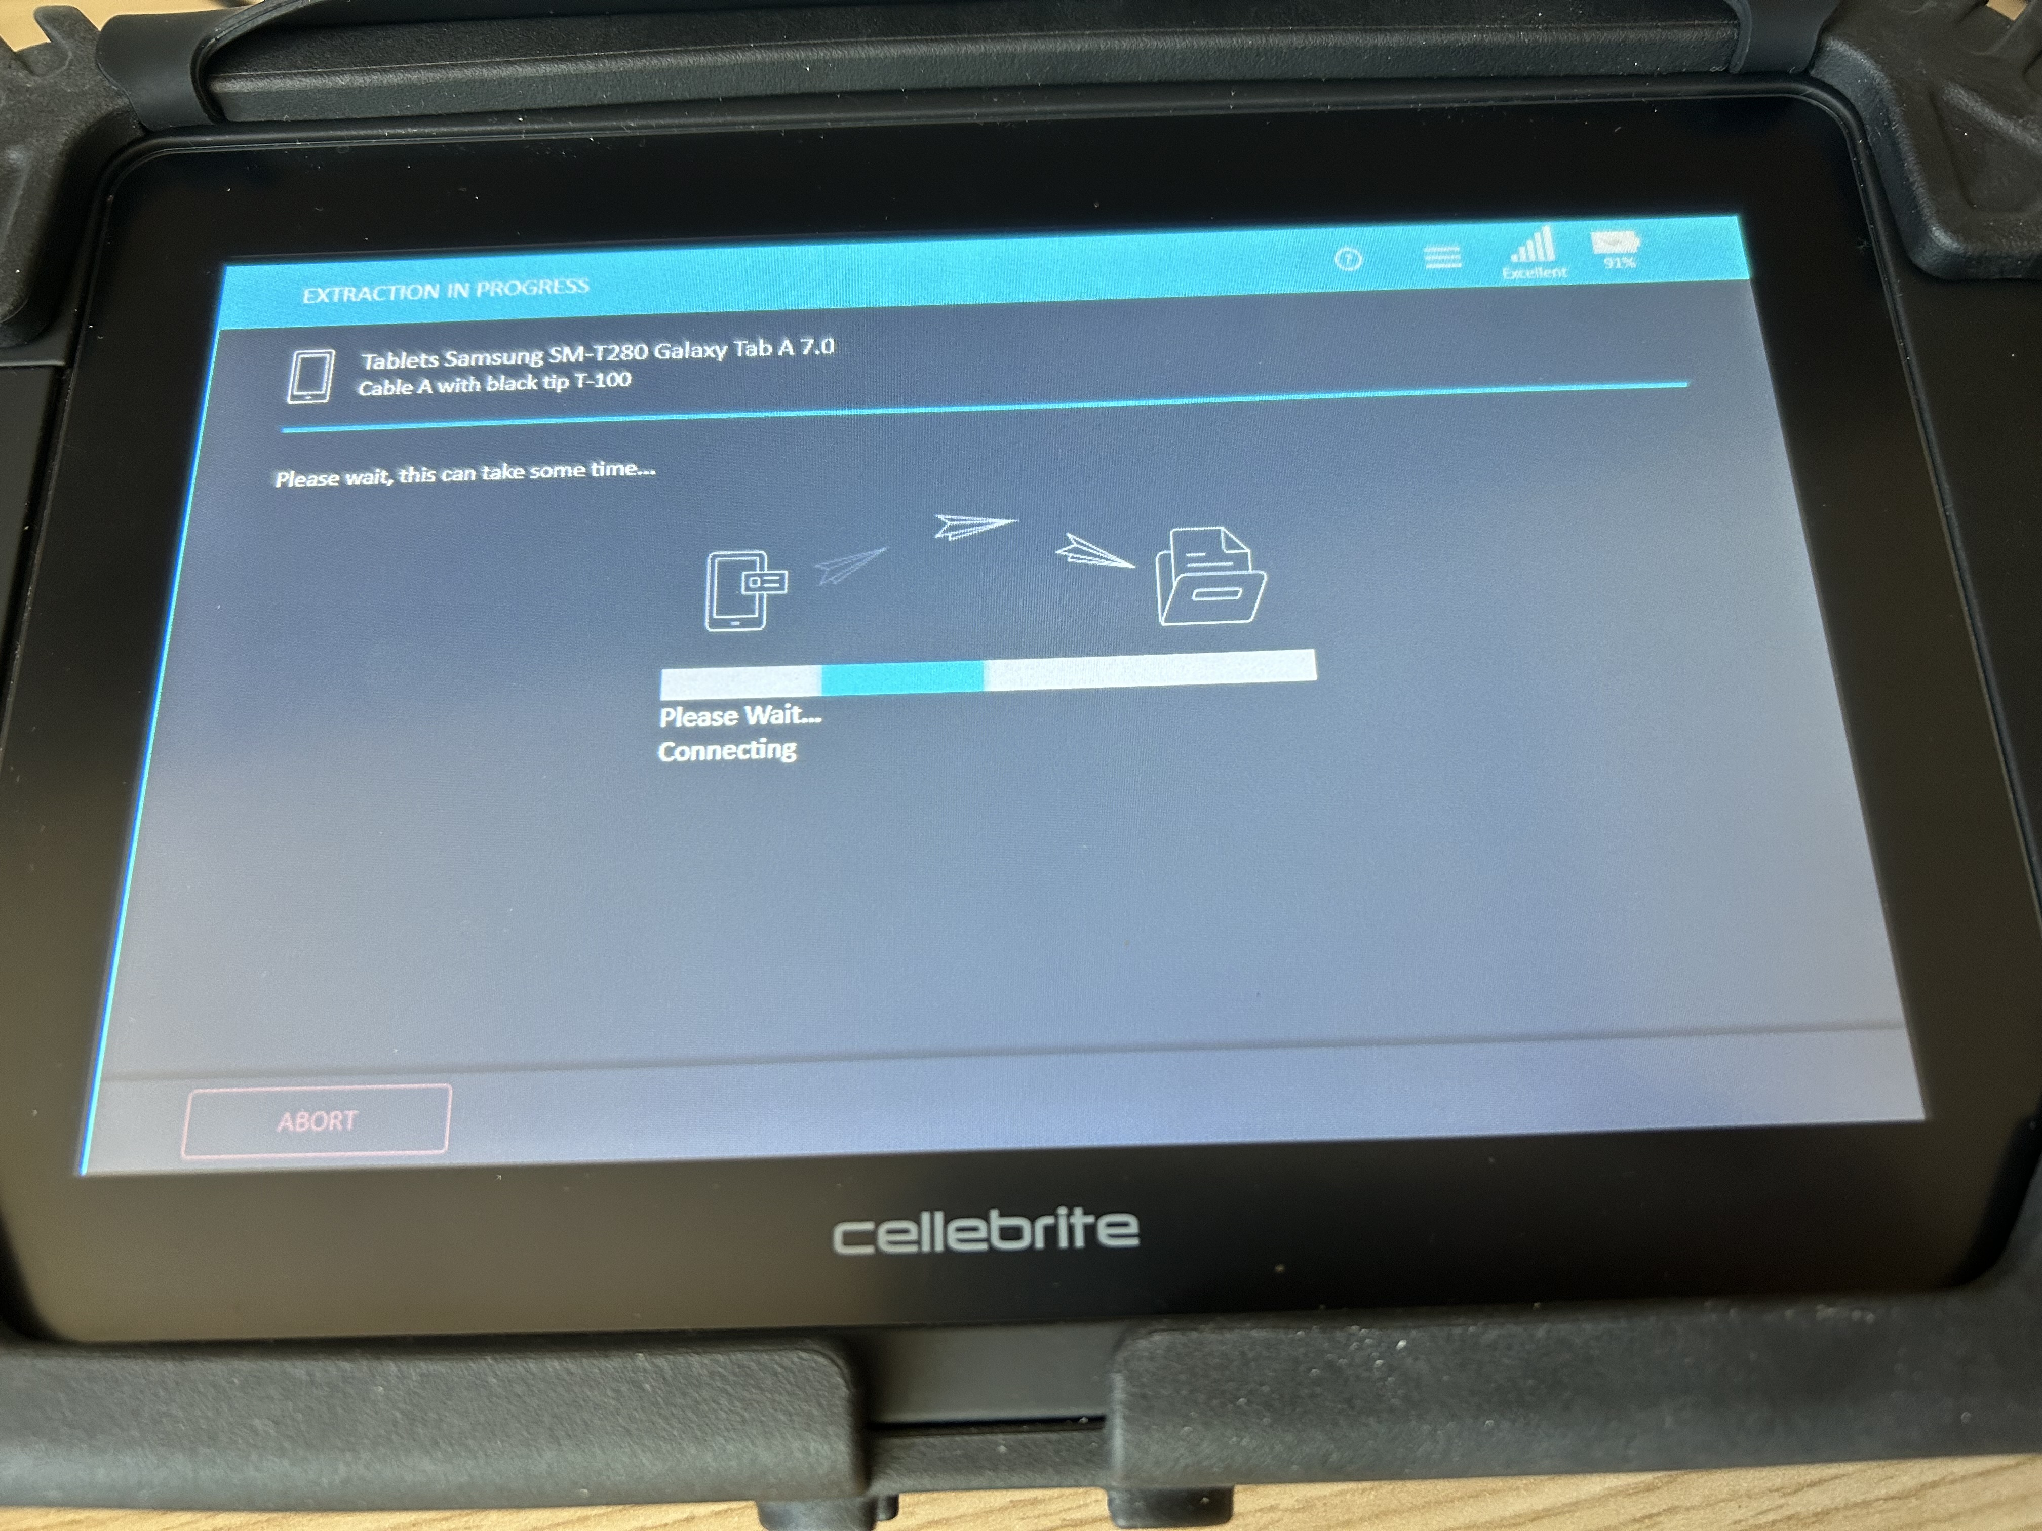
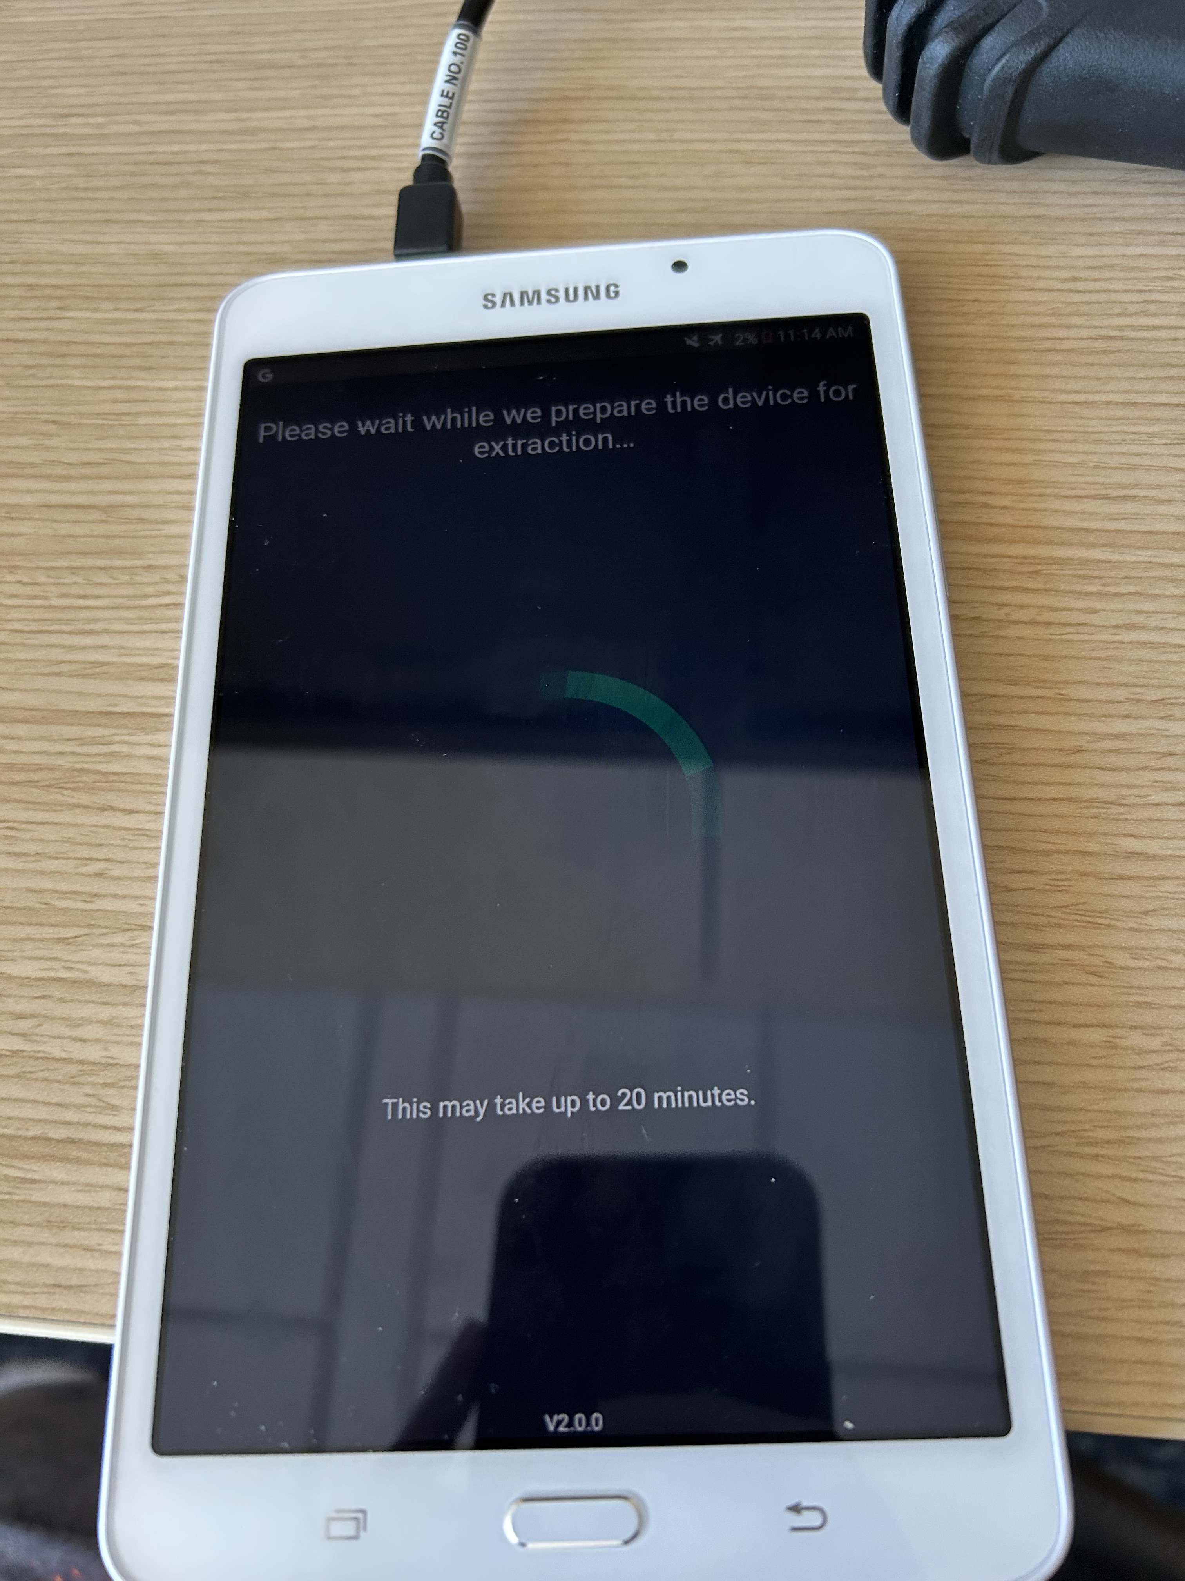
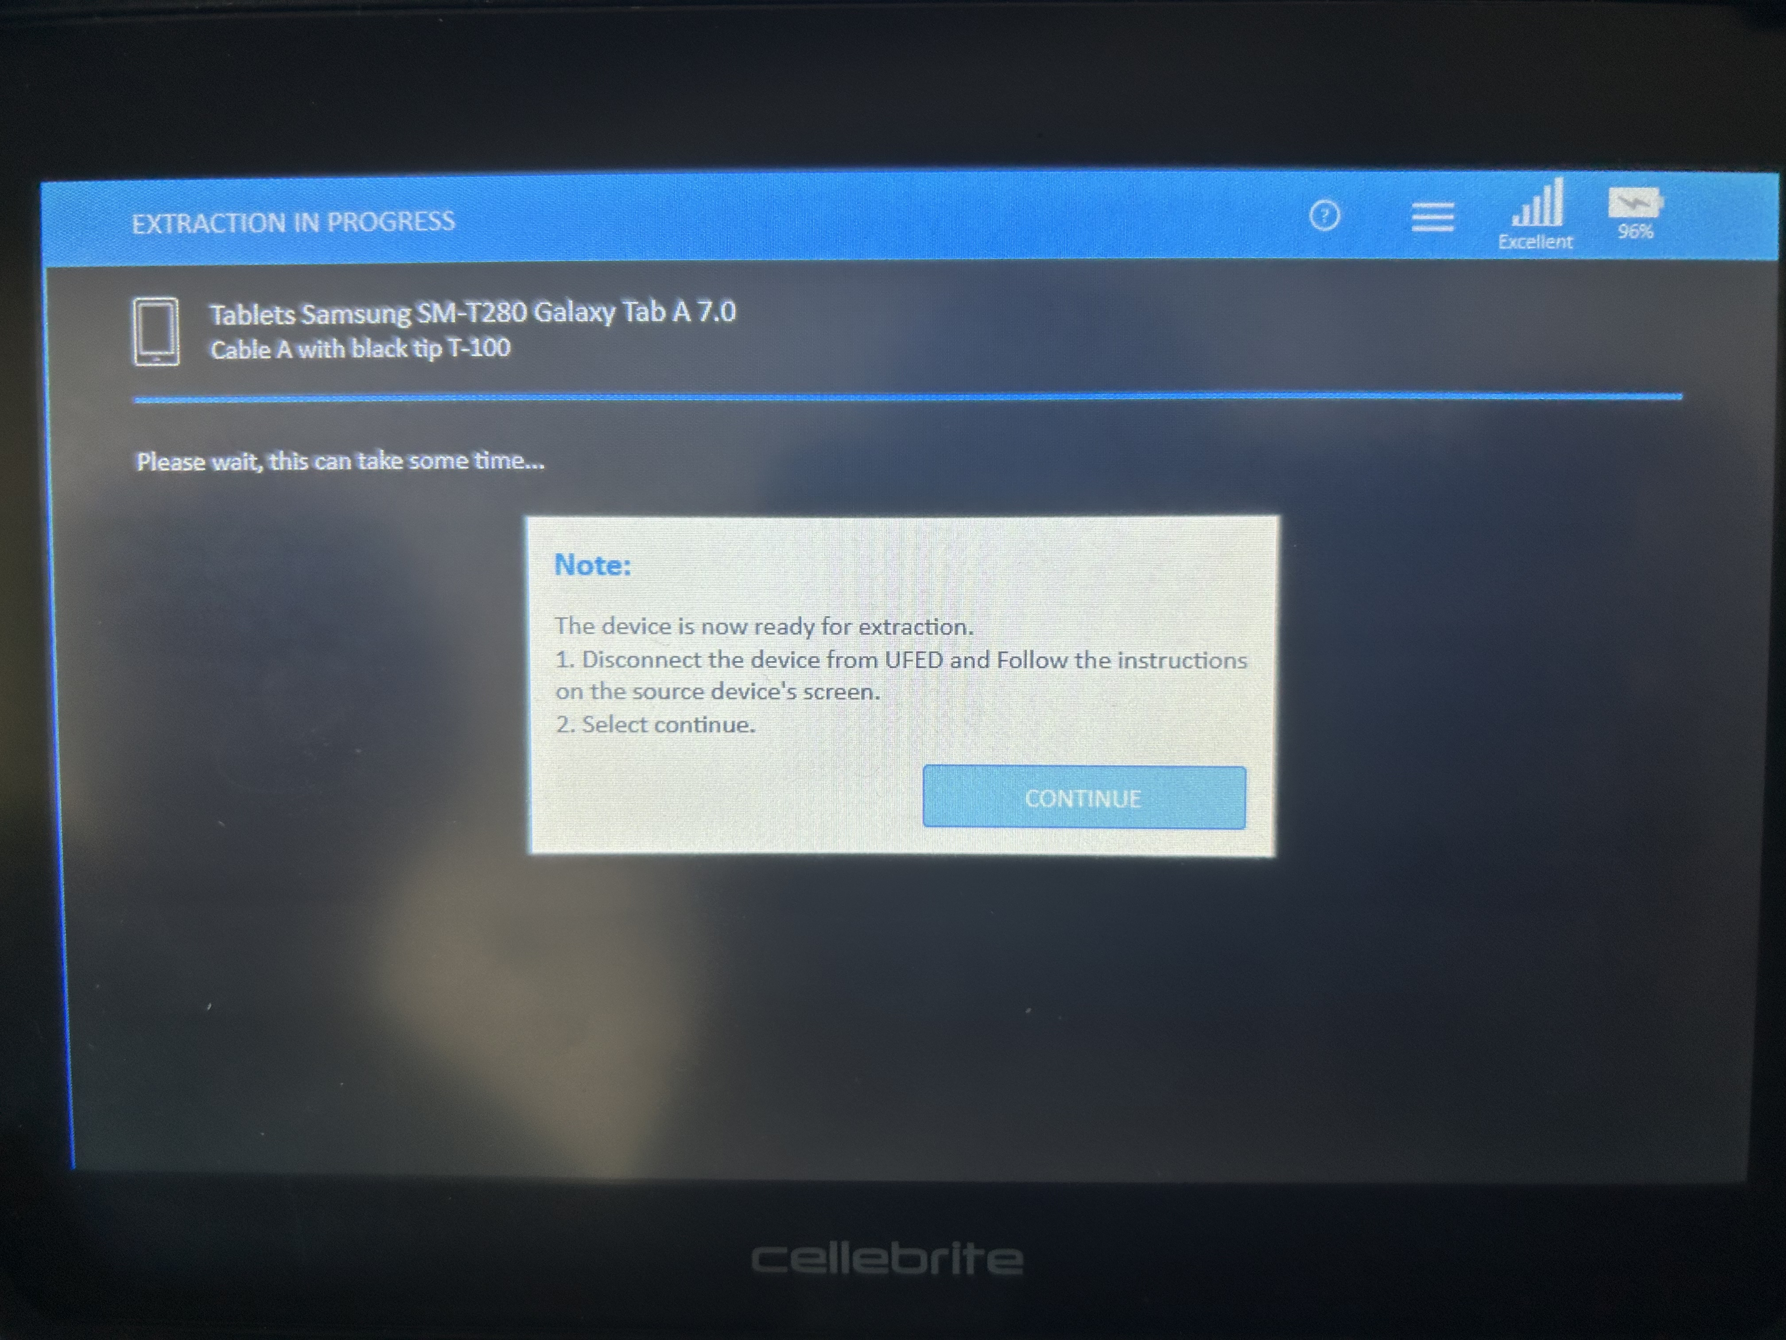
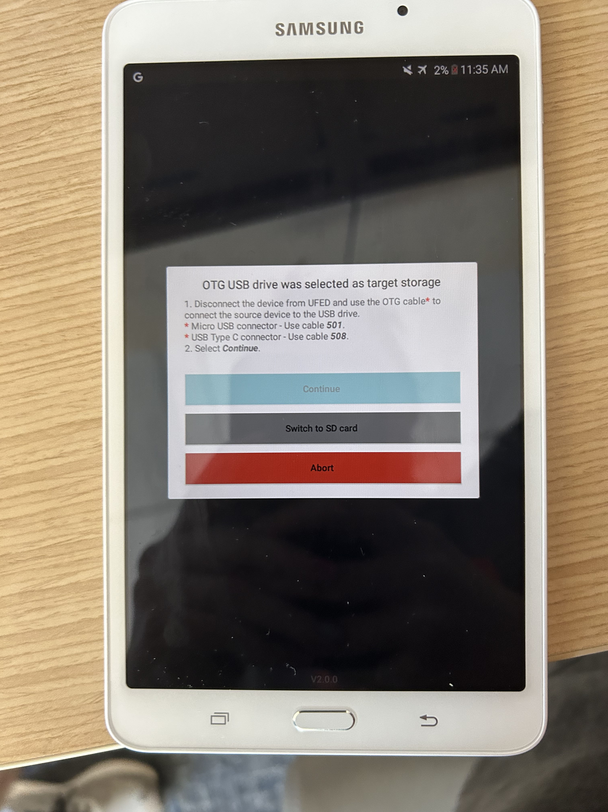
Access, Analysis, Legal Steps
Limited to older versions of iOS
Barriers include passcodes: numeric, complex, biometric
Analysis is time consuming
Evidence must be legally obtained, follow chain of custody

Slide 9
Key for device is a hash function for device extraction/analysis to ensure chain of custody
Must have Cellebrite Dongle (contains software) to analyze the Target with extracted data
Very user friendly with data organization for all information used within the device

Slide 10
Real life Case
In a 2023 case study with Cellebrite and the Georgia Cyber Crime Center (G3C), there were important key factors identified in the importance of having devices such as Cellebrite used in investigations. This case study discusses the specific case of Ahmaud Arbery, who was shot and killed on February 23rd, 2020. The men who were responsible for Ahmaud’s death were suspected of committing this crime with racism in mind, but all three men pled “not guilty”. There was evidence pointing to racism, and the G3C was able to unveil a total of 41 pieces of digital evidence across several different devices, including: iPhones (iOS), Android Phones, Tablets (iOS and Android), Computers, and Flash Drives. Through all of this evidence, they were able to provide that there were many racist texts and social media posts that the jury was able to conclude that race was involved in influencing the criminals’ decision in committing the crime.

Slide 11
Conclusion
Cellebrite is a top digital forensics tool
Principal in helping Law Enforcement Solve Cases

Slide 12
References
Author links open overlay panelChrista M. Miller, & AbstractDigital evidence is essential to criminal investigations and prosecutions. (2022, December 30). A survey of prosecutors and investigators using digital evidence: A starting point. Forensic Science International: Synergy. https://www.sciencedirect.com/science/article/pii/S2589871X2200081X#:~:text=By%20one%20estimate%2C%20digital%20evidence,of%20criminal%20cases%20%5B1%5D.
Cellebrite. (n.d.). Case studies - cellebrite Georgia Cyber Crime. Cellebrite. https://cellebrite.com/en/resources/case-studies/
Cellebrite ufed | access and collect mobile device data. (n.d.). https://cellebrite.com/en/ufed/
CISA. (n.d.). Cisa Insights: Chain of custody and Critical Infrastructure Systems. CISA Insights. https://www.cisa.gov/sites/default/files/publications/cisa-insights_chain-of-custody-and-ci-systems_508.pdf
Digital Evidence and Forensics. National Institute of Justice. (n.d.). https://nij.ojp.gov/digital-evidence-and-forensics#:~:text=Digital%20evidence%20is%20commonly%20associated,%2C%20not%20just%20e%2Dcrime
Digital Forensics. INTERPOL. (n.d.). https://www.interpol.int/en/How-we-work/Innovation/Digital-forensics
Federal judge sentences three men convicted of racially motivated hate crimes in connection with the killing of Ahmaud Arbery in Georgia. Office of Public Affairs | Federal Judge Sentences Three Men Convicted of Racially Motivated Hate Crimes in Connection with the Killing of Ahmaud Arbery in Georgia | United States Department of Justice. (2022, August 8). https://www.justice.gov/opa/pr/federal-judge-sentences-three-men-convicted-racially-motivated-hate-crimes-connection-killing
How cellebrite works. EndPoint Forensics. (n.d.). https://sites.google.com/site/endpointforensics/how-cellebrite-works
Joseph, D. P., & Norman, J. (1970, January 1). An analysis of digital forensics in Cyber Security. SpringerLink. https://link.springer.com/chapter/10.1007/978-981-13-1580-0_67
Katharina.kiener-Manu. (n.d.). Cybercrime module 6 key issues: Handling of digital evidence. UNODC. Cybercrime Module 6 Key Issues: Handling of Digital Evidence. https://www.unodc.org/e4j/zh/cybercrime/module-6/key-issues/handling-of-digital-evidence.html#:~:text=There%20are%20four%20phases%20involved,on%20Introduction%20to%20Digital%20Forensics).
Lovejoy, B. (2022, April 29). Cellebrite iPhone cracking: Here’s which models the kit can unlock and access, and how to protect your data. 9to5Mac. https://9to5mac.com/2022/04/29/cellebrite-iphone-cracking/
What happens when you press that button? - smarter forensics. (n.d.). https://smarterforensics.com/wp-content/uploads/2014/06/Explaining-Cellebrite-UFED-Data-Extraction-Processes-final.pdf
https://en.wikipedia.org/wiki/Cellebrite#:~:text=digital%20forensic%20examiners.-,History,left%20the%20company%20in%202020.
YouTube. (2018). Cellebrite Mobile Tool Forensics Demonstration. YouTube. Retrieved July 15, 2023, from https://www.youtube.com/watch?v=5fEYqpJ6Mrw.

