Slide 1
Is the Corruption Crisis in Georgia’s Prison System Predictive of Future Challenges for Policing?
Cynthia Atwood
Department of Criminal Justice and Public Policy
College of Coastal Georgia

Slide 2
U.S. Criminal Justice System
Law Enforcement/Police
Corrections
Courts

Slide 3
Impacts of Corruption on the Criminal Justice System
“Corruption can be profoundly toxic.”
Aaron Littman, an assistant professor at the UCLA School of Law and faculty director of UCLA’s Prisoners’ Rights Clinic
Misuse of power for private gain
Negatively impacts on the legitimacy of the government
Key policing values:
Respect for human rights
Upholding the rule of law

Slide 4
A Crisis of Corruption
Is there really a crisis?
If so, is this crisis predictive of future challenges in policing?
I

Slide 5
A Crisis of Corruption
At least 360 employees of Georgia's state prison system have been arrested on accusations of smuggling contraband into prisons since 2018
More fired for smuggling but not arrested.
At least a 13 officers holding ranks of sergeant or above arrested or fired since 2018 for contraband offenses.
Identified as a “chronic, persistent issue” inside the state of Georgia (DA T. Wright Barksdale).
AJC, Sept-October 2023

Slide 6
Cell Phones
“Central to those illegal activities inside the prisons was the unbridled use of cell phones.” J. Britt Johnson, FBI SAIC Atlanta Division
Corrupt guards typically earned $500 to $1K for smuggling a single cell phone to a prisoner.
2014 and 2015- >23k contraband phones seized throughout GA prisons—which house 50k inmates
phones were used for a variety of crimes that put prison security and public safety at risk.

Slide 7
As of February 2023

Slide 8
A Crisis of Corruption

Slide 11
Correctional Officers Charged Autry State Prison
Shalonda Baker, 33, of Bainbridge, Georgia, formerly a Correctional Officer, conspiring to accept bribe payments to smuggle contraband into the prison.
Jokelera Copeland, 28, of Doerun, Georgia, a Correctional Officer, conspiring to accept bribe payments to smuggle contraband into the prison.
Jonathan Jamaal Daniels, 22, of Camilla, Georgia, formerly a Correctional Officer, accepting bribe payments to smuggle contraband into the prison.
Tyler Dickens, 22, of Bainbridge, Georgia, formerly a Correctional Officer and formerly an Early County Sheriff’s Deputy, conspiring to accept bribe payments to smuggle contraband into the prison.
Renaldo Freeman, 30, of Pelham, Georgia, a Correctional Officer, conspiring to accept bribe payments to smuggle contraband into the prison.

Slide 12
Correctional Officers Charged Autry State Prison
Dayia Gilbert, 23, Camilla, Georgia, formerly a Correctional Officer, conspiring to accept bribe payments to smuggle contraband into the prison.
Chameta Isom, 32, of Camilla, Georgia, a Correctional Officer at Autry State Prison, conspiring to accept bribe payments to smuggle contraband into the prison.
Brian Kennedy, 25, of Thomasville, Georgia, formerly a Correctional Officer, accepting bribe payments to smuggle contraband into the prison.
Calvin Martin, 21, of Albany, Georgia, formerly a Correctional Officer, conspiring to accept bribe payments to smuggle contraband into the prison.
Tadia Mercer, 41, of Leesburg, Georgia, formerly a Correctional Officer, extortion under color of official right.
Kiatya Milton, 42, of Sylvester, Georgia, formerly a Correctional Officer, conspiring to commit wire fraud and money laundering.

Slide 13
Correctional Officers Charged Autry State Prison
Shebrikia Stewart, 28, of Albany, Georgia, formerly a Correctional Officer, conspiring to accept bribe payments to smuggle contraband into the prison.
Shameka Williams, 31, of Albany, Georgia, a Correctional Officer, accepting bribe payments in exchange for not reporting criminal acts of other Corrections Officers.
Christina Wilson, 34, of Albany, Georgia, formerly a Correctional Officer, conspiring to accept bribe payments to smuggle contraband into the prison.
Ermesha Wingfield, 25, of Albany, Georgia, formerly a Correctional Officer, conspiring to bribe Correctional Officers to smuggle contraband into the prison.

Slide 14
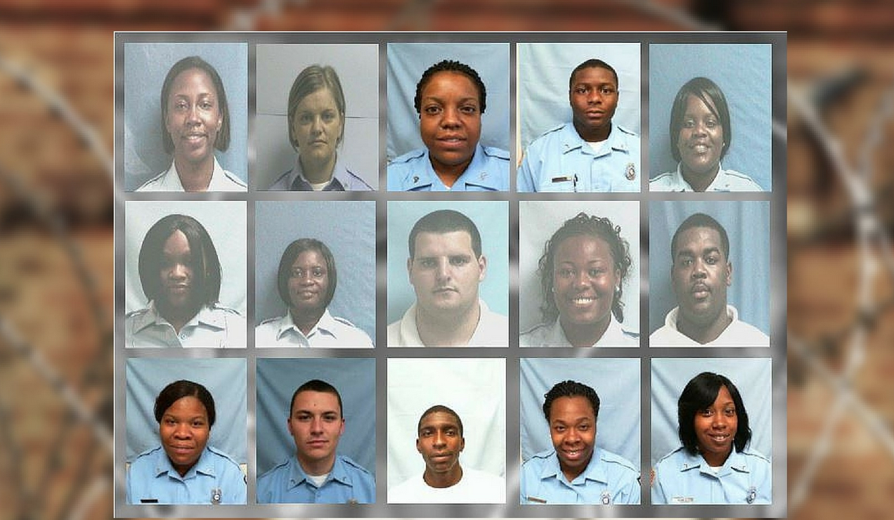

Slide 15
Crisis of Corruption
Youngest: 21 years old
Mean: 29.1 years old
Mode: 22, 25, 28 years old
Median age: 28 years old
First quartile: 23 years old

Slide 16
Current AJC Investigative Reporting
2022-Series of AJC reports revealed mounting violence and criminal activities in Georgia’s prisons
2023-AJC reported 46 current or former COs indicted on federal charges

Slide 17
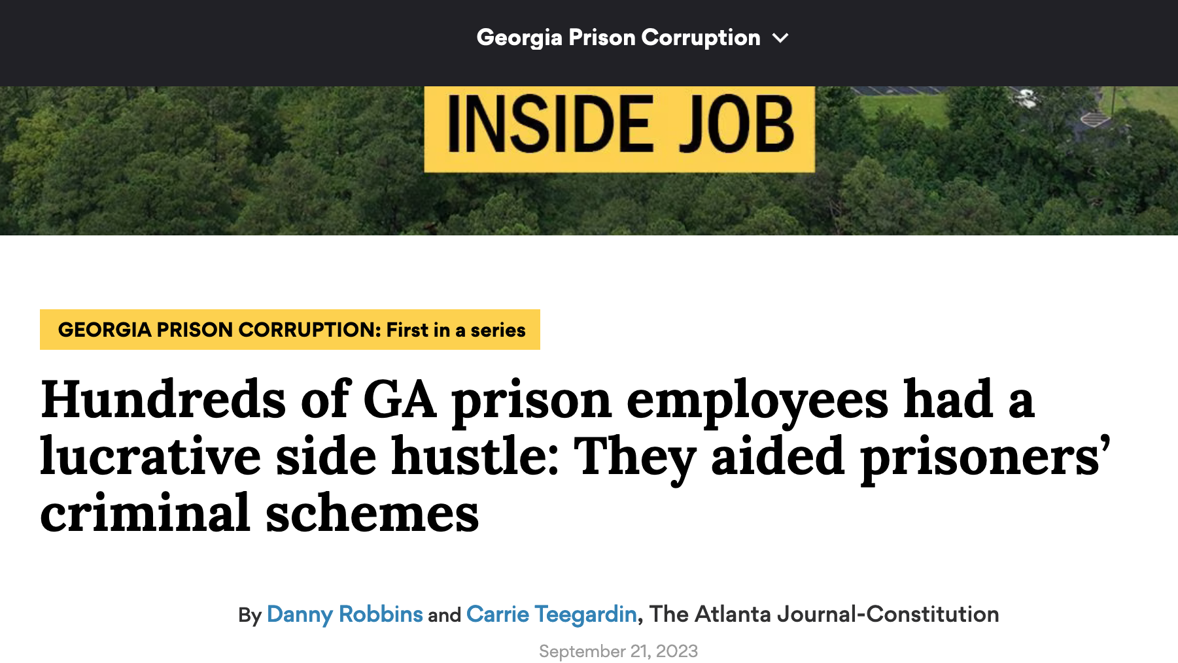

Slide 18
Crisis of Corruption
May 2022 request from the Georgia AG’s Office to the GBI to investigate corruption at Smith State Prison based on evidence discovered while conducting a murder investigation.
Led to termination and arrest of Brian Adams, Warden.
Widespread racketeering operation operated by a gang inside the prison.
Multi-million-dollar criminal enterprise responsible for smuggling contraband into the state’s close security prison was operating entirely from behind the walls of the penitentiary.
Three murders connected to the gang (Yves Saint Laurent Squad)
Nathan Weekes, aka “Kash”, a current Georgia DOC inmate, indicted for Conspiracy to Commit Murder and the Georgia RICO act.
Two former Correctional Officers implicated along with a former Smith State inmate, Christopher R. Sumlin, Jr. and a hired hit man, Dennis Kraft “John Wick”, and Aerial Murphy.
Jessica Gerling (allegedly participated in a murder and then became a murder victim-- both murders allegedly directed from prison)
Keisha Jones

Slide 19
Georgia Prison Corruption

Slide 21
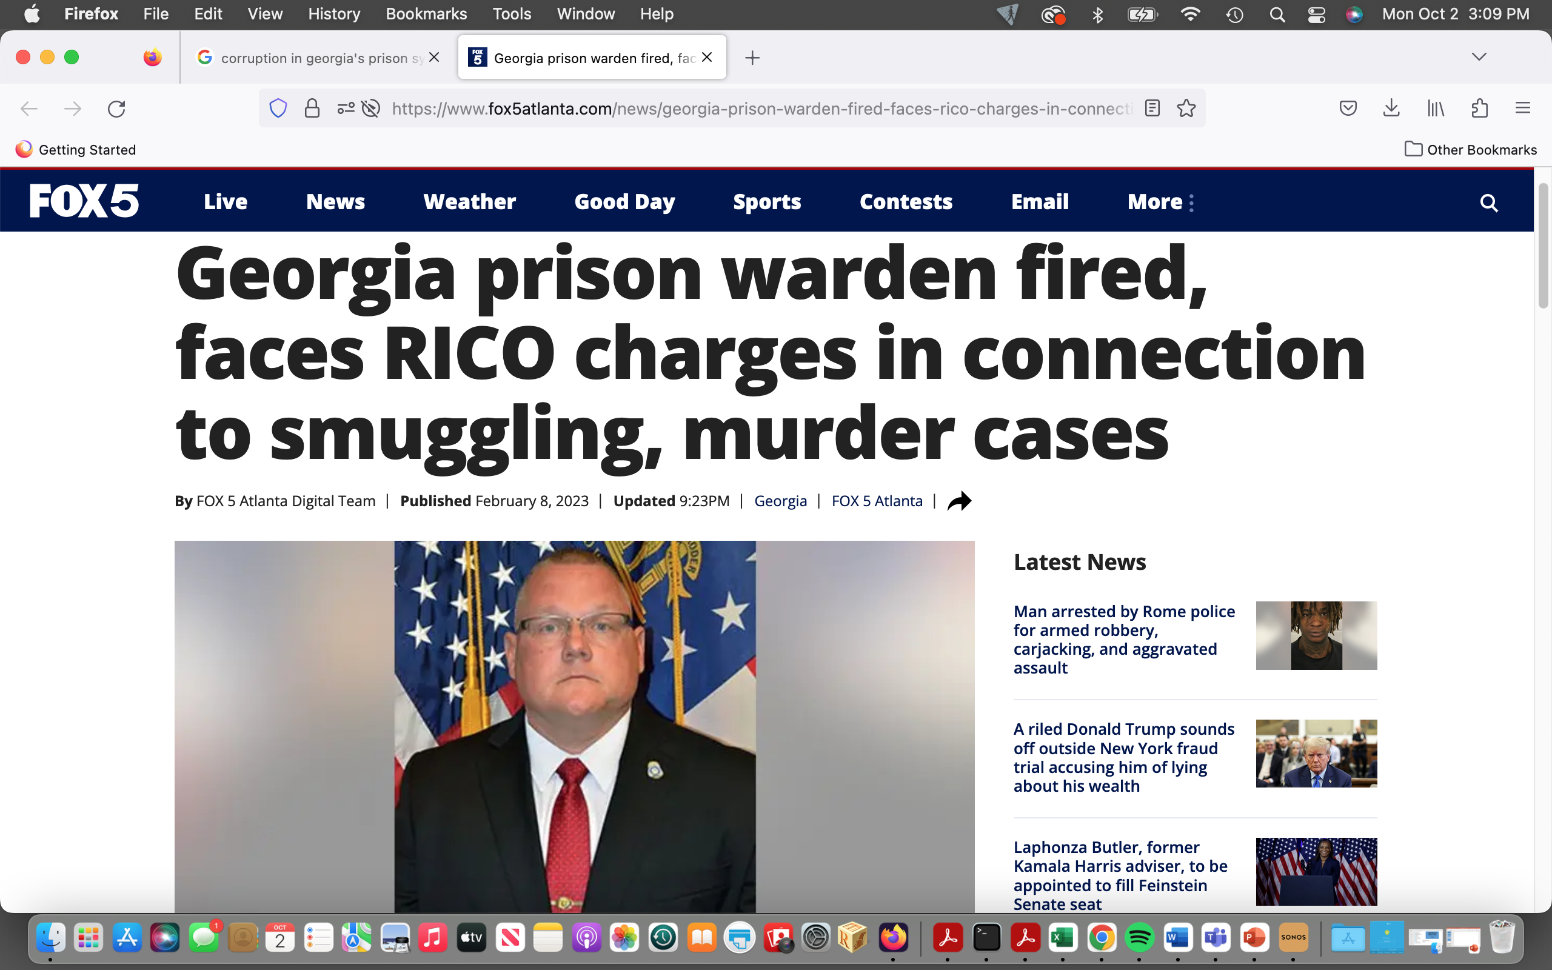

Slide 22
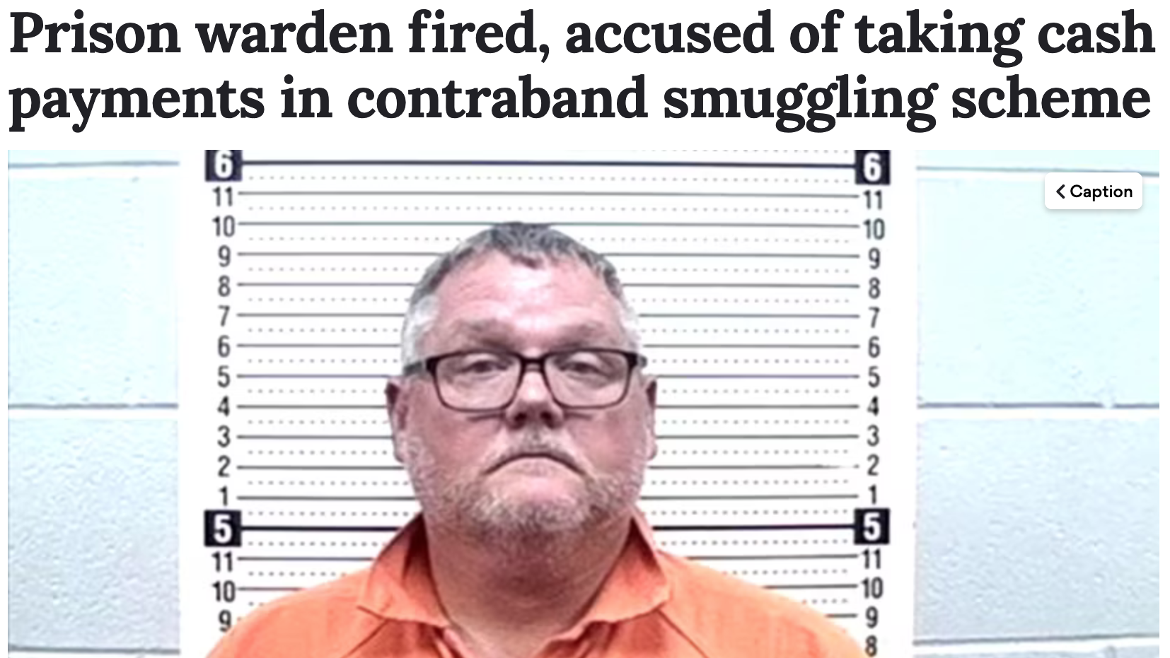

Slide 23
Scope of Crisis
Pervasive
From Cooks to Lieutenants to Wardens
Arrests on nearly a weekly basis
Particularly for contraband
Over 3 days in January 2023, four employees (at four separate prisons) charged in contraband cases

Slide 24
Recent cases
2023 (ongoing)-Telfair State Prison
Operation Ghost Busted
Ghost Face Gangsters, White Supremacist Gang
Massive drug trafficking network
Extended to 10 South Georgia counties
CO helped an inmate convicted of murder, smuggle meth into prison for distribution
Sentenced to 18 months in prison
2022 (ongoing)-Smith State Prison
Massive contraband scheme inside prison
Led by the Yves Saint Laurent Squad, headed by inmate, Nathan Weekes
Weekes and his associates have been charged with 3 murders related to the contraband operation
Led to the arrest and dismissal of Brian Adams, warden
Charged with violating GA’s RICO Act, bribery, false statements, violating oath of office
2021-Rutledge State Prison
Seized cellphone revealed series of payments to CO
Sentenced to 5 years in federal prison

Slide 25
Recent cases
2021-Baldwin State Prison
Recently promoted Lieutenant
Phone info found on a confiscated prisoner’s contraband phone
2019-Hays State Prison
CO, Lieutenant
GBI investigation revealed evidence she was bringing in drugs to Jarico Deshun ”Goon” Brown
Convicted and is serving time in the Pulaski State Prison
Brown is serving life sentence plus 15 years for the 2014 execution-style murders of two men in Coweta County
2018-Georgia Diagnostic and Classification Prison
CO paid to provide a death row inmate information regarding shakedowns
Received five years probation as first offender

Slide 26
Recent cases
2018-Baldwin State Prison
22-year-old CO hired in 2012
Fired nine months later for smuggling contraband (drugs)
2018-Hays State Prison
CO Received 7k for marijuana, cocaine, and meth in noodle soup containers
Sentenced to 8 years in federal prison
2018-Calhoun State Prison
At least 19 employees caught bringing in contraband

Slide 27
Recent cases
2016-Operation Ghost Guard
Criminal and corrupt activities found in 11 of the 35 state corrections facilities.
One of the largest corruption busts in GA corrections history
Undertaken in collaboration with the GA DOC
FBI’s Public Corruption Unit launched nationwide Prison Corruption Initiative
One of the seven prisons where officers were arrested run by a private company called the Geo Group.
2015-Autry State Prison
Jury scam
Of the 51 charged, 15 were current or former corrections officers

Slide 29
A Crisis of Corruption
Is this crisis predictive of future challenges in policing?
I

Slide 30
Contributing Factors
Contraband
Identified as the “driving force” for violence inside Georgia’s prisons.
Understaffing
Encourages gang participation to ensure safety
Constant Turnover
Low Pay
Georgia ranks as fourth lowest for CO pay in the nation
$34,830
Affiliation with criminals
Weak accountability
Minimal requirements
High School diploma
Criminal history acceptable if no felony violations
No credit checks
New officer profile:
Female
Aged 20s or younger
No law enforcement experience
Gangs recruit people on the outside to apply for corrections jobs

Slide 31
Key Areas of Literature Review
2022-Negative public perceptions of both the police and government particularly troublesome in violently divided societies (UK study)
2022-Questions validity of low wage earning as causal to police corruption
2023-Significant predictors of officers’ support for corruption (Mexican police agencies)
Perception of corruption prevalence
Lack of deterrence and oversight
Higher levels of job dissatisfaction
2023-Nefarious/disconcerting motivations for seeking job of CO
Deviant case method
Thematic analytic approach identified 5 broad themes:
use of force, punitive focus, power and control, cavalier ulterior motives, and problematic social boundaries.
Theorize these individuals could constitute a meaningful minority that may contribute to the detriment of both their organizations and those they are overseeing. Future research should explore this possibility.
2023-There is limited understanding of the components of officers' attitudes towards police legitimacy, or the predictors of those components

Slide 32
References
Amagnya, M. A. (2023). Police officers’ support for corruption: examining the impact of police culture. Policing: An International Journal, 46(1), 84–99. https://doi.org/10.1108/PIJPSM-06-2022-0085
Burton, A. L., Jonson, C. L., M. Petrich, D., & Miller, W. T. (2023). Nefarious and Disconcerting Motivations for Choosing a Correctional Officer Position: A Deviant Case Analysis. Criminal Justice & Behavior, 50(10), 1506–1525. https://doi.org/10.1177/00938548231187415
Doyle, M. K., & Roche, S. P. (2023). Investigating police self-legitimacy: individual-level predictors of self-identification and perceived external legitimacy. Policing: An International Journal, 46(2), 209–226. https://doi.org/10.1108/PIJPSM-08-2022-0112
Garduno, L. S. (2019). Explaining Police Corruption among Mexican Police Officers through a Social Learning Perspective. Deviant Behavior, 40(5), 602–620. https://doi.org/10.1080/01639625.2019.1593293
Singh, D. (2022). The Causes of Police Corruption and Working towards Prevention in Conflict-Stricken States. Laws (2075-471X), 11(5), 69. https://doi.org/10.3390/laws11050069
https://worldpopulationreview.com/state-rankings/correctional-officer-salary-by-state

