Slide 1
Georgia Fentanyl Deaths (2018-2022): Racial Disparity and Unequal Treatment University of North Georgia
John Stuart Batchelder & Jon Hager

Slide 2
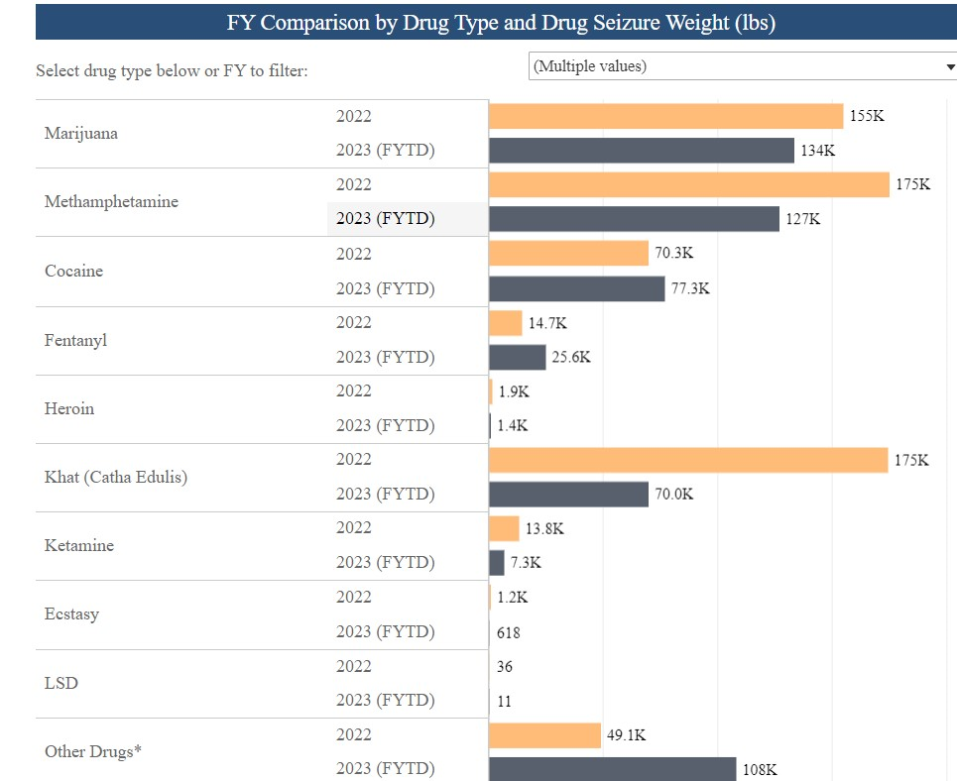

Slide 3
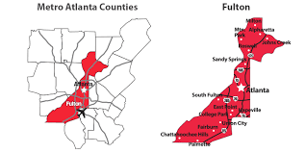

Slide 4
Fulton County Demographics
10% of Georgia’s population
42.5% Black
39.3% White (non-Hispanic)
8.7% Asian
8.1% Hispanic/Latino (Fulton County Government, 2020).

Slide 5
Fulton County Fentanyl Deaths vs Rest of State (2021)
Per the Georgia Department of Public Health’s (2023) Online Analytical Statistical Information System (OASIS) recorded a total of 1,379 synthetic overdose deaths (e.g. fentanyl and not including methadone) in 2021 (most recent data) in Georgia.
Fulton County, 147, (~.10%).
Gwinnett County, 117, (~.08).

Slide 6
National Studies
The Black population, to include both sexes, surpassed the number of the White population for fentanyl deaths. The most prominent racial disparity was evident in Washington D.C. In Washington D.C., Black males recorded 134 overdose deaths per 1,000 due to fentanyl which was 9.4 times greater than White males (D’Orsogna et al., 2023).
Whites had an increase in opioid-related deaths from 1999 to 2006, 2006 to 2013, and with the greatest increase from 2013 to 2016. From 2013 to present (wave 3), a time period identified by the CDC as being the introduction of illicitly manufactured fentanyl, the annual percentage of change was greater for Blacks than Whites. Furr-Holden et al. (2020) demonstrated that Blacks now outpace Whites in the United States for opioid-related deaths (Furr-Holden et al., 2020).

Slide 7
Regional Studies
From 2018 to 2019, HEALing Communities located in Ohio, Massachusetts, New York, and Kentucky were examined to assist in identifying any existing racial/ethnicity disparities related to opioid overdose deaths. The authors did estimate a 40% increase in opioid overdose deaths for non-Hispanic Blacks relative to non-Hispanic Whites. The authors concluded an overall leveling of opioid-related deaths, but an increase was observed for non-Hispanic Blacks (Larochelle et al, 2021).
The areas of opioid overdose deaths identified as hotspots included Maryland, Illinois, Michigan, Pennsylvania, and Washington D.C. After the authors reviewed reports from 2013 to 2020 from the Chief Medical Examiners and Department of Health, in 2020, the Black overdose deaths exceeded Whites by four to six-fold. Fentanyl and heroin were the greatest contributors to deaths of Blacks (Gondre-Lewis et al., 2023).

Slide 8
Local Studies
(St. Louis, MO): The pre-fentanyl deaths (2011-2015) were distinct racially, with Black and White deaths occurring in a primarily Black community. During the fentanyl era (2016-2021), the authors found a more densely cluster of Black decedents versus White decedents. Racial differences existed with overdose deaths shifting from where White people live to where Black people live (Banks et al., 2023b).
(Marion County, IN): The coroner recorded a total of 1,583 deaths between January 1, 2010 and April 30, 2017. The model was used to predict fentanyl-related overdoses while including age, race, sex, zip code, and date of death. Of the 1583 recorded overdose deaths, 379 contained fentanyl. From 2010 to 2017, the percentage of overdose deaths grew from below 15% to nearly 50% in 2017. At the beginning (2010), Blacks had the lowest number of overdose deaths, but continued to increase at a fast rate and eventually surpassed the number of White deaths.

Slide 9
Findings
Agegroup * Sex Crosstabulation
Sex Total
Female Male
Agegroup Young Count 65 149 (214)
% 44.5% 36.3% 38.5%
Old Count 81 261 (342)
% 55.5% 63.7% 61.5%
Total (146) (410) (556)
Pearson Chi-Square 3.042 1 P. = .081

Slide 10
Findings
Agegroup * BinaryRace Crosstabulation
BinaryRace Total
Caucasian Nonwhite
Agegroup Young 122 92 214
% 48.8% 30.1% 38.5%
Agegroup Old 128 214 342
% 51.2% 69.9% 61.5%
Total 250 306 556
Chi-Square Tests
Pearson Chi-Square 20.398 P. = <.001

Slide 11
Findings
T-Test
Syntax T-TEST GROUPS=Caunon(0 1)
Group Statistics
Caunon N Mean Std. Deviation Std. Error Mean
Age White. 250 38.19 11.646 .737
NonWhite 306 44.18 13.878 .793
t₍₅₅₄₎ = 5.432, p. = <.001

