Slide 1
Faith-Based Organizations (FBOs) & Restorative Justice (RJ)
Shani P. Wilfred, Valdosta State University
Jewrell Rivers, Abraham Baldwin Agricultural College
L’Tyra Williams, Valdosta State University

Slide 2
Study Overview & Methodology
Purpose: take a deeper look into how faith-based organizations implement restorative justice processes and strategies into their practices.
Methodology: Mixed
Phase One: IRS Exempt Organizations Business Master File Extract
Phase Two: participants in the focus groups convenience sample of individuals from faith-based organizations known by the researcher.
Protocol revision: surveys completed at the start and end of the focus groups.

Slide 3
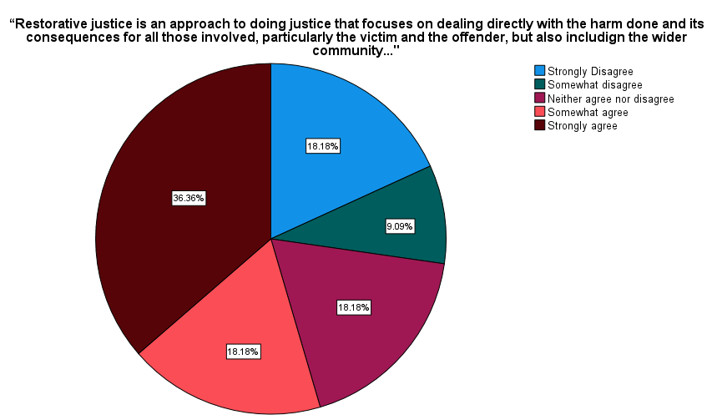
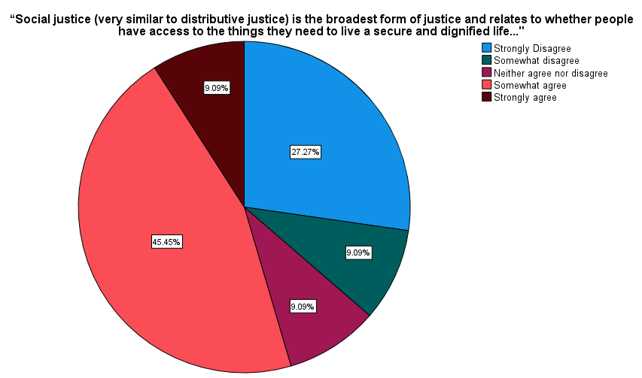
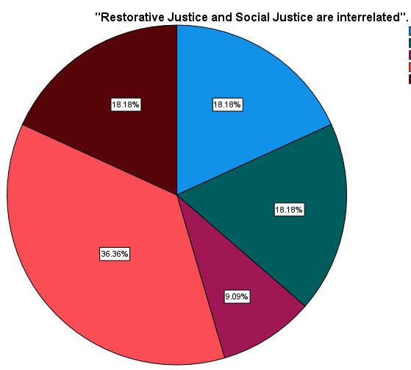
Surveys Questions (N=11)

Slide 4
Focus Group Questions
Define restorative and social justice and discuss how, if at all, the concepts are related.
Discuss how the church engage in and/or use restorative justice practices in the community and internally, and any related shortcomings?
Discuss the current emphasis of the church’s community engagement and whether restorative and/or social justice is part of that emphasis.
Discuss who in the FBO is involved with restorative justice , their role, and the aim of their work.

Slide 5
Focus Group Themes (1)
Lack of representation of African Americans in the prison chaplaincy.
Church alienation of offenders.
Lack of reintegration of offenders in the community assisted by the church.
Notion of habilitation verses rehabilitation.
Church is not doing enough.
Money over personal interaction – more willing to write a check then to send people to engage.

Slide 6
Focus Group Themes (2)
Restorative Justice is a matter of the heart and mind – inside/out change
Church is doing a lot, just not being acknowledged
It’s about using people’s gifting regardless of the focus of the interaction
Church has to do a reality check of how they are perceived in the community and reevaluate the type of engagement desired by the community.
Need for more collaboration between FBOs without territorial issues.

Slide 7
Next Steps
Explore the relationship between FBO interconnectivity and perceptions about restorative justice.
Expand the research to include FBOs from other regions – virtual/in-person using the revised methodology.

Slide 8
References
Braithwaite, J. (2016). Redeeming the “F” word in restorative justice. Oxford Journal of Law & Religion, 5(1), 79–93. https://doi.org/10.1093/ojlr/rwv049
Broughton, G. (2009). Restorative justice: Opportunities for Christian engagement. International Journal of Public Theology, 3, 299-318.
Christe, K. B. (2006). Faith-Based Organizations and the pursuit of restorative justice. Manitoba Law Journal, 32(1), 27-59. https://canlii.ca/t/2cbt
Fiddes, P. S. (2016). Restorative justice and the theological dynamic of forgiveness. Oxford Journal of Law & Religion, 5(1), 54–65. https://doi.org/10.1093/ojlr/rwv037
Mansill, D. (2015). Prophecy and social justice: Christian influences and the development of restorative justice in new zealand’s adult systems of social regulation, control and punishment. Stimulus: The New Zealand Journal of Christian Thought & Practice, 22(2), 4–11. https://search.informit.org/doi/10.3316/informit.577812569132513
Osakabe, Y. (2016). Restoring restorative justice: Beyond the theology of reconciliation and forgiveness. International Journal of Public Theology, 10(2), 247-271. doi: https://doi.org/10.1163/15697320-12341445
Reisch, M. (2002). Defining social justice in a socially unjust world. Families in Society, 83(4), 343-354.
Richards, K. (2009). Rewriting and reclaiming history: An analysis of the emergence of restorative justice in western criminal justice systems. International Journal of Restorative Justice, 5(1), 104-128. Retrieved from https://www.proquest.com/scholarly-journals/v-rewriting-reclaiming-history-analysis-emergence/docview/89190817/se-2
Sarre, R., & Young, J. (2011). Christian approaches to the restorative justice movement: observations on scripture and praxis. Contemporary Justice Review, 14(3), 345–355. https://doi.org/10.1080/10282580.2011.589670

Slide 9
FBOs & Restorative Justice
Notes:
Comments Photo: This Photo by Unknown Author is licensed under CC BY-SA-NC
Questions Photo: This Photo by Unknown Author is licensed under CC BY-NC

Slide 10
FBOs & Restorative Justice
Contact:
Shá Wilfred
spgray@valdosta.edu
Jewrell Rivers
jrivers@abac.edu
Notes:
Thank you image: This Photo by Unknown Author is licensed under CC BY-SA

