Slide 1
Examining Spikes and Long Trends in American Homicides Dr. Brent Paterline University of North Georgia

Slide 2
Data and Methods
Federal Bureau of Investigation’s Supplementary Homicide Reports (SHR)
The FBI’s Supplementary Homicide Reports (SHR) are part of the Uniform Crime Reporting (UCR) Program which obtains data from law enforcement agencies across the United States.
The Centers for Disease Control and Prevention’s National Vital Statistics System.
The Centers for Disease Control (CDC) National Vital Statistics System (NVSS), obtain homicide data from standardized death certificates filed throughout the United States.
Unemployment Data from several of the largest U.S. Cities
State Level Gun ownership and Gun Sales Restriction Laws.
Policing Data from the Fairfax County Virginia Police Department (2020)

Slide 3
The United States has one of the Highest Homicide Rates of any Industrialized Country
The homicide rate in the U.S. is roughly 15 times higher than in Germany, 13 times greater than they are in France, 22 times great than the European Union as a whole, and 23 time greater than the homicide rate in Australia.

Slide 4
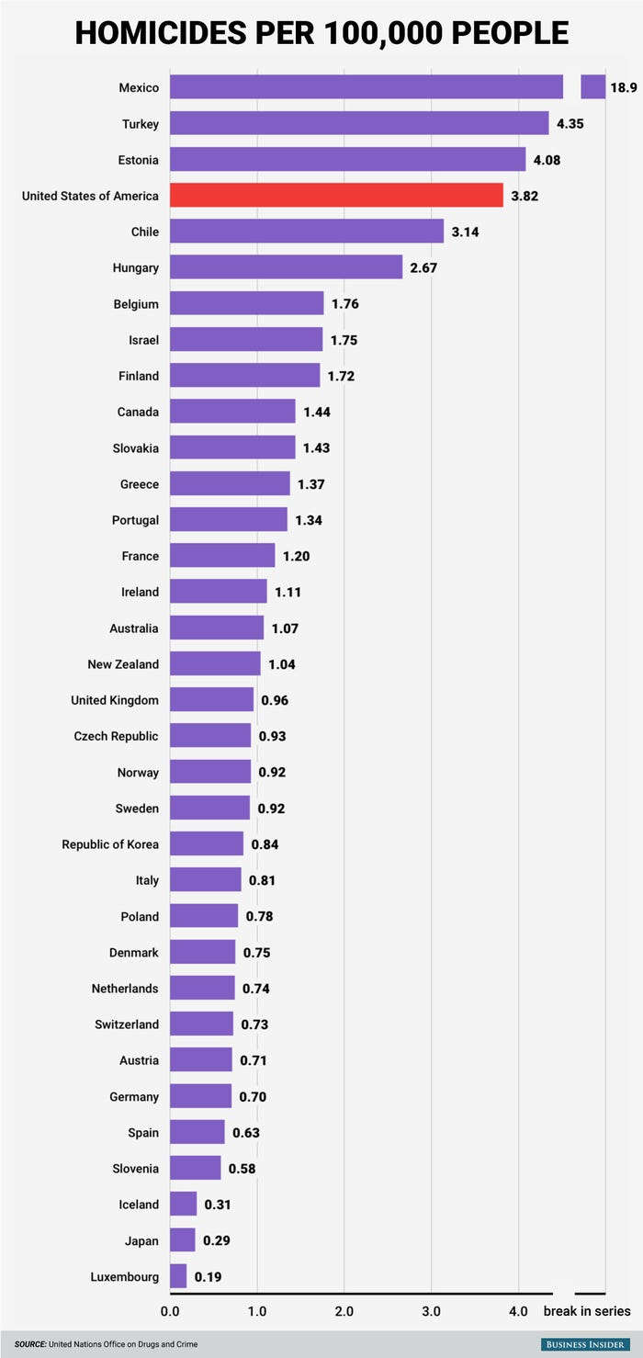

Slide 5
Guns and Homicide
In terms of gun ownership, America is by far the world leader, at 120 guns per 100 population, with about 40 percent of Americans owning firearms.
International studies show that gun homicide is considerably more prevalent in the U.S. relative to other high-income countries.
A study of 31 high income countries found that approximately 84 percent of all firearm homicides occurred in the United States and that 92 percent of all women killed by firearms were killed in the United.

Slide 6
There is not a clear relationship between gun ownership and homicide rates.
An international study conducted in 2021, for example, examined three possible correlates of homicide rates: (1) violent video game consumption, (2) gun ownership, and (3) income inequality in over 90 countries.
The results of the studies show that economic factors were primarily related to homicide rates, while violent video game consumption and per capita gun ownership were not strong correlates of homicide rates.
Within the Unites States, states like Montana, Wyoming, and Idaho have high gun ownership rates, but have low homicide rates.

Slide 7
Table 1.2: Most Murders by State
1. Louisiana 22.9 2. Missouri 18 3. South Carolina 17.4 4. Arkansas 16.1 5. Tennessee 14 6. Alaska 12.3 7. Maryland 11.9 8. Oklahoma 11.9 9. Mississippi 11.8 10. North Carolina 11.4
Table 1.3: States with the Lowest Murder Rates
1. New Hampshire 1.5 2. Maine 2.9 3. Massachusetts 3.3 4. Pennsylvania 3.3 5. Idaho 3.7 6. Vermont 3.7 7. Rhode Island 4.2 8. Oregon 4.4

Slide 8
What we do know is that there is a relationship between homicide rates and gun laws that restrict the access to guns
Permit-to-purchase (PTP) laws and laws prohibiting individuals convicted of violent misdemeanors (VM) have been associated with decreases in firearm homicide rates.
Right-to-carry (RTC) and stand your ground (SYG) laws have been associated with increases in firearm homicide
Several academic studies have found that PTP laws are associated with lower homicide rates and that repealing PTP laws lead to an increase in homicides. Connecticut, Missouri, and Iowa all saw a dramatic increase in homicide when they repealed PTP laws.

Slide 9
Table 1.4: U.S. States by Poverty Rate
Mississippi 22%
New Mexico 21%
Louisiana 20%
Alabama 19%
Kentucky 19%
Georgia 18%

Slide 10
Table 1.5
Most Common to Least Common Types of Homicides
Argumentative-Relate Homicide: 43 percent
Domestic Homicide: 25 percent
Felony-Related Homicide 23 percent
Gang-Related Murder: 8 percent
Multiple Murders: 1 percent

Slide 11
Table 1.6
United States Homicide Rates in Selected Years
Year Rate per 100,000 Persons
1960 5.0
1970 8.8
1980 10.0
1990 9.5
1995 8.2
2000 5.9
2005 6.1
2015 5.7
2017 6.2
2019 6.0
2020 7.8

Slide 12
There was a Significant Spike in Homicides in 2020
Nationally, in 2020, homicides increased 29.4% from 2019. According to the FBI, this is the largest single year increase since 1968 when the increase was 12.7%.
It is important to note that the United States’ national murder rate of murders per 100,000 still remains 1/3 below the rate seen in the early 1990s.
Overall, total reported crime was 22% lower in 2020 when compared to 2019.
Property crime fell 7.8% (which would be expected with persons staying in place).
One of the most drastic arrest increases during 2020 has been from carjacking. In fact, in many major cities across the United States, carjacking has increased by more than one hundred percent.
In 2020, the overall percentage of mass shootings increased by 46.7%; but only in rural areas.

Slide 13
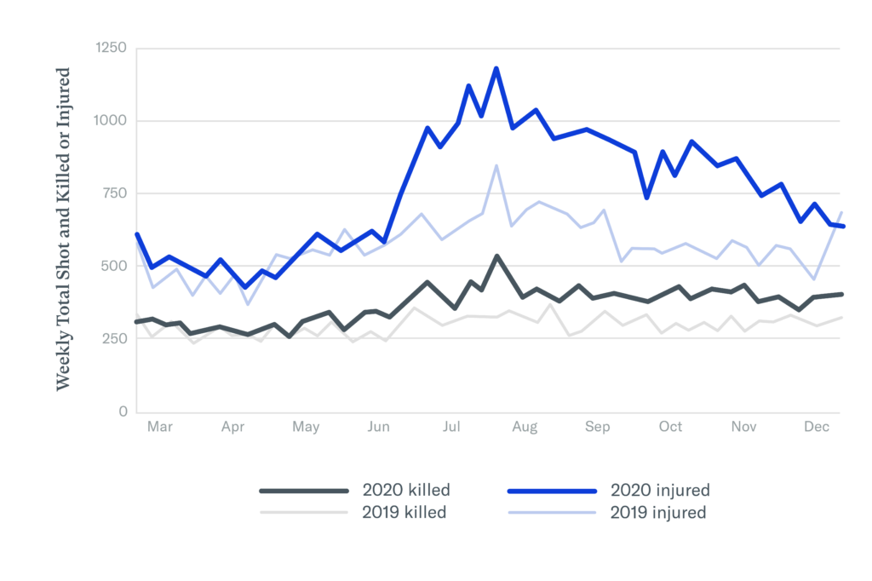

Slide 14
Possible Reasons for the Spike in American Homicides During Covid

Slide 15
1. Social Strain
Reports during the pandemic are that mental health crises in the United States reached all-time highs related to the forced isolation of individuals with pre-existing mental health issues
The main by-products of the COVID-19 pandemic were trauma and anxiety. Many individuals regularly experienced anxiety due to joblessness, financial strain, and other factors that trigger a fight or flight response
Trauma can leave people confused and more willing to act out negatively to regain some semblance of control (Boden et al., 2021).

Slide 16
Counter Argument Against Social Strain The
Social distancing in the United States began around mid-March 2020’
If pent-up violence due to being confined at home was a trigger for homicides, then homicides should have begun increasing somewhere around mid-March to early April—rather than weeks later.
However, homicides did not appear to generally increase in cities in this country until around the last week in May

Slide 17
2. Unemployment
During the pandemic, the percentage of the adult population who were unemployed was 8.1 percentage points higher.
A studying in 2021 (Boden et. al) showed that increases in unemployment were associated with increases in firearm violence and homicide across several large cities.
Study found no association between unemployment and aggravated assault or any other crime.
Findings suggest that the sharp rise in unemployment during the pandemic may have contributed to increases in firearm violence and homicide, but not other crime.

Slide 18
Unemployed Continued
Once again, the timing of changes in unemployment does not correspond with the homicide spikes. The massive surge in unemployment began mid-March and continued to be far above average through July. Also, unemployment claims reached their peak in early May and then began declining. As shown by the vertical line in the graph, this pattern does link to the abrupt spike in homicides and shootings that followed shortly after late May.
Another significant problem with pinning the homicide spikes to unemployment is that increases in unemployment have more often been linked to increases in crime generally or to increases in property crimes—not to increases in homicides and related violent crimes in particular.
No substantial theoretical basis exists for projecting that rising unemployment—even sharply rising unemployment—would uniquely cause gun violence to increase while leaving other forms of crime unaffected.

Slide 19
3. An Increase in Firearm Purchases
Another possible explanation for the homicide spikes is that a surge in firearms purchases lead to more gun violence.
During March of 2020, there were over 900,000 purchased.
The increase in firearms lead to and increase in firearm related homicide.

Slide 20
Firearms Continued
The most significant increase of firearm purchase was in March 2020—well before the homicide spikes appear.
Large numbers of firearms continued to be purchases throughout 2020.

Slide 21
3. Changes in Police Strategies
De-policing causes by the Pandemic
Less police presence (as officers were out ill with COVID), forced self-isolation.
Police became more reactive than proactive.
The Effect of the George Floyd Protests
In the wake of anti-police protests after the death of George Floyd, officers were disengaging from discretionary enforcement activities and criminals felt empowered

Slide 22
The Effect of the George Floyd Protests
In the wake of the antipolice protests surrounding George Floyd’s death, less proactive policing occurred.
Police were redeployed to manage the protests, diverting them from anti-gun patrols and other activities that deter the carrying of illegal firearms.
And even after protests began to wane, police pulled back from several of types proactive policing—that is, self-initiated policing methods designed to reduce crime by using preventive strategies, such as street stops or anti-gun patrols.
The consequence of reducing law enforcement activity directed against gun violence has been, perhaps unsurprisingly, an increase in gun violence.

Slide 23
Evidence of De-Policing
Data from 10 major cities shows a decline in law enforcement activity several months after the protests of the murder of George Floyd.
In New York, for example, the New York Police Department logged 45,000 fewer arrets from June to December, while the homicide rate increased by 58 percent.
During the month of June 2002 in Chicago, traffic stops dropped by 86%, street stops by 74%,99 and arrests by 55% compared to the same period in 2019.
And murders were up in Chicago by a staggering 83% compared to the same period in June 2019.
Louisville, police made 42% less arrests as homicide increase by over 85 percent

Slide 24
Preliminary data from 2022 shows the homicide rate in the United States may be beginning to drop.
While data from the FBI and CDC are not available yet, data form the United States Attorney’s General’s Office (2023) show that there was an approximately 9 percent drop in the number of homicides from 2021 to 2022.
A research firm, AH Datalytics, which collects data on murders from police departments in nearly a hundred cities found the in large cities, murders rose in 2020 and 2021, but declined 5 percent in 2022.
Several large cities have also seen a drop in homicide. Atlanta, Los Angeles, Philadelphia, and Miami, for example, have all seen a decline in the number of homicides in the Spring of 2023.

Slide 25
Conclusion
It is important to understand that this presentation is not simplistically arguing that protests-produce a dramatic spike homicides.
Instead, the argument here is that the protests served as a trigger for de-policing, which then occurred in various ways in cities across the country.
Disadvantaged communities of color in particular, drew even further away from the police due to breached trust and lost confidence. As a result of diminished police legitimacy, fewer people reported crimes to the police or cooperated in investigations, and more engaged in street justice to settle disputes.

Slide 26
Suggestions for Further Research
Research examining the Fairfax County Police Department (FCPD) has found that the reduction of in-person community-policing activities has continued after the pandemic, suggesting that community-oriented policing activities have been slow to return to normal levels.
During the pandemic, many police calls were handled remotely and FCPD officers still strongly prefer this adjustment and feel that the services they provide remotely are as just as good or better than services provided in person.
An examination of how Covid has permanently changed other services in the criminal justice as well as among social service agencies.

