Slide 1
Evaluating the Impact of Speed Cameras in School Zones: A Case Study in Albany, Georgia
Dr. Kizzie Donaldson-Richard
&
Dr. Jason Armstrong

Slide 2
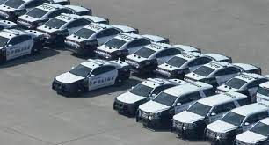
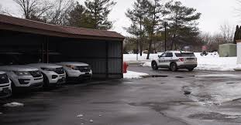
Introduction
In the face of a persistent shortage of law enforcement officers, intensified by the post-pandemic era, the demand for comprehensive police services remains unabated. To address this deficit, police and municipal leaders have increasingly turned to technology, such as speed zone cameras, to supplement law enforcement efforts. Unlike human officers, electronic devices are not subject to breaks, illness, vacations, or career changes, and can operate continuously.
College of Business, Education, & Professional Studies

Slide 3
O.C.G.A. §40-14-8
Authorizes municipalities to use speed detection cameras to enforce 40-14-8
School zones are monitored one hour before, during, and one hour after the normal hours of school operation.
During active school zone times, drivers must travel at the posted school speed. There is no overage allowance.
In all other times as stated above, you can drive the roadway posted speed plus ten miles over before receiving a citation.
College of Business, Education, & Professional Studies

Slide 4
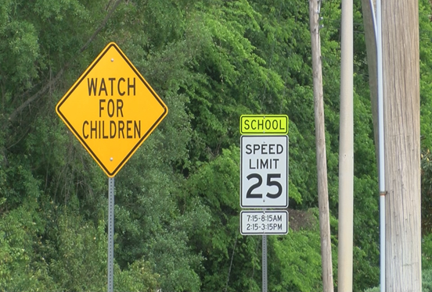
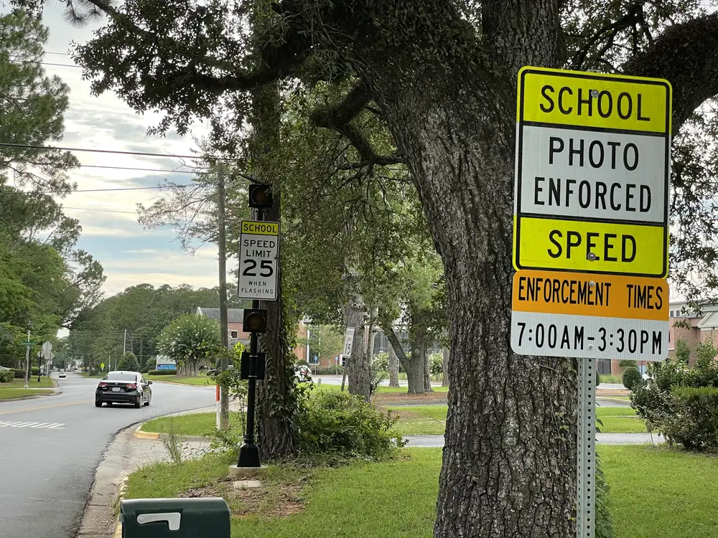
College of Business, Education, & Professional Studies

Slide 5
Why in Albany?
September 16, 2016
4 elementary school children were struck by a vehicle while walking to school
One of them, a 9-year-old boy, was killed
He saved his 6-year-old sister
Albany man advocates for changes to school zone
College of Business, Education, & Professional Studies

Slide 6
Speed Zone Camera Locations
Elementary Schools (7/14)
Alice Coachman – Speed Zone camera
Lincoln Elementary Magnet School – Speed Zone camera
Live Oak – Speed Zone camera
Morningside – Speed Zone camera
Robert H. Harvey – Speed Zone camera
Sherwood Acres – Speed Zone camera
Northside – Speed Zone camera
Lake Park
International Studies
Lamar Reese Magnet School of Arts
Martin Luther King Jr.
Radium Springs
Turner**
West Town
College of Business, Education, & Professional Studies

Slide 7
Speed Zone Camera Locations
Middle Schools (0/4)
Albany Middle
Merry Acres
Radium Springs
Robert Cross
High Schools (3/3)
Dougherty – Speed Zone camera
Monroe – Speed Zone camera
Westover – Speed Zone camera
College of Business, Education, & Professional Studies

Slide 8
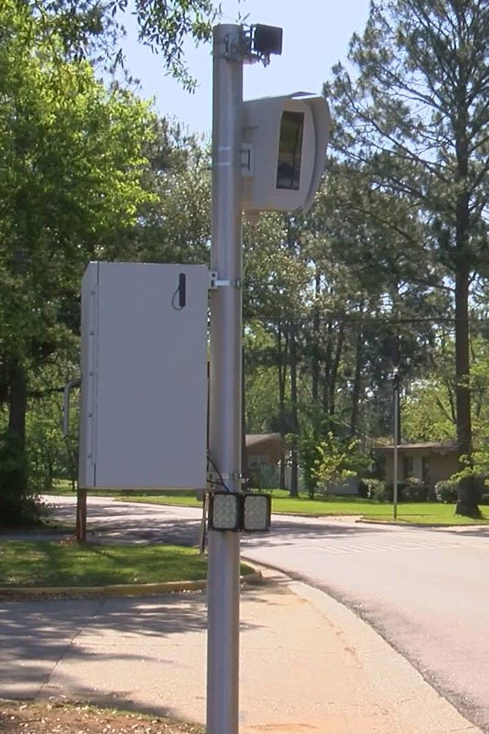
The Research Process
In Albany, Georgia, the city has implemented a speed zone camera program in selected school zones. This initiative aims to encourage motorists to reduce speed in school zones, thereby mitigating the risk of serious or fatal accidents involving children. The proposed research will explore the impact of this safety measure in three distinct phases:
College of Business, Education, & Professional Studies

Slide 9
III Phases
College of Business, Education, & Professional Studies

Slide 10
Data
Open-source reporting from the local media
From August 2021 through March 31, 2023, the cameras have generated a total of $4,791,551.30 in citations.
All 17 speed zone cameras have issued over 118,000 citations combined (began with just 4).
35% of that revenue goes to the company, and 65% goes to the City of Albany.
College of Business, Education, & Professional Studies

Slide 11
Issues
Times are staggered depending school type
Some have flashing lights and some do not
Lack of knowledge of the state law
College of Business, Education, & Professional Studies

Slide 12
Statement from Albany P.D.
Over the past ten years, there has been a nationwide spike in pedestrian fatalities due to a combination of speeding and distracted driving. Communities are turning to automated enforcement as a means of encouraging to follow speed limits and pay attention. Automated Enforcement is endorsed as a safety tool by the Governor’s Highway Safety Association, AAA, Advocates for Highway and Auto Safety, the Insurance Institute for Highway Safety, and the National Safety Council. Slower driving saves lives. A person is about 70% more likely to be killed if they are struck by a vehicle traveling 30mph versus 25 mph. There is a 93% chance of survival if a pedestrian is struck at 20mph.
College of Business, Education, & Professional Studies

Slide 13
Quantitative analysis
Effectiveness?
How do we define that?
Look at the number of traffic crashes and fatalities in the selected school zones before and after the implementation of speed zone cameras.
Community survey
College of Business, Education, & Professional Studies

Slide 14
Qualitative analysis
Perceptions of the community
Citizens
Police
Survey and/or interviews
Focus groups
College of Business, Education, & Professional Studies

Slide 15
Questions & Recommendations
Dr. Kizzie Donaldson-Richard
Criminal Justice Undergraduate Program Coordinator
Assistant Professor of Criminal Justice
Kizzie.Donaldson-Richard@asurams.edu
Dr. Jason Armstrong
Associate Provost & Associate VP of Academic Affairs (interim)
Associate Professor of Criminal Justice
Jason.Armstrong@asurams.edu
College of Business, Education, & Professional Studies

