Slide 1
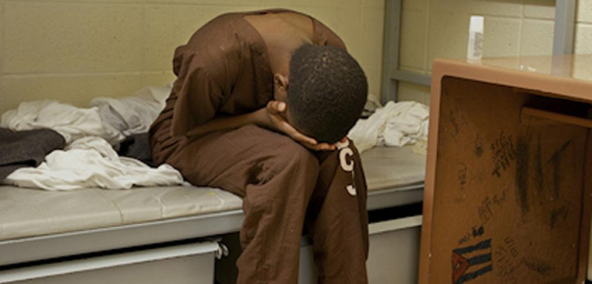
The EFFECTS of Laws, Policies, and Rehabilitation Programs on African American Male Juvenile Recidivism in Southwest Georgia.
Dr. Kizzie Donaldson-Richard

Slide 2
Background of Study
African American male juveniles continue to engage in high rates of re-offending behaviors.
Georgia have failed to reduce the rates of those behaviors in this subgroup through rehabilitation and supervision programs.
The ripple effect of the failing system has a detrimental impact on some of the poorest counties of Southwest Georgia, specifically, Dougherty County (Albany) and Tift County (Tifton).
In the most impoverished neighborhoods in Georgia, many juvenile justice administrators and community leaders struggle to proactively address factors that lead to confinement and recidivism and to implement evidence-based community programs for adjudicated youth; instead, the solution is often to build more out-of-home correctional facilities.

Slide 3
Background of the Study Cont.…….
According to the FBI Crime in the United States report (2019), Georgia recorded 16,933 arrests of juveniles under the age of 18 for drugs and property crimes.
For example, 6,837 juveniles were referred to juvenile court, 2,061 were referred to adult/criminal court, and 1,959 were handled within the department and majority of those numbers of juvenile offenders were African American males (UCR, 2019).

Slide 4
Problem Statement
The problem is that current literature fails to explain why African American males continue to re-offend at such high rates in Georgia especially in the Southwest region.

Slide 5
The Purpose & Scope of the Study
The purpose of this general qualitative study was to examine the lived experiences of African American male juvenile ex-offenders, who were over the age of 18 but less than 40 years of age, resided in Southwest Georgia, and had a recidivism rate of three or more arrests within a 3-year period.
The participants for the study were juvenile officials, female parents/guardians of African American males who were previous offenders, and African American male juvenile Ex-offenders, who were over the age of 18 but less than 40 years of age, and resided in southwest Georgia.
General Qualitative
Depth Interview
Follow-up Interview

Slide 6
Research Questions
The primary research question for the study was the following: How do laws and policies issued by Georgia’s judicial officials impact the high recidivism rates of African American male juvenile ex-offenders in Southwest Georgia, and what are the perceptions of Georgia’s juvenile officials, African American male juvenile ex-offenders over the age of 18 but less than 40, and their mothers/guardian regarding rehabilitation programs in the State of Georgia?

Slide 7
Participants and Sample Size
Six African American male ex-juvenile offenders, over the age of 18 but less than 40, eleven judicial officials, and seven mother’s of African American male juvenile participants in Tift & Dougherty County.
Participants

Slide 8
Findings/ Emerged Themes Supported in the Literature
Georgia rehabilitation programs need revamping
The lacking component in Georgia’s rehabilitation programs and the way they are designed.
The rehabilitation programs is not designed to focused on the reason why crimes were committed.

Slide 9
The Emerging Themes:
Theme 1: Rehabilitation (Before and After)
Theme 2: Georgia Regulations
Theme 3: Role Models
Theme 4: Learned Behavior
Theme 5: Accountability/Responsibility
Theme 6: Lack of Parenting Skills and Support
Theme 7: Lack of Community/Resources Programs

Slide 10
Recommendations for action
Recommendation 1
The rehabilitation programs for African American male juveniles should include male-on-male consultation. A male can provide guidance and answer questions that a young male has about manhood, which is something a female cannot contribute. Having more African American males in a counselor/probation positions should decrease African American male juvenile recidivism rates among Georgia's highest recidivist group.
Recommendation 2
Georgia should revamp their laws and policies as it relates to juvenile offenders. Current policies are outdated and ineffective, and do not provide the desired consequence for the crime that was committed; an example is detaining a juvenile for 30 days with the expectation of making a change in juvenile behaviors. Current policies have failed the state as well as juvenile offenders. Policies today allow juveniles too many opportunities before being detained. To be detained, there is a specific criterion that must be met. Those criteria are determined by Georgia’s juvenile point system, which is monitored by the juvenile courts and probation.

Slide 11
Concluding Thoughts…
Recidivism exacerbates the juvenile incarceration rate in Georgia, and African American males surpass any demographics.
Laws, policies, and rehabilitation programs are instrumental in determining the outcome of offenders sentencing and release.
It is paramount to investigate the ineffectiveness and the effectiveness programs to determine what contributed to African American male juvenile’s high recidivism rate in Southwest Georgia.
Several possible predictors might impact the recidivism rates of African American males causing this subgroup to recidivate at such a high rate than other race.
Statement:
Although re-offending acts will occur and there is no way to prevent them from reoccurring; sentencing should be applied accordingly to the law and policies that are in placed and not whom you know and what you know status. This would limit court officials discretions in the courts and bring equality to everyone.

Slide 13
References
Bureau of Justice Statistics. (1990). Retrieved from https://www.bjs.gov/index.cfm?ty=
pbdetail&iid=4042
FBI Uniform Crime Reporting Program. (2016). Crime in the United States 2016. Retrieved from https://ucr.fbi.gov/crime-in-the-u.s/2016/crime-in-the-u.s.-2016/topic-pages/persons-arrested
FBI Uniform Crime Reporting Program. (2017). Crime in the United States 2017. Retrieved from https://ucr.fbi.gov/crime-in-the-u.s/2017/crime-in-the-u.s.-2017/tables/table-69
Justice Reform HB 242. (2014). Georgia State University Law Review, 30(1). Retrieved from https://readingroom.law.gsu.edu/cgi/viewcontent.cgi?referer= https: Search.yahoo.com/
&httpsredir=1&article=2731&context=gsulr
Sutherland, E. H. (1939). Principles of criminology. Philadelphia: J.B. Lippincott Company.
Sutherland, E. H. (1947). Principles of criminology. 4th edn. New York: J.B. Lippincott Company.

