Slide 1
Developing and Validating an ONN Efficacy Scale
MariTere Molinet
PhD Candidate, Criminology and Criminal Justice
Georgia State University

Slide 2
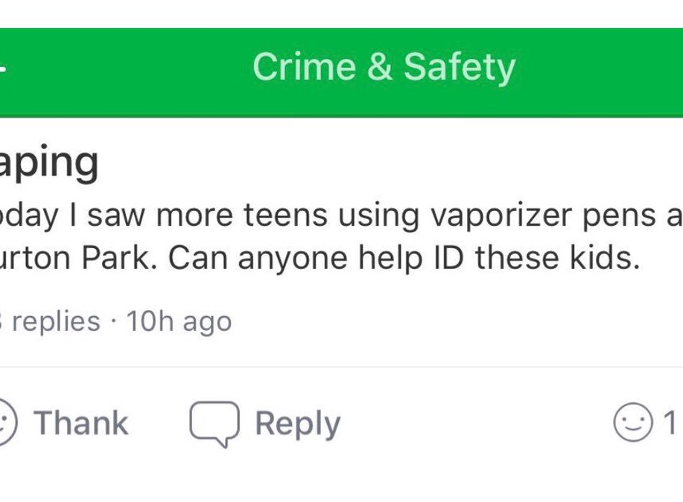
What Is an Online Neighborhood Network?
Restricted social media platforms designed to organize neighborhoods and connect neighbors online based on socio-spatially defined boundaries and identity verification
Distinct from other social media in its membership protocols and spatial delineation of neighborhoods
Specified by the applications, the neighbors, or a combination of both
Nebenand.de
Notes:
DESCRIBE AS MUCH AS POSSIBLE-
Front Porch Forum, European ones, Restricted Facebook Groups.
- Physical space is NOT a necessary condition anymore to form community
- While spatial boundaries initially play a role, it may also shift what we consider our own personal neighborhoods to be.
- Citizen – Mention
All promise safety, some anonymity

Slide 3
Research Question
How can collective efficacy be conceptualized and operationalized in a communal space that lacks the physical characteristics and structural factors found in traditional neighborhood studies?
Does social cohesion operate distinctly from social cohesion offline and what measure are best for capturing this construct in the online space
Would an instrument measuring social controls in the digital space be able to operationalize items that measure individual perceptions of social control actions rather than expectation of social control?

Slide 4
Motivation for RESEARCH
Global reach and continued growth and penetration in communities
Question of processes occurring online and how these relate to offline outcomes
Lack of research on the role of online neighborhood networks engendering and sustaining collective efficacy beliefs
Understand if and how individuals develop collective efficacy beliefs online
Distinction from offline processes and outcomes
Notes:
**Mention Nextdoor Numbers, Ring numbers, Fb and Whats App group
Nextdoor: 11 countries, 300,000 nhoods worldwide
Ring: #36 app downloaded in Google Play (news & magazine)and #32 in usage
Whatsapp and Facebook Groups
Citizen (Vigilante) -
***Studies from Europe mobilization support, sense of community etc
***Studies about police and WHATapp crime groups
**** Don’t know exactly how these networks generate, sustain, or even undermine collective efficacy.
*** Moreover, it is not clear whether collective efficacy online is distinct, both conceptually and empirically, from traditional collective efficacy.

Slide 5
What is ONN Efficacy
Rooted in Collective Efficacy Theory
social cohesion characterized by informational privilege, perceived sense of security, and facilitated by the efficiency of online interactions.

Slide 6
DESIGN
> Grounded in qualitative work
Conceptualization of ONN
Neighborhood Watch / Community within Community
> Traditional measures facilitated by security and efficiency
Notes:
Interviews based on exploring traditional collective efficacy measures
Nhood Watch: characterized by users’ expectations that anyone who is part of ONNs needs to actively participate and report in any situation that may pose a threat to the neighborhood.
Comm w/in Comm: characterized by the exclusivity provided through membership protocols and the access to informational privilege.
**VERY SALIENT IN SMALLER GROUPS
Conducted EFA and CFA to develop and validate ONN efficacy instrument
Traditional measures Salient: Facilitated by Security & Efficiency = Safety (+awareness) & Protection (Sus activity, traffic and service recommendations)
Efficiency = online communication especially with regards to security-related neighborhood issues.

Slide 7
VARIABLES
Items operationalized based on individual perceptions of online space
Likert-Type Items (2 scales)
Global Dimensions of ONNs (Neighborhood Watch / Community within Community)
Specificity in item construction
Notes:
TRUST – Information relayed to the ONN, rather than trust developed from personal connection (evidence: video/images/second hand confirmation)
So the item was operationalized to address this conceptualization of online trust.
Values – Communal values (safety and respect in the online space)

Slide 8
Data & METHODS
EFA CFA
> Pilot testing of items > n=423
> n= 236 > 24 : 1
> Eligibility Criteria > Same Preliminary Analysis
> Measure to avoid social desirability bias
> Four sections, 40 items, 33 observed variables
> Analysis
Various tests to determine the appropriateness of the data for factor analysis
Notes:
Tested for comprehension, readability, timing, technical errors.
Criteria: age, living arrangement. If not eligible, redirected to questions about neighborhood collective efficacy.
236 (5:1) ratio No rule for sample sized (at least 50)
Correlational matrix, normality testing (avoid skewed results and overestimation) – Avoid multicollinearity and oblique or orthogonal
Bartlett’s Test of Sphericity / KMO Test Sampling Adequacy to avoid violating assumptions related to the strength of the relationship among the variables
EFA is more appropriate unrestricted measurement and allows explore relationship between observed variables and the possible factors with latent construct
Promax rotation – correlations exceeding .32
3 factor model
Chronbach’s Alpha
Two measures: (level of agreement to items) / level of truthfulness)

Slide 9
EFA Summary Statistics
own | 156 / 236 | 66%
rent | 80 / 236 | 34%
Age
18-24 | 17 / 236 | 7.2%
25-34 | 98 / 236 | 42%
35-44 | 61 / 236 | 26%
45-54 | 34 / 236 | 14%
55+ | 25 / 236 | 10.7%
Race / Ethnicity
White | 194 / 236 | 82%
Black | 13 / 236 | 5.5%
Latino | 15 / 236 | 6.4%
Asian | 12 / 236 | 5.1%
Gender
female/nonbinary/trans/other | 120 / 236 | 51%
male | 116 / 236 | 49%
Education
HS or less | 19 / 236 | 8.1%
some college | 52 / 236 | 22%
4-year degree | 110 / 236 | 47%
post graduate | 55 / 236 | 23%
HH Income
under 50k | 59 / 236 | 25%
50-80k | 52 / 236 | 22%
80-110K | 43 / 236 | 18%
over 110k | 82 / 236 | 35%
Marital Status
married | 142 / 236 | 60%
not married | 94 / 236 | 40%
Visits p/week | 14 (16) | 0 100
Minutes p/week | 31 (45) | 0 351
Categorical Variables | N | %
ONN Groups
nextdoor | 150 / 236 | 64%
neighbors | 49 / 236 | 21%
fb_onn | 81 / 236 | 34%
whatsapp_onn | 12 / 236 | 5.1%
Other_onn | 12 / 236 | 5%
# of ONN Groups
1 | 171 / 236 | 72%
2 | 62 / 236 | 26%
3 | 3 / 236 | 1.3%
Posts read p/ week
none | 3 / 236 | 1.3%
1-2 | 49 / 236 | 21%
3-5 | 93 / 236 | 39%
6-9 | 41 / 236 | 17%
10+ | 50 / 236 | 21%
Post Respond per week
none | 146 / 236 | 62%
1-2 | 74 / 236 | 31%
3-5 | 14 / 236 | 5.9%
6-9 | 1 / 236 | 0.4%
10+ | 1 / 236 | 0.4%
Publish per week
none | 194 / 236 | 82%
1-2 | 40 / 236 | 17%
3-5 | 2 / 236 | 0.8%
¹n / N %; Mean SD) Minimum Maximum

Slide 10
EFA RESULTS
 | Cohesion | Security | Efficiency | h2
My online neighbors provide information I can trust | 0.61 | 0.27 | -0.11 | 0.56
My online neighbors care about our community | 0.66 | -0.08 | 0.09 | 0.43
My online neighbors share resources that keep me safe | 0.30 | 0.52 | 0.01 | 0.55
My online neighbors come together to help in tragedies | 0.67 | 0.09 | -0.04 | 0.49
My online neighbors provide information that helps protect me | 0.32 | 0.52 | 0.07 | 0.62
Crimes have been stopped thanks to my online neighborhood group | -0.05 | 0.66 | 0.06 | 0.43
My online neighbors share helpful recommendations | 0.66 | 0.05 | -0.08 | 0.43
I know what is going on in my community thanks to my online neighbors | 0.58 | 0.15 | 0.03 | 0.48
My online neighborhood group is like a community within a community | 0.68 | 0.09 | 0.04 | 0.57
My online neighbors help others in need | 0.79 | -0.03 | -0.05 | 0.56
My community is safer thanks to my online neighborhood group | 0.29 | 0.55 | 0.03 | 0.60
My online neighbors watch out for each other | 0.59 | 0.30 | -0.08 | 0.59
Suspicious Activity | -0.23 | 0.42 | 0.66 | 0.62
Trespassers | -0.19 | 0.17 | 0.77 | 0.59
Break-Ins | -0.23 | 0.19 | 0.84 | 0.69
Unsafe Drivers | 0.14 | -0.12 | 0.62 | 0.43
Car Accidents | 0.19 | -0.14 | 0.49 | 0.30
Missing Children | -0.08 | 0.24 | 0.56 | 0.42
to alert neighbors about Pets | 0.30 | -0.18 | 0.40 | 0.28
Notes:
8 Social Cohesion Indicators
4 Security Indicators
5 Efficiency Indicators (THREAT RELATED)

Slide 11
CFA Summary Statistics
Variable | N | %
home: own | 268 | 63.0%
home: rent | 155 | 37.0%
race: white | 229 | 54.1%
race: black | 80 | 18.9%
race: latino | 49 | 11.6%
race: asian | 48 | 11.3%
race: other | 7 | 1.7%
race:missing | 10 | 2.4%
gen: female/other | 246 | 58.2%
gen: male | 174 | 41.1%
education: HS or less | 30 | 7.1%
education: some college | 124 | 29.3%
education: ba | 190 | 44.9%
education: post grad | 79 | 18.7%
income: under 50k | 116 | 27.4%
income:50-80k | 124 | 29.3%
income: 80-110K | 55 | 13.0%
income: over 110k | 123 | 29.1%
income: missing | 5 | 1.2%
marital: married | 211 | 50.0%
marital: not married | 212 | 50.0%
 | M | SD | Min | Max
age | 41 | 13 | 19 | 77
Variable | M | SD | Min | Max
visits p/week | 4.7 | 4.8 | 0 | 50
minutes p/week | 31 | 44 | 0 | 360
nextdoor | 275 | 65.0%
neighbors | 96 | 23.0%
facebook onn | 146 | 35.0%
whatsapp_onn | 46 | 1.0%
frontporch | 5 | 1.2%
onn_other | 10 | 2.4%
onngroups: 1 | 276 | 65.0%
onngroups:2 | 111 | 26.0%
onngroups: 3 | 30 | 7.1%
onngroups: 4+ | 5 | 1.1%
missing | 1 | 0.2%
read: none | 5 | 1.2%
read: 1-3 | 113 | 27.0%
read: 4-6 | 109 | 26.0%
read: 7-9 | 64 | 15.0%
read: 10+ | 132 | 31.0%
respond:none | 204 | 48%
respond:1-3 | 169 | 40.0%
respond:4-6 | 30 | 7.1%
respond:7-9 | 7 | 1.7%
respond:10+ | 13 | 3.1%
publishmonth: none | 241 | 57.0%
publishmonth:1-3 | 133 | 31.0%
publishmonth: 4-6 | 35 | 8.3%
publishmonth: 7-9 | 8 | 1.9%
publishmonth: 10+ | 6 | 1.4%

Slide 12
Relation/Variable | Estimate | SE | z-value | p | Std
Cohesion
My online neighbors provide information I can trust | 1.00 |  |  |  | 0.790
My online neighbors care about our community | 0.904 | 0.082 | 11.072 | <.0001 | 0.729
My online neighbors share helpful recommendations | 1.011 | 0.069 | 14.568 | <.0001 | 0.783
My online neighbors come together to help in tragedies | 1.078 | 0.075 | 14.419 | <.0001 | 0.713
I know what is going on in my community thanks to my online neighbors | 0.83 | 0.083 | 9.977 | <.0001 | 0.672
My online neighbors do not watch out for each other | 0.93 | 0.091 | 10.197 | <.0001 | 0.647
My online neighborhood group is like a community within a community | 1.076 | 0.084 | 12.812 | <.0001 | 0.723
My online neighbors do not help others in need | 0.892 | 0.09 | 9.929 | <.0001 | 0.622
Security
My online neighbors share resources that keep me safe | 1.00 |  |  |  | 86.9
My online neighbors provide information that helps protect me |  | 0.039 | 26.211 | <.0001 | 0.87
My community is safer thanks to my online neighborhood group |  | 0.059 | 16.692 | <.0001 | 0.782
Crimes have been stopped thanks to my online neighborhood group |  | 0.074 | 11.375 | <.0001 | 0.591

Slide 13
Efficiency | Estimate | SE | z-value | p | Std
Suspicious Activity | 1.00 |  |  |  | 0.892
Trespassers |  | 0.034 | 30.264 | <.0001 | 0.880
Break-ins |  | 0.031 | 32.417 | <.0001 | 0.898
Drivers |  | 0.044 | 19.051 | <.0001 | 0.686
Children |  | 0.053 | 16.278 | <.0001 | 0.660
ONNEfficacy~
Cohesion | 1 |  |  |  | 0.957
Security | 1.145 | 0.079 | 14.409 | <.0001 | 0.959
Covariances
Efficiency~ONNEfficacy | 0.499 | 0.061 | 8.171 | <.0001 | 0.668

Slide 14
CFA RESULTS
Model Name | χ² | df | p | CFI | TLI | SRMR | RMSEA | 90% CI RMSEA
Second Order | 329.278 | 116 | <.001 | 94.1 | 93.0 | .048 | .75 | [0.065-0.084]
Average Variance Extracted
Cohesion | Security | Efficiency
.502 | .590 | .639

Slide 15
Discussion
ONN Efficacy - Latent Construct
Social cohesion and security can be generated and measured online
Saliency to ONN users
ONN users can not only distinguish between physical and online neighbors, but they also have knowledge that their online neighbors behave in ways that deter neighborhood crime
Efficiency – Factor Loadings -> Events that threaten the safety of others tap into the factor.
Security / Social Cohesion ->Interrelated factors of ONN. Treated as one scale
Efficiency – Functional aspect of ONN, yet conceptually and empirically distinct
Across multiple platforms ONN users may not only believe that these platforms stimulate social cohesion and safety, but crime prevention, deterrence, and safety are principal indicators of ONN efficacy.

