Slide 1
Criminalized Women’s Negotiations of Domination and Agency and the Methods that Illuminate them.
Denise Ruth Woodall, Ph.D. CPS-AD
University of North Georgia
denise.woodall@ung.edu

Slide 2
Initial vision VS what this became
How interviewing technicalities of method reproduce power and we get canned responses and regurgitations of what they think they’re supposed to say.
I found that some adjustments can be made when collecting data to minimize ‘speaking the script’.
But what about if the data is already collected and you can’t go back and you cannot recreate the conditions that the data were collected under?
I suggest-- analyzing with another’s gaze…..

Slide 3
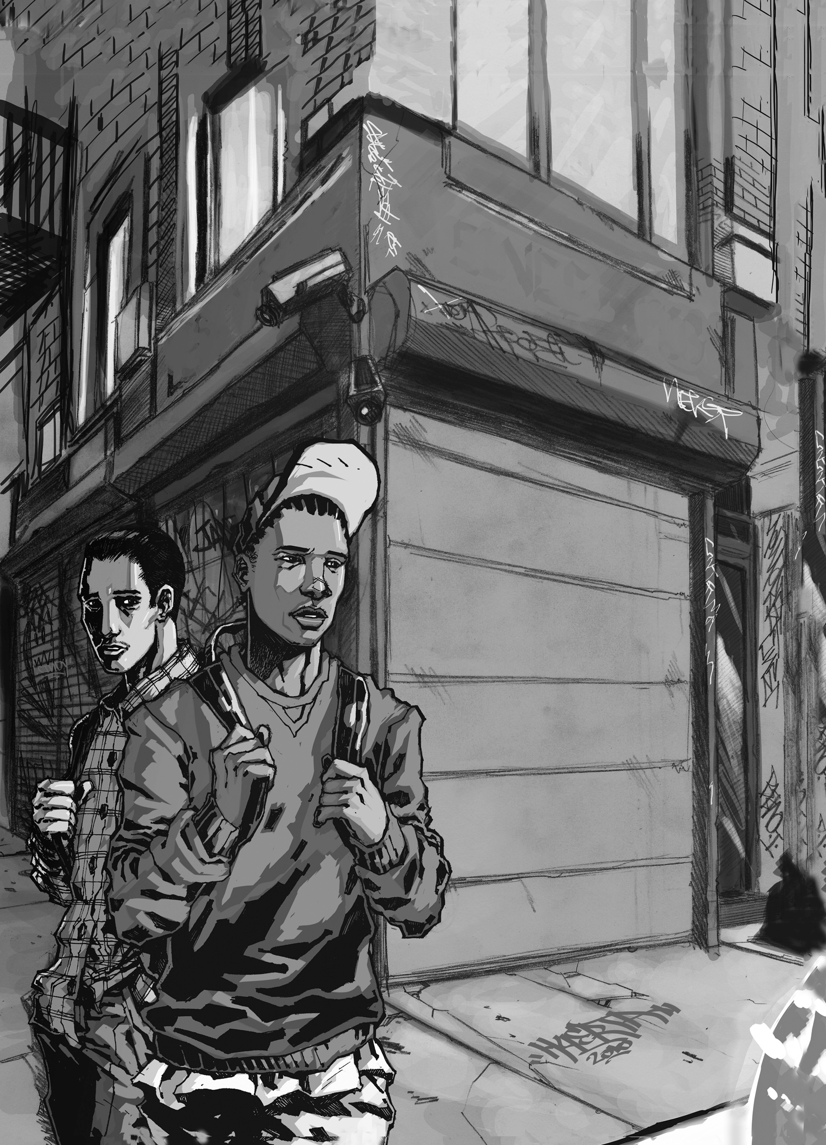
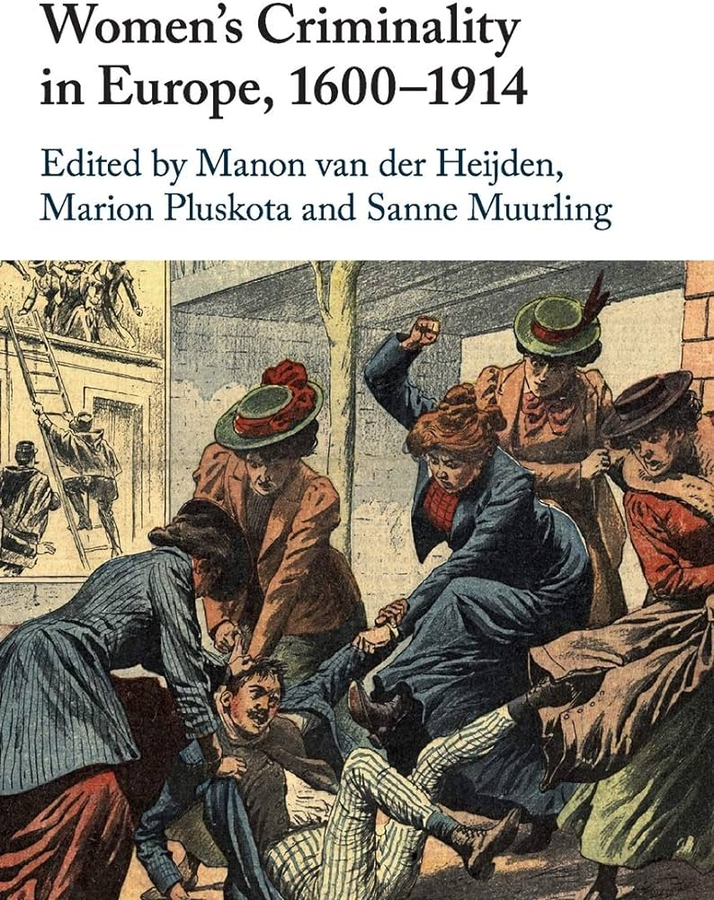
System-Blame, Criminality as Resistance, & Feminist Inquiry
Project is rooted in….
The Criminal legal system is very Unequal and Oppressive (the pathology of that gets translated into personal pathology (Jill McCorkle, Shoshana Pollack, Hannah Moffet)
Systemic Oppressions Coerce and even Mandate criminal behavior (Agnew; Broidy and Agnew, Wacquant; Western; Garland).
A Critical or Penal Abolitionist assertion that a considerable amount of criminal behavior is a means of resistance to those inequalities, blocked opportunities, and intersecting oppressions (Potter, Alexander, Rios).
Alternatives to viewing criminalized women as either victims or villains ( Anderson et al).
A search to understand how pathways to re-entry and recovery are problematic for women when the alternative to criminality is engaging in traditional gender schemas in which they do not feel they’ll ever fit, have been denied (ex parental rights termination), or do not want.
Notes:
Rooted in the/a sociological perspective that views actors as responding to the social environment (Eitzen, Zinn, Smith 2018)
Criminal Legal system rife with inequities and oppressions often get lopped onto individuals as personal problems (Eitzen, Zinn, Smith 2018)
The research comes from the perspective that systemic oppressions and systemic arrangements (in many ways) coerce (strain and gendered strain theory) and even mandate criminal behavior (Western).
A Critical or Penal Abolitionist assertion that a considerable amount of criminal behavior is a means of resistance to those inequalities, blocked opportunities, and intersecting oppressions (Agnew, Potter, Alexander, Wacquant, Garland, Western, Rios).

Slide 4
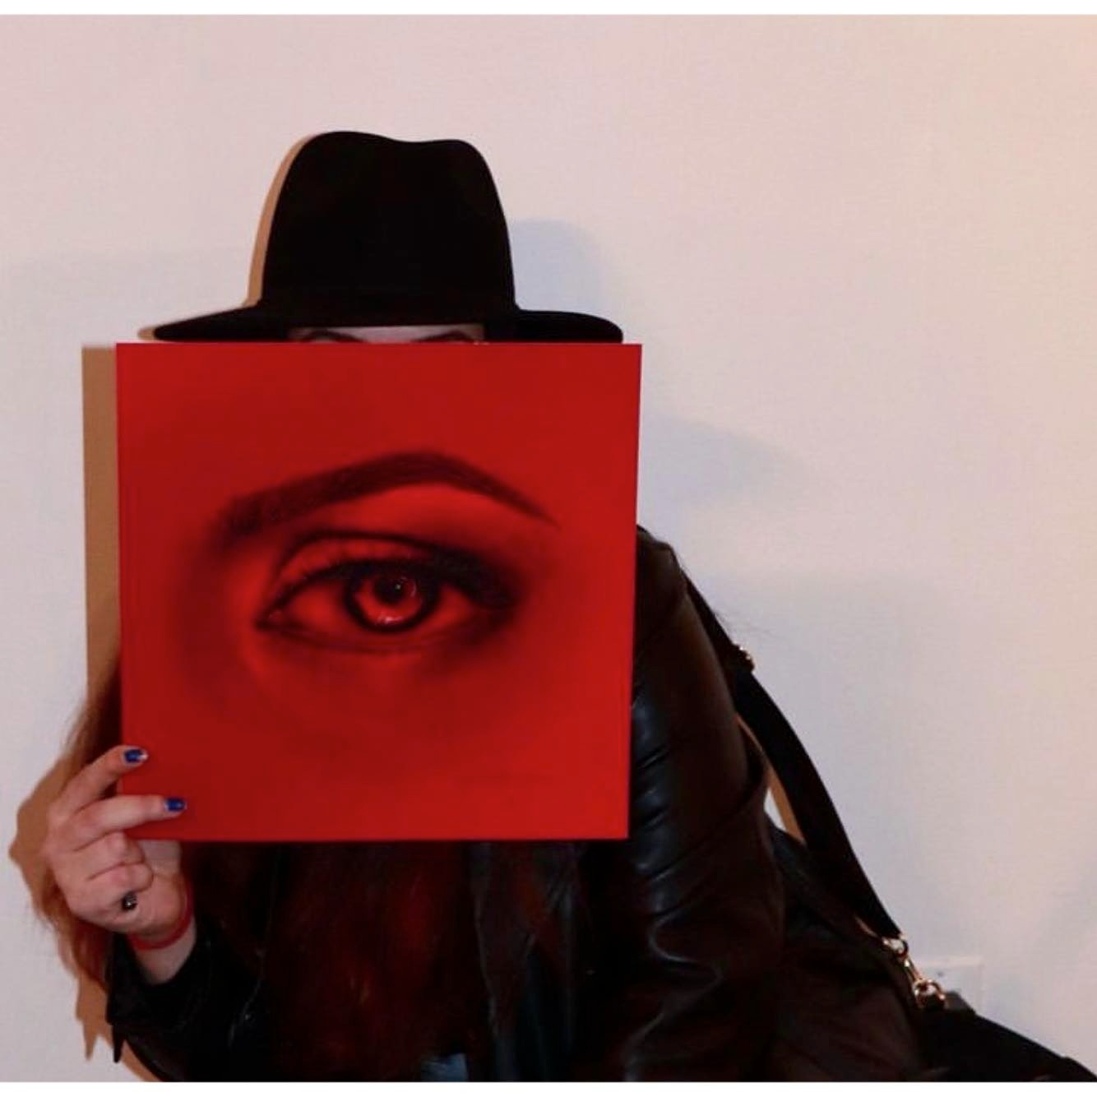
Literature
Standpoint epistemology – Dorothy Smith
Insider/outsider - Patricia Hill-Collins
Intersectionality - Kimberle Crenshaw
Cyborgian goddess assemblages – Puar
Fierce Mothering - Grace Gamez
Deleuzian theory of addiction - Atte Oksanen 2013
Women, power, drugs and embodiment - Elizabeth Ettore
Situated knowledges – Donna Haraway.
I have borrowed Haraway’s theorizing and used it to suggest that we try (although partially) the creative use of another’s gaze to re-interpret and reframe participant responses.

Slide 5
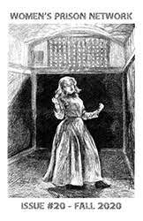
Research Questions
to prevent casting criminalized women as all consumed and void of agency
In what ways do criminalized women exhibit agency under an oppressive CL system and Patriarchal society?(in non-conforming ways)
What methods and techniques can we employ to uncover those answers?

Slide 6
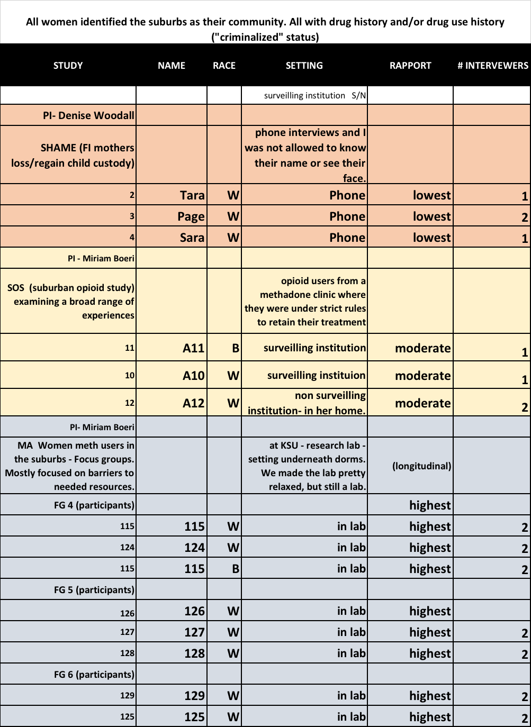
Conducted a re-reading of a selection of Interviews from 3 different studies
Details: ALL WOMEN
-SHAME – Drug using mothers in recovery (interviews),
-SOS- suburban opioid using women (interviews)
-MA- suburban meth using women (focus groups)
Entered in NVivo, coded for themes, I’ll explain in a moment, and wrote reflective notes.

Slide 7
Previous problems in findings - oppression
Good mom/Bad mom narratives (perpetuate gender ineq)
“I went all their functions and did all the things the mother is supposed to do” Page
“a woman is supposed to be all about her kids” TARA
Hard work pays off (perpetuates neoliberal ideals, ignores real barriers)
“it feels good to know that I worked so hard at something and got my kids back, others don’t because they don’t get their life together” -TARA
Justifying trauma (approve social harms as ‘good things’)
“It motivated me more than anything, to do whatever I had to do to get her back” – mable
just not having her ….I cherish every day with her now more than ever. And I don’t know that if I would be if I never lost her.”
“It took me overdosing twice after they took my kids, to help me really wake up” – TARA
Idolize Routines (idealizes confining sanction social control)
I needed a lot of structure and a lot of rules because I was so comfortable with that active addiction lifestyle – Sara

Slide 8
Liberating Perceptions in Data Analysis
Coded for themes self-blame and system blame, expected to FEW DIFFERENCES ACROSS SETTINGS. Found problems with methodologies like intimacy, leading, and generally wasn’t finding anything too different. (Esterberg and McCorkel)
Re-reading, reflecting, and engaging the feminist literature. LOOKING FOR WHAT WAS SURPRISING. NOT MUCH.
Looked to the power that drug dependence has over our bodies and that’s one additional oppression. So, I went to LITERATURE OF EMBODIMENT AND NEUROFEMINISM (Oksanen, Tammy Anderson, and Elizabeth Ettorre). Looking for ways that women can be ‘agentic’ Decided THAT THEY REALLY AREN’T SURE EITHER.
Using the ideas of standpoint epistemology and situated knowledges, I used what I know about the experience being dependent on drugs, with incarceration, THE GAZE OF A FORMERLY INCARCERATED SCHOLAR (GRACE GAMEZ 2012) who saw the power women probationers exhibited in mothering. She called it ‘FIERCE MOTHERING.’ I engaged with her perspectives to try and “see” my participants words differently.
The next slides explain is what was uncovered……..
Notes:
Could Just print this slide and skip over it.
A NEW “GAZE” and “DISCOVERING” RESISTANCE
First reading Harraway’s situated knowledges, I turned to someone elses’s standpoint, Grace Gamez. to learn through her experience, and see how I was resistant all along. I began to dig into intersectionality considering the negotiations between their gender and their criminalized identity. The women in the shame study had all been incarcerated and they were all mothers. So, an analysis of those three – against the grain were like a fresh new set of eyes…that revealed all new findings.
I began to think about a theory of women’s punishment. The evil woman hypothesis. Claims that women violate two norms, that of good standing citizen and her woman role. I think that maybe “evil” and “woman” contend with one another, and offer routes to freedom for women under different circumstances, like a “fierce cyborg goddesses.” (Gamez 2015 and Puar, 2011) Identity is so complex and our identities don’t marginalize us completely, nor do they empower us wholly. They aren’t static and they are more like assemblages. I wanted to look for “fierce negotiations” of feminine weakness and masculine criminality. Drawing from Gamez’s gaze, though impossible to achieve and partial, I could see justice, where before I could not.
I framed this segment of coding the data sensitized to a criminological theory that women get dually punished for crimes. One, in that they committed a crime and two, because they violated their gender roles. How women negotiate the “Evil Woman”, in absence of a better phrase is how I proceeded, but with intent to reframe justice by reading ‘against the grain,’
First, I feel compelled to write on the tensions in feminist literature with the particular population that I’m dealing with which has bothered me throughout this process. Although my focus here is on criminalization. Each of the women had a history, or currently have, drug dependency. I struggled with how I could possibly articulate agency knowing personally what the virtual prison of drug dependency is like. Briefly, the research and treatment approach to drug use has incorporated a disease model of drug addiction, which assumes a flattened subject with a static and diseased brain. Social scientists and feminists have railed against such an essentialist claim. For example, Tammy Anderson introducing the 2008 edited volume Neither Villian nor Victim, challenges such essentialist claims as well as the pathologization and powerlessness narratives of women drug users specifically. Elizzabeth Ettorre, chapter reconceptualizes the “failed femininity” discourse into a creative femininity of drug use and associated behavior. For example, criminal pleasure may serve as escape from domination, how they insert their economic power in the drug economy (as consumers, or dealers), how they use Family relations for business, and wield their feminine power to evade unsuspecting police. Yet, such claims seem inadequate to describe a severe drug dependency, “feminists” may go as far as to claim that we’ve only been made to believe that we didn’t have control. However, this assertion seems inadequate to explain the thousands, maybe millions of women, who have consumed their drug into the gates of insanity or death.
More recent neuroscientific knowledge and feminist thought – particularly inspired under new materialism, have a more promising approach, though I still proceed with caution. They come to question how the body is affected by such substances. The brain disease model has been used by progressives to forward an agenda of decriminalizing drug users as under the control of amoral unconscious controls. But new frontiers point to the plasticity of the brain to recovery. To forge new pathways and ultimately change itself. Although this line of research and innovation is exciting and gives new promise for people to transform their lives, it also revives neoliberal arguments of personal responsibility and personal choice ( (EDITORIAL _____)
But a more happy medium, for my tastes, lies in a Deleuzian critique and interpretation of a theory of addiction. Basically that Addiction are situational and interactional processes. Alcohol and drugs are used to connect us to context in a production of desire, but this behavior changes and alters the body, and thus alters the production of desire and life becomes reduced to a specific model of behavior shaped by alcohol and drugs. In order to recover the body must increase its capacity to be affected in order to create new “biopsychosocial connections of desire” (Oksanen 2013).
I say all that to preface the following findings of women drug users navigation of conventional femininity and a very real experience of bodily subjugation under “addiction.” in the absence of better theorizing, I can’t say with what conscious thought women negotiate their fieiminity and criminality, or drug use. But we are actors in the process of becoming always making decisions shaped by a variety of cultural expectations of gendered responsibilities perhaps internalized as desires, and the physiologically based desire that have come to dominate us. Though the plasticity of the mind and ability of the body to recover, why women negotiate the borders of femininity and drug dependency in the ways that they do, I can’t say. Only that gender is a system of power that constrains and shapes bodies and drug dependency can inhibit our process of becoming, both, then, are a systems of control that shape us. But women, find, in particular space, time, and milieus ways to negotiate those two experiences on their paths. Although much further research is needed to explore this tension, the following is what I found in the data.
Using Gamez’s gaze, and feeling fairly confident that feminist research has not come to terms with the intricacies of neuroscience and embodied drug dependency, I feel somewhat satisfied given my extremely limited data to illustrate the following themes of Rejections and reclamations of both criminality and femininity – as a multi-dimensional negotiation of agency and oppression the woman con identity.

Slide 9
focus on the unexpected (racism)
reflection writing and design adjustment
focus on Haraway's "situated knowledges"
use of another's gaze - completely partial - Gamez
explore my barriers to "seeing" (neuro-feminism)
re-read and participants agency "discovered"
problems making sense of data
rigid research design
belief in complete standpoint
intersectionality literature
The
Research
Process

Slide 10
Rejection of Criminal Seduction by Avenging the Domestic Body and Radical Homemaking
Women took hold of conventional feminine roles as a tool to help them avoid engaging in behavior defined as criminal, or activity which they self-declared - harmful.
Tara-
“just not having the little freedoms in life was the hardest for me for sure….but it was what I needed.”
Page-
“I did what I was told to do….and I just went to meetings, and I listened.
I spent a lot of time alone and with my child that I did have custody of, I mean it was boring and lonely, but I just knew I had to do it.”
Notes:
Tara
Cuts from quote “I wasn't strong enough to say “no, no I quit” you know…not being able to use the telephone, not being able to go smoke a cigarette when I wanted to, not being able to run to the grocery store and pick up something, you know

Slide 11
Transcendent Femininity as Stylized Resistance
Claiming criminalized behaviors when womanhood is stripped, or when domestic roles are not desired.
Sara-
“I tried to be a good mom to my son, but I wasn’t capable. So no, I did not ask for help …I felt I didn't deserve it…so I went out and earned money in my own way.”
Page-
“So when I got out of there [residential treatment] nothing had changed. Somebody else still had my kids, so I was just angry and I went right back to what I knew how to do.”

Slide 12
Transcendent Femininity as Stylized Resistance (contd)
A12-
I put in every nickel I had into that home and then I lost it all. And then at that point, my drinking got even worse and so I was just like– whatever and was back at it.”
Tara –
“I had so many responsibilities as a young parent… I personally know that I didn't use drugs and alcohol because I necessarily liked it, it was because I have been trapped…When my kids got taken, it’s sad that it was almost a relief.”

Slide 13
Conspiracy Femininity (or hyper-feminine criminality))
Women used crime to assist their feminine power, or used their feminine power in gaining resources on the streets.
Tara –
“I think why I really started using meth, was for weight control.”
SOS A12 -
“[Drugs] probably wouldn’t have been as easy to get if I were a guy (laughs), honestly. I mean truthfully, like that’s the way it is. Guys would just hand me whatever I wanted, you know.”

Slide 14
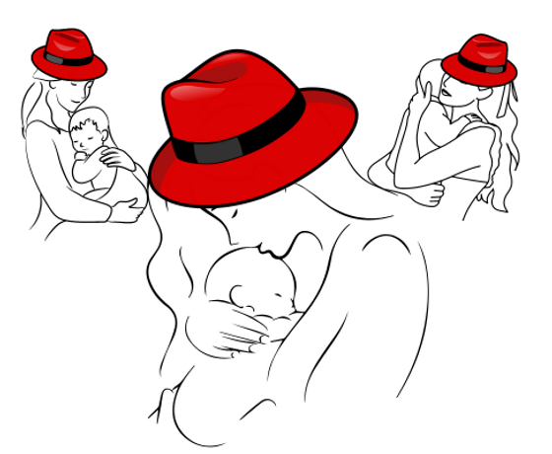
Hedging Domestication and Transcendence
Women had to negotiate criminality, drug use or dependency as well as their roles as women and mothers. I anticipate that fewer of these themes exist since the original interviewing was not designed to uncover such resistance, and this behavior is demonized in traditional treatment discourse.
Sara-
The people who were supervising the visits reported me to DFACS
for drinking during our visit and I did take a Coke bottle full of whiskey
into the visit with me because I was drinking 24-7 and so I’d get by.
Page –
I had a job and a car but I was still dabbling in using and all that stuff I didn't have all my shit together. I did just enough to be present like I did. Where they could still come over and I could be more involved

Slide 15
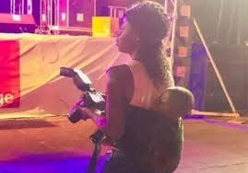
Provisioning resources with hustling skills.
Sara-
“they have a waiting list at this rehabI had sat down one day, high as a kite on meth and I wrote this letter, like asking them to let me in and give me residential treatment…and I got in. And there were friends that would give me odd jobs to pay my way”
Tara -
“I’m a very analytical person anyway I've had to literally work my way up from the minute I had gotten clean you know. I applied for a license to work in real estate , it got declined because of my arrest. I fought through appeals and got that judge to grant me my insurance license which the lawyer said the insurance commissioner said was almost unheard of.”

Slide 16
Provisioning resources with hustling skills (contd)
A12 –
“I didn’t use drugs at the club [as a dancer] because it would keep me from making money. But I drank at the club. I didn’t use because it would keep me from making money (mumbles)—I had certain frame of mind I had to be in to work.”
Page -
So [I found meetings] through my second ex-husband who had gone to [a men’s treatment facility] and then from there, I met someone who told me about [a recovery clubhouse] where I went to a lot of meetings on nights my kids had football and cheerleading or I’d have the lady I was staying with watch them.

Slide 17
Conclusion
It’s difficult to uncover women’s agentic moves when they’re multiply marginalized. Participants Speaking the script is a problem in qualitative research.
Some technicalities of method in collection can offset this but internalization is powerful.
Radical Re-framing can be accomplished when we draw from (borrow) another’s gaze (although partial).
There is a deep and detailed relationship between the performance of gender and criminality that is largely under-theorized in contemporary scholarship.

Slide 18
Limitations
A full examination of the literature is needed to understand if these themes fit, disrupt, or have relevancy for advancing gender or criminal legal theory
Limited sample
Taking the gaze of another is always and subject to methodological scrutiny.
More border negotiation research and theorizing between gender and carceral status necessary intersected with other identity categories.

Slide 19
THANK YOU Criminalized Women’s Negotiations of Domination and Agency and the Methods that Illuminate them.
Denise Ruth Woodall, Ph.D. CPS-AD
University of North Georgia
denise.woodall@ung.edu
Notes:
engaging the feminist literature throughout the process of analysis, active reflection and subsequent processual adjustment as well as employing an active awareness of my representation of this marginalized population of drug using and criminalized women in write up, all helped me to “discover” the ways in which agency and oppression are negotiated between intersecting identities.
We can all adopt some these practices in researching and representing criminalized people. First, Allowing preconceived notions about our own socio-legal identity to be challenged in our research and willingness to adjust accordingly is critical for any claim to “giving voice” to others. Active reflexivity, serious absorption of feminist thought, and a commitment to producing the kind of research that respects our participants experiences are how we become better researchers and how we can better represent ourselves and our incarcerated family in ways that tell their story as living, thriving, agentic bodies, who are siblings, brother, sisters, mothers, daughter, , and hope.
Regarding my own criminal history and particular situation, I choose to not publish nor claim that identity. So, what is there to do? It’s a secret I feel I need to keep and an identity I make visible in circles where I feel safe. That is my right.
I’ve been told “what good are you to a department as a graduate student, if you’re not going to publish your experience?”
I’ve heard the president of the ASC call for women to publish, with such flippant consideration for the devastation that can create for a budding faculty member.
I would love to say that I found a way that , for those like me who choose to stay closeted that we have a way to personally represent our own story and separate that from our own formal academic identity. However, I didn’t find that
What I did find, was innovative ways that we can conduct our research with other intersectionally marginalized people reflexively. Calling to attention the centrality of intersectionality to our perspective and seeking to re-envision incarcerated people through the eyes of others who’s identities and experiences are different than ours, and who may be better situated to see the way out of piling up more rhetoric about the ways we become damaged goods through the ringer of carceral processing, by sharing each other’s vision what we could not see, becomes visible.
In this case, to represent participants with agency and self-determination
I argue that standpoint is indeed an entry point, but one we must continually reflect on and adjust through the research the process in order to have fruitful findings.
reify current oppressions or nd intersectionality as a useful tool in theorizing justice for this population,
For me, what I conceived to be “release” from domination – that is - externaliproblematized how I’m conceptualizing “release from domination”, it’s viewed differently for these women. The work of postmodern feminist conceptions of standpoint, informed this point in the research process. Finally, borrowing someone else’s gaze revealed agency I couldn’t otherwise see with my own eyes. I then trusted my own experiences as well to forge new paths for wielding the neurofeminist literature, no matter how foreign it may seem so that I can move closer to less partial truth.

Slide 20
The so what question?
If women are going to recover we need new schemas for them to identify themselves with and sociallyaccepted alternatives of what they can be.
Notes:
engagement with the feminist literature on intersectionality helped me to question the utility of looking for externalization of blames for feminist goals, and intersectionality as a concept useful for theorizing justice for this population, allowing preconceived notions about our own identity to be challenged. I realize that their racism problematized how I’m conceptualizing “release from domination”, it’s viewed differently for these women. The work of postmodern feminist conceptions of standpoint, informed this point in the research process. Finally, borrowing someone else’s gaze revealed agency I couldn’t otherwise see with my own eyes. I then trusted my own experiences as well to forge new paths for wielding the neurofeminist literature, no matter how foreign it may seem so that I can move closer to less partial truth. I argue that standpoint is indeed an entry point, but one we must continually reflect on and adjust through the research the process in order to have fruitful findings. In this case, to represent participants with agency and self-determination

