Slide 1
Criminal Profiling Plus a Little Luck in Capturing Serial Killers
Dr. Pamela Pitman Brown, Associate Professor of Sociology, ASU
Dr. Jason Armstrong, Associate Professor of Criminal Justice, ASU

Slide 2
Criminal Profiling
Criminal profiling provides crucial information about behavioral patterns and characteristics, helping investigators focus their resources and efforts effectively.
It's crucial to understand that profiling does not guarantee the capture of the perpetrator. While it provides valuable insights, it's only one piece of the puzzle.
Successful capture requires a combination of profiling techniques and meticulous investigative work to gather evidence and build a solid case against the suspect.
Department of Criminal Justice
Notes:
Criminal profiling provides valuable insights into patterns and characteristics, narrowing down the suspect pool. However, it's important to note that profiling alone does not confirm or capture suspects. Good investigative work is still required for successful arrests. Let's explore how criminal profiling, combined with a stroke of luck, has led to the capture of notorious serial killers.

Slide 3
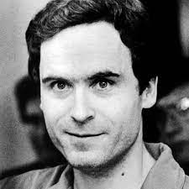
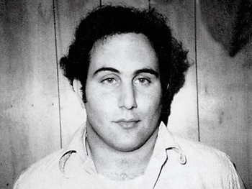
Organized Serial Killers
Organized Offenders:
Plan and execute their crimes
Target victims
Take time to remove evidence
May move/conceal the victim
Theodore Bundy David Berkowitz
Behavior/Personality
Average to Above Average IQ
Crime scene away from home
Has car
Follows the media
Plays games with police
Department of Criminal Justice
Notes:
Criminal profiling provides valuable insights into patterns and characteristics, narrowing down the suspect pool. However, it's important to note that profiling alone does not confirm or capture suspects. Good investigative work is still required for successful arrests. Let's explore how criminal profiling, combined with a stroke of luck, has led to the capture of notorious serial killers.

Slide 4
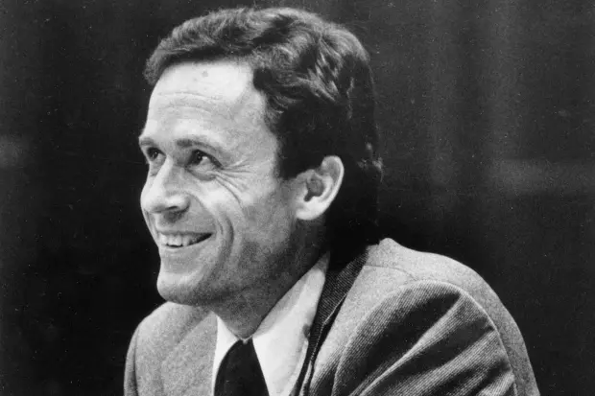
Theodore Bundy
Over the span of four years, from 1974 to 1978, Bundy ruthlessly claimed the lives of more than 30 women across Washington, Oregon, Utah, Colorado, Idaho,
Using brutal methods such as bludgeoning and strangulation, Bundy exerted a terrifying level of power and control over his victims.
Bundy would often pose as an injured individual or an authoritative figure, expertly luring his victims into his trap.
Department of Criminal Justice
Notes:
Criminal profiling provides valuable insights into patterns and characteristics, narrowing down the suspect pool. However, it's important to note that profiling alone does not confirm or capture suspects. Good investigative work is still required for successful arrests. Let's explore how criminal profiling, combined with a stroke of luck, has led to the capture of notorious serial killers.

Slide 5
Theodore Bundy’s MO
Public Lure: Bundy targeted victims in public venues like parks and college campuses, taking advantage of their innocence and vulnerability.
Deception Tactics: Posing as an injured person or flashing a fake badge, Bundy skillfully gained his victims' trust.
Rendition and Transport: Once lured, Bundy would render his victims unconscious and transport them to secondary locations, enabling his heinous acts.
Pattern of Control: Bundy's killings followed an organized pattern, driven by his desire for control over his victims' lives.
Department of Criminal Justice
Notes:
Criminal profiling provides valuable insights into patterns and characteristics, narrowing down the suspect pool. However, it's important to note that profiling alone does not confirm or capture suspects. Good investigative work is still required for successful arrests. Let's explore how criminal profiling, combined with a stroke of luck, has led to the capture of notorious serial killers.

Slide 6
Bundy’s Arrests
First Brush with the Law: Utah (August 16, 1975)
Bundy was arrested by Sgt. Robert Hayward. Had his “kill kit” with him. Did not comply with officer.
Second Arrest: Utah (August 21, 1975)
Possession of burglary tools by Deputy Darrel Ondrak. October 2, 1975 Bundy was identified by Carol DaRonch as the person who tried to abduct her and who assaulted her. Charged with attempted criminal assault and aggravated kidnapping of DaRonch
Department of Criminal Justice
Notes:
Criminal profiling provides valuable insights into patterns and characteristics, narrowing down the suspect pool. However, it's important to note that profiling alone does not confirm or capture suspects. Good investigative work is still required for successful arrests. Let's explore how criminal profiling, combined with a stroke of luck, has led to the capture of notorious serial killers.

Slide 7
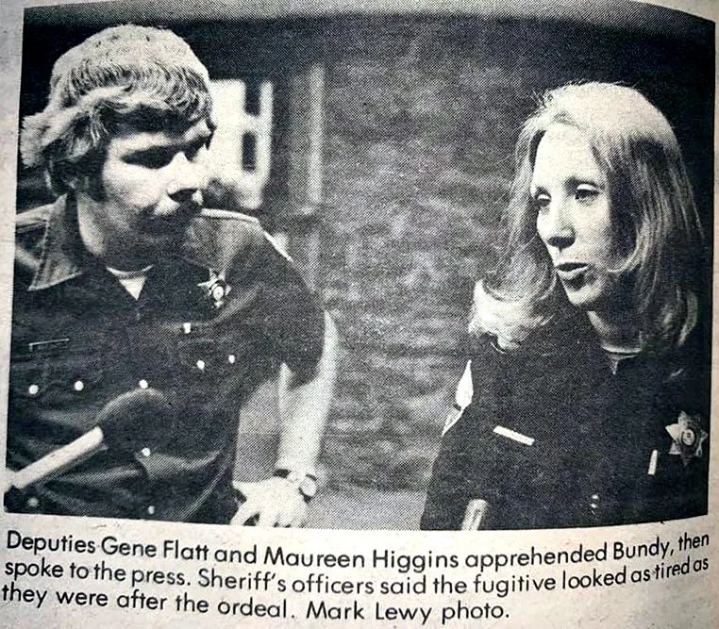
Bundy’s First Escape & Recapture
First Escape & Recapture:
Bundy was moved to Colorado (January 1977) for the trial of Caryn Eileen Campbell (killed January 1975). Pleaded “not guilty” (May 1977), escaped from Pitkin Co. Jail Law Library (June, 7 1977) [Jumped from second floor window].
Captured five days later (June 13, 1977).
Made a U-turn in a stolen 1966 Cadillac at 2am
Deputy Sheriffs: Gene Flatt and Maureen Higgins.
Assisted by Officer Terry Quirk.
Arrested and charged with escape, burglary, and felony theft on June 15, 1977
Department of Criminal Justice
Notes:
Criminal profiling provides valuable insights into patterns and characteristics, narrowing down the suspect pool. However, it's important to note that profiling alone does not confirm or capture suspects. Good investigative work is still required for successful arrests. Let's explore how criminal profiling, combined with a stroke of luck, has led to the capture of notorious serial killers.

Slide 8
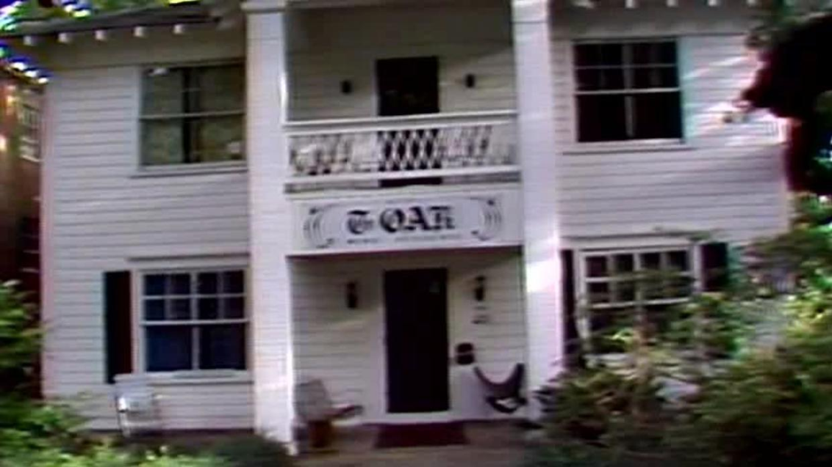
Bundy’s Second Escape
Second Escape:
Bundy escaped from Glenwood Springs, Colorado (Garfield County Jail) (December 30, 1977).
Made his way to Tallahassee Florida via a plane from Chicago, train to Ann Arbor, a stolen vehicle where he drove south to Atlanta and took a bus to Tallahassee.
He then rented a room (using the name Chris Hagen) at The Oaks.
Department of Criminal Justice
Notes:
Criminal profiling provides valuable insights into patterns and characteristics, narrowing down the suspect pool. However, it's important to note that profiling alone does not confirm or capture suspects. Good investigative work is still required for successful arrests. Let's explore how criminal profiling, combined with a stroke of luck, has led to the capture of notorious serial killers.

Slide 9
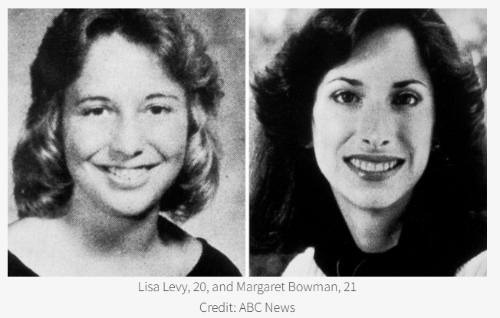
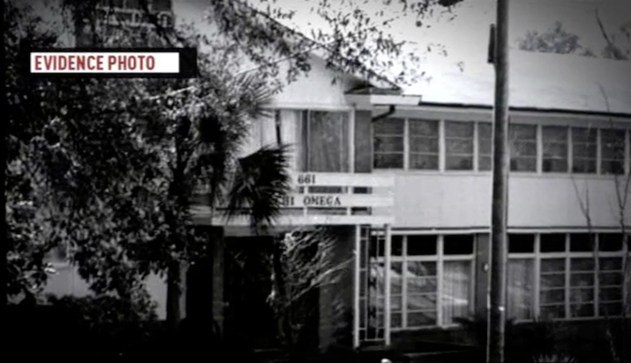
The Chi Omega Murders
January 15, 1978, Bundy entered the Chi Omega sorority house at Florida State University and murdered 20-year-old Lisa Levy and 21-year-old Margaret Bowman.
Department of Criminal Justice
Notes:
Criminal profiling provides valuable insights into patterns and characteristics, narrowing down the suspect pool. However, it's important to note that profiling alone does not confirm or capture suspects. Good investigative work is still required for successful arrests. Let's explore how criminal profiling, combined with a stroke of luck, has led to the capture of notorious serial killers.

Slide 10
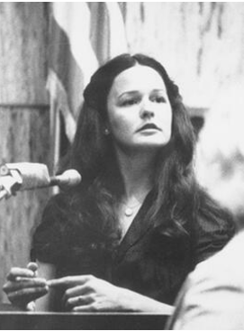
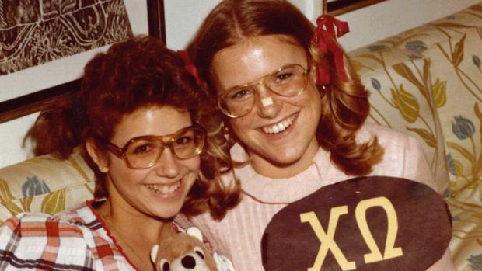
The Chi Omega Murders
He also severely beat Kathy Kleiner and Karen Ann Chandler, but they both survived with severe injuries. He left the Chi Omega house and broke into the apartment of Cheryl Thomas, where her neighbors heard noises and called the police. Thomas survived the attack but Bundy escaped.
Cheryl Thomas
Kathy Kleiner and Karen Ann Chandler, October 1977
Department of Criminal Justice
Notes:
Criminal profiling provides valuable insights into patterns and characteristics, narrowing down the suspect pool. However, it's important to note that profiling alone does not confirm or capture suspects. Good investigative work is still required for successful arrests. Let's explore how criminal profiling, combined with a stroke of luck, has led to the capture of notorious serial killers.

Slide 11
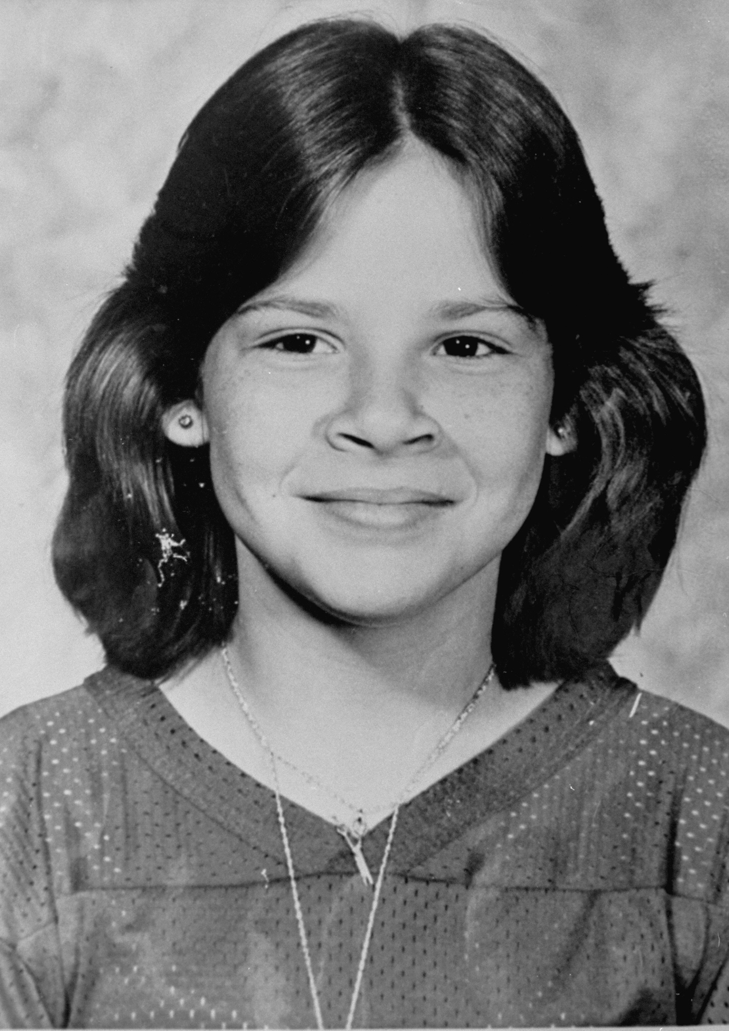
After the Chi Omega Murders
On February 8th, 1978, Bundy stole an FSU van and headed to Jacksonville, where he attempted to abduct 14-year-old Leslie Parmenter. Leslie was the daughter of Jacksonville Police Department's Chief of Detectives, but Bundy abandoned the attempt after Leslie's older brother confronted him and scared him away.
February 9, 1978 in Lake City, Florida, Bundy abducted, assaulted, and killed 12-year-old Kimberly Dianne Leach at Lake City Junior High, leaving her body in a shed (Suwannee River State Park) 35 miles from where she was abducted.
Department of Criminal Justice
Notes:
Criminal profiling provides valuable insights into patterns and characteristics, narrowing down the suspect pool. However, it's important to note that profiling alone does not confirm or capture suspects. Good investigative work is still required for successful arrests. Let's explore how criminal profiling, combined with a stroke of luck, has led to the capture of notorious serial killers.

Slide 12
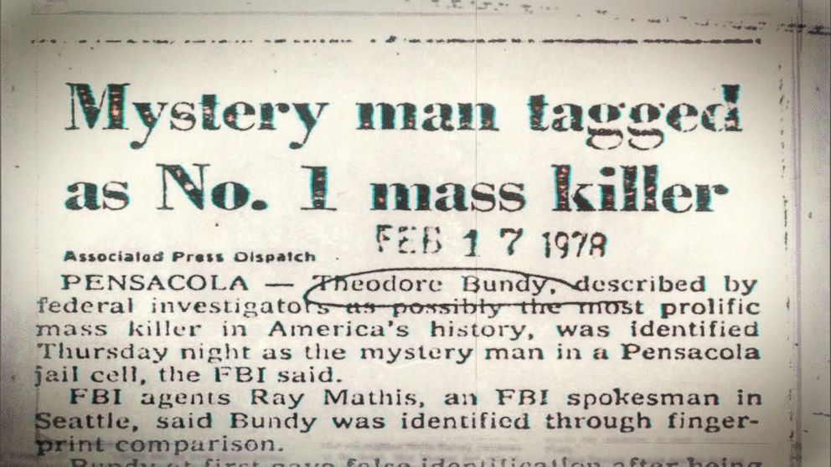
Bundy’s Luck Runs Out!
Bundy was arrested February 15, 1978 in Pensacola, by chance. Patrolman David Lee saw an orange VW driving erratically leaving a restaurant (Oscar’s) on W Cervantes Street. The officer then ran the plates discovering the car was stolen. After refusing to give Officer Lee his name and resisting arrest, a struggle ensued but Bundy was subdued and arrested after Office Lee firing two shots after him.
During the arrest he gave the officers a stolen ID. On February 17, 1978 Bundy finally identified himself.
Department of Criminal Justice
Notes:
Criminal profiling provides valuable insights into patterns and characteristics, narrowing down the suspect pool. However, it's important to note that profiling alone does not confirm or capture suspects. Good investigative work is still required for successful arrests. Let's explore how criminal profiling, combined with a stroke of luck, has led to the capture of notorious serial killers.

Slide 13
Chi Omega: Departure from Bundy MO
A Shocking Departure:
The Chi Omega murders marked a significant deviation from Bundy's usual modus operandi, characterized by a violent frenzy.
Recklessness Unveiled:
Leaving behind a mask with hair and bite marks that deviated from his typical control, Bundy began engaging in disorganized killings.
Risks and Mistakes:
The Chi Omega murders demonstrated a critical turning point, revealing Bundy's growing disregard for caution and ultimately hastening his apprehension.
Department of Criminal Justice
Notes:
Criminal profiling provides valuable insights into patterns and characteristics, narrowing down the suspect pool. However, it's important to note that profiling alone does not confirm or capture suspects. Good investigative work is still required for successful arrests. Let's explore how criminal profiling, combined with a stroke of luck, has led to the capture of notorious serial killers.

Slide 14
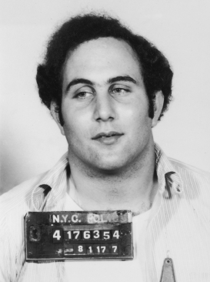
David Berkowitz “Son of Sam”
On Christmas Eve 1975, Berkowitz stabbed two women with a hunting knife; one was never identified, and the other one was a 15-year-old sophomore in high school, Michelle Forman. He stabbed her six times on a bridge near Dreiser Loop, but she survived after hospitalization.
This was an area that Berkowitz knew as he had lived in an apartment at Dreiser Loop from 1967 to 1971.
Between then and July 31, 1977 Berkowitz struck fear into New Yorkers, killing six people and injuring seven, using a .44 caliber Bulldog revolver.
Department of Criminal Justice
Notes:
Criminal profiling provides valuable insights into patterns and characteristics, narrowing down the suspect pool. However, it's important to note that profiling alone does not confirm or capture suspects. Good investigative work is still required for successful arrests. Let's explore how criminal profiling, combined with a stroke of luck, has led to the capture of notorious serial killers.

Slide 15
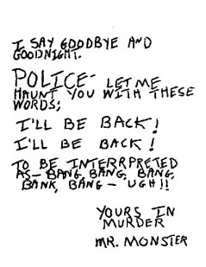
Berkowitz “Son of Sam”
Berkowitz strategically chose to communicate through letters, incessantly taunting the police and authorities.
In his letters, Berkowitz revealed chilling details about the crimes that had not been released to the public, creating a sense of urgency for his capture.
Profiling experts deduced that the writer of the letters was a shy, loner individual, likely a Caucasian man of the Catholic faith.
Department of Criminal Justice
Notes:
Criminal profiling provides valuable insights into patterns and characteristics, narrowing down the suspect pool. However, it's important to note that profiling alone does not confirm or capture suspects. Good investigative work is still required for successful arrests. Let's explore how criminal profiling, combined with a stroke of luck, has led to the capture of notorious serial killers.

Slide 16
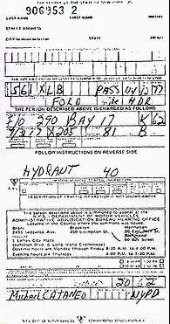
Berkowitz “Son of Sam”
A parking ticket on a car near Berkowitz's last shooting location provided a crucial lead for the authorities.
Neighbors, astutely observing Berkowitz's suspicious behavior, contacted the police, firmly believing that he matched the shooter's description.
Department of Criminal Justice
Notes:
Criminal profiling provides valuable insights into patterns and characteristics, narrowing down the suspect pool. However, it's important to note that profiling alone does not confirm or capture suspects. Good investigative work is still required for successful arrests. Let's explore how criminal profiling, combined with a stroke of luck, has led to the capture of notorious serial killers.

Slide 17
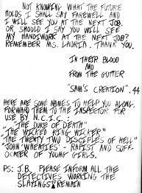
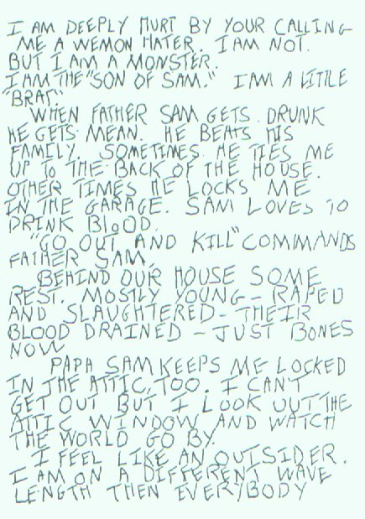
Berkowitz “Son of Sam”
Neighbors, astutely observing Berkowitz's suspicious behavior, contacted the police, firmly believing that he matched the shooter's description.
Department of Criminal Justice
Notes:
Criminal profiling provides valuable insights into patterns and characteristics, narrowing down the suspect pool. However, it's important to note that profiling alone does not confirm or capture suspects. Good investigative work is still required for successful arrests. Let's explore how criminal profiling, combined with a stroke of luck, has led to the capture of notorious serial killers.

Slide 18
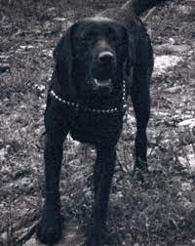
Berkowitz’s Neighbors
In 1976 Sam Carr, one of Berkowitz’s neighbors, received a letter that complained about his dog, Harvey, barking and Harvey was shot in September of 1976.
In 1977, another neighbor Jack Cassara received a get-well card from Sam Carr and his wife; however, Jack is not sick or injured.
Cassara and Carr determine that their letters and cards are written by Berkowitz, and Carr contacts the police to say that he believes Berkowitz is the Son of Sam killer. The police do nothing.
Department of Criminal Justice
Notes:
Criminal profiling provides valuable insights into patterns and characteristics, narrowing down the suspect pool. However, it's important to note that profiling alone does not confirm or capture suspects. Good investigative work is still required for successful arrests. Let's explore how criminal profiling, combined with a stroke of luck, has led to the capture of notorious serial killers.

Slide 19
Berkowitz’s Neighbors
On August 6, 1977, Glassman found a bucket on fire outside his door that was filled with gunpowder and .22 bullets . He files a complaint against Berkowitz and told some of his police force colleagues that he thought Berkowitz could be the Son of Sam.
Glassman was a 29 year old Westchester County auxiliary deputy sheriff and aided in Berkowitz’s arrest!
Department of Criminal Justice
Notes:
Criminal profiling provides valuable insights into patterns and characteristics, narrowing down the suspect pool. However, it's important to note that profiling alone does not confirm or capture suspects. Good investigative work is still required for successful arrests. Let's explore how criminal profiling, combined with a stroke of luck, has led to the capture of notorious serial killers.

Slide 20
Did Bundy and Berkowitz “Want” to get caught?
Toward the end of both Bundy and Berkowitz’s run of murders, there were a series of mishaps and missteps that made it easier for them to be caught. This leads to the myth that they “wanted” to be caught in order to “stop the killing.”
It is often referenced to Freud, and as Bonn (2014) notes, serial killers get better and bolder with their experience. One key point to this is that it takes time to get the experience to not be detected, and therefore they have to perfect their skills while avoiding mistakes. As they continue to kill, and avoid being caught they are more willing to take risks in their killing.
They began to believe they are invincible but as Bonn notes they “may become bored, reckless, or sloppy in their work and make mistakes that can lead to their apprehension” (2014).
Department of Criminal Justice

Slide 21
Berkowitz Profile
Due to the numerous psychologists/psychiatrists who were weighing in on the profile Berkowitz, the police issued the profile as follows,
“neurotic, schizophrenic and paranoid individual who might believe that he was suffering from a kind of demonic possession, … probably shy and odd, a loner inept in establishing personal relationships, especially with women” (Ewings, 2008, p. 41).
Brussel also noted that the individual most likely enjoyed “toying” with the police, and was certain that the killer would kill again rather than turn himself in or attempt to communicate with the police (Ewings, 2008, p. 41). They later suggested he was a “polite, very intelligent, probably college educated, worked days at a white collar job, and was likely a Catholic or Episcopalian” (Ewings, 2008, p. 42).
Department of Criminal Justice
Notes:
Criminal profiling provides valuable insights into patterns and characteristics, narrowing down the suspect pool. However, it's important to note that profiling alone does not confirm or capture suspects. Good investigative work is still required for successful arrests. Let's explore how criminal profiling, combined with a stroke of luck, has led to the capture of notorious serial killers.

Slide 22
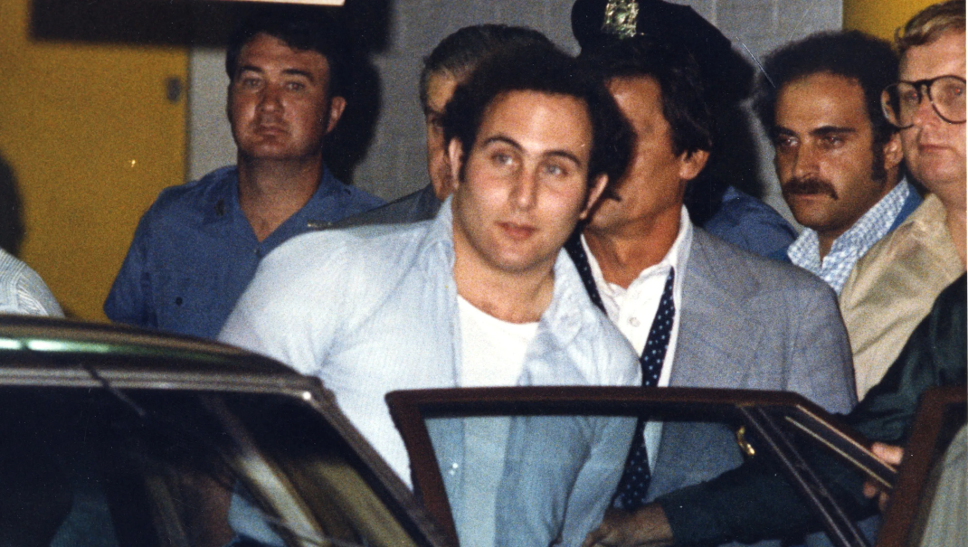
Berkowitz “Son of Sam”
After Berkowitz’s last shooting (July 31, 1977) the police were able to match the bullets and connect them to the same .44 caliber Charter Arms Bulldog. There were several witnesses, Cacilia Davis who was walking her dog. She also provided the information on the ticket writing police officer, Michael Cataneo. This lead to a ticket just before another shooting…which lead them to his Ford Galaxie, and his Yonkers address!
Department of Criminal Justice
Notes:
Criminal profiling provides valuable insights into patterns and characteristics, narrowing down the suspect pool. However, it's important to note that profiling alone does not confirm or capture suspects. Good investigative work is still required for successful arrests. Let's explore how criminal profiling, combined with a stroke of luck, has led to the capture of notorious serial killers.

Slide 23
Berkowitz’s Luck Ran Out
Berkowitz’s arrest was a good bit of luck. It was also some of his arrogance of writing letters to his neighbors, the police, and to the newspaper that allowed some of the pieces to fit together.
Additionally, the location of his car and the parking tickets which placed him in the area of the Moskowtiz, Esau, and Suriani shootings were fortuitous. This allowed for the police to search for his address.
If the dog walker, Cacilia Davis had not noticed the ticketing, and had not been out walking her dog during the time frame of that even recalling that she had seen the police officer giving out tickets.
In fact, a police officer who attended the Moskowitz funeral, Irving Levitan, said it would be something “silly” that would get him, like a traffic ticket (Sherman, et al., 1977). It seems that the Police Inspector Levitan knew that there were often pieces of evidence that were sheer “luck” that allowed them to capture offenders.
Department of Criminal Justice
Notes:
Criminal profiling provides valuable insights into patterns and characteristics, narrowing down the suspect pool. However, it's important to note that profiling alone does not confirm or capture suspects. Good investigative work is still required for successful arrests. Let's explore how criminal profiling, combined with a stroke of luck, has led to the capture of notorious serial killers.

Slide 24
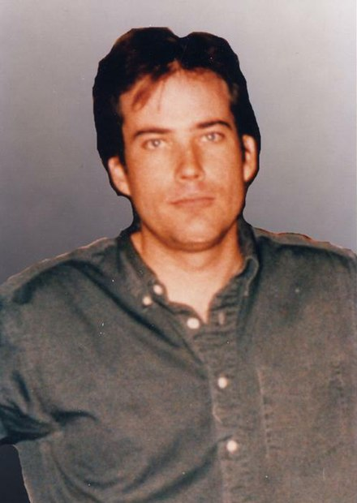
Eric Rudolph
Serial bomber (2 killed, over 100 injured)
Atlanta Olympic Park (1996)
Atlanta abortion clinic (1997)
Atlanta LGBTQ+ bar (1997)
Birmingham abortion clinic (1998)
FBI spent $24 million and 5 years searching for him in the North Carolina mountains
Department of Criminal Justice
Notes:
Criminal profiling provides valuable insights into patterns and characteristics, narrowing down the suspect pool. However, it's important to note that profiling alone does not confirm or capture suspects. Good investigative work is still required for successful arrests. Let's explore how criminal profiling, combined with a stroke of luck, has led to the capture of notorious serial killers.

Slide 25
Eric Rudolph
Captured on May 31, 2003, by a 21-year-old rookie police officer, Jeffery Postell.
Gave a false name (Jerry Wilson)
At the jail he finally confessed who he was
Department of Criminal Justice
Notes:
Criminal profiling provides valuable insights into patterns and characteristics, narrowing down the suspect pool. However, it's important to note that profiling alone does not confirm or capture suspects. Good investigative work is still required for successful arrests. Let's explore how criminal profiling, combined with a stroke of luck, has led to the capture of notorious serial killers.

Slide 26
Thank you!
Department of Criminal Justice
Notes:
Criminal profiling provides valuable insights into patterns and characteristics, narrowing down the suspect pool. However, it's important to note that profiling alone does not confirm or capture suspects. Good investigative work is still required for successful arrests. Let's explore how criminal profiling, combined with a stroke of luck, has led to the capture of notorious serial killers.

