Slide 1
Child Maltreatment and other Childhood Factors as a Significant Cause of Juvenile Delinquency
Destiny Gabriel
University of North Georgia

Slide 2
Understanding Juvenile Delinquency in the U.S.
72,822,113 (Juvenile Total)
7,632,470 (Total delinquency)
424,300 Arrests in 2020
2020 Statistics
Notes:
First we are going to want to understand juvenile delinquency as a problem
The following are statistics that will help to put into perspective the severity of the issue and the importance for a push for change
Total juvenile population which dictates that juveniles make up 1in 5 people in the US (0-17)
Second: 25% of that which stimulates from juveniles of the ages 15-17 years old
In 2020, law enforcement agencies in the U.S. made an estimated 424,300 arrests of persons under age 18, however 71% less than the number of arrests in 2011.

Slide 3
Common Offenses
Property Offenses
Status Offenses
Disorderly conduct/ Drug offenses
Theft
Shoplifting
Vandalism
Truancy
Curfew Violations
Runaway
Disturbances
Public Intoxication
Possession
Distribution
Notes:
-Property crimes can provide a sense of excitement and adventure for some juveniles. The act of committing a crime and avoiding detection can be appealing to those seeking thrills, allowing being destructive but not harmful.
-Adolescents are still developing their decision-making abilities and impulse control. They may not fully consider the consequences of their actions and may engage in property crimes on impulse.
- Drug offenses are one of the leading offenses among juveniles due to: Peer influence, and the use as a coping mechanism for underlying factors

Slide 4
Emergence of Juvenile Delinquency
Individual
Family
Peers
Notes:
Individual factors stemming from Psychological Factors such as mental illness
Family factors that emerge through Parenting and Family Dynamics, Family Dysfunction and parental bonding
Peer factors is often demonstrated through peer influence, however can also be shown after peer rejection

Slide 5
Demographics and Delinquency
Gender
Race
Age
15-17
Identity development
Peer pressure
Males vs. females
Socioeconomic inequalities
Bias in system
Limited access to resources
Notes:
-Adolescents, particularly those in mid-to-late adolescence (ages 15 to 17), are more likely to engage in delinquent behavior. This age group often faces challenges related to identity development, and peer pressure.
-Historically, males have been more likely to engage in delinquent behavior compared to females.
-Racial and ethnic disparities may result from various factors, including socioeconomic inequalities, bias within the justice system, and limited access to resources.

Slide 6
Factors Associated with Juvenile Crime
Low-income family status
Drug abuse
Poverty
Family violence
Notes:
-Low-income family status, drug abuse, poverty, unemployment, and family violence are all interconnected factors that can significantly contribute to juvenile delinquency.
-Low income: leads to stress and tension within household, use delinquency as a coping mechanism
-Drug Abuse: Increases the likelihood of impaired judgment and decision making
-Poverty: Lack of opportunities provides a negative outlet for youths struggling, Economic desperation
-Family Violence:Exposure to family violence can cause emotional trauma in children, leading to aggression, acting out, or other delinquent behaviors as a response to their traumatic experiences. “Monkey see, Monkey do”response.

Slide 7
Impact of Family Environment
Authoritative VS. Permissive parenting
Abuse
Neglect
Notes:
-The family environment has a profound impact on juvenile delinquency. The family is often considered the primary socialization agent, and its dynamics, relationships, and experiences significantly influence a young person's behavior and choices. Here are ways in which the family environment can impact juvenile delinquency:
-the absence of parenting or authority through permissive parenting provides juveniles unsupervised access to make impulsive decisions subject from environmental and peer influence
- Abuse and neglect are the maltreatments caused by family and peers that affect likelihoods of delinquency as coping mechanism
-

Slide 8
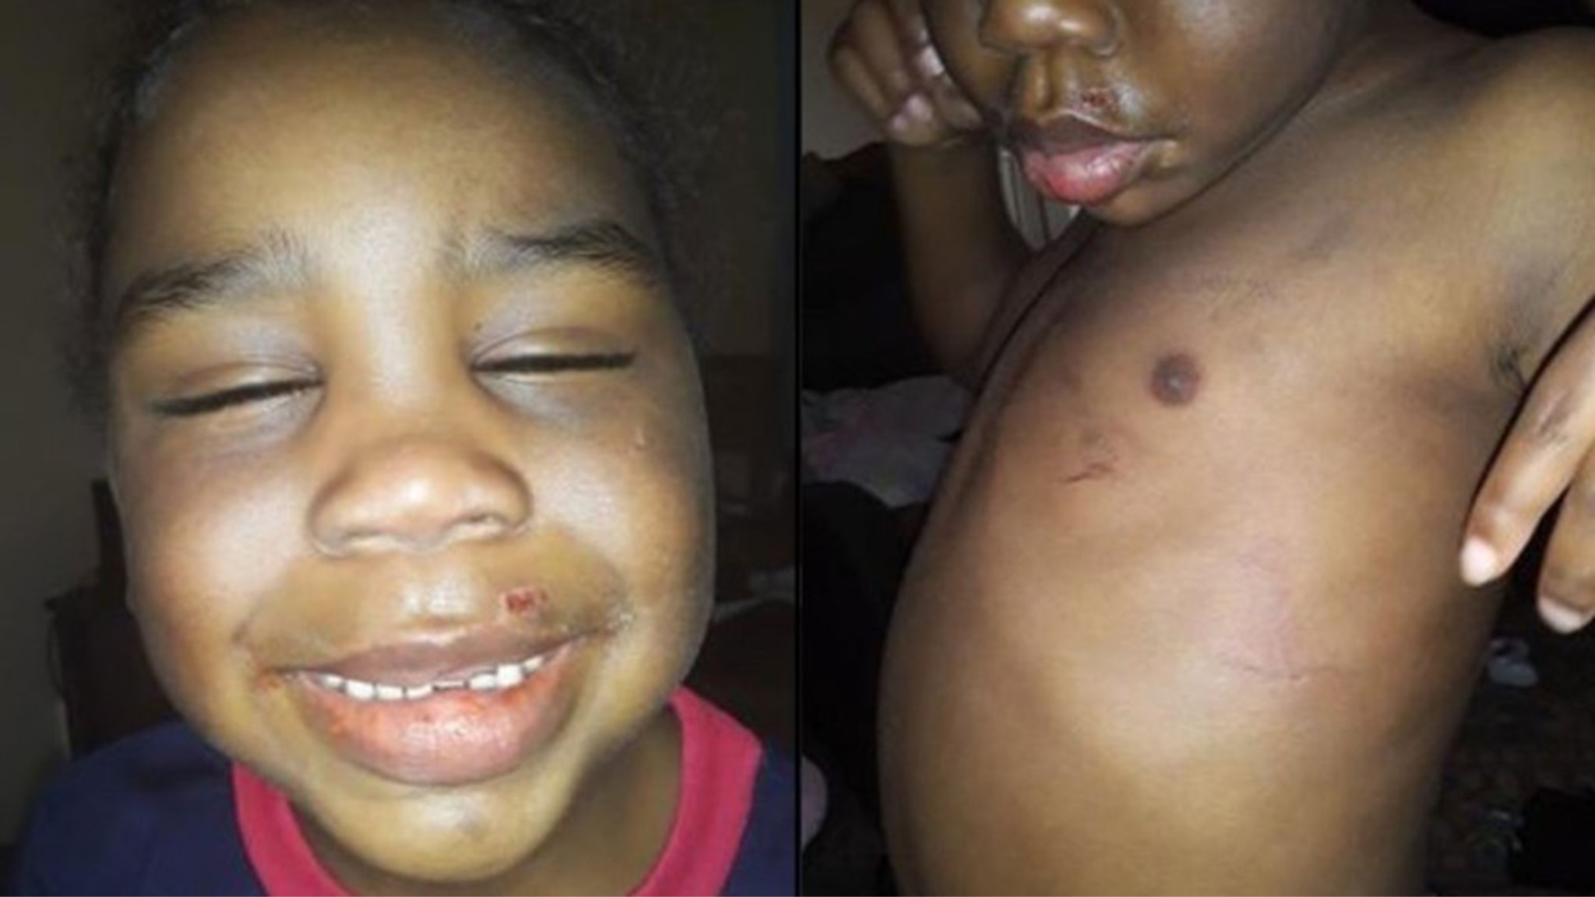
Abuse
Physical
Emotional
Sexual
Notes:
-Children who experience physical abuse may internalize aggressive behavior as a way to cope with stress and may use violence to resolve conflicts in the future, since they find it difficult to manage their emotions.
-such as criticism, belittling, humiliation, or rejection by caregivers. Juveniles acquire low self-worth and poor coping mechanisms, which may lead to delinquent behavior as an attempt to gain control or express frustration.
-non-consensual activities can result in impulsive coping strategies, such as engaging in risky sexual behaviors or forming unhealthy relationships, which can increase the risk of delinquency

Slide 9
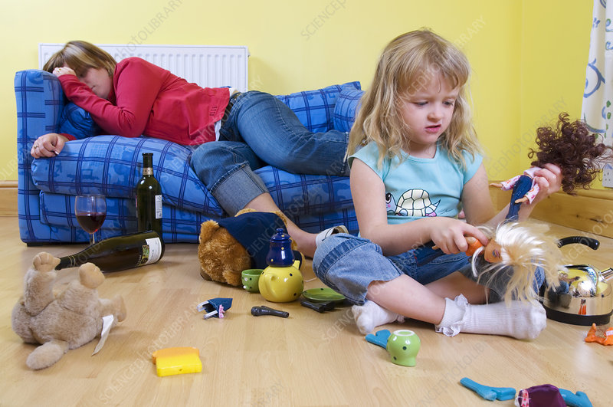
Neglect
Physical
Emotional
Notes:
expose children to delinquent peers and environments, making them more susceptible to engaging in delinquent activities to meet their basic needs or seek belonging.
may struggle with emotional regulation, forming healthy relationships, and developing empath, and can result in feelings of emptiness and isolation, which may drive juveniles to seek validation or connection in negative peer groups or through delinquent behavior.
And While maltreatment can increase the risk of delinquency, not all individuals who experience maltreatment will engage in delinquent behavior, it just makes them more susceptible to the delinquent behavior.

Slide 10
Family Interactions
Parent/ Child Bonds
Family Conflict Resolutions
Parental Supervision
Dysfunction
Notes:
-Family interactions play a crucial role in influencing juvenile delinquency.
-Bonds: Lack of a strong parent-child bond or feelings of rejection from parents can increase a juvenile's vulnerability to delinquency
-Conflict: Families that model constructive ways to address disagreements and conflicts can help juveniles develop similar problem-solving abilities.
-Supervision: inadequate supervision can create opportunities for juveniles to engage in delinquent activities
-Dysfunction: exposure to family dysfunction, such as substance abuse, domestic violence, or criminal behavior among family members, can increase the likelihood that juveniles will engage in delinquent activities as they may normalize such behaviors or be directly influenced by them. Again, “monkey see, monkey do”

Slide 11
Preventative Measures
Family Therapy
Mentoring Programs
School based Interventions
Mental Health services
Notes:
How do we fix this? How can we get ahead of the delinquency?
Early intervention is key in these instances to provide guidance while still in the developmental phase of adolescence
Family therapy, mentoring programs, school based interventions and mental health services to include substance abuse programs are highly recommended to provide A holistic approach that addresses the underlying causes and provides support and resources to at-risk youth is essential in reducing juvenile delinquency rates.

Slide 12
Conclusion
Crime association
Maltreatment
Family Interactions
Notes:
-Juvenile crime has been frequently associated with low-income family status, drug abuse, poverty, unemployment, and family violence. It is examined that different types of maltreatment, underlined by abuse and neglect, have been found to have a link to delinquent offending. The differences in adverse treatment within a child’s home life are the leading causes of susceptibility of juvenile delinquency. Additional factors associated with delinquency include demographics and other specific family interactions.

Slide 13
Works Cited
Asscher, J., Put, C., & Stams, G. (2015). Gender Differences in the Impact of Abuse and Neglect Victimization on Adolescent Offending Behavior. Journal of Family Violence, 30(2), 215–225.
Evans, C. B. R., & Burton, D. L. (2013). Five Types of Child Maltreatment and Subsequent Delinquency: Physical Neglect as the Most Significant Predictor. Journal of Child & Adolescent Trauma, 6(4), 231–245.
Kostyuk, M. F., & Kunts, E. V. (2022). The Impact of Deviant Behavior on Juvenile Delinquency: Current State of the Problem. Ius Humani, 11(1), 15–27.
Schwartz, I. M., Rendon, J. A., & Chang-Ming Hsieh. (1994). Is Child Maltreatment a Leading Cause of Delinquency? Child Welfare, 73(5), 639–655.
Stouthamer-Loeber, M., Wei, E. H., Homish, D. L., & Loeber, R. (2002). Which Family and Demographic Factors Are Related to Both Maltreatment and Persistent Serious Juvenile Delinquency? Children’s Services: Social Policy, Research & Practice, 5(4), 261–272.

