Slide 1
Analyzing the War on Drugs and its Effectiveness as a Global Campaign
Katie Colwell
University of North Georgia
Notes:
Hi, My name is Katrina Colwell and my research paper topic is Analyzing the War on Drugs and its Effectiveness as a Global Campaign.

Slide 2
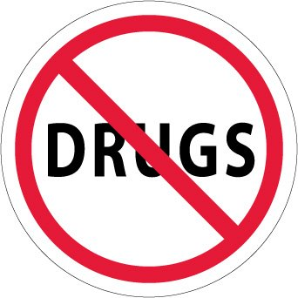
Introduction
There have been drug users and abusers since the beginning of human civilization.
The “War on Drugs” began in June 1971 when President Richard Nixon issued a public statement to the U.S. that drug abuse was “public enemy number one.”
The War on Drugs is a government-led initiative designed to stop the production, distribution, and consumption of illegal psychoactive drugs.
Notes:
By nature, almost all humans are psychoactive drug users, whether it be a cigarette, caffeinated soda, or a controlled substance you take for pain. There have been drug users and drug abusers since the beginning of human civilization. Because of this, policymakers have felt a need to try to control and regulate these psychoactive drugs. The “War on Drugs” began in June 1971 when President Richard Nixon issued a public statement to the United States that drug abuse was “public enemy number one.” The War on Drugs is a government-led initiative designed to stop the production, distribution, and consumption of illegal psychoactive drugs.

Slide 3
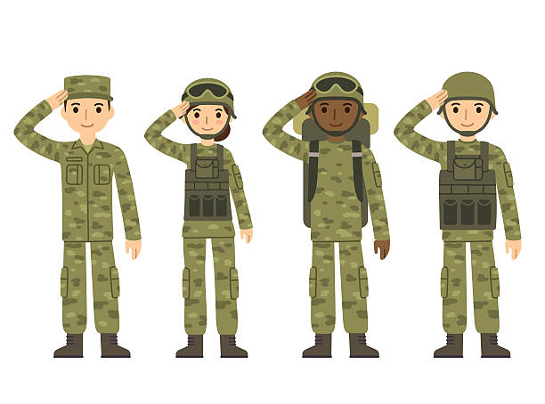
Introduction
“War on Drugs” is a global campaign that utilizes military intervention and increases mandatory minimum prison sentencing.
The campaign has been harshly criticized by the public, including claims that is has racial and political objectives and that it is overall ineffective (Doyle, 2018).
Notes:
The War on Drugs is a global campaign that utilizes military intervention and increases mandatory minimum prison sentencing for drug crime offenders. The campaign has been harshly criticized by the public, including claims that it has racial and political objectives and that it is overall ineffective.

Slide 4
Analyzing the War on Drugs
The drug war has been a controversial issue with mixed opinions and has left other countries feeling resentful with the supply and demand of drugs unchanged (Doyle, 2018).
President Bush and Reagan’s administrations focused primarily on military interventions for drug control.
The resulting effect was dispersed drug trade over wider territories and ultimately no change in the flow of drugs (Doyle, 2018).
Notes:
The U.S. drug war is a “war that has failed to live up to the promise of its proponents, and whose support among policymakers is broad but often shallow”. The drug war has been a controversial issue with mixed opinions and has left other countries feeling resentful with the supply and demand of drugs unchanged. With the focus of President Bush’s and Reagan’s administrations being primarily on military interventions for drug control, the resulting effect was only dispersed drug trade over wider territories and ultimately no change in the flow of drugs.

Slide 5
Analyzing the War on Drugs
The U.S.- Mexico border has been a primary focus and concern of the drug war.
Policies have been geared toward control of the supply and flow of drugs in the U.S.
The campaign has entailed supply side reduction strategies that are centered on eradicating the primary source or root of the drug problem.
Notes:
The U.S.- Mexico border has been a primary focus and concern of the drug war, while policies have been geared toward control of the supply and flow of drugs in the United States. The war on drugs campaign has entailed supply side reduction strategies that are centered on eradicating the primary source or root of the drug problem, focusing on efforts such as crop eradication, crop substitution, and treaty negotiations. However, “several scholars criticize these types of policies arguing that they are unable to effect prices reliably”.

Slide 6
Analyzing the War on Drugs
Bivariate analysis study results provide evidence of mixed success on the illegal drug market.
Many obstacles stand in the way of border control, such as drug trafficking networks that have many advantages, such as transnational connections and forces of the drug market on their side (Keck & Correa-Cabrera, 2015).
Notes:
Bivariate analysis research results provide evidence of mixed success on the illegal drug market. Many obstacles stand in the way of border control, such as drug trafficking networks that have many advantages, including transnational connections and forces of the drug market on their side.

Slide 7
Analyzing the War on Drugs
By focusing on eradicating crops and targeting drug cartels via military interventions, the drug war has lost sight on the influence of the market system (Sharpe & Spencer, 2001).
Creating and enforcing drug policies that place emphasis on controlling drug demand creates a black market (Sharpe & Spencer, 2001).
Government officials and policymakers need to have the correct focus in order to make progress.
Notes:
By focusing on eradicating crops and targeting drug cartels via military interventions, the drug war has lost sight on the influence of the market system. By creating and enforcing drug policies that place emphasis on controlling drug demand, it creates a black market which creates high profits for drug traffickers. If the policymakers and government officials had the correct focus on the proper area of concern, progress could be made. However, it seems as though some of the drug war policies have not only not been efficient in eradicating the drug problem in the United States, but have even intensified and made the drug problem worse.

Slide 8
War on Drugs
The drug war has cost over $1 trillion dollars and put millions of people in prison for casual drug use (Thompson, 2014).
Drug war policies are not only ineffective but have created harm to society.
Anti-drug campaign has been active in spreading misleading and misinformative information about drugs to society.
Thompson suggests that illegal drugs should be regulated like alcohol and tobacco instead of criminalized.
Results would be similar to that of other countries with liberalized drug policies (Thompson, 2014).
Notes:
The drug war has cost over $1 trillion U.S. dollars and put millions of people in prison for casual drug use. The drug war’s policies that are centered on control and criminalizing illegal drugs have not only been ineffective but have created harm to society. The U.S. government’s anti-drug campaign has been active in spreading misleading and misinformative information about drugs to society. According to an article by Glen Thompson, “the answer to the problem of drug use and abuse lies in liberalizing current drug policy while passing reasonable regulation and control”. Thompson suggests that illegal drugs should be regulated like alcohol and tobacco instead of criminalized. He claims the results would be similar to that of other countries with liberalized drug policies, such as reduced drug use and greater public revenue from taxes.

Slide 9
War on Drugs
The main underlying issue lies not in the policy details, but rather the foundation of the policies (Doyle, 1993).
Anna burke details many underlying ideas and policies regarding control and demand-reduction strategies
The war should focus on stabilizing other countries so the drug market is no longer a luring option.
Allegations that u.s. funds for the drug war have been misused by military personnel (doyle, 1993).
Most analysts agree the drug war has been a resounding failure (doyle, 1993).
Notes:
An article by Anna Burke on the U.S. drug war details many underlying ideas and policies regarding control and demand-reduction strategies. Overall, the main underlying issue lies in not the policy details, but rather the foundation that these policies are created from. Instead of focusing on eliminating the source of the drug problem in other countries, the drug war should be focused on investing in stabilizing other countries so the drug market will no longer be a luring option. There have even been allegations that U.S. funds for the drug war have been misused by military personnel in other countries, especially in Latin America. While policy schemes have been proven to be inadequate and poorly managed, most analysts agree that the drug war has been a resounding failure.

Slide 10
Conclusion
Many problems lie in the focus and foundation of the drug war campaign.
Popular opinion believes the war should shift its focus onto helping to stabilize other countries and to regulate drugs rather than criminalize them.
The drug market remains at the heart of the problem and should be a sincere focus of the global campaign.
Notes:
In conclusion, there are many problems and issues that lie within not just the details of the drug war’s policies, but also the focus and foundation of the campaign. Some of these issues revolve around the supply and demand focus of the drug war, and the inapt focus on eradicating the source of the drug problem. It is popular opinion that the drug war should shift its focus from these tactics onto helping to stabilize other countries and to regulate rather than criminalize illegal drugs. The drug market also remains at the heart of the problem and should be a sincere focus of the global campaign. To put it bluntly, “there is no way anyone can say that the war has been won, has been even moderately successful, or has even made [miniscule] progress”.

Slide 11
References
Burke, A. C. (1992). Between Entitlement and Control: Dimensions of U.S. Drug Policy. Social Service Review, 66(4), 571–581.
Doyle, K. (2018). Drug War: A Quietly Escalating Failure. NACLA Report on the Americas, 50(3), 313–317.
Keck, M., & Correa-Cabrera, G. (2015). U.S. Drug Policy and Supply-Side Strategies: Assessing Effectiveness and Results. La Política Antidrogas de Estados Unidos y Las Estrategias de Control de Oferta: Una Evaluación de Su Efectividad y Resultados., 10(2), 47–67.
Sharpe, K. E., & Spencer, W. (2001). REFUELED A DOOMED WAR ON DRUGS. NACLA Report on the Americas, 35(3), 21.
Thompson, G. O. (2014). Slowly Learning the Hard Way: U.S. America’s War on Drugs And Implications for Mexico. Norteamérica: Revista Académica Del CISAN-UNAM, 9(2), 59–83.

