Slide 1
Acworth, Georgia Home of Infamous Killers
Stan Crowder, Ph.D.
Kennesaw State University

Slide 3
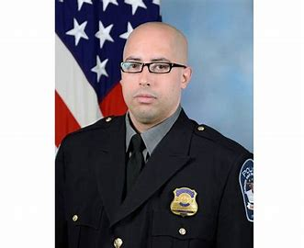
Matthew Lanz Austin Lanz

Slide 4
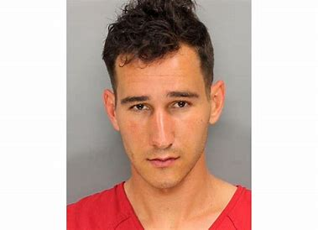
Austin Lanz – Killer Number One and the Oldest Son
August 3, 2021
Austin William Lanz, age 27, stabbed and killed Pentagon Force Protection Police Officer George Gonzalez at the subway station at the Pentagon.
Between 10:30 am and 10:40 am, twenty-seven (27) year old Austin Lanz exited a bus at the Pentagon Transit Center in Arlington, Virginia. He immediately and without provocation attacked Officer Gonzalez with a knife stabbing him in the neck
In the fight with Lanz, Officer Gonzalez was shot with his own service weapon. Lanz then turned the gun on himself. Other police officers apparently engaged Lanz.

Slide 5
Matthew Lanz – Accused Killer Number Two the younger brother
November 17, 2021, Matthew Lanz is accused of murdering 31-year-old Timothy Justin Hicks and his wife, 31-year-old Amber Hicks.***106-days after his brother killed Officer Gonzalez***
Both victims were found dead from gunshot wounds in their home in Acworth, GA.
November 18, 2021, Matthew Lanz allegedly stabbed a Sandy Springs (GA) Police Officer that was responding to a burglary in progress call.

Slide 6
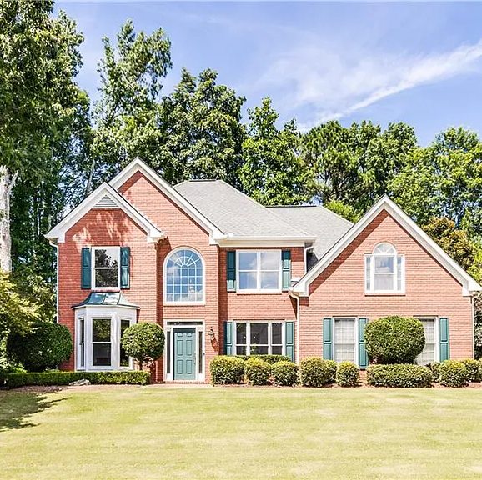
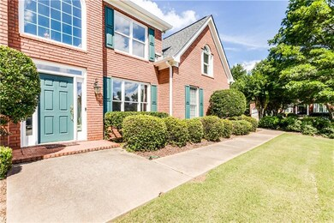
The House: 5059 Verbena Dr. NW, Acworth, GA
GPS = 34.066354, -84.566820

Slide 7
WHAT IS IT About this House? Austin LANZ
July 19, 2020: Cobb County Police Department (CCPD) Officer Schweitzer filed a report that complainants Phillip Brent and Eliza Wells found pornographic pictures, messages, and “odd items” in their mailbox and by their garage.
Evidence from the NEST cameras showed Austin Lanz dropping off items at 0130 hours.
Initially denying the incident, Austin admitted it was him after being shown photos.
Officer Schweitzer also noted a previous incident and report case number 20-031920, but this report was NOT provided by CCPD.

Slide 8
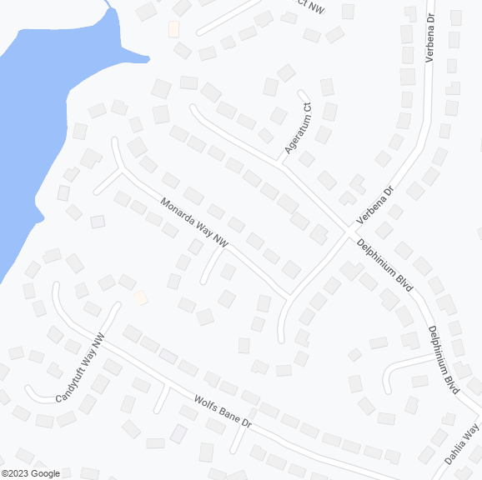
WHAT IS IT About this House? Austin LANZ
April 18, 2021: 0018 hours. CCPD Officer Welch and Officer Daley reported that complainant Phillip Brent again had video evidence of Austin Lanz walking around his property and placing something in the Brent mailbox.
Lanz was found in front of his home, 600 Delphinium Blvd. He was given a trespass warning by Officer Daley.

Slide 9
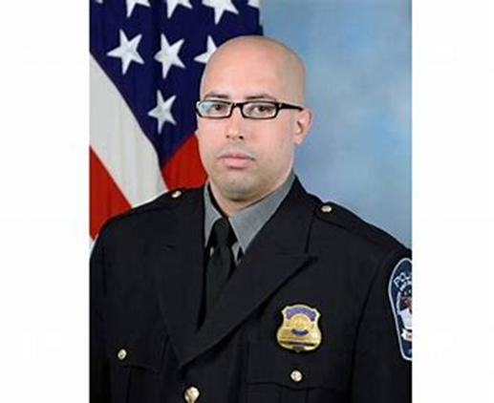
WHAT IS IT About this House? Austin LANZ
April 24, 2021: Officer Loveleady, CCPD, arrested Austin Lanz for Criminal Trespass Entering the Premise of Another and Burglary First Degree on Warrant Number 21-W-3472 with the original CCPD case number 21-031644. The location of the arrest was Lanz home, 600 Delphinium Blvd., Acworth, GA.
Location of the trespass and burglary cannot be documented, but it is assumed to be 5059 Verbena Dr. NW (the Brent residence).
Because these charges were never adjudicated, the report will not be released.
On August 3, 2021, Austin Lanz killed Pentagon Police Officer George Gonzalez and took his life.

Slide 10
WHAT IS IT About this House? Matthew LANZ
November 17, 2021, 1900 hours (7 pm) to November 18, 0934 hours (9:34 am)
Matthew Lanz forcibly entered 5059 Verbena Drive, Acworth, GA, and shot Timothy Justin Hicks multiple times with a firearm and killed him.
Matthew Lanz also shot multiple times and killed Amber Michelle Hicks.
Matthew Lanz was also charged with 2-counts of Aggravated Assault Weapon, Burglary-Home Invasion 1st degree, and Possession of Firearm during commission of a crime.

Slide 11
The Trek Continues
F.B.I. Challenges
Release of Records – Cobb DA Office
Interview with the Dentist
Interviews with Parents…
Thanks for your interest. Maybe more next year.

