Slide 1
Relationship between Family Violence and Juvenile Delinquency
Camila Colman

Slide 2
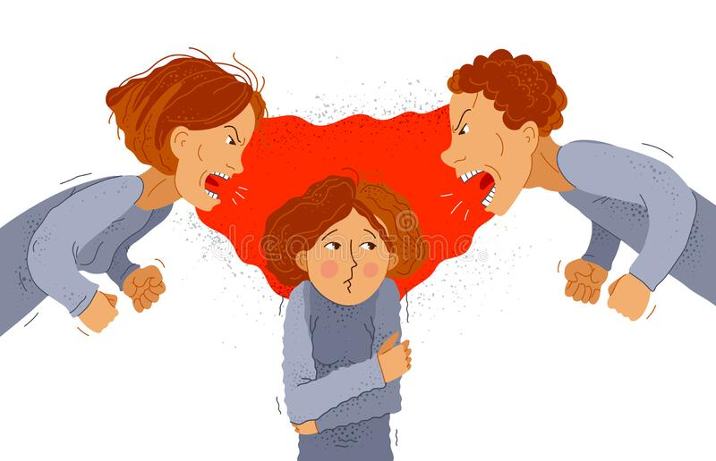
Social Learning Theory
What is this Theory?
What does it Explain?
Children learn to be aggressive and or are taught to be aggressive by mimicking and observing role models
This theory explains the intergenerational violence concept which is the passing down of aggression from parent to child to future relationships leading to dating violence

Slide 3
Study Using Empirical Testing
This study researched the exposure to mother’s verbal conflict with her intimate partner and aggressive behavior of urban adolescents using General Strain Theory
Based on the statistical testing we see statistically significant relationship between indirect effects of family violence and emotional distress when it comes to youth aggression. An example of this would be parents fighting even if the violence is not directly towards the adolescent it can still push the individual toward aggression and potential criminal activities (Hong et al.).
They found that exposure to verbal conflict between the mother and her intimate partner was not directly associated with youth aggression. This was interesting because there were other covariables that affected this such as age, sex, race, two-parent family and receiving free lunch.
Meaning the stressors of having violence in the home can be complex can be due to many factors
The research proposed more research on the relationship between strain and behavioral outcomes with consideration to biological and psychological factors.
Notes:
Limitations to the study were: only using black youth

Slide 4
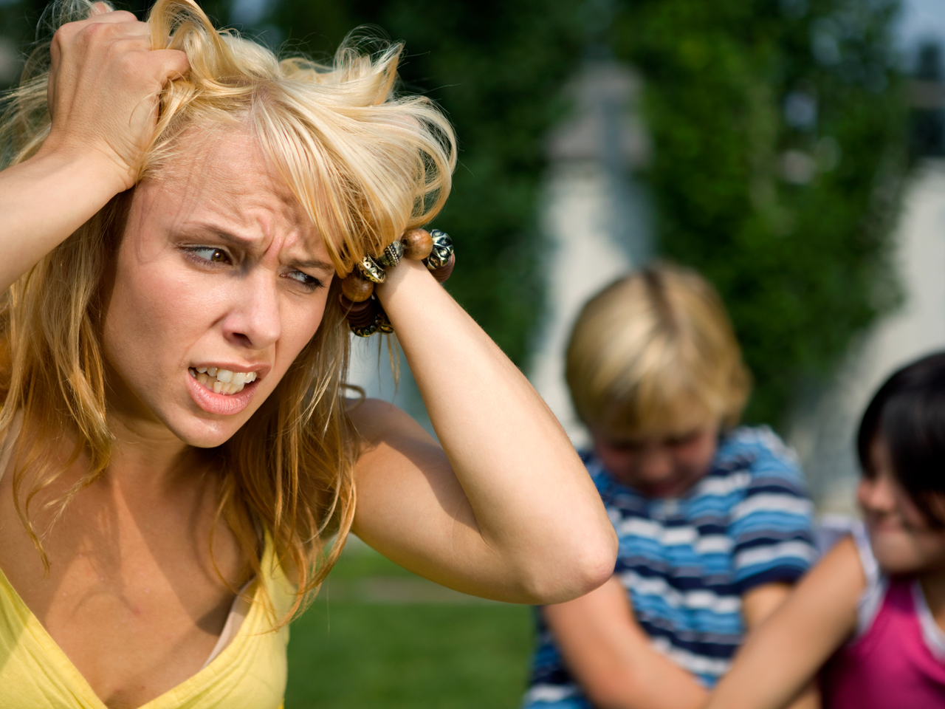
General Strain Theory
What does it Explain?
What is this Theory?
Strain and conflict in social relationships and events can result in feelings of anger frustration and distress which then pushes individuals to participate in delinquent acts.
Explains the development of adolescent delinquent behaviors, including aggression.

Slide 5
Long-term effect of childhood exposure to intimate partner violence: Externalizing Behaviors in Males and Females
This study looks at the effects of partner violence against children and adolescents.
Two groups the IPV-exposed group and non-IPV exposed group
This study recognizes that while a child may react to certain external behaviors with resilience there are those who have long-term impacts from the exposure to violence
The IPV group who was exposed to violence are at a greater risk of internalizing and externalizing problems and that the risk of males is greater as compared with females
This group engages more in severe forms of intimate partner violence in adulthood.
This study also mentioned that environment alone is not the sole factor there are genetic factors that are in play.

Slide 6
Impact of partner violence on female delinquency
A sample of 94 women were very diverse because they interview women from many different countries and 81 were in prison.
Two main categories were found:
Affective bonds with the partner: escape bonds, emotional dependence, economic dependence, positive bonds
gender violence: direct violence, structural violence and symbolic violence
Findings: affective bonds and gender violence interact with one another resulting in female delinquency.

Slide 7
Cont.
Escape bonds:
All the stories refer to having suffered gender or domestic violence
“¿Qué creo que llevó a cometer el crimen? Salí de la casa de mis padres con él (ex esposo) y no por amor sino para escapar de mi madre, de sus maltratos y luego me escapé de él y me metí en esto (el crimen)
Emotional Dependence: One the characteristics of gender violence is the emotional manipulation that generates a strong emotional dependence in the woman on her aggressor. The same interactions between parents and children from an early age become an educator in such dependence
“ Pues yo seguia con el porque no queria estar sola, eso era muy extrano por que nos dejabamos y luego volviamos. Asi lo hicimos durante anos y yo no me aguantaba que me humillara, me pegara…., por que pues finalmente… el hacia compania y cuando queria portarse bien, pues lo hacia.
This was a mexican women who was expressing her experience with violence from her partner. This emotional dependence was loaded with previous issues of failure and abandonment that made her vulnerable to other types of violence or social reactions.

Slide 8
Cont.
Economic Dependence: “Eramos tan pobres que nos tocaba conformarnos con lo que el trajera. A mi lo unico que me importaba era que a mis hijos no les faltara la comida, si ellos comian, aunque fuera un pan con aguapanela… A mi toco soportar muchas cosas con el, pero pues el era el que llevaba la remesa a la casa. “

Slide 9
Importance and Policy
Social Learning Theories and its impact on adolescence relationships, and how General Strain Theory explains the negative behaviors of parents and juveniles later on in life. There should be more research on the influence of genetics in regards to social learning theory and general strain theory.
Parent- child parenting classes
After school programs Better training in school for signs of abuse
Emotional Regulation tactics in schools

