Slide 1

The Importance of Operational Definitions in Criminal Justice Research
Matilda Foster

Slide 2

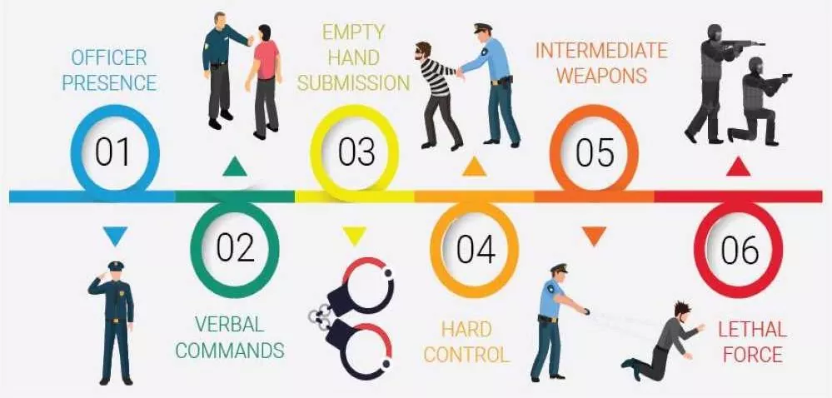
Concept of force:
  Something that causes a change in motion, activity, or change.
Most police-citizen interactions include some form of force

Slide 3

Measuring Use of Force
What would happen if we conducted a study operationalizing officer use of force as officer presence?
Force as verbal commands:
  Coercive Actions
    Ordering citizens to do something (Alpert & Dunham, 1997)
    Shouts or using a command voice (Garner et al., 1995)
Empty Hand Submission:
  Soft Hands (Alert & Dunham, 1997)
    Pat downs
    Handcuffs
  Hard Hands
    More than restraints and pat downs (Terrill, 2001)
Less Lethal & Lethal Force
Actions that makes a citizen feel threatened or if the police use physical force.

Slide 4

Recidivism
“The reversion of an individual to criminal behavior after he or she has been convicted of a prior offence, sentenced, and (presumably) corrected” (Spohn & Holleran, 2002, p. 332).
  re-arrest
    First new arrest after release (Dean, Brame, & Piquero, 1996)
    First arrest or parole revocation after release (Bulmsten & Nakamura, 2009)
      People arrested are not always convicted
  re-conviction
    A guilty finding (Bushway, Piquero & Blokland, 2011)
    Adjustments to probation/ parole requirements
    Not all e-convictions result in re-incarceration
  re-incarceration (Lattimore & Baker, 1993)
  Minor Traffic instances? Affrays?
    These are not standardized
    Studies show Measurements of recidivisms so little differences in study results

Slide 5

Trust & Confidence in the Police
Trust
Confidence
Helpful
Safer
Avoid
Directions
Solve Crime
Respond
Good job
Community Problems

Slide 6


Slide 7
Media
Internet
Paper Media
Radio
TV News
Dramas
Reality Shows
Movies
Social Media
YouTube

Slide 9

Questions?

Slide 10

References
Alpert, Geoffrey P. and Roger G. Dunham. 1997. The Force Factor: Measuring Police Use of
Force Relative to Suspect Resistance. Washington, DC: Police Executive Research Forum.
Garner, J. H., Schade, T, John Hepburn, J, & Buchanan, J. (1995). “Measuring the
Continuum of Force Used By and Against the Police.” Criminal Justice Review 20:146–68.
Terrill, W. & Reising, M. D. (2003). JOURNAL OF RESEARCH IN CRIME AND DELINQUENCY, (40) 3, 291-321.
Dean, C. W., Brame, R. & Piquero, A. R. (1996). Criminal propensities, discrete groups of offenders, and persistence in crime. Criminology, 34(4), 547-574.
Blumstein, A., & Beck, A. J. (2005). Reentry as a transient state between liberty and commitment. In Allen, J., & Visher, C. (eds.), Prisoner Reentry and Crime in America, pp. 50-79. New York: Cambridge University Press.
Bushway, S. D. Piquero, A. R., Broidy, L. M., Cauffman, E., & Mazerolle, P. (2001). An empirical framework for studying desistance as a process. Criminology, 39(2), 491-513.
Lattimore, P. K., & Baker, J. R. (1993). The impact of recidivism and capacity on prison populations. Journal of Quantitative Criminology 8(2), 189-215.

