Slide 1
The History, Evolution, & Impact of the Opioid Crisis
Jon Hager & John Stuart Batchelder
University of North Georgia

Slide 3
History of the Opioid Crisis
1. 1990s:
Big Pharma convinced medical community opioids not being addictive, prescribed more
2. 2017:
U.S. Department of Health and Human Services declared public health emergency

Slide 4
CDC (2021)

Slide 5
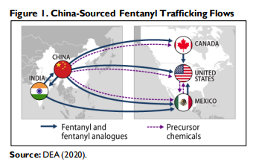
History of the Opioid Crisis (con’t)
3. Present
Fentanyl

Slide 6
Illicitly Manufactured Fentanyl (IMF) Powder vs. Liquid
CDC (2022)

Slide 7
Rainbow Fentanyl
DEA (2022)

Slide 8
Fentanyl Seizures
U.S. Customs and Border Protection (2022)

Slide 9
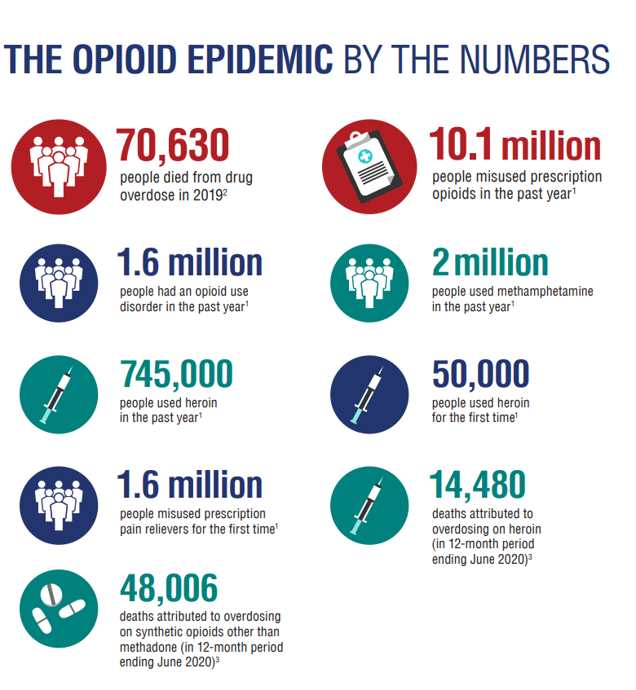
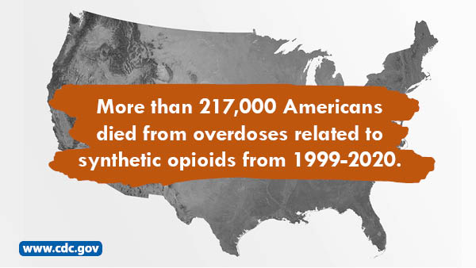
The Numbers
HHS (2021)

Slide 10
CDC Dashboard
https://www.cdc.gov/drugoverdose/nonfatal/dashboard/index.html

Slide 11
CDC 5-Prong Approach
1. Monitoring Trends
2. Equipping communities with resources for data collection
3. Educating the healthcare system
4. Partnering with LE and community organizations
5. Increase public awareness

Slide 12
Solutions?
1. Prescription Monitoring Program
2.
3. S.3959 — 117th Congress (2021-2022)
Sen. Bill Hagerty (R-TN), March 30, 2022
Authorizes HHS to restrict migration & imports from foreign countries
4. Naloxone Vending Machines
HHS (2019)

