Slide 1
The Four-Year Police Academy:
An Examination of Attrition Rate Patterns in the University of North Georgia’s Public Safety Academy
Dr. Butch Newkirk, Director
Dr. Stu Batchelder
Elisabeth Edler
University of North Georgia
Public Safety Academy
October 2022

Slide 2
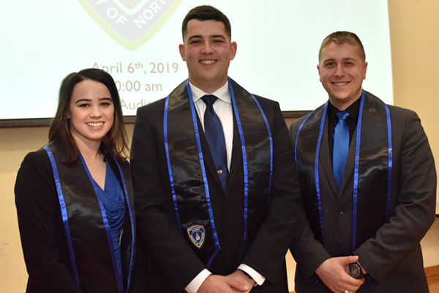
Background
The University of North Georgia’s Public Safety Academy (PSA) was established in 2015 as the United States’ first-ever, four-year police academy
Different than the traditional twelve-week police academy model
The University of North Georgia PSA’s first graduating class
October 2022

Slide 3
Research Problem
Research Questions
How do PSA graduation and attrition rates compare to their traditional police academy counterparts in the State of Georgia?
How can the PSA address and improve its retention rates?
Are there any factors that specifically contribute to attrition rates in the four-year pole academy model that have not been previously identified as withdrawal factors within traditional police academies?
There are no established data on PSA graduation rates, comparisons between the PSA and traditional academies, or confirmed attrition factors that are specific to the higher education environment of the PSA
WHY IS THIS IMPORTANT?
Establishing data on the PSA provides the framework for future practical applications and research in the field of law enforcement.
October 2022

Slide 4
Compile and compare PSA graduation rates to traditional academies
Proposed Solutions
Identify if there are any attrition factors specific to the four-year model
WHAT I WANT TO ACHIEVE
Make recommendations for how the PSA can address attrition factors
October 2022

Slide 5
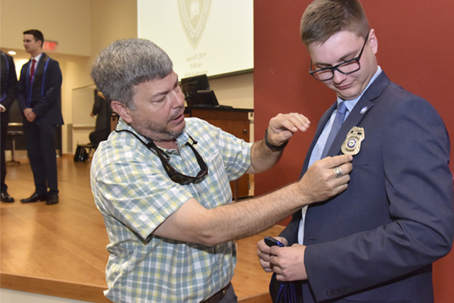
Significance of the Study
First empirical data collected on the four-year police academy model
Practical applications in the future establishment of other four-year police academies
October 2022

Slide 6
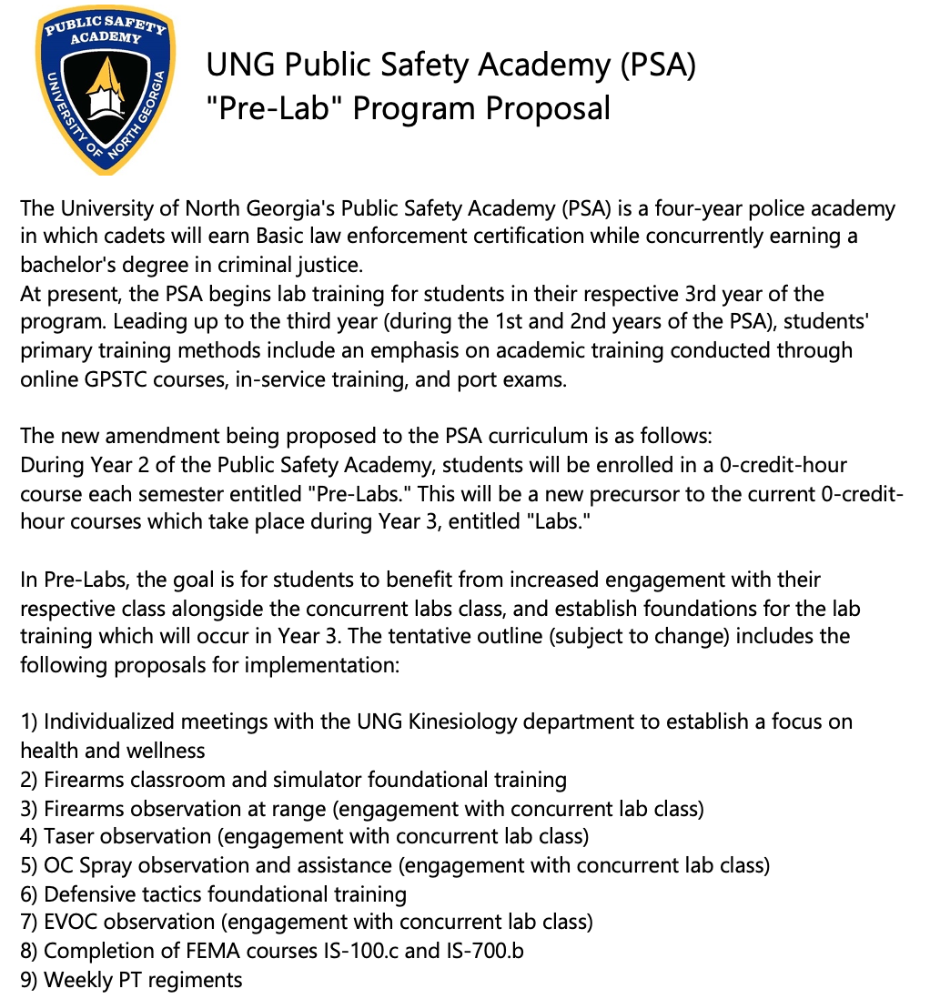
Survey Distribution
Mixed-Methods
October 2022
THESISDEFENSE

Slide 7
The “Pre-Lab” Proposal
A CURRICULUM MODIFICATION TO ADDRESS ENGAGEMENT AND COMMUNITY IN YEAR 2 OF THE PSA
ENGAGEMENT
COMMUNITY
SUPPORT
Subjects were asked if the proposed curriculum modification would increase their engagement levels in the PSA.
Subjects were asked if the proposed curriculum modification would increase their sense of community in the PSA.
Subjects were asked if they would support the proposed curriculum modification in the PSA.
LIMITATIONS WITH INITIAL SAMPLE POPULATION:
Low anticipated response rate
Access to contact information
APRIL 2022
THESIS DEFENSE

Slide 8
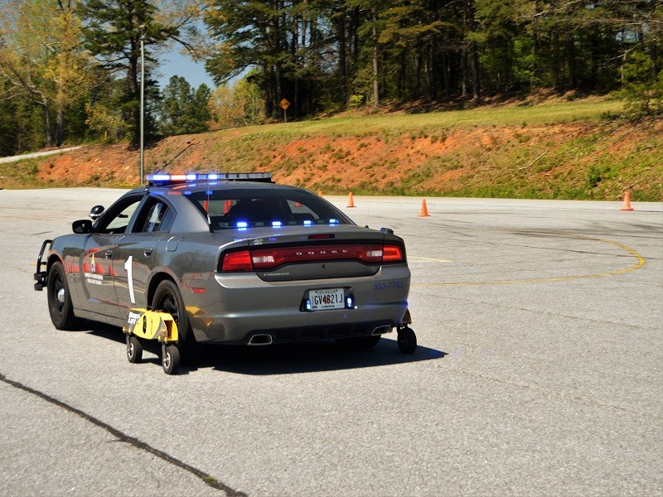
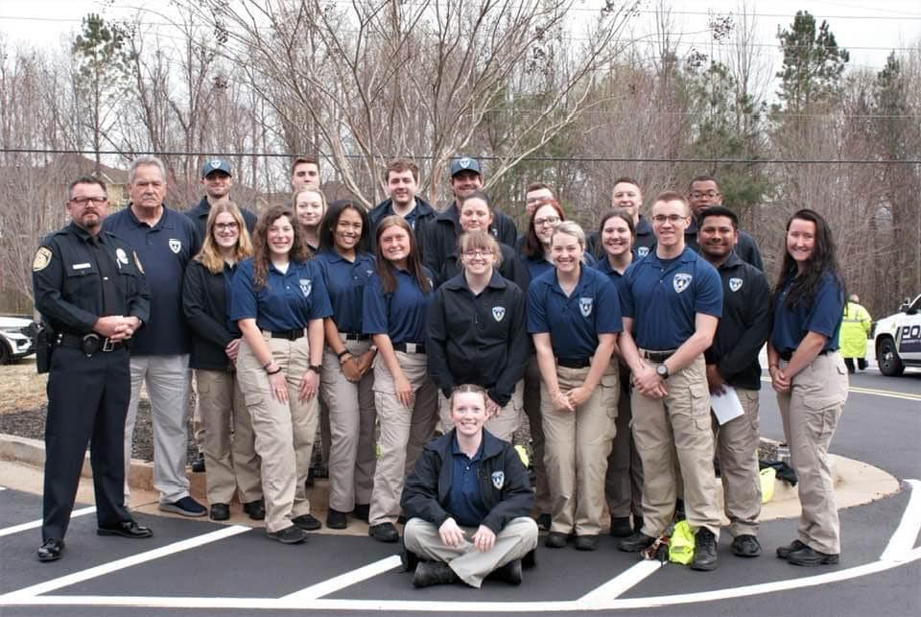
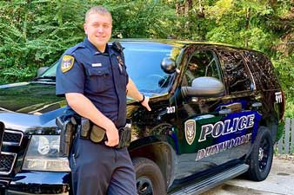
Research Participants
SUBJECTS OF THIS STUDY
Voluntarily Withdrawn Students
Current Members
PSA Graduates
APRIL 2022
THESIS DEFENSE

Slide 9
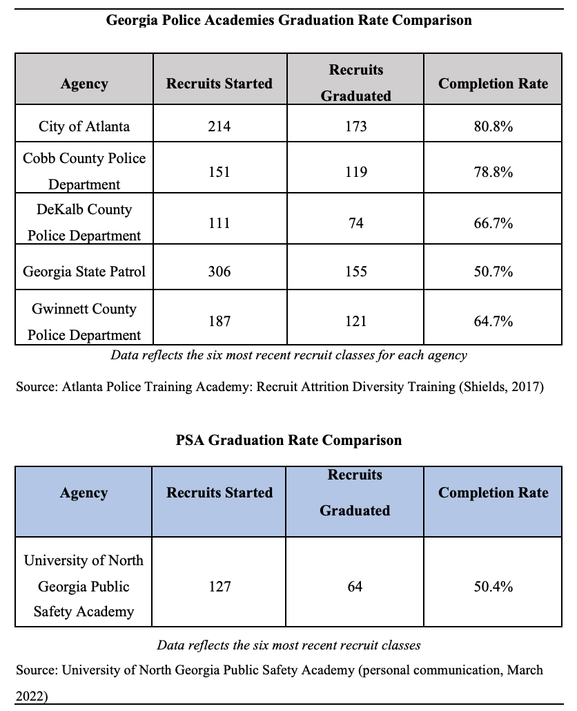
How do PSA graduation rates compare to traditional police academies?
The top chart depicts the graduation (completion) rates of six recruit classes from five metro-Atlanta police academies.
Recruits Graduated / Recruits Started = Completion Rate
The PSA’s six graduated classes were used in comparison
PSA graduation rate: 50.4%
October 2022

Slide 10
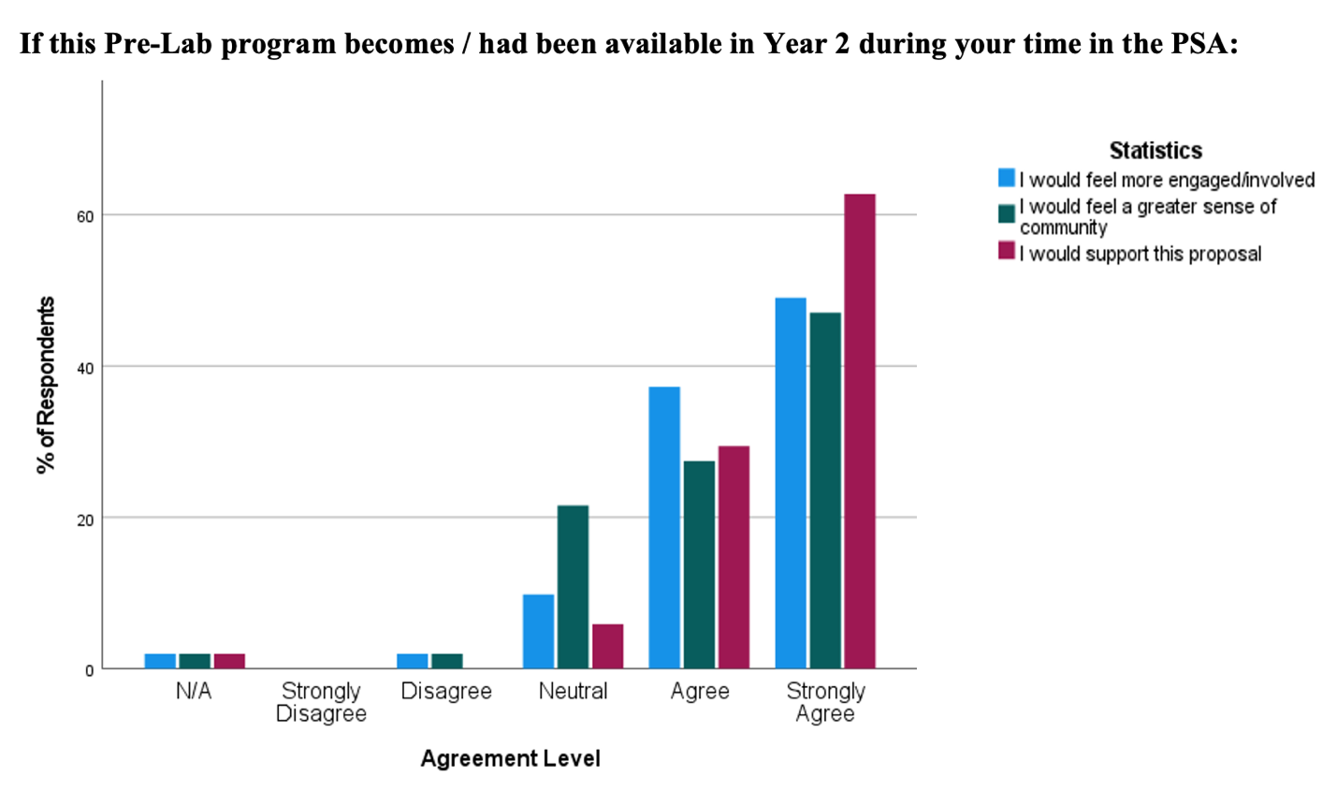
How can the PSA address and improve its retention rates?
All three sample populations indicated that:
The proposed program would make them feel more engaged
The proposed program would give them a greater sense of community
They would support this proposal
October 2022

Slide 11
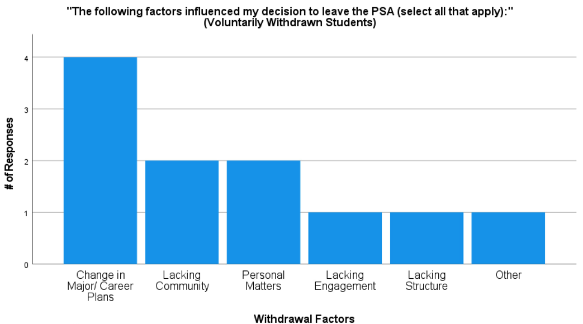
Are there any attrition factors that are specific to the PSA?
Low response rate
Students who had voluntarily withdrawn indicated that a change in academic major/ career plans, lacking community, and personal matters were the highest influences in withdrawal decisions
Not generalizable
October 2022

Slide 12
Study highlights
UNCOVERED KEY RESEARCH TRENDS
The environment of higher education facilitates a police academy training environment different than a traditional academy
Engagement and a sense of community are important in this environment
Significant discovery
NEW UNDERSTANDING OF THE PROBLEM
Voluntarily withdrawn students, current students, and PSA graduates largely support a curriculum modification designed to increase levels of community and engagement
Interpretation
of findings
AGREEMENTS & DISAGREEMENTS WITH HYPOTHESIS
The PSA has statistically lower graduation rates than traditional academies
However, these lower rates may be indicative of the specific environment in higher education
October 2022
THESIS DEFENSE

Slide 13
Implications of the research
PRACTICAL APPLICATIONS AND ADVICE
A curriculum modification that targets increased levels of community and engagement is consistent with literature in higher education
It is also supported by all three sample populations
Future four-year police academies are able to build upon the research done at UNG
Areas of improvement
NOTES FOR FUTURE RESEARCH
Further research on engagement and community levels in the PSA is necessary
Exit surveys conducted upon departure from the PSA (and any future four-year academies) would provide valuable attrition data
Non-institutional contact information gathered upon entry and exit from the program increases potential sample size
Generalizability: larger sample sizes are needed
APRIL 2022
THESIS DEFENSE

