Slide 1
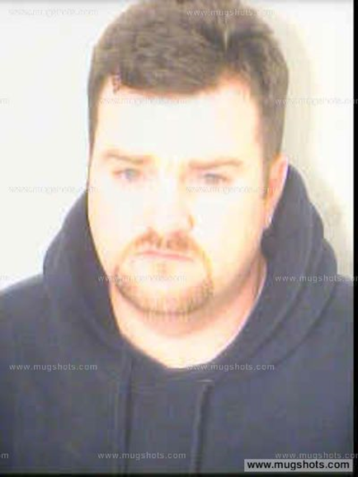

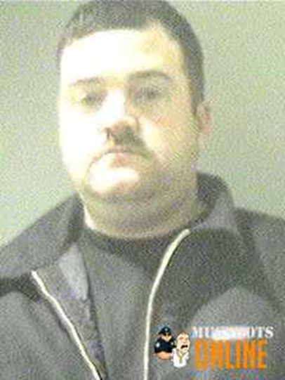
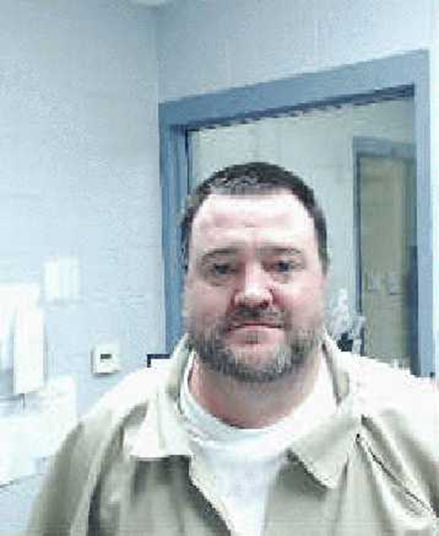
The Dressler Case Study:
A Career Criminal
Stan Crowder, Ph.D.
Associate Professor of Criminal Justice
Kennesaw State University

Slide 2

The Dressler Case Study: A Career Criminal
The Basics
Kevin Andrew Dressler
Date of Birth: August 26, 1972 – now 50-years old
Adopted August 1972 by Richard and Judy Dressler within days
No known information on biological parents
Attorney that handled the adoption is in Witness Protection Program
According to Richard Dressler – “Nothing – not a serious scolding nor a positive incentive…affected him.”
At age 15, Kevin became distant, disrespectful, angry, and running with the wrong crowd…

Slide 3
The Dressler Case Study: A Career Criminal
“With an IQ of 170, Kevin had the capacity to pursue any field he desired.”
Kevin attracted plenty of friends as an attention lover and manipulator,” (p.46).
Richard Dressler does not explain when Kevin’s intelligence quotient was tested or how he knows Kevin has an I.Q. of 170.
An IQ score of 170 implies a genius and in the top 0.1% of the population. No evidence of this IQ.

Slide 4
The Dressler Case Study: A Career Criminal
At age 15, Kevin became distant, disrespectful, angry, and running with the wrong crowd (R. Dressler, p.77); yet Kevin’s parents felt “his demeanor seemed typical of a teenager to us,” (p.79).
When Kevin’s “wholesome circle of friends turned into a gang of teens who went looking for trouble…Cobb County police officers were standing on my porch displaying a warrant for Kevin’s arrest,” (p.79). “Kevin and his friends had burglarized some area homes. Kevin had a gun in his possession a felony charge that carried a twenty-five-year jail sentence. He was seventeen years old…” (p. 80).
And so begins the life of a career criminal.

Slide 5
The Dressler Case Study: A Career Criminal
The early criminal career of Kevin Dressler is confusing, in that, records available and Richard Dessler’s book do not match.
Dressler’s book notes the arrest for burglaries at age 17 (Kevin was born in 1972) for Kevin Dressler which would make the crimes occurring in 1989 or 1990, but it appears the arrest and conviction for the crimes was August 1992.
Richard Dressler does not comment on the crimes and arrests of Kevin Dressler in 1990 and 1991.
Tracking information on Kevin Dressler included Federal Bureau of Investigation (FBI) Number: 57740NA5 and his state identification number 01683805E from the Department of Corrections.

Slide 6
The Dressler Case Study: A Career Criminal
Chronological Listing of Kevin Andrew Dressler - Career Criminal
Date | Crime | Action | Other Information
August 21, 1990 (almost 18 yoa) | Theft by Conversion | Arrest | Warrant 90W8976
September 17, 1990 | Entering Auto (3-counts) | Arrest-Marietta P.D. | Warrant Number 90W11777- Judge Chesbor
March 27, 1991 | Alcohol- Minor Possession | Arrest | Case appears to have never been adjudicated.
July 5, 1991 | Burglary | Suspect/Arrest | Victim- Richard M. Dressler
July 19, 1992 | Burglary | Suspect/Arrest | November 25,1992 Arrest
July 25, 1992 | Burglary | Suspect/Arrest | November 25,1992 Arrest
July 26, 1992 | Burglary | Suspect/Arrest | November 25,1992 Arrest
August 1, 1992 | Burglary | Suspect/Arrest | November 25,1992 Arrest
August 1, 1992 | Entering Auto | Suspect/Arrest | November 25,1992 Arrest
August 11, 1992 | Burglary | Suspect/Arrest | November 25,1992 Arrest
November 12, 1992 to September 4, 1997 1757- days incarcerated | Incarceration for 5-counts of burglary | Inmate- Georgia Department of Corrections | Warrant Numbers: 92-W-13563,13564,13565,12373, & 91-0864/91-9-0684-22 (Violation of Probation). Sentenced to 20-years with 15-years to serve and 5-years of probation. Time Served: 4-years and 297-days.

Slide 7
The Dressler Case Study: A Career Criminal
September 14, 1998 | Parole Violation | Arrest | Note about 1-year after release from prison.
May 26, 1999 | Warrant from Henry County for Fraud. Warrant from Roswell for Failure to Appear | Arrest | Neither the case in Henry County or the City of Roswell appears to have been adjudicated. No records were provided by Henry County or City of Roswell.
June 18, 1999 | Suicide | Witness | Dressler was only person with the victim when the incident occurred.
June 20, 1999 | Burglary | Suspect/Arrest
July 11, 1999 | Burglary | Suspect
July 13, 1999 | Theft by Taking | Suspect/Arrest
July 13, 1999 | Obstruction of an Officer, Theft by Receiving Stolen Property (2-counts), Burglary, and Violation of Probation | Arrest | Warrant numbers include: 99-w-7867, 99-w-8315, and 92-4018-22.
July 7, 2000 | Failure to Appear | Arrest | Note about 1-year from previous arrest.
January 8, 2001 to April 29, 2003 750-days incarcerated | Incarcerated | Inmate- Georgia Department of Corrections | This incarceration appears to be for violation of parole and or probation.

Slide 8
The Dressler Case Study: A Career Criminal
February 10, 2004 to December 28, 2004 320-days incarcerated | Incarcerated | Inmate- Georgia Department of Corrections | This incarceration appears to be for violation of parole and or probation.
January 22, 2005 | Suspect/Aggressor in Domestic Dispute | Incident Report filed
January 31, 2005 to February 18, 2005 19-days jailed | Parole Violation | Arrest | 19-days in jail
November 17, 2005 | Theft | Dressler claims victim status as “someone” had used his EBT card.
January 25, 2006 | Drug Purchase | Dressler trades girlfriend’s car for drugs. | Kevin released to Richard Dressler.
February 9, 2006 | Aggravated Assault (2 counts); Possession of Cocaine; Reckless Driving; Driving on Suspended/Revoked License | Arrest / Fulton County Conviction | Served 6-months (180-days) in jail
April 5, 2007 to August 7, 2007 186-days incarceration | Incarcerated | Inmate | This incarceration appears to be for violation of parole and or probation.

Slide 9
The Dressler Case Study: A Career Criminal
August 18, 2007 | Car Accident | Dressler - driver
September 24, 2007 | Stolen Car | Richard Dressler claims Kevin’s car was stolen. | Vehicle returned to Richard Dressler.
April 28, 2008 | Possession of Cocaine and Marijuana; Violation of Probation | Arrest
October 28, 2008 to August 7, 2012 per Department of Corrections Inmate History.**This date of release, August 7, 2012 does not reveal the 2010 case.*** 1314-days incarceration minus the number of days as an escapee which is unknown | Incarcerated | Inmate- Georgia Department of Corrections | Possession of Cocaine and Marijuana; Violation of Probation. 1314-days incarceration minus the number of days as an escapee which is unknown

Slide 10
The Dressler Case Study: A Career Criminal
August 31, 2010 | Theft by Conversion | Warrant | While escaped from prison, Dressler takes a car and traded the car for crack cocaine.
September 10, 2012 | Theft by Conversion plea of guilty | Two (2)-years confinement sentence was suspended. | No jail or prison time for this felony.
May 9, 2014 | Theft by Shoplifting | Never prosecuted | No official report provided by agency.
June 4, 2014 | Disorderly Conduct (possession of drugs) | Released on copy of charges (ticket) | Felony possession of drugs – No charges.
June 24, 2014 | Domestic Dispute | Kevin Dressler – suspect. Richard Dressler - Complainant
October 7, 2014 | Warrant Outstanding Arrest | Arrested for Outstanding Warrant out of Dunwoody PD. | It appears this is related to the May 9, 2014, arrest for shoplifting and a possible failure to appear.
February 16, 2015 | Drug Possession and Drug Related Objects | Arrested by Woodstock PD | Jailed for 88-days. A probated sentence again.
August 5, 2015 | Domestic Dispute | Richard Dressler – complainant; Kevin Dressler – aggressor.
September 5, 2015 to July 6, 2016. | Assault and Battery with weapon. Noted as: the Tina Brown stabbing case | Dressler stabbed a woman, Tina Brown, with a knife. | 304-days in jail.

Slide 11
The Dressler Case Study: A Career Criminal
July 8, 2016 | Dressler injured inside a Cobb County Sheriff’s Office transport vehicle. | Treated and returned to jail.
July 16, 2016 ***Note this case because Dressler has many violations of probation are linked back to this case and sentence.*** | Stabbing case plea. Noted as: the Tina Brown stabbing case | Sentenced to 10-years- probation. | No prison time – just probation for stabbing a woman. Judge Staley-Clark
April 14, 2019 | Possession of Marijuana | Dressler was in possession but was not arrested.
May 28, 2019 | Arrest of Wanted Person | Probation Violation warrant. | Warrant number 159436128
June 11, 2019 | Revocation of Probation Order | Dressler admits to violating his probation (10-year probated sentence). | Dressler sentenced to 15-days in jail (which he had already served since his arrest on May 28, 2019).

Slide 12
The Dressler Case Study: A Career Criminal
August 13, 2020 [the Billy Crowder case] | Warrant 20-W-3738 – Speeding and DUI Drugs Warrant 20-W-3739 – Possession of controlled substance (2-counts) | Dressler -driver. | Did not go to jail on this warrant until May 1, 2021, when he was arrested by Marietta PD.
February 14, 2021 [the Kennesaw P.D. Valentine’s Day case] | Warrant 21-W-1253 – Driving suspended registration – Driving no insurance – Possession of Amphetamine – Tampering with Evidence | Dressler arrested and released at Waffle House | This case was not prosecuted by the Cobb DA office. Charges dropped.
May 1, 2021 [the Marietta P.D. May Day case] | Warrant 21-W-3694 Possession of Methamphetamine and Marijuana Less than One Ounce | Arrest | Judges: Hicks, Feingold, Murphy, Staley-Clark

Slide 13


GA Dept. of Corrections – State Prison INCARCERATION
Conviction and Sentence
Time Actually Served in State Prison
5-counts of burglary (previously given first offender for theft by conversion, 3-counts of entering auto, minor possession of alcohol). Sentenced to 20-years with 15-years to serve.
Violation of parole and probation (arrested for parole violation, fraud, failure to appear, 2-counts of burlary, theft by taking, obstruction, theft by receiving, probation violation)
Parole and Probation violations
2-counts Aggravated assault, Poss of Cocaine, Reckless Driving, Driving on Revoked license, Parole and Probation violations
Poss of cocaine and marijuana. Parole violation.
From 2012 release to November 2021 incarceration Dressler arrested for: 2- counts Theft by Conversion, Theft by Shoplifting, Disorderly Conduct (drugs), Drugs/Drug Related Objects, Aggravated Assault (stabbing), Poss of Marijuana, Probation violation, DUI (drugs Meth) & Speeding, Possession of Heroin & Marijuana, Driving on Suspended License, No Insurance, Poss of Meth, Tampering with Evidence, Poss of Meth (again) and Marijuana (again)…Sentenced to one-year.
BEGIN: 11/12/1992 END: 09/04/1997
Served 4-years & 297-days
BEGIN: 01/08/2001 END: 04/29/2003
Served 750-days
BEGIN: 02/10/2004 END: 12/28/2004
Served 320-days
BEGIN: 04/05/2007 END: 08/07/2007
Served 186-days
BEGIN: 10/28/2008 END: 08/07/2012
Served 1314- days MINUS days as Escapee
BEGIN: 11/02/2021 END: 04/30/2022
Served 180-days

Slide 14
The Dressler Case Study: A Career Criminal
Kevin Andrew Dressler goes to court on October 18, 2021, facing prosecution for (1) Possession of Schedule I Controlled Substance (heroin)*, (2) Possession of Methamphetamine*, (3) Driving Under the Influence Less Safe Drugs* (the Speeding charge was never considered or charged) [the Billy Crowder case], (4) Possession of Methamphetamine** (the marijuana possession of less than one ounce was never considered) [the Marietta P.D. May Day case], and the revocation of probation [from the Tina Brown stabbing case].
Dressler was sentenced to one-year in prison with credit given back to his May 1, 2021, arrest by Marietta PD.
The Kennesaw PD cases from February 14, 2021: Possession of Amphetamine, Tampering with Evidence, No Proof of Insurance, and Knowingly Driving Motor Vehicle on Suspended, Canceled, or Revoked Registration, [the Kennesaw P.D. Valentine’s Day case] were dismissed.
Dressler was convicted of four felonies, one misdemeanor, and dismissal of two felonies and two misdemeanors and this results in one-year in prison for a person previously convicted many times and with multiple incarceration periods in Georgia prisons.

Slide 15
Who’s NEXT?

