Slide 1
Social Justice courses through USG eMajor: A collaborative approach

Slide 2
Today’s Presentation
Social Justice courses and a concentration were developed by committed faculty among numerous USG institutions and dedicated instructional design professionals. Each course is consistent in quality, design, and accessibility standards. The social justice concentration provides increased awareness of social equity issues in an accessible and distributed educational model providing increased educational access. The presentation will explore the social justice curriculum through the context of collaborative course creation and delivery. A review of student outcomes and feedback from students and instructors will inform the program’s performance thus far. Information will be provided on how interested USG partner institutions can offer these courses to their students.

Slide 3
About us
Dr. Sarah Kuck
Executive Director of Academics, USG eCampus
Professor of Political Science, Albany State University
Dr. Pamela Pitman Brown
Associate Professor of Sociology, Albany State University
Dr. Jason Armstrong
Associate Dean: College of Business, Education, & Professional Studies
Associate Professor of Criminal Justice, Albany State University

Slide 5
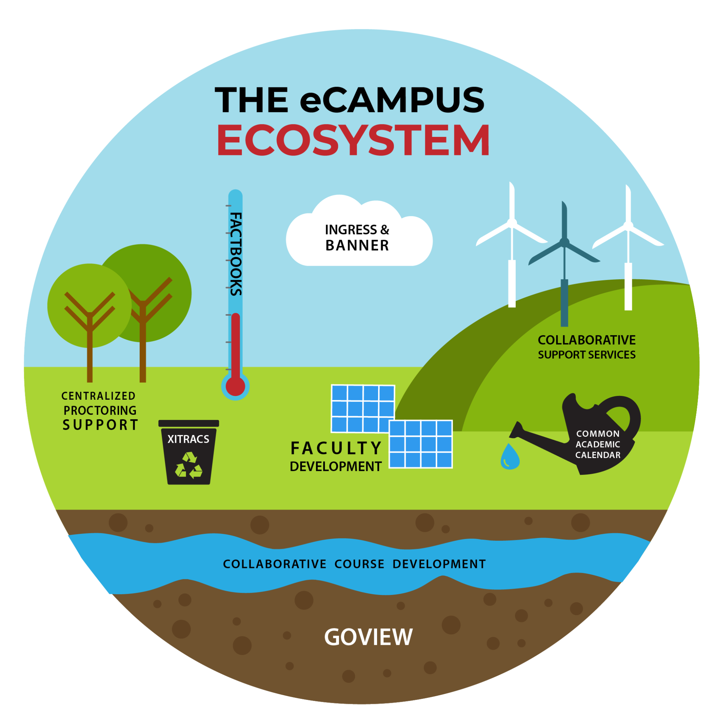

Slide 6
Social Justice Courses- concept
Originated in the CLCs
Established Working group
Draft Course Descriptions
Learning outcomes
Approved by CLC
Requires Institutional Governance Processes
No BOR Action

Slide 7
Social Justice Courses
SJUS 3000, Intro to Social Justice
SJUS 3050, Politics of Social Justice
SJUS 4000, Social Justice Culture
SJUS 4050, Law and Social Justice
SJUS 4800, Social Justice Policy Analysis

Slide 8
Social Justice Course Development
Interdisciplinary approach
3 SMES, 1 OER librarian, 1 ID per development team
Multiple Institutions

Slide 9
SJUS 3000 - Intro to Social Justice
Course description:
This course will introduce the student to the concept of social justice and social change. Examines various social justice theories such as restorative and distributive justice, postmodernism, feminism, and others. Theorists include Rawls, Mills, Kant, and others. A review of institutional systems and how social change occurs within the institutional framework.
Course objectives:
Upon successful completion of the course students will be able to:
Define social justice.
Summarize various social justice theories.
Distinguish institutional systems that have been influenced by social justice and change.
Interpret a current event using a social justice framework.

Slide 10
SJUS 3050 - Politics of Social Justice
Course description:
This course examines selected contemporary issues of social justice at the national, state, and local level of politics in the United States. This course analyzes various social justice issues through an economic, demographic, institutional, and political lens. Course topics include a critical analysis of governance, criminal law, economic development, immigration, poverty and race, drugs, and social equity.
Course objectives:
Upon successful completion of the course students will be able to:
Explain the role of politics in social justice issues.
Evaluate how political policy and laws impact different racial, ethnic, religious, socioeconomic, and gender groups.
Summarize the various views of immigration and immigration policy in the U.S.
Dissect the concept of systemic racism and its influence on politics and political policies.

Slide 11
SJUS 4000 - Social Justice Culture
Course description:
This course examines the relationship between music, art, movies & television, and social justice in the United States. These mediums bring people together, challenge the status quo, and shine a light on what is happening in various communities. This course will explore a range of music, art, movies, and television that reflect and influence social justice issues.
Course objectives:
Upon successful completion of the course students will be able to:
Explain the role of music, art, movies, and television as a motivating force in social justice issues.
Analyze social justice themes in song lyrics, art, movies, and television.
Evaluate the role and effectiveness of music, art, movies, and television as a tool of political protest.
Identify connections between artistic expression and the broader social and political context in which that expression occurs.
Interpret information presented visually, quantitatively, and orally in diverse media and formats.

Slide 12
SJUS 4050 - Law and Social Justice
Course description:
This course analyzes the relationship between legal institutions, inequality, and the ability of social groups to produce fundamental social change.
Course objectives:
Upon successful completion of the course students will be able to:
Describe ways in which law can be seen as both an instrument of positive social change and a means of confirming existing social arrangements and resisting social change.
Compare theoretical perspectives on law, justice, and society.
Critically analyze case studies concerning the struggles to achieve justice and involvement in legal processes and institutions by particular groups and individuals.
Examine a selection of issues such as gender politics, ethnicity, race, indigenous politics, sexual orientation, class, and economic struggles, social dissent, and the experience of non-traditional and minority populations.

Slide 13
SJUS 4800 - Social Justice Policy Analysis
Course description:
This course provides students with the tools to analyze policy implementation and effectiveness in the criminal justice system. Policies are evaluated in the areas of policing, corrections, courts, and criminal justice. Research methods and case study analysis will be used to evaluate and inform the creation of crime-related policies.
Course objectives:
Upon successful completion of the course students will be able to:
Explore concepts, theories, and empirical research used to explain crime in the United States.
Evaluate the development and complexities of criminal justice policy, specifically describing the steps involved in policy implementation.
Discuss the various ways crime and justice policy is evaluated.
Demonstrate an awareness of public policy issues as they relate to the development, implementation, and evaluation of criminal justice policies.

Slide 14
Social Justice Courses
Concentration/ General Electives
CJ
ORGL
Interdisciplinary degrees

Slide 15
Social Justice Courses
Launched Fall 2021
Fall 2021
Course | Enrollment | ABC Rate | Course Completion
SJUS 3000 | 29 | 89.66% | 96.55%
SJUS 3050 | 14 | 57.14% | 92.86%
SJUS 4000 | 1 | 100.00% | 100.00%
Total | 44 | 79.55% | 95.45%
Spring 2022
Course | Enrollment | ABC Rate | Course Completion
SJUS 3000 | 32 | 65.63% | 93.75%
SJUS 4050 | 2 | 50.00% | 50.00%
Total | 34 | 64.71% | 91.18%
Summer 2022
Course | Enrollment | ABC Rate | Course Completion
SJUS 3000 | 9 | 77.78% | 88.89%
Total | 9 | 77.78% | 88.89%
Fall 2022
Course | Enrollment
SJUS 3000 | 28
SJUS 3050 | 44
SJUS 4000 | 9
Total | 81

Slide 16
Faculty Comments
The interdisciplinary approach to the course development provides a rich and unique experience for both faculty and students- Sarah Kuck
The need to understand what social justice is (and is not) and the historical perspectives of social justice literature was a key influencer in determining the course content. It was important that students know social justice is not a “new” concept but a focus of philosophers back to the time of Plato’s Republic. - Pamela Brown

Slide 17
Discussion
-

