Slide 1
Planning for Substance Use and Suicide Prevention Programs on a College Campus
Rani George, Ph.D.
George Thomas, Ph.D.
Department of Criminal Justice
Albany State University, Georgia
Paper presented at the Criminal Justice Association of Georgia Conference October 2022
Note: This research was made possible with funding from SAMHSA’s Garrett Lee Campus Suicide Prevention grant Number 1U79SM061463-01. Any opinions, findings, and conclusions or recommendations expressed here are those of the author(s) and do not necessarily reflect the views of SAMHSA.

Slide 2
Images of a University/college
What images or photographs comes to your mind when you think of a University/College?

Slide 3
When we think of college/university…
Source: Free images from the web.

Slide 4
Rarely do we think of …

Slide 5
INTRODUCTION
Every college/university cares a lot about its retention rate because it is one of the best indicators of operating a successful institution.
High retention rates imply that students want to stay and be successful in college.
One of the factors that lead to academic success is the emotional and mental health of students.
So, student mental health is central to the mission, purpose and outcomes of every college and university.

Slide 6
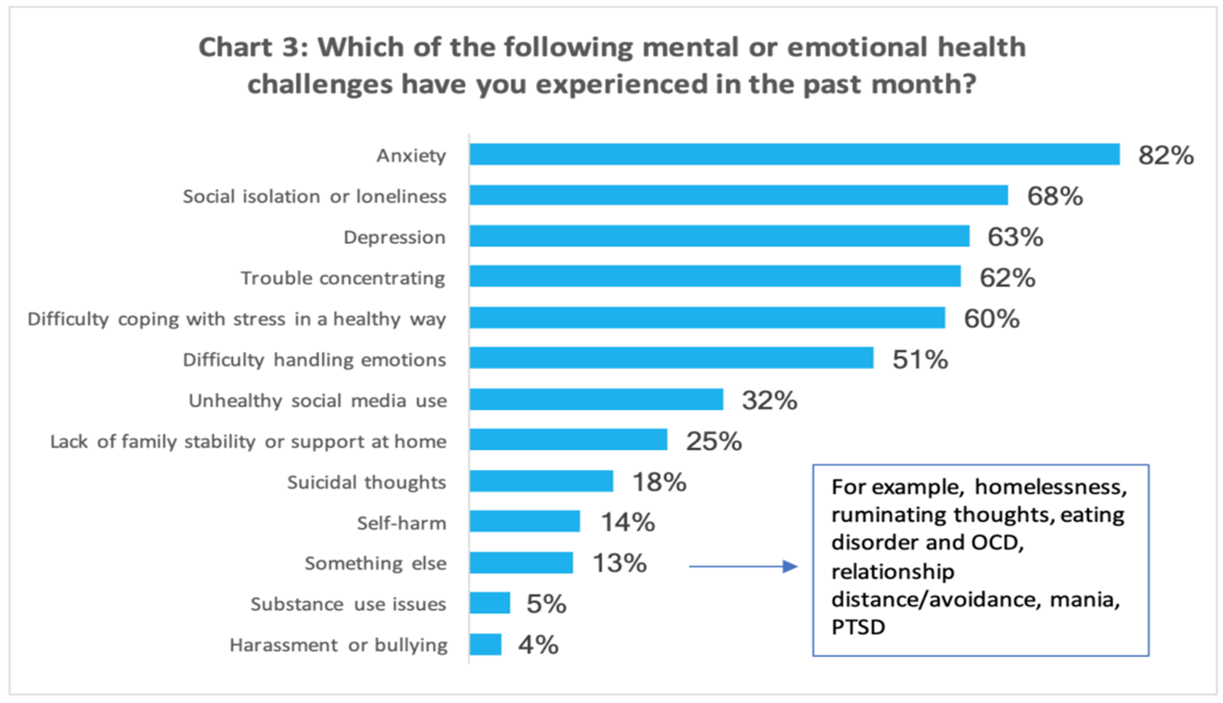
Review of Literature

Slide 7
Mental Health and Substance Use
The survey was conducted by the Healthy Minds Network for Research on Adolescent and Young Adult Mental Health and the American College Health Association
N = 18,764 students

Slide 8
Substance use among college students
Monitoring the Future Study National Survey Results on Drug use (2020) reports:
In 2020, annual prevalence of any illicit drug for college students was 46%.
Annual prevalence was 19% for any illicit drug other than marijuana.

Slide 9
Substance use among college students
Annual prevalence of marijuana use was 44%, and 30-day use was 25%.
Daily marijuana use was 7.9%.
30-day alcohol use and 30-day been drunk for college students was 6.4% and 7.2%

Slide 10
Substance use among college students
Binge drinking declined in 2020, reduced by a significant 7.8% points to 24%, a new historic low over the past four decades.
It is possible that this significant decline between 2019 and 2020 was partly due to the pandemic in terms of reduced time with friends, with the pandemic serving to accelerate the decline that had already been
occurring.

Slide 11
Substance use among college students
Cigarette use declined, with 30-day smoking at a new all-time low of 4.1% in 2020 (a 3.8% decline from 2019)
Prevalence of vaping nicotine for college students was 19%, nonsignificant decline.

Slide 12
Description of grant funding
Title of our grant: We Are Albany State University (We Are One ASU)
Three-year grant (2019-2022) funded under the Garrett Lee Smith (GLS) Campus Suicide Prevention grant program by SAMHSA’s Center for Mental Health Services.
Purpose: Suicide and substance abuse prevention
Grant PIs: Dr. Rani George & George Thomas

Slide 14
Our community partners
Phoebe’s Network of Trust
NAMI of Albany
ASPIRE
Georgia Department of Behavioral Health and Developmental Disabilities (GABHDD)
Morehouse School of Medicine
Sherwood Baptist Church

Slide 15
Results
Goal 1 Create comprehensive infrastructure and collaborative networking.
Campus partners including Counseling department, key members of Student Affairs, SGA, Active Minds chapter, some student organizations, Athletics, Human Resources and faculty senate.
Community partners include the local NAMI, Phoebe’s Network of Trust, Sherwood Baptist Church, and ASPIRE

Slide 16
Results
Goal 2 Increase knowledge of prevention of suicides, mental and substance use disorders.
Offered workshops and trained campus community using Kognito.
Kognito certifications Year 1 Year 2 Year 3
Faculty/Staff 31 27 42
Students 674 * 464 910*
Total 705 491 952
Offered workshops on substance abuse prevention.

Slide 17
Results
Goal 3 Promote help-seeking behaviors and reduce stigma and negative public attitudes
Offered more than 50 life skills workshops
Used Kognito modules to reduce stigma.
Walk away from stigma with 100 students. Due to pandemic, we did only one in Year 3. None were done in Year 1 and Year 2 due to the pandemic.

Slide 18
Results
Goal 4 Create a campus community “We Are One ASU,” where the community is engaged in assuring that each student experiencing mental distress is identified, screened and referred.
Offered at least 15 substance use prevention workshops and monthly table with resources
Counseling director and her staff screened and provided counseling services

Slide 19
Results
Goal 4
We provided posters, wallet cards with emergency phone numbers to the ASU Counseling Center, ASU Police Department, ASU Health Center and the local mental health agencies.
We also promoted the Georgia Crisis & Access Line (GCAL) 800-715-4225 and the National Crisis Line

Slide 20
Results
We had planned to do a mental health fair each year.
Phoebe’s Network of Trust, our main community partner, created YouTube videos (Yoga, Tai chi) for the grant during the pandemic in lieu of a Mental Health Fair.
In Year 3 we did a grand event with the help of our campus and community partners.
Flyer is provided next.

Slide 22
Success stories
2048 students and about 100 faculty/staff successfully completed training and obtained certification.
Many students provided testimonies about being able to help their friends in crisis as a result of the training.
At least two students were able to save their friends who were considering suicide.

Slide 23
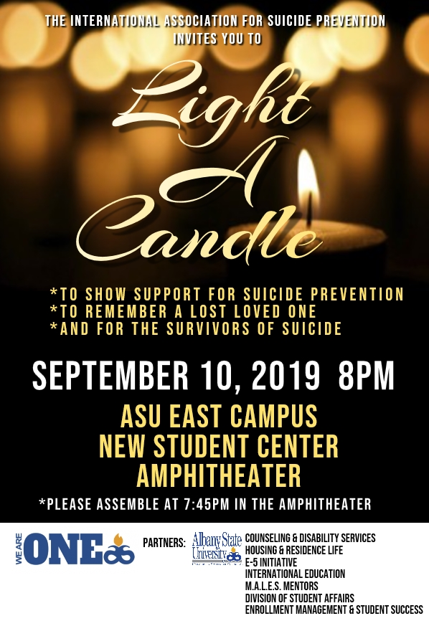

Slide 24
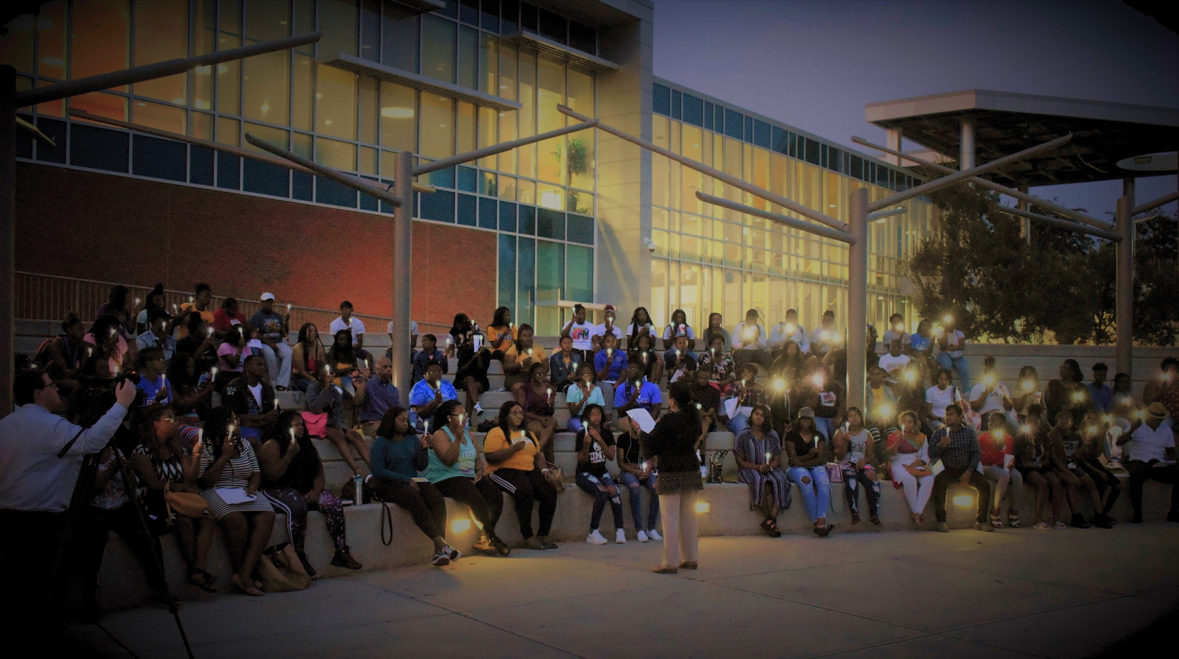
World Suicide Prevention Day – September 10, 2019
Light a candle at 8pm on World Suicide Prevention Day to remember families who have lost a loved one to suicide. Program was covered by a local channel.

Slide 25
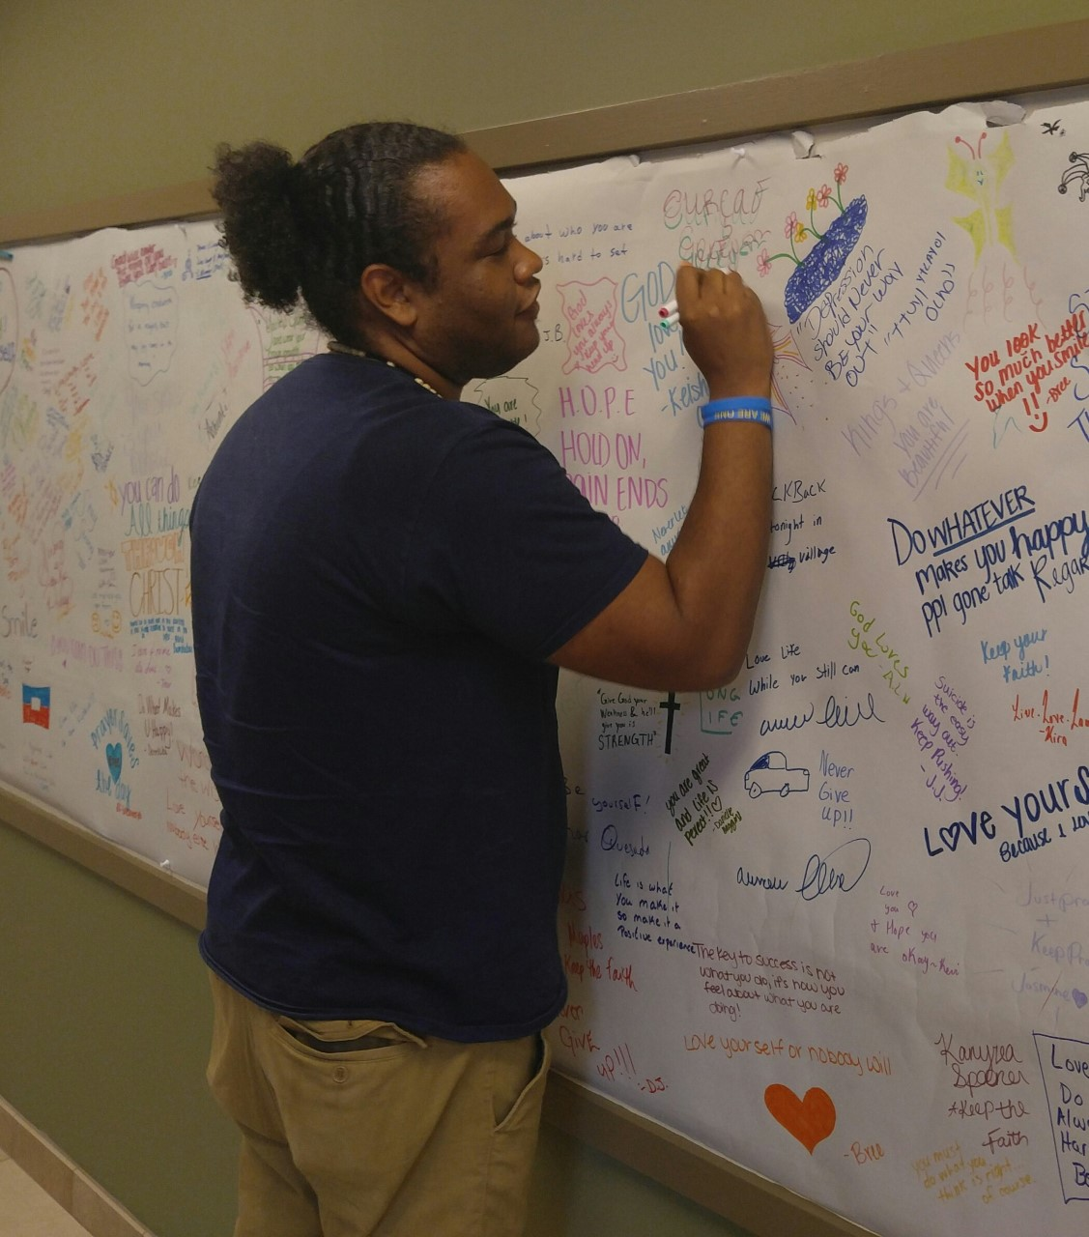
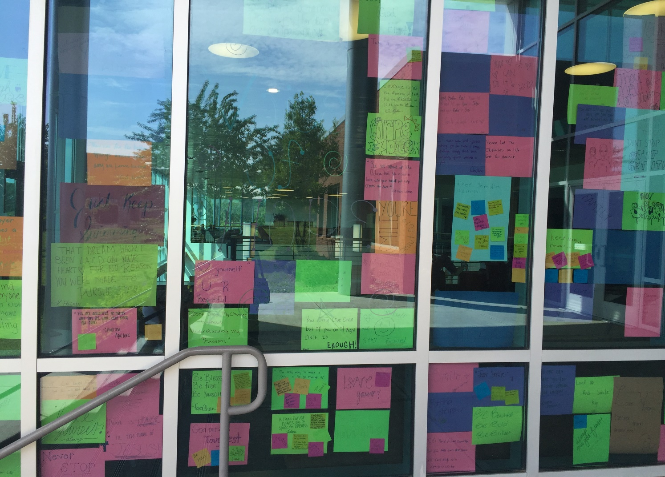
Wall of Hope
Yoga

Slide 26
Conclusions
When students experience academic difficulties because of mental health and substance use issues, retention and graduation are affected.
Providing comprehensive mental health services to students can help them better adjust to college life and have academic success.

Slide 27
Implications
Mental health and substance use disorders are major factors in poor academic outcomes.
So, it is important to have
Mental health training for faculty, staff and students.
Substance use prevention training
Suicide prevention programs
Social support systems

Slide 28
Implications
Peer-run, student mental health organizations.
Walk-in student health centers.
24-hour crisis hotlines
Ongoing individual counseling services, screening and evaluation services.
Comprehensive referrals to off-campus services and supports (NAMI , 2022).

Slide 29
Building a community of Caring at ASU
At ASU, funding for the We Are One ASU grant has helped us create a caring community.
Our logo is recognized by many on our campus.
Although the grant ended, we have been invited to partner with GABHDD to continue the prevention activities.
A “win win” situation for all.

