Slide 1
Forensic Genealogy:
The Newest Crime Solver
Ansley Graham
University of North Georgia

Slide 2
What is Forensic Genealogy?
Aka Forensic Genetic Genealogy
Genetic Genealogy
DNA profiles
Crime scenes
Unknown remains
GED Match vs 23andme
Familial Matches
Notes:
DNA collected from the scene/ scenes
DNA collected from Unknown remains
Submitted to DNA testing to create a DNA profile and then submitted to a public DNA database such as GED-match to find either the suspect/unknown victim or, more commonly, connect the DNA to familial matches and narrow down the suspect pool to the area where the crime was committed/ body was found.

Slide 3
• The History of Forensic Genealogy
1986 DNA Fingerprinting
Colleen Fitzpatrick
DNA Doe Project

Slide 4
• How is Forensic Genealogy being used today?
Generate Investigative Leads
Unresolved Cold Cases
Identify Unknown Remains
Notes:
Violent Crimes
Unresolved Cold Cases
Generate Investigative leads for these cases
Identify Unknown remains

Slide 5
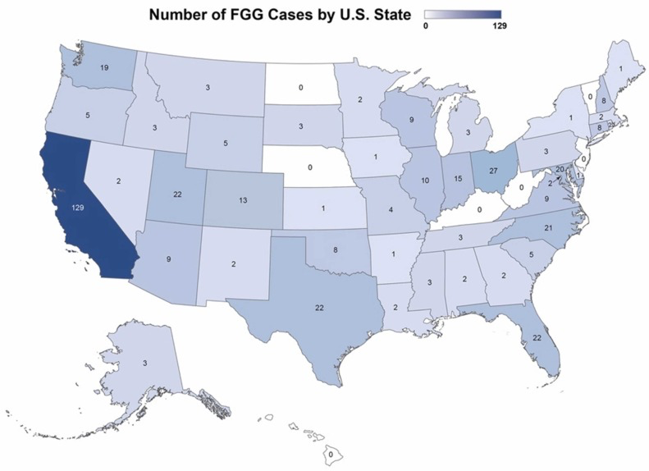

Slide 6
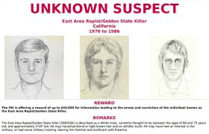
• Example Case: The Golden State Killer
1976-1986
Murdered 13
Raped 50
DNA evidence
Modus operandi
Taunted police
Notes:
Serial rapist and murder who reigned terror over California from 1976-1986
Committed at least 13 murders and over 50 rapes
DNA evidence and modus operandi was used to connect these cases
Taunted the police with letters

Slide 7
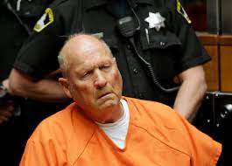
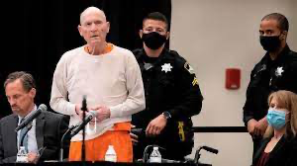
• Example Case: The Golden State Killer
2016: public eye
DNA profile (2018)
GED-match
Joseph DeAngelo (arrested 2018)
Guilty
Notes:
In 2016 the case was brought back into the public eye due to media, documentaries and books being made
Investigators decided to send in the DNA found at all the scenes to be tested and create a DNA profile for the killer
Next the profile was inserted into GED match or a website

Slide 8
• Public Opinion on Forensic Genealogy
Some Public Approval
4th amendment
Ethical Issues
Should law enforcement be allowed to send an unknown DNA profile into a public genetic database to solve cases?

Slide 9
•Pros and Cons
Pros | Cons
Solve age old crimes | 4th amendment
Accuracy | Time for process
Narrows suspect pool | Human Error
Courtroom | Uninvolved DNA match
Notes:
Pros:
Solving many cold cases that stumped investigators
DNA is proven to be an accurate piece of evidence
Narrows down the suspect pool
Reliable and accepted in the court room
Cons:
Public concerns about privacy
Timely process
Subject to human error
DNA match may be uninvolved in the incident

Slide 10
•Conclusion
Pros outweigh Cons
Cold Cases and Unidentified Remains
Court Order for DTC companies
Standard Set
Notes:
Pros outweigh the cons in that cases are getting solved by this investigative technique
This technique should be used mostly for cold cases and unidentified remains
Investigators should request and receive a court order before utilizing this technique
If they need a court order, then a standard needs to be set on when is an appropriate time to request a court order.
Unidentified remains: when all other means of identification are inconclusive
Cold Cases: depending on the severity of the case, before statute of limitations runs out, 5-10 years after case has gone cold

Slide 11
Thank you! Questions?

