Slide 1
Exploring Policy Improvements Criminal Justice Managers Need to Reduce Cultural Bias in a State Correctional System
Dr. Kristi Pitts, RYT, MSCJ, DM
Purdue University Global

Slide 2
Research Study Overview
Qualitative study
Improve cultural language
Improve cultural sensitivity awareness
Prevent overly targeting of African Americans
2

Slide 3
Problem
The problem addressed in this study was the policy improvements criminal justice managers need to reduce cultural bias in a state correctional system has not been established.
3

Slide 4
Purpose and Significance
Explore policy improvements
Reduce cultural biases
Significance of this study
4
Notes:
The purpose of this qualitative study has the potential of producing police officers and correctional officers with clearly defined and outlined policies that could lead to improved cultural language and cultural sensitivity awareness, prevent overly targeting of African Americans and other minorities in a state correctional system.

Slide 5
Research Question
What policy improvements criminal justice managers need to reduce cultural bias in a state correctional system?
5
Notes:
The data collected from criminal justice experts helped to identify improvements needed in policy and procedures in a state correctional system that will be advantageous to African Americans and other minorities.

Slide 6
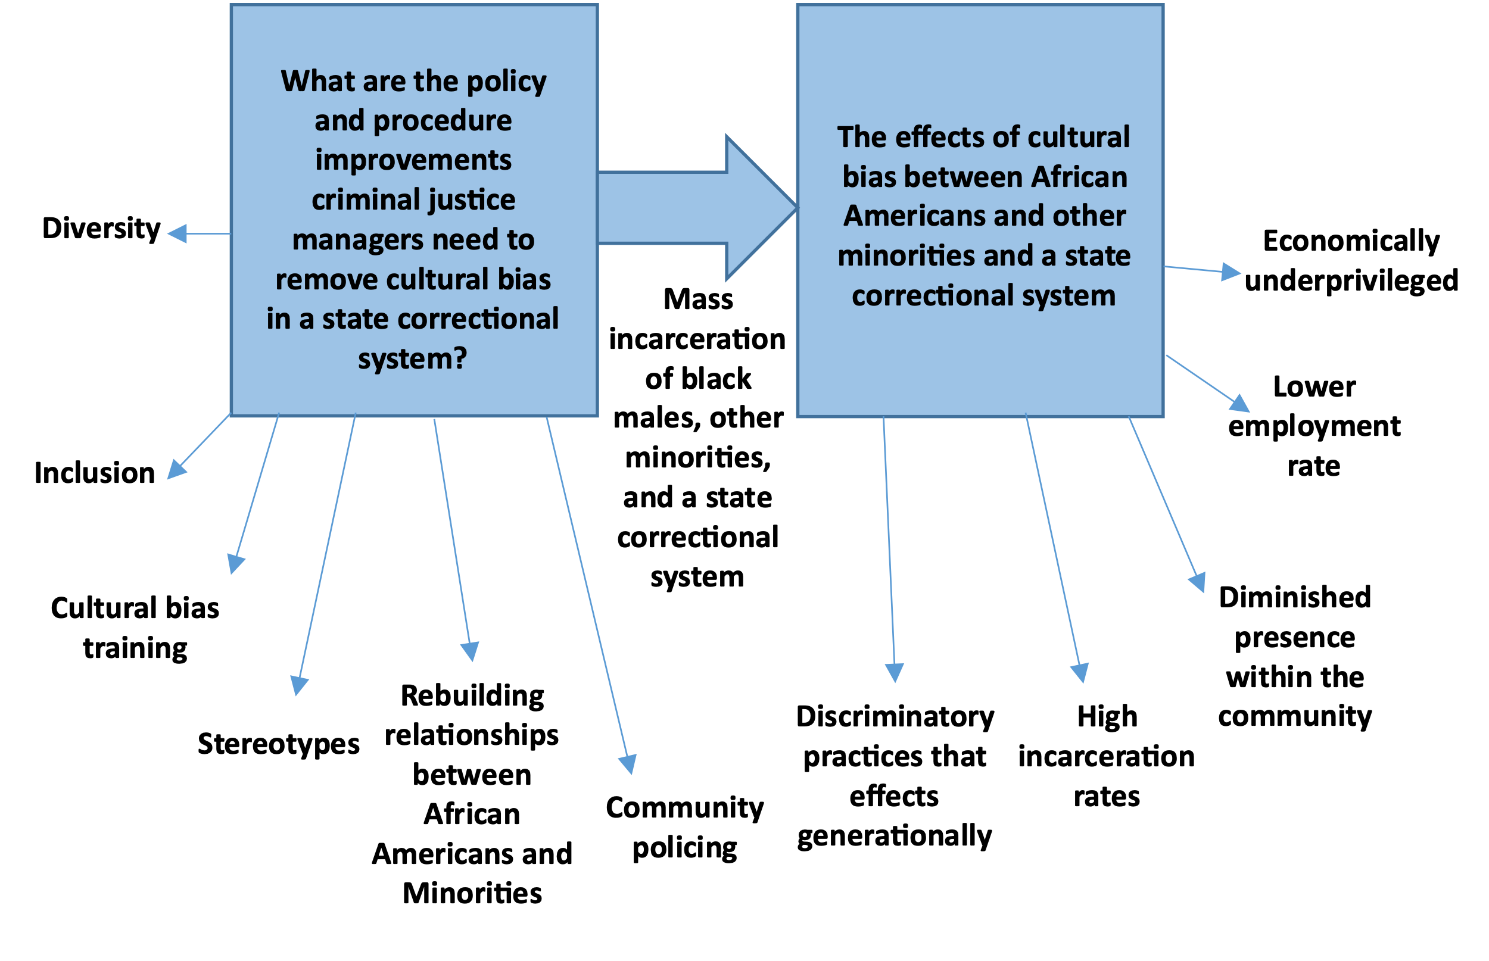
Conceptual Framework
6
Notes:
Conceptual frameworks are developed through an iterative process, providing an understanding through qualitative analysis (Creswell, 2014). Conceptual frameworks are created when the researcher collects the beliefs, concepts, assumptions, theories, and expectations that support the researcher’s concept and displays the researcher’s concept in a graphical and narrative form (Creswell, 2014).

Slide 7
Research Method and Design
Qualitative research
Studying a situation
Exploratory design
Better understanding of phenomenon
7

Slide 8
Population and Sampling
The population
Purposeful sampling
The sample size
Data saturation
8

Slide 9
Instrumentation
Semi-structured interviews
Recruitment email
Inclusion criteria
ZOOM
9

Slide 10
Data Collection
Semi-structured interviews
Zoom
Field notes/Audio Recordings
Transcription
General process
Member checking
10

Slide 11
Data Analysis
Manual Coding
Themes/ Major themes
Triangulation
11
Notes:
In Step 1, the researcher reviewed the transcript in its totality to gain an understanding of the underlying sense of the description relative to its situated form (Giorgi et al., 2017). Step 2, the researcher assumed the attitude of scientific reduction (Giorgi et al., 2017). In Step 3, the researcher created parts by defining meaning from the units of analysis. The meaning is stated to be determined when the researcher, while being mindful of the phenomenon under evaluation, experience a transition in meaning (Giorgi et al., 2017). Step 4, the researcher transformed the participants’ lifeworld expressions into expressions that highlight the meanings lived by the participant (Giorgi et al., 2017). Lastly, Step 5 was based on the transformed meaning units where the researcher used the transformed meaning expressions as the basis for describing the structure of the experience (Giorgi et al., 2017).

Slide 12
Demographic Characteristics
Participant Demographics
PID | Gender | Position
1 | Male | Senior correctional officer
2 | Male | Special agent DPS & corrections
3 | Male | LT. Colonel Deputy Sheriff
4 | Male | Director of police and justice
5 | Male | Senior lead investigator
6 | Male | Deputy chief investigator
7 | Female | Administrator of institutional management department of corrections
8 | Male | Chief of police
9 | Female | Correctional officer
10 | Male | Law enforcement specialist
12

Slide 13
FINDINGS
Cultural bias policies are needed
Cultural diversity training is needed
Improve stereotypes and assumptions
Improve community involvement
Notes:
The participant responses show a universal need for training on cultural bias in a state correctional system and a criminal justice system as a whole when moving a criminal justice system in the future.
These findings clearly show that there is a dire need to remove cultural bias in a state correctional system and the areas that need the most establishing, focus and improving.

Slide 14
FINDINGS
Major Themes | 160
Cultural Diversity Training | 98%
Establishment of cultural bias policy | 39%
Stereotypes and Assumptions | 17%
Improve community involvement | 6%

Slide 15
Limitations
Participants not representing all criminal justice professionals
15

Slide 16
Conclusions
Key findings revealed
Creating policy improvements that reduce cultural bias
1. Establish/ Improve cultural bias policies
2. Establish/ Improve cultural diversity training
3. Improve stereotypes & assumptions
4. Improve community involvement
16

Slide 17
Implications for the Discipline
Aligned to the current literature
Problematic areas
Participant experiences
17

Slide 18
Implications for Practice
Long-term effects
Individual discriminatory attitudes
Exclusionary behaviors
Institutionalized racism
18

Slide 19
Future Research
Present findings to criminal justice agencies globally
Collaborate with state correctional departments and other criminal justice agencies
19

Slide 20
Future Scholarship
Closing comments
Conduct further research
Teaching
20

Slide 21
Thank you
Questions?
21

Slide 22
Exploring Policy Improvements Criminal Justice Managers Need to Reduce Cultural Bias in a State Correctional System
Dr. Kristi Pitts, RYT, MSCJ, DM
Purdue University Global

