Slide 1
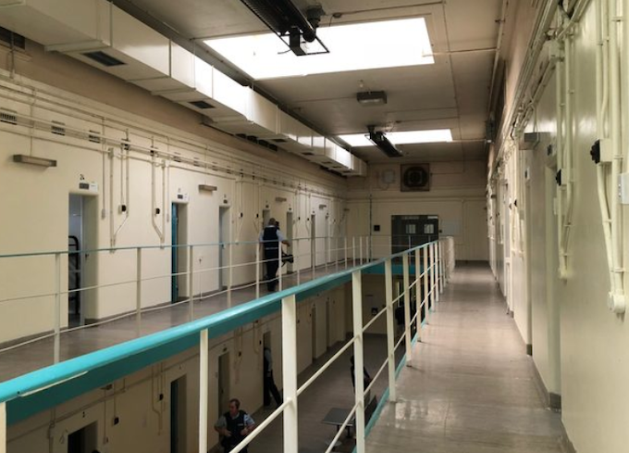
Economic Cost of Incarceration
Ashlie Fuller
University of North Georgia
This Photo by Unknown Author is licensed under CC BY-SA-NC

Slide 2
The Criminal Justice Systems Response to Crime, Centers Around Incarceration
Enormous economic cost: to taxpayers and families of the prisoners.
Families: Providing necessities and conveniences
Borne by the inmates partner the sole caregiver of the partner’s children.
This study seeks to examine the financial burden of incarceration

Slide 3
Case Study – Consisted of Five Children
Unable to feed, clothe, and house family – Sourced from charity
Unable to celebrate Christmas – Sourced from Salvation Army, Schools, and Churches
Scarce resources were even less available because of sending money to incarcerated spouse to help with his/her necessities, court fees, restitutions, and fines
Childcare unavailable – children have to take care of their selves
Incarcerated for alcohol, drug, domestic violence, and failure to pay child support

Slide 4
Technological Advances
I pads,
Virtual Videos
Phone Calls
Email
Limited Internet Access

Slide 5
Conclusion
Implement more community service programs in the jails that will give credits that will go towards their fines, fees, and restitutions
Reduce length of time charges stay on record for employment purposes
Work to reduce the cost

