Slide 1
THE DETENTION OF ASYLUM SEEKERS IN THE U.S. AND THE DUE PROCESS CLAUSE
Jim Nzonguma Mayua
Fall 2022

Slide 2
Agenda
I. INTRODUCTION
A trend of detaining asylum seekers
Criminal justice as a tool to enforce immigration policy
2. MAIN ARGUMENT
3. RESEARCH QUESTION
4. DUE PROCESS CLAUSE
5. IMMIGRATION DETENTION IN THE U.S.
Detention statute
Jurisprudence of immigration detention
6. CONCLUSION AND RECOMMENDATIONS

Slide 3
I. introduction
A. A trend on detaining asylum seekers
A growing trend among receiving states to detain –illegal entry
Detention deters asylum seekers
Recent statistics: more than 100 million people were forced to flee their homes during the last decade.

Slide 4
introduction (CONT.)
4.4 million are asylum seekers
At least 2,000 facilities used for immigration detention purposes in approximately 100 different countries over the last decade.
(UNHCR) shows that 622,542 persons were detained for immigration related purposes
Among these people, there were 77,038 asylum seekers.

Slide 5
introduction (CONT.)
Why should asylum seekers have the right to be released from detention during their proceedings? Why Should we care?

Slide 6
introduction (CONT.)
Detention does not serve the government legitimate purpose
Detention tends to discourage bona fide asylum seekers form asserting and proving claims

Slide 7
introduction (CONT.)
Detention may narrow asylum seekers rights to access to justice.
Detention prevents asylum seekers from meeting their court deadlines
Detention negatively affects the mental health of asylum seekers.

Slide 8
Definition of asylum seeker
Article 1 of the Refugee Convention of 1951
An asylum seeker is a person looking for protection because they fear persecution, or they have experienced violence or human rights violations.
A refugee is a person who asked for protection and was given refugee status.

Slide 9
2. Main Claim
My claim in this dissertation is that if asylum seekers are detained, they have a right to seek relief.
Unfortunately, courts in receiving countries like the US have denied asylum seekers protection from detention
Exclusion from domestic protections (Due Process)

Slide 10
3. RESEARCH QUESTION and its significance
Are unlawful entrants seeking asylum entitled to due process, to seek release into receiving states?

Slide 11
3. RESEARCH QUESTION and its significance(continued)
Although immigration scholars continue to explore issues in the context of mandatory detention, they have yet to examine whether unlawful entrants seeking asylum are entitled to Due Process
This paper builds on that scholarship but makes a unique contribution to the existing analyses of mandatory detention of immigrants by focusing on mandatory detention of unlawful entrants seeking asylum in the US

Slide 12
3. RESEARCH QUESTION and its significance
The question whether the detention of asylum seekers does serve the government's legitimate purpose, remains unclear.

Slide 13
4. DUE PROCESS CLAUSE
Each amendment contains a due process clause
Due process clause prevents the government from taking any action that would deprive a person of “life, liberty, or property without due process of law."
The due process clause provides several types of protection

Slide 14
4. DUE PROCESS CLAUSE (continued)
The due process clause provides several types of protection:
procedural protections, such as notice and a hearing before termination of entitlements such as publicly funded medical insurance;
individual rights listed in the Bill of Rights, including freedom of speech, free exercise of religion, the right to bear arms, and a variety of criminal procedure protections;
fundamental rights that are not specifically enumerated elsewhere in the Constitution, including the right to marry, the right to use contraception, and the right to abortion.

Slide 15
4. DUE PROCESS CLAUSE (continued)
Procedural Due Process
“Procedural due process” concerns the procedures that the government must follow before it deprives an individual of life, liberty, or property. The key questions are: What procedures satisfy due process? And what constitutes “life, liberty, or property”?

Slide 16
4. DUE PROCESS CLAUSE (continued)
Substantive Due Process
The Court has also deemed the due process guarantees of the Fifth and Fourteenth Amendments to protect certain substantive rights that are not listed (or “enumerated”) in the Constitution. The idea is that certain liberties are so important that they cannot be infringed without a compelling reason no matter how much process is given.

Slide 17
5. IMMIGRATION Detention Under the u.s. laws & jurisprudence
The current detention law
Due Process Clause-asylum seekers

Slide 18
5.The current detention law
The provision of INA authorizes DHS officials to detain non-U.S. citizens who are subject to removal from the United States. This detention program has different dimensions, with rules that turn on several factors such as
whether the non-citizen is seeking admission (8 USC § 1225); or
whether the non-citizen has engaged in certain criminal conduct (8 USC § 1226); and
whether the non-citizen has been issued a final order of removal (8 USC § 1231).

Slide 19
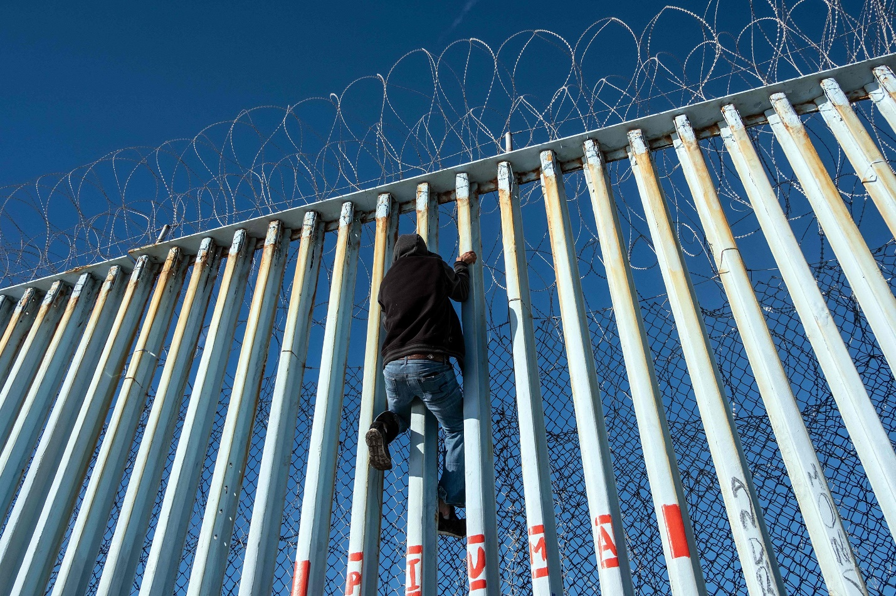
5. IMMIGRATION Detention Under the u.s. laws & jurisprudence
A. The statute
The provision of title 8 USC § 1225 is crucial to my paper, because it authorizes immigration officers to detain unlawful entrants into the United States, without a bond hearing, who establishing a credible fear of persecution or torture for further consideration of the application for asylum” in formal removal proceedings.

Slide 20
5. IMMIGRATION Detention Under the u.s. laws & jurisprudence
1. The statute
Credible fear interview
Screening mechanism meaning in expedited removal Proceedings
Prevents those who may be eligible for asylum from being wrongfully removed.
she establishes that there is a “significant possibility” that the person will be able to demonstrate eligibility for asylum

Slide 21
5. IMMIGRATION Detention Under the u.s. laws & jurisprudence
2. Jurisprudence: Current Ruling of Supreme Court
Jennings v. Rodriguez, 583 U.S. (2018).
Padilla v DHS, NO 20-234, (2021).
RULING: Unlawful entrants seeking asylum are not entitled to the Due Process Clause

Slide 22
5. Under the u.s. laws & jurisprudence: Due Process Clause
2. Jurisprudence: Previous ruling
Zadvydas v. Davis, 533 U.S. 678 (2001)
Zadvydas stated that “a statute permitting indefinite detention of an alien would raise a serious constitutional problem” under the Due Process Clause.
However, Zadvydas' circumstances were distinct from those of asylum seekers (such as in Padilla)-Lawful permanent resident v asylum seekers

Slide 23
5. IMMIGRATION Detention IN THE U.S.
A. Under the u.s. laws & jurisprudence: Due Process Clause
2. Jurisprudence: Previous ruling
Clark v. Martinez, 543 U.S. 371 (2005)
Clark v. Martinez, the Supreme Court resolved the issues, in ruling that the Zadvydas decision must be applied liberally to both documented and undocumented immigrants.

Slide 24
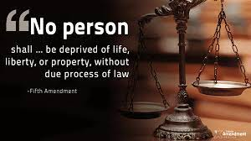
5. IMMIGRATION Detention IN THE U.S.
A. Under the u.s. laws & jurisprudence: Due Process Clause
3. Due Process Claude under the U.S. Constitution.
Due Process Clause is part of the U.S bill of rights
The bill of rights uses neutral character, “every one”.
It covers both documented and undocumented immigrants

Slide 25
5. IMMIGRATION Detention IN THE U.S.
A. Under the u.s. laws & jurisprudence: Due Process Clause
3. Due Process Claude under the U.S. Constitution.
Practically speaking
Fair hearing
Lawyer

Slide 26
6. Conclusion and Recommendations
Although ineffective, immigration detention has been used as one of the principal restrictive measures to deter asylum seekers.
The U.S. Constitutions does not discriminate against unlawful entrants seeking asylum
As a result, courts around the world should not deny them domestic protection.

Slide 27
6. Conclusion and Recommendations (continued
This would positively impact on asylum seekers, by invoking due process to seek release.

Slide 28
THANK YOU!

