Slide 1
CJAG Conference
Demystifying the “Crime of Aggression”
under the International Law
Dr. Roger-Claude Liwanga & Dr. Patrick Ibe
Albany State University
October 2022

Slide 2
Presentation Objectives
Since the 1940s, the “crime of aggression” or “crime against peace” has never been prosecuted despite the occurrence of acts of aggression around the world:
    The 1990 Iraq’s invasion of Kuwait
    The 2003 US-led coalition invading Iraq
    Current Russia’s invasion of Ukraine.
The offenders of crime of aggression have been avoiding prosecution because there were:
    Neither a clear court to prosecute this crime
    Nor was there any universal agreement on the scope of the definition of this offense until recently in 2010.

Slide 3
Presentation Objectives
The presentation seeks to answer a series of questions regarding the “crime of aggression” or “crime against peace”:
  What is really the “crime of aggression” under international law?
  What are the criteria to assess acts of aggression?
  In light of the current crisis in Ukraine, can the Russian authorities be prosecuted for the crime of aggression?
    If not, what could be some practical and judicial barriers to prosecuting them?

Slide 4
Plan
I. Overview of
Crime of Aggression
II. Definition of Crime of Aggression under International Law
Crime of Aggression
III. Criteria for Assessment of Crime of Aggression
IV. Case of Study of the Ukraine Crisis

Slide 5
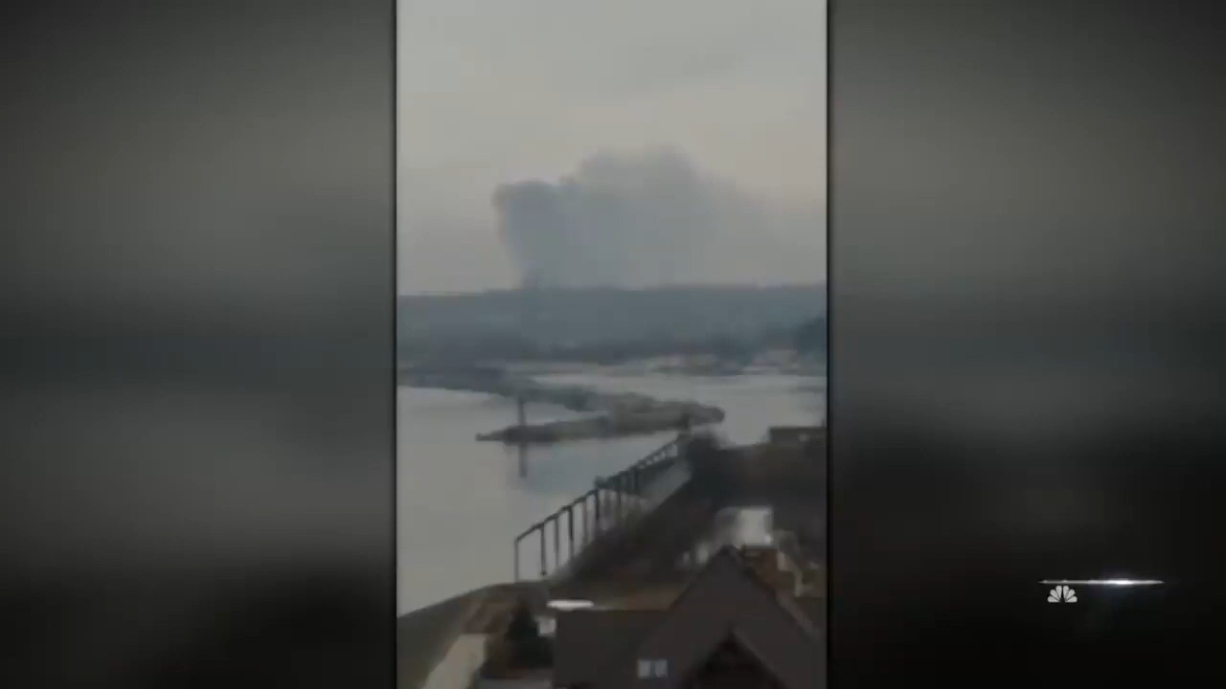
Video: Russia Launches Full-Scale Invasion of Ukraine

Slide 6
I. Contextual Background on “Crime of Aggression”
After the Second World War (1939-1945), the United Nations (UN) was founded in 1945 with the mission to maintain peace and security in the world (Article 1 of the UN Charter).
The UN Charter compels the State members to refrain from using threat or force against the territorial integrity of another State [Art 2(4) ].
Yet, such a prohibition of the use of force under the UN Charter is subjected to two exceptions:
  Self-defense (when a State is defending itself against an armed attack emanating from another State) [Art 51 of UN Charter]
  UN Security Council’s authorization of armed interventions under Chapter VII to maintain or restore international peace (Art 42-48 of the UN Charter).

Slide 7
I. Contextual Background on “Crime of Aggression”(cont.)
In other words, there are limited conditions under which States may resort to the use of armed force.
  Using of force without legal justification (self-defense or UN Sec. Coun. authorization) would amount to an “act of aggression.”
Despite States (as “juristic persons”) can engage their international responsibility for an act of aggression, the crime of aggression also targets the individual criminal responsibility of the State’s leadership (e.g.: President, Army chief, etc.).

Slide 8
I. Contextual Background on “Crime of Aggression”(cont.)
Since the 1940s Nuremberg and Tokyo trials (against senior officials of defeated Nazi Germany and Japan), there has been no international prosecution for crimes against peace or crimes of aggression.
    Nuremberg and Tokyo tribunals were established ad hoc courts, whose mandates expired after holding trials.
    The 1945 Charter of the Nuremberg International Military Tribunal used term “crime against peace” instead of “crime of aggression.”

Slide 9
I. Contextual Background on “Crime of Aggression”(cont.)
Since 1940s, what constituted “aggression” was not clearly defined.
Because of the Cold War and ideological conflict within the UN Security Council:
  The scope of the concept of “aggression” dwelled ambiguous for decades.
  There was no clear court to prosecute acts of aggression
The first the tentative definition was provided by the Resolution 3314 of The UN General Assembly of 1974.
The most holistic and universally accepted of “crime of aggression” emanates from the 2010 Amendments of the Rome Statute of the International Criminal Court of 1998.

Slide 10
II. What is the Crime of Aggression under International Law?
Article 6(2)(a) of the 1945 Charter of the Nuremberg International Military Tribunal defines Crimes against peace as:
“The planning, preparation, initiation or waging of a war of aggression, or a war in violation of international treaties, agreements or assurances, or participation in a common plan or conspiracy for the accomplishment of any of the foregoing”
No explicit specification under the 1945 Charter of the Nuremberg International Military Tribunal if the “act of aggression” must be committed in the context of the conduct of the State, or the individual criminal conduct, or both.

Slide 11
II. What is the Crime of Aggression under International Law?
Resolution 3314 of The UN General Assembly of 1974 defines aggression as:
“The use of armed force by a State against the sovereignty, territorial integrity or political independence of another State, or in any other manner inconsistent with the Charter of the United Nations,”
Resolution 3314 only describes an “act of aggression” in the context of the conduct of the State.
It does not cover the individual criminal conduct arising from an act of aggression.
[see also: Sarkin & Almeida, The Crime of Aggression at the ICC, p. 525].

Slide 12
II. What is the Crime of Aggression under International Law?
Under the 1998 Rome Statute of the International Criminal Court (as amended in 2010)
Crime of Aggression means:
Act of Aggression means:
“The planning, preparation, initiation or execution, by a person in a position effectively to exercise control over or to direct the political or military action of a State, of an act of aggression which, by its character, gravity, and scale, constitutes a manifest violation of the Charter of the United Nations.”
Art 8 bis 1 of the Rome Statute
“The use of armed force by a State against the sovereignty, territorial integrity or political independence of another State, or in any other manner inconsistent with the Charter of the United Nations.”
These acts can include: invasion, bombardment, military occupation, annexation by the use of force, blockade by the ports or coasts, attack by the armed forces, sending of armed bands/groups on behalf of the State, etc.
      Art 8 bis 2 of the Rome Statute

Slide 13
III. Criteria for Assessment of Crime of Aggression
Under the 1998 Rome Statute of the International Criminal Court
Three elements are required for the Crime of Aggression:
  1. The perpetrator must be a political or military leader
    Being in a position of effectively exercising control over the political or military action of a State.
  2. The perpetrator was involved in the planning, preparation, initiation, or execution of such a State act of aggression.
    Planning implies participation in high-level meetings during which plans for the acts of aggression are formulated
    Preparation implies taking concrete actions to realize the plan (e.g.: Creating the necessary military capacities)
                See: Open Society Justice Initiative, Model Indictment for the Crime of Aggression, 2022, pp.28-59.

Slide 14
III. Criteria for Assessment of Crime of Aggression
Under the 1998 Rome Statute of the International Criminal Court
Three elements are required for the Crime of Aggression (cont.)
  2. The perpetrator was involved in the planning, preparation, initiation, or execution of such a State act of aggression.
    Initiation implies taking a decision just before the first tangible use of force to commit the act of aggression (e.g.: Declaration of hostilities)
    Execution implies commanding armed forces to conduct acts of aggression, occupying territories as a result of acts of aggression, etc.
                See: Open Society Justice Initiative, Model Indictment for the Crime of Aggression, 2022, pp.28-59

Slide 15
III. Criteria for Assessment of Crime of Aggression
Under the 1998 Rome Statute of the International Criminal Court
Three elements are required for the Crime of Aggression (cont.)
  3. The State’s act must amount to an act of aggression:
    Based on the Resolution 3314 of the UN General Assembly of 1974.
    Based on the character, gravity and scale of such an act that manifestly violates the UN Charter (prohibiting unlawful use of force).
                See: “The Global Campaign for Ratification and Implementation of the Kampala Amendments on Crime of Aggression,” at: https://crimeofaggression.info/.

Slide 16
IV. Case of Study of the Ukraine Crisis
From the viewpoint of the legality of war:
  Russia’s invasion of Ukraine constitutes aggression under international law [Art 2(4) of UN Charter and Resolution 3314 of the UN GA].
  Russia did not act in self-defense nor did the UN Sec. Coun. authorize the armed interventions against Ukraine under Chapter VII of the UN Charter.
Questions:
  Does the conduct of the Russian authorities (such as President Vladimir Putin) amount to a crime of aggression under the Rome Statute of the ICC?
  If yes, can President Putin be prosecuted by the ICC?

Slide 17
IV. Case of Study of the Ukraine Crisis (cont.)
Yes, the conduct of President Putin amounts to a crime of aggression under Articles 8 bis 1 and 2.
Yet practically, President Putin cannot be prosecuted by the ICC because neither Russia nor Ukraine ratified the 1998 Rome Statute.
The ICC’s jurisdiction is not universal. It can only exercise its jurisdiction if:
  The accused person is the national of State Party to the Rome Statute or State accepting the ICC’s jurisdiction (Art 12 of the Rome Statute).

Slide 18
IV. Case of Study of the Ukraine Crisis (cont.)
The ICC can also exercise its jurisdiction if:
  The crime took place on the territory of a State Party or State accepting the ICC’s jurisdiction (Art 12 of the Rome Statute).
  The UN Sec. Council has referred the situation to the ICC Prosecutor, no matter the nationality of the accused or the location of the crime (Art 15 bis & 15 ter of the Rome Statute).
    It is impossible for the UN Sec. Council to adopt a resolution referring the Russia case to the ICC because Russia has a veto right.
  The ICC Prosecutor believes that there is a reasonable basis to investigate the commission of an international crime, and seeks authorization from the ICC Pre-Trial Chamber (Art 15 of the Rome Statute).

Slide 19
IV. Case of Study of the Ukraine Crisis (cont.)
Possible options to Vladimir Putin criminally accountable?
  Creation of an ad hoc international criminal tribunal to adjudicate international crimes committed in Ukraine.
    But: Russia could still use its veto right at UN Sec. Council to block any resolution on that ad hoc tribunal.
  Prosecution before the domestic courts of countries that have universal jurisdiction over international crimes (including aggression).
    But: It is unlikely the judicial and political authorities in Russia would cooperate with those countries.
  Holding trials in absentia in Ukraine. But it would not have a deterrent effect on Putin.

Slide 20
List of References
Gegout, Catherine. The Crime of Aggression, the UK and France: Time to Show Leadership on the Principles of International Law at the International Criminal Court. Available at: https://www.opendemocracy.net.
Coalition for the International Criminal Court. Historic Activation of the Crime of Aggression. Available at: https://www.coalitionfortheicc.org.
Sarkin, Jeremy & Almeida, Juliana (2020). Understanding the Activation of the Crime of Aggression at the International Criminal Court: Progress and Pitfalls. Available a https://wilj.law.wisc.edu/wp-content/uploads/sites/1270/2020/01/36.3_518-551_SarkinAlmeida.pdf
United Nations, Amendments on the Crime of Aggression to the Rome Statute of the International Criminal Court Kampala, 11 June 2010.
United Nations, Charter of the United Nations, 24 October 1945, 1 UNTS XVI.
United Nations, Charter of the International Military Tribunal - Annex to the Agreement for the prosecution and punishment of the major war criminals of the European Axis ("London Agreement"), 8 August 1945.
“The Practical Guide to Humanitarian Law: Aggression.” Available at : https://guide-humanitarian-law.org
“The Global Campaign for Ratification and Implementation of the Kampala Amendments on Crime of Aggression.” Available at: https://crimeofaggression.info/role-of-the-icc/definition-of-the-crime-of-aggression/

Slide 21
Thank You

