Slide 1
A Meta-analysis of D.A.R.E Program Effectiveness
Chris Bakke
Timothy Hayes
University of North Georgia

Slide 2
Things to Cover
What is D.A.R.E?
Literature review of past program and updated curriculum (KIR)
Theory and Methods
Research Questions
Initial Findings
Conclusions and Next Steps

Slide 3
Introduction
Drug use among adolescents
Original D.A.R.E Program - 1983
Updated Curriculum - 2009
Notes:
Drug use among children
Research has shown drug use among children can have damaging effects on brain development as well as other physiological delays. The brain’s development stage during childhood is sensitive and vulnerable (Vijayakumar et al.,2018). Damage from drug use can potentially have long-term or irreversible effects on cognitive, social, and behavioral skills.
The interference with the brain structure and development inhibits the development of the brain’s prefrontal cortex (the area of the brain regulating behavior and emotion).
Research has shown a damaged prefrontal cortex contributes to the propensity to engage in risky and impulsive behaviors. This neurobiological interference from substance use affects brain development on either a short-term, long-term or even permanent level (Volkow et al., 2018).
These key neurological areas underdeveloped carry on into adulthood, interfering with their overall mental well-being – including social, emotional, and cognitive processes that ultimately carry on into adulthood and also contribute to social deviance and criminal behavior (Vijayakumar et al.,2018).
D.A.R.E. America
In 1983, the Los Angeles police department (L.A.P.D.) partnered with the Los Angeles Unified School District (LAUSD) to develop the Drug Abuse Resistance Education (D.A.R.E.) program. D.A.R.E. was designed as a preventative or intervention resource focused on educating elementary school students on the dangers of alcohol and other drugs. Law enforcement officers taught this 17-week curriculum with the intended benefit of improving community-police relations (D.A.R.E. America, 2022b; Nordrum, 2014). However, this program quickly gained notoriety despite scientific research evaluating or showing any empirical evidence regarding its effectiveness in reducing alcohol or other drug use among children completing the program.
Research began emerging in the 1990s and early 2000s regarding a multitude of studies consistently showing an ineffectiveness of the D.A.R.E. program on the reduction of children engaging in antisocial behavior, particularly alcohol or other drug use or drug abuse following the completion of the D.A.R.E. program. This included criticism in the early 1990s after the American Psychological Association (A.P.A.) conducted a significant study expressing concerns regarding the program’s failure to prevent or reduce alcohol or other drug use in juveniles (Lynam et al., 2009). This contradicting the program existence and challenging the usefulness of the program moving forward. Efforts for program reform also failed to address the continued evidence expressing failure of the program curriculum. This raised the questions regarding continued federal funding and implementation of the D.A.R.E. program in schools nationwide.

Slide 4
Problem Statement / Questions
School-based drug prevention programs are designed to educate students and reduce the risk of drug use in adolescents. Research shows interference with adolescent brain development from drug use possess the potential for harmful long-term or irreversible effects on cognitive, social, and behavioral skills.
Research shows the original D.A.R.E. curriculum was mostly ineffective. However, the “new” D.A.R.E. curriculum (Keepin’ it REAL) needs to be evaluated more thoroughly.

Slide 5
Literature Review
Studies/Data from the 1990s
Mostly showed little or no beneficial effects (see Lynam, et al. 2009; Ennett et al. 1994; Hansen and McNeal, 1997, Rosenbaum, et al. 1994)
Studies/Data from the early 2000s’
Rodgers, et al. 2007; Zong et al. 2005
Meta analysis examining D.A.R.E. effectiveness from 1993-2003 (Pan and Bai, 2009)
Notes:
Studies from the 90s,
During the 90s, consistent results from numerous studies shows an ineffectiveness for the DARE program to reduce drugs and violence in adolescence. This includes a longitudinal study from Lynam et al. in 2009 who published findings from data collected from 1999 to 2009 showing no statistically beneficial effect in reduced alcohol or other drug use in teens who completed the DARE program.
During this time, other studies including Ennett et al., 1994; Hansen and McNeal, 1997; Rosenbaum et al., 1994), challenge the validity of the program.
Studies from the early 2000s
In the early 2000s, a meeting was held by the Departments of Education and Department of Justice to come together and address the support and critics of the D.A.R.E. program. This led to the Surgeon General—who was also in attendance—to classifying the D.A.R.E. program by as an ineffective program (Rodgers et al., 2007). In response, in February 2001, the D.A.R.E. curriculum was reviewed and considered for revisions by DARE America.
DARE America experimented with a pilot program called “Take Charge of your life” however, 6 long term studies showed no significant difference in alcohol or other drug use between students who received the new D.A.R.E. education versus students who had not received the new D.A.R.E. curriculum (Rodgers et al., 2007). Once again, the D.A.R.E. program considered revisions (Zong et al., 2005).
Meta analysis examining DARE effectiveness from 1993-2003
In 2009, Pan and Bai published a meta-analysis examining the DARE effectiveness between 1993 and 2003. This study is significant in consolidating twenty years of research regarding the overall effectiveness of the school-based drug prevention program. Consistently showing an ineffectiveness of the overall DARE program.

Slide 6
Literature pt. 2
The new Keepin’ it REAL (KIR) curriculum (Refuse, Explain, Avoid, Leave)
Preliminary findings (Day et al. 2017)
Elementary School | Middle School
self-control emotional awareness communication social problem-solving academic support, especially in reading | study habits and academic support communication peer relationships self-efficacy and assertiveness drug resistance skills reinforcement of anti-drug attitudes strengthening of personal commitments against drug abuse
Notes:
New D.A.R.E., The Keepin’ it REAL curriculum
The Keepin’ it REAL (REAL is an acronym for Refuse, Explain, Avoid, and Leave) curriculum was adopted by D.A.R.E. and emphasized a revision of the programs delivery method and applying a more interactive and emphasis on facilitation. Traditionally, D.A.R.E. had been a 17-week lecture based anti-drug curriculum consisting of each session with a 45-minute lecture from the D.A.R.E. officer on the risks and dangers of alcohol or other drug use. Keepin it REAL curriculum replaced drug-fact specific lectures with lessons that engaged students in group-based interaction designed to illicit and entice group-based interactive lesions on making more informed and intelligent decisions regarding avoidance of alcohol or other drugs, violence, or gang involvement/behavior.
Preliminary findings
In 2017, Day et al. published their preliminary findings of the Keepin’ it REAL curriculum among 7th-grade students.
Results showed an overall improvement with variables such as resisting peer pressure, decision-making knowledge and skills, and confidence in articulating the refusal of cigarettes (Day et al., 2017).
The effectiveness in this new program is credited in its emphasis on making and communicating the right decisions and not lecture style drug education—but also applies to anti-drug material.

Slide 7
Theoretical Perspective and Methodology
Social-Emotional Learning utilized by D.A.R.E. America
Methodology for this study:
Inclusion Criteria
Relevant Variables
Meta-Analysis using effect sizes once suitable studies are found
Notes:
Socio-Emotional Learning theory
SEL is a theory in which emphasizes building emotional awareness, expressing and managing emotions appropriately, making informed decisions or responsible choices, developing positive social relationships, and effectively addressing challenging interpersonal relationships (Hoffman, 2009).
SEL coincides with the KIR program because it focuses on strengthening children’s ability to understand and control their emotions as well as problem solving and decision-making skills through social exercises, including teamwork and groupwork.
Literature search
Existing literature on the effectiveness of DARE were collected between 2010 and 2022through peer reviewed databases and search engines such as the UNG library, google scholar, sage publications, PsychINFO, and numerous others.
Study inclusion criteria
Inclusion criteria require selected studies to be an evaluative study on the D.A.R.E. program effectiveness between the years 2010 and 2022.
The effectiveness criteria includes drug use prevention and psychosocial behavior effects, which could be analyzed to find the difference between the control and sample groups.
The program outcome of drug use and behavior would need to be measured since the D.A.R.E. program emphasizes reducing drug use and risky behavior in adolescence.
Experimental design is also considered, differentiating between quantitative methods such as general linear, descriptive statistic, or multilevel models.
Recorded variables
Key outcome measures
Alcohol or other drug use in adolescence, psychosocial behaviors such as antisocial behavior or attitudes towards authority figures as well as stress management and risk-taking behaviors.
Key predictors measured
Participation in the KIR DARE program, the use of control groups, comparisons between old program versus new, or otherwise a reliable ability to compare and contrast the effectiveness of KIR.
Summary of results
A summary regarding the overall statistical findings measuring and evaluating the effectiveness of KIR.

Slide 8
Research Questions
Did revising the D.A.R.E. program (KIR) improve overall effectiveness?
Have substance abuse outcomes improved?
Have school violence related outcomes improved?
Are the new learning objectives effective?

Slide 9
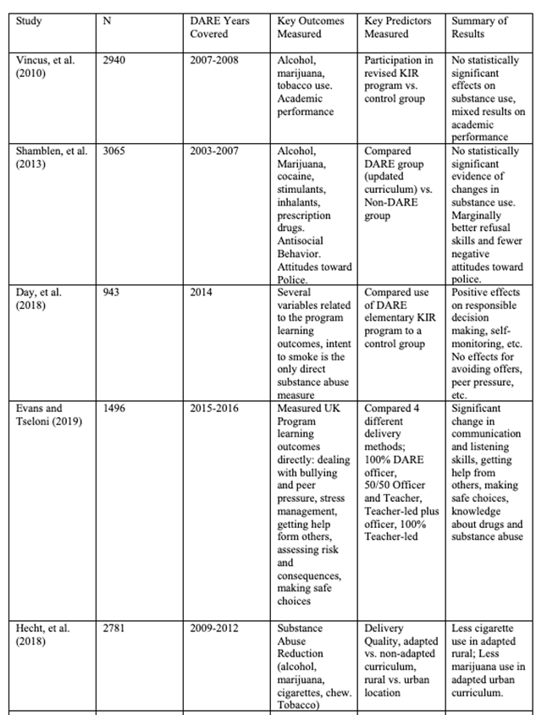
Initial Findings
5 studies identified related to KIR program
Mixed results in terms of substance abuse outcomes
Positive results on some of the revised program goals (listening skills, communication, decision making)
Notes:
Table 1
Of the 5 studies collected so far, 2 showed no statistically significant effect in reduced drug use compared to the former program, mixed results in academic performance, and only marginal improvement in refusal skills and negative attitudes towards police.
3 studies showed positive program results with decision making skills, alcohol or other drug refusal skills, communication and listening skills, as well as less cigarette and marijuana use.
It is interesting to note the two studies showing no significant effect had data collected between 2003 to 2008 (during the piloting and early implementation of KIR) versus the three studies with positive results with data collected between 2009 and 2016.

Slide 10
Initial findings and recommendations
The literature between 2010-2022 was limited; therefore, exposing a significant gap needing to be filled. However, the literature that was able to be found between 2010-2022 showed little to no effectiveness in adolescent drug prevention.
More research is needed to fully evaluate the KIR revisions and the overall effectiveness of the new curriculum. The results so far on the most recent revision, KIR, are therefore inconclusive. We are continuing this study by searching for more previous work studying the KIR Curriculum in order to complete the meta-analysis.

Slide 11
Conclusion
Improving community/police relations
Reduce drug use and violence amongst adolescents
Educate students on the D.A.R.E. decision making model
The KIR curriculum utilizes the SEL theoretical perspective and is supported through a science based education curriculum shifting from a lecture style curriculum to a small group based and interactive learning style.
More research is needed and continued evaluation for program effectiveness.
Notes:
Conclusion
Although there are studies showing a reduction in drug use amongst adolescence. Some are significant and some are not. However, there are none showing an increase in drug use.
This program still serves as an opportunity to improve community and police relations between children and law enforcement.
Instead of pushing the narrative of a drug and violence prevention program, DARE America may consider to promote it as a police and community relations program. With positive police interactions to imprint on the youth within their community, it may serve to promote lasting positive relationship between police and the community—improving police legitimacy and an overall positive relationships between children and the police.
For some children, DARE might be their first interaction with law enforcement while for other children its numerous. Here is at least one positive interaction. 12 classes within the DARE program are 12 opportunities for the DARE officer to imprint a positive influence or image on children.
SEL also educates students on identifying and managing their emotional wellbeing as well as developing or improving their social skills. This is also a positive effect from shifting from a lecture style teaching method to a small group and interactive based learning style.

Slide 12
Additional References
D.A.R.E. America (2022a). D.A.R.E., Teaching students decision making for safe and healthy living. Retrieved July 31, 2022, from https://dare.org/
Pan, W., & Bai, H. (2009). A multivariate approach to a meta-analytic review of the effectiveness of the D.A.R.E. program. International Journal of Environmental Research and Public Health, 6(1), 267–277. https://doi.org/10.3390/ijerph6010267
Singh, R. D., Jimerson, S. R., Renshaw, T., Saeki, E., Hart, S., Earhart, J., & Stewart, K. (2011). Dare (Drug Abuse Resistance Education), I. The National Program. Contemp School Psycho, 15, 93–102. https://doi.org/10.1007/BF03340966

Slide 13
Questions?

