Slide 1
Georgia Peace Officer Standards & Training Council
Mike Ayers
Executive Director
Peace Officers Standards and Training Council
Mike.Ayers@gapost.org
(706)421-8217 (cell)

Slide 2
Welcome to the Peace Officer Standards & Training Council
It is my privilege to welcome you to the Georgia Peace Officer Standards and Training (POST) Council. I truly look forward to your service as a member of this Council, and I want you to know that your work in this role is extremely vital to the law enforcement, corrections, and communications officers of Georgia. You and your fellow Council members help to insure that only the most qualified and best-trained officers are allowed to serve our citizens.
The Georgia POST Council is recognized as a leader in many areas of the peace officer training and certification process. Many exciting projects are being put forth by the POST Council staff in the coming months, and you will be a part of getting these projects implemented to assist Georgia’s academies, agencies, and individual officers. However, there are also many challenges facing our law enforcement community that we must address. A significant effort will be required to accomplish addressing these challenges, and we depend upon your support to assist us in obtaining these very necessary resources.
The Council’s dedicated staff is committed to the mission, vision, and goals. You will find that you can readily call on them to assist you with any questions or concerns. No mission such as ours is a solo effort, and your insight, comments, and assistance in our process are truly appreciated.
Helping shape the future of Georgia law enforcement and defining the direction of the Georgia Peace Officers Standards and Training Council are a tremendous responsibility. You have my personal thanks and the appreciation of Georgia’s law enforcement communities for taking your time to serve.
Sincerely,
Mike Ayers
Executive Director

Slide 3
About Georgia POST Council
The Georgia Peace Officer Standards and Training Council (POST) was established in 1970 by the Georgia General Assembly as a regulatory body. The composition of the Council, its power, and function is established in Title 35 Chapter 8 of the Official Code of Georgia, Annotated. The Council is responsible for the certification and regulation of Georgia's peace officers and other various public safety personnel. Additionally, POST Council is responsible for establishing the minimum training standards and curriculum of the personnel certified by the agency.
The POST Council consists of twenty-two (22) voting members and a number of advisory members and meets quarterly. Members of the Council are appointed from state, county and local law enforcement agencies, professional associations, and from the peace officer population. The Council members serve the peace officers and citizens of this state without compensation.
The purpose of the Georgia POST Council is to ensure that only qualified and well-trained persons are employed and remain employed as peace officers in this state. In order to attain this goal, the Council has been given the statutory authority to enforce those qualifications and training requirements. These are enumerated by laws to ensure standards are maintained by peace officers. In the event that they are not maintained, they serve to allow for actions to decertify, suspend or take corrective measures against officers who violate those standards.

Slide 4
Georgia POST Council Functions
Developing and adopting quality training for all peace officers, including basic, advanced, specialized and executive levels.
Researching, planning, and establishing policies relative to peace officer training;
Developing, adopting, and issuing advanced or professional peace officer certificates based on education, training, and experience;
Determining whether a peace officer candidate has met legal pre-employment and training requirements;
Refusing to grant a certificate or disciplining certified peace officers and exempt officers who have not met or have failed to maintain the minimal standards or acceptable and prevailing practices of peace officers;
Providing technical assistance by law enforcement units;
Providing and administering the certification of persons qualified to operate speed detection devices and withdrawing and suspending such certifications;

Slide 5
Georgia POST Council Functions (Cont.)
Establishing criteria and certifying schools to conduct training;
Establishing minimum qualifications for school directors and certifying those qualified;
Certifying instructors and withdrawing or suspending such certifications;
Establishing and modifying the curriculum, including methods of instruction, and composing the basic course;
Evaluating schools annually for recertification; and
Withdrawing or suspending certification of schools or school directors who fail to continue to meet or maintain, at any given time, the criteria and qualifications required.

Slide 6
Our Mission
It is the mission of the Georgia Peace Officer Standards and Training (POST) Council to provide the citizens of Georgia with qualified, professionally trained, ethical and competent peace officers and criminal justice professionals.
The Georgia POST Council administers the regulatory process, sets the standards for training and certification, and provides essential technical assistance to the law enforcement community.
The Georgia POST Council provides the highest degree of excellence in public safety service and eliminates unqualified individuals from the law enforcement profession.

Slide 7
The POST Council Composition
The POST Council Consists of twenty-two (22) voting members and is supported by an advisory board. The voting members are comprised of:
An appointee of the Governor who is NOT the Attorney General* | President of the Georgia Association of Chiefs of Police* | President of the Georgia Sheriffs’ Association* | President of the Georgia Municipal Association* | President of the Georgia Association of County Commissioners*
Commissioner of the Georgia Department of Public Safety* | Commissioner of the Georgia Department of Corrections* | President of the Peace Officers’ Association of Georgia* | Chairman of the State Board of Pardons and Paroles* | President of the Georgia Prison Wardens’ Association*
Director of Investigations for the Georgia Bureau of Investigation* | Commissioner of the Georgia Department of Community Supervision* | Commissioner of the Georgia Department of Juvenile Justice* | Commissioner of the Georgia Department of Natural Resources* | And…
* Or their appointed designees.

Slide 8
The POST Council Composition (Cont.)
Eight Members Appointed by the Governor Who Hold Office As:
Chief of Police (1) | County Sheriff (1)
City Manager or Mayor (1) | Municipal Police Officers (2)
County Commissioner (1) | Peace Officers (2)

Slide 9
The Current Council Members
A member other than the Attorney General | Mr. Don Banks
The President of the Georgia Association of Chiefs of Police or Designee | Chief Alan Rowe – Valdosta State University Police Department
The President of the Georgia Sheriffs' Association or designee | Sheriff Jimmy McDuffie –Effingham County Sheriff’s Office
The President of the Georgia Municipal Association or designee | Mayor J. Clark Boddie (Designee)– City of Palmetto
The President of the Association County Commissioners of Georgia or designee | Commissioner Lamar Paris – Union County
The Commissioner of Public Safety or designee | Lt. Col. Billy Hitchens (Designee)
The Commissioner of Corrections or designee | Director Terry Edge (Designee)

Slide 10
The Current Council Members (Cont.)
The President of the Peace Officers Association of Georgia or designee | Scott Andrews
The Chairman of the State Board of Pardons and Paroles or designee | Director Chris Barnett (Designee)
The President of the Georgia Prison Wardens' Association | Warden Cynthia Nelson – Harris County Correctional Facility
Director of Investigations for Georgia Bureau of Investigation or designee | Assistant Director John Melvin (Designee)
Georgia Department of Community Supervision or designee | Asst. Commissioner Scott Maurer (Designee)
Department of Juvenile Justice or designee | Chief Scott Cagle (Designee)
Department of Natural Resources | Major Stephen Adams (Vice-Chairman)

Slide 11
The Current Council Members (Cont.)
A Chief of Police | Chief Mark Amerman – Henry County Police Department
A County Sheriff | Sheriff Mitch Raslton – Gordon County
A City Manager or Mayor | Mayor Mike Eason – Dawsonville, GA
Two Municipal Police Officers other than a Chief of Police | Steve Hyman (Chairman) - Tifton Police Department Captain Bryan Hunter – Byron Police Department
A County Commissioner | Commissioner John Daniel - Haralson County, GA
Two Members who are Peace Officers | Sheriff Ray Paulk, Jr. – Berrien County Sheriff’s Office Sheriff Andy Hester – Turner County Sheriff’s Office

Slide 12
The Current Advisory Members
The advisory members are appointed by Council to serve in an advisory capacity and represent a cross-section of the criminal justice system.
State Officer(s) | Director Chris Wigginton - Georgia Public Safety Training Center
Association Director(s) | Mr. Butch Ayers - Executive Director, Georgia Association of Chiefs of Police Mr. Terry Norris - Executive Director, Georgia Sheriffs' Association Inv. Mark Adair – President, Georgia Internal Affairs Investigator’s Association
Communications | Lt. Barry Woodward – Decatur Police Department

Slide 13
The Current Advisory Members (Cont.)
The advisory members are appointed by Council to serve in an advisory capacity and represent a cross-section of the criminal justice system.
Campus Law Enforcement | Chief N.T. Marinelli – Georgia Perimeter College Police Department
Technical College System | Jennifer Ziifle
Police Chief(s) | Chief Wayne Dennard – Acworth Police Department Chief Bruce Hedley – Lilburn Police Department
University System of Georgia | Chief Mike Coverson Stan Crowder – Kennesaw State University
Georgia Military College | Lt. General William Caldwell, IV

Slide 14
The Current Advisory Members (Cont.)
The advisory members are appointed by Council to serve in an advisory capacity and represent a cross-section of the criminal justice system.
Law Enforcement Officer(s) | Sheriff Dan Kilgore – Upson County Sheriff’s Office Chief Mike Register – Cobb County Sheriff’s Office Major Fred Watson – Atlanta Police Department
Georgia Emergency Management Agency (GEMA) | Director Greg Whitaker – Local Government 911 Authority
Federal Law Enforcement Training Center | Thomas Walters

Slide 15
Powers of the Council
O.C.G.A. § 35-8-7
Certify peace officers
Develop training curricula
Certify schools and their directors
Establish qualifications for instructors
Refuse to grant certificates to or to discipline peace officers
Develop, adopt and issue advanced or professional peace officer certificates
Provide and administer the certification of speed detection operators

Slide 16
Sanctions the Council is Empowered to Administer
O.C.G.A. § 35-8-7.1
Refuse to grant certification to applicant
Issue public reprimand
Suspend certificate for a definite period
Limit or restrict certificate
Revoke certificate
Condition penalty, or withhold disposition until officer completes care, counseling or treatment directed by the council
Place officers on probation with reasonable terms

Slide 17
Committee Duties & Responsibilities

Slide 18
The Agency

Slide 19
The Agency (Cont.)
The Executive Director oversees the operation of the Council’s staff and is responsible for ensuring that the Council’s policies are executed.

Slide 20
The Agency (Cont.)
Processes applications for various peace officer certifications
Issues basic and voluntary certifications
Certifies Speed Detection Operator status
Needs training standards information!!!

Slide 21
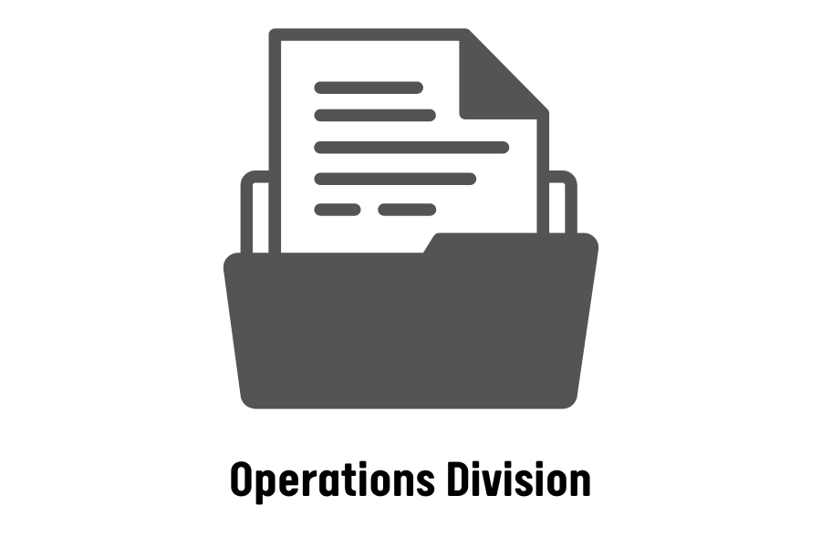
The Agency (Cont.)
Maintains computerized and hard copy files of peace officer records
Fulfills Open Records Requests (ORR)
Conducts pre-hearings
Coordinates projects
Monitors individuals placed on probation by the Council
Coordinates Council hearings pertaining to sanctions imposed upon an officer’s certification
These proceedings are conducted in accordance with the Administrative Procedures Act (O.C.G.A. § 50-13)
Conducts agency audits to ensure compliance with state law

Slide 22
The Agency (Cont.)
Investigates allegations of misconduct by a peace officer that are in violation of O.C.G.A. § 35-8-7.1
Conducts investigations of individual applicants who are seeking peace officer certification

Slide 23
The Agency (Cont.)

Slide 24
Georgia Peace Officer Population
51,000+
FY2023

Slide 25
Georgia Peace Officer Certification Requirements
O.C.G.A. § 35-8-8
18 years of age
U.S. citizen
High school diploma
Processed GCIC and NCIC fingerprint cards
Free from physical, emotional or mental conditions which would affect exercising power of arrest
Entrance examination
Not been convicted of felony or sufficient misdemeanors
Possess good moral character as determined by a background investigation

Slide 26
POST Certification Process

Slide 27
Required Annual In-Service Training
20 hours each calendar year
Must include a minimum of 5 of the required 20 hours for:
Firearms Requalification – 1 hour
User of Deadly Force – 1 hour
De-escalation – 1 hour
Community Policing – 1 hour
Must be POST recognized training, including online training

Slide 28
Where to Get Annual Training
Department in-service
Regional academies
Georgia Public Safety Training Center
In-state POST approved seminars
Out-of-state training programs submitted to POST for recognition

Slide 29
Training Deficiency Consequences
LOSS OF ARREST POWERS
Occurs when annual training requirements are not met by midnight of December 31st.
Loss of arrest powers is effective at 12:01 a.m. on January 1st.

Slide 30
Recovering Arrest Powers
Procedures and Processing Fees
First and second waiver
May be granted by POST Council staff under POST rules
First waiver - $200 processing fee, if applicable
Second waiver - $400 processing fee
Third waiver
Must go before Council to explain
Third waiver - $400 processing fee

Slide 31
Notifying POST
Officer Responsibilities
An officer must notify POST of
Arrests
The officer has 15 days to notify POST of an arrest
Suspensions of 30 or more days
Indictments/presentments
Convictions/bond forfeitures
Minor traffic citations need not be reported

Slide 32
Notifying POST
Agency Responsibilities
An agency must notify POST of
Arrests
Suspensions of 30 or more days
Indictments/presentments
Convictions/bond forfeitures
Discharging an officer for disciplinary reasons
Accepting resignations in lieu of termination or during an internal investigation
Disciplinary demotions
The agency has 15 days to notify POST

Slide 33
Notifying POST
Agency Reporting Process
Submit a Change of Status (C11) form through the POST Data Gateway
Include all information related to any incident
Avoid ambiguity, such as “department rules violation”
Give specific details of rule and act of violation
Provide all necessary documentation including
Police reports
Statements
Related disciplinary/termination letters

Slide 34
Sanctioning Process

Slide 35
Hearings Process

