Slide 1
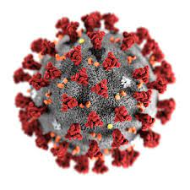
To Tell The Truth: What are the real numbers related to COVID-19 deaths?
Jon Hager
University of North Georgia
Department of Criminal Justice

Slide 2
Perception of Deaths

Slide 3
The Conundrum of Accurate COVID-19 Deaths
“People are not dying from, but with, COVID-19. Deaths classified as from COVID-19 result from largely false positive polymerase chain reaction (PCR) test results” (Oliver, 2021, p. 1).

Slide 4
Undercounting of COVID-19 Deaths?
1. Black
2. Indigenous
3. Latinos (Kreiger, 2021)

Slide 5
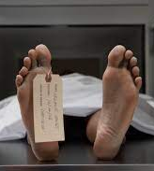
Determining the Cause & Manner of Death
1. Full Autopsy
2. Limited Autopsy
3. External Examination
4. Sign Out

Slide 6
Inside the Numbers (Fulton County Board of Health Epidemiology, 2020)
1. December 1, 2020 = 37,504 cases
2. 670 Confirmed Deaths
3. 79 Deaths Under Investigation

Slide 7
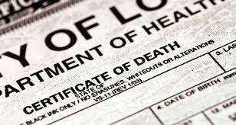
Inside the Numbers (Fulton County Medical Examiner’s Office)
1. 29 Certified Deaths
2. 2 of 29 (6.8%), Full Autopsy
3. 1 of 29 (3.4%), Limited Autopsy
4. 26 of 29 (89.6%), External Exam or Sign Out

Slide 8
Hospital Fraud?

Slide 9
Criminal Justice vs COVID-19 Council on Criminal Justice
Key Findings & Recommendations (5)
1. Ill-preparation for public health crisis
Create crisis plan (CJ, public health, community-based org.)
2. Absence of an effective public health coordination
Rebalance public health & CJ system (Social Distance, Limit Contact, Reduce Density)

Slide 10
Criminal Justice vs COVID-19 Council on Criminal Justice (cont)
Key Findings & Recommendations (5)
3. Lack of consistency & variation of responses
Adoption of shared best practices
4. Inability to respond quickly due to lack of reliable data and research
Increase research & collection of data for the CJ population

Slide 11
Criminal Justice vs COVID-19 Council on Criminal Justice (cont)
Key Findings & Recommendations (5)
5. Lack of transparency & communication among CJ agencies
Develop & invest in a reliable means of communication

Slide 12
Questions?

Slide 13
References
1. Council for Criminal Justice. (2020). Experiencing to action: Reshaping criminal justice after COVID-19. [Online] [September 11, 2021] final_report_-_designed.83f2289da58b
2. Krieger, N. (2021). Counting for accountability in a time of catastrophe: COVID-19 and other deaths, cohorts, color lines, and dollar signs. American Journal of Public Health, 111(S2), S91–S92.
3. Oliver, D. (2021). David Oliver: Mistruths and misunderstandings about COVID-19 death numbers. BMJ; 372: n352. doi:10.1136/bmj.n352

