Slide 1
Police Unions- Why there are none in Britain
Criminal Justice Association of North Georgia
Fall 2021 Conference
Friday 8th October 2021
Dr. M.Hanif Majothi, Associate Professor M.Hanif.Majothi@ung.edu
College of Arts & Letters

Slide 2
Objectives
1. A ‘problem’ with US Police Unions
Interference with police disciplinary procedures
Public perceptions
2. Why there no unions in Britain now
Previously
National Union of Police
& Prison Officers (NUPPO)
1918 & 1919 Police strikes
British Government strategy & action
Argument: Adoption some such strategies could assist assuage US public opinion regarding the ‘problem.
With reference to primary sources from the National Archives (TNA) Kew- London

Slide 3
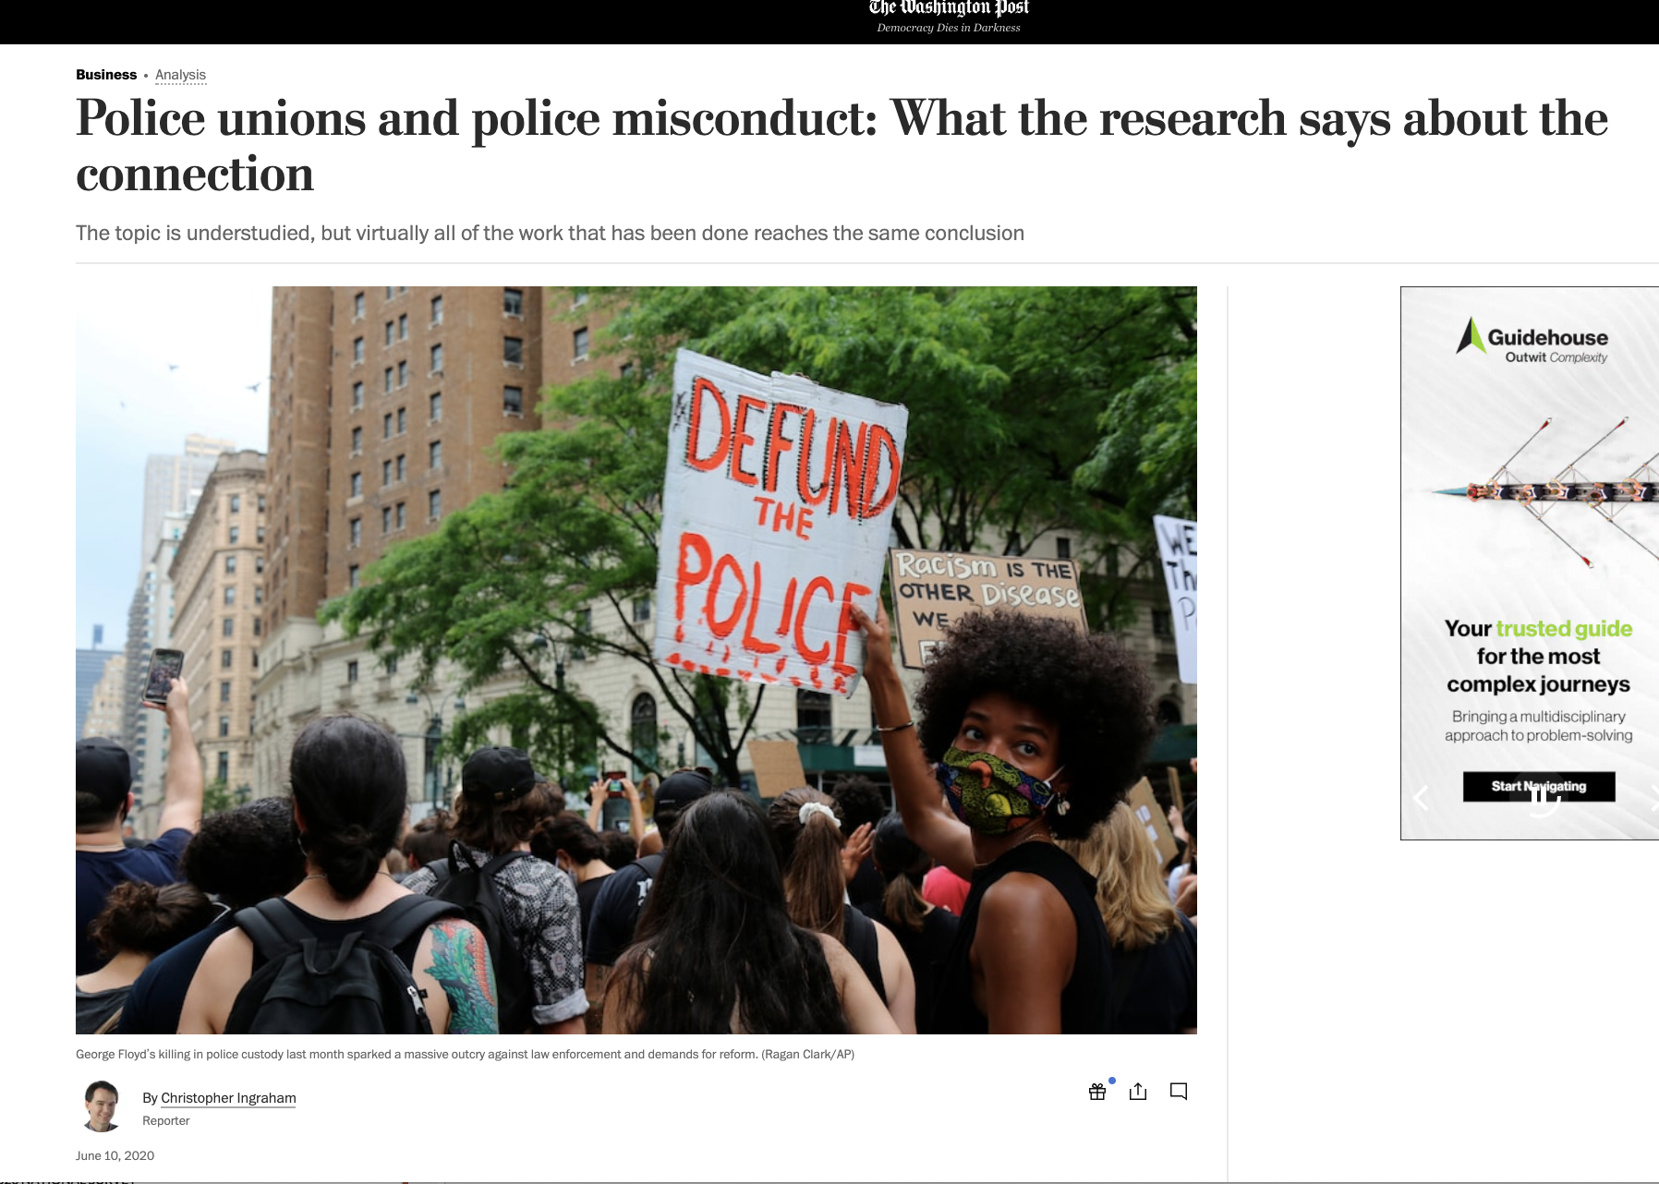
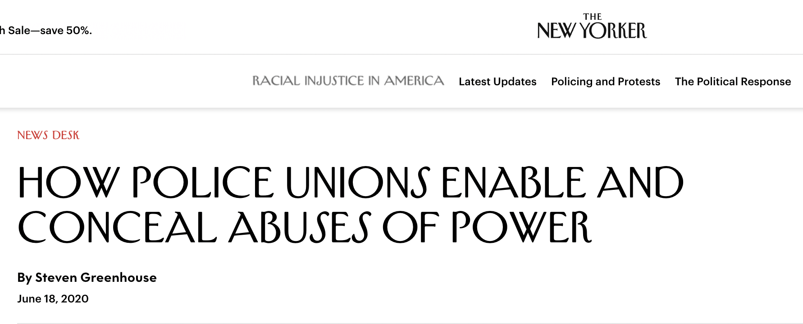
1. A ‘problem’ with US Police Union -Public Perception

Slide 4
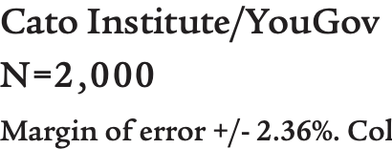
Survey Data re: the ‘Problem
https://www.cato.org/survey-reports/poll-63-americans-favor-eliminating-qualified-immunity-police#police-unions

Slide 5
Survey Data re: the ‘Problem
N=36,463 U.S. adults,
95% confidence (+ 1.4% sampling error)
https://news.gallup.com/poll/315962/americans-say-policing-needs-major-changes.aspx

Slide 6
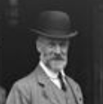
2. Why Britain does not have Police Unions Timeline of British Police Union Movement to Sept 1918
Police Strike
in London
Jan 1914
NUPPO formed
Mid-Feb 1917
15 NUPPO
members sacked
Early 1918
12,000 NUPPO
Members in London
Pre 1913
1875-
1890-
30 Aug 1918
1913
Jan 1916
NUPPO membership
Banned
(TNA MEPO 3/254 )
Aug 28 1918
PC Tommy Thiel
dismissed
Nov 1917
Q’s in Parliament
re Police discontent
(HoC Hansard, 29 Nov 1917).
John Syme League 1912 >
Metropolitan Police Union
Objective –Pay & Conditions
(TNA HO/24576)
Notes:
A national union of police and prison officers was formed in 1913 by John Syme a Metropolitan Police Inspector who was dismissed for threatening to write to his MP in 1910, to air his grievances. In 1918 there was a police strike by Metropolitan Police officers over pay and they also wanted to be able to join the Police and Prison Officers Union. Lord Desborough was appointed to head a committee of enquiry and this reported in 1919. The subsequent Police Act of 1919 gave rise to the Police Federation.
‘The John Syme League’ in August 1912 and under that banner, eventually established the ‘Metropolitan Police Union’ on 24th October 1913,
To support his campaign, Syme formed ‘The John Syme League’ in August 1912 and under that banner, eventually established the ‘Metropolitan Police Union’ on 24th October 1913, with the objective to campaign for matters such as pay, conditions of service and promotion.
Consequently, five Metropolitan Police officers were dismissed for belonging to NUPPO As this order now specifically targeted the union by name, it was an acknowledgement by the authorities that NUPPO was becoming a notable threat to police discipline.
This reminder to police officers in London not to join NUPPO was not an empty threat as into as by mid-February 1917, sixteen officers had been dismissed and others fined for NUPPO activities. This crackdown by the authorities put desired strain on NUPPO activism, as this could not now be done in the open but it also drove the movement underground.
TNA MEPO 3/254, File 147595/17, Initially there were three but subsequently two more were also sacked; "Three Policemen Dismissed," The Globe, Friday Evening, November 17, 1916.1.; These dismissals on the 16th caused questions to be asked in Parliament regarding whether a police union should now be allowed. See: PA, Hansard, Police (Trade Unions), HC Deb 19 December 1916 vol 88 cc1302-3 [Thomas, Cave, Duncan, Thorne]
"Police and Prison Officers’ Union," The Herald, March 17, 1917.3.; "More Policemen Dismissed," The Times, Friday, February 16, 1917.
"Police Union Still Struggling," The Herald, Saturday, 17 February 1917.8.

Slide 7
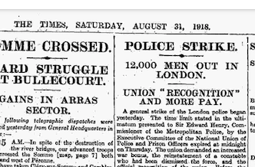
Why Britain does not have Police Unions Timeline of British Police Union Movement to Aug 1918
Strike Demands
Pay & Conditions
Reinstatement of Thiel
1918 Police Strike
in London
31 August
4176 out of 7381 officers
(52% of workforce)
on strike
(TNA MEPO 3/257A)
Press reports -
Govt Alarmed-
Capitulates to most Union Demands
NUPPO not recognized
Notes:
A national union of police and prison officers was formed in 1913 by John Syme a Metropolitan Police Inspector who was dismissed for threatening to write to his MP in 1910, to air his grievances. In 1918 there was a police strike by Metropolitan Police officers over pay and they also wanted to be able to join the Police and Prison Officers Union. Lord Desborough was appointed to head a committee of enquiry and this reported in 1919. The subsequent Police Act of 1919 gave rise to the Police Federation.
‘The John Syme League’ in August 1912 and under that banner, eventually established the ‘Metropolitan Police Union’ on 24th October 1913,
To support his campaign, Syme formed ‘The John Syme League’ in August 1912 and under that banner, eventually established the ‘Metropolitan Police Union’ on 24th October 1913, with the objective to campaign for matters such as pay, conditions of service and promotion.
Consequently, five Metropolitan Police officers were dismissed for belonging to NUPPO As this order now specifically targeted the union by name, it was an acknowledgement by the authorities that NUPPO was becoming a notable threat to police discipline.
This reminder to police officers in London not to join NUPPO was not an empty threat as into as by mid-February 1917, sixteen officers had been dismissed and others fined for NUPPO activities. This crackdown by the authorities put desired strain on NUPPO activism, as this could not now be done in the open but it also drove the movement underground.
TNA MEPO 3/254, File 147595/17, Initially there were three but subsequently two more were also sacked; "Three Policemen Dismissed," The Globe, Friday Evening, November 17, 1916.1.; These dismissals on the 16th caused questions to be asked in Parliament regarding whether a police union should now be allowed. See: PA, Hansard, Police (Trade Unions), HC Deb 19 December 1916 vol 88 cc1302-3 [Thomas, Cave, Duncan, Thorne]
"Police and Prison Officers’ Union," The Herald, March 17, 1917.3.; "More Policemen Dismissed," The Times, Friday, February 16, 1917.
"Police Union Still Struggling," The Herald, Saturday, 17 February 1917.8.

Slide 8
Why Britain does not have Police Unions Timeline of British Police Union Movement to July 1919
Jan – July 1919
NUPPO continues to agitate threatening another strike
Context –
Major Industrial Strikes in UK
April 2019 –
Directorate of Intelligence formed
(TNA, CAB 127/356 )
Fear of Bolshevism
Reports that officers are not politically militant -
Government offers even better pay & conditions
Sir Basil Thomson
A non-union body offered

Slide 9
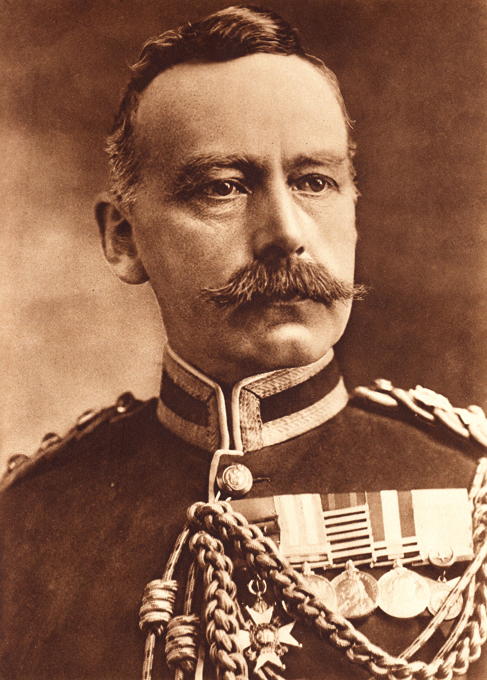
Why Britain does not have Police Unions Timeline of British Police Union Movement to July 1919
July 2019
Another NUPPO activist is sacked -
NUPPO calls for another strike
31st July 2019
National Strike Called
New Police Commissioner threatens instant dismissal of any strikers with no reinstatement
Government does not capitulate this time
1020 officers striking in London immediately sacked
Sir Neville Macready
Further Government Action
Pay increase for rank & file
A non-union Police Federation created to replace NUPPO
NUPPO dies
a slow death
Police Act 1919

Slide 10
Conclusion
1918 – Government succumbs to NUPPO strike demands
1919 – NUPPO threatens another strike
Government uses intelligence to gauge reasons for union support - pay & conditions
Government stands up to NUPPO strike
Creates Police Federation to represent member’s interests
Federation can negotiate pay but have no say in discipline matters.
Can any such strategy from history be applied to the US context?

Slide 11
References
TNA HO 45/24576, ‘Case of ex-Inspector Syme’
HoC, Hansard, Metropolitan Police, HC Deb 28 November 1917, Vol. 99, c2051W [Wiles, Cave, Touche];
TNA, CAB 127/356 – Minutes of Third Meeting, Secret Service Committee, dated 4th April 1919
TNA MEPO 3/257A

