Slide 1
Psychosocial Processes and offline neighborhood outcomes in Online Neighborhood Networks (ONNs)
MariTere Molinet
PhD Candidate, Criminology and criminal justice
Georgia state university

Slide 2
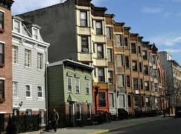
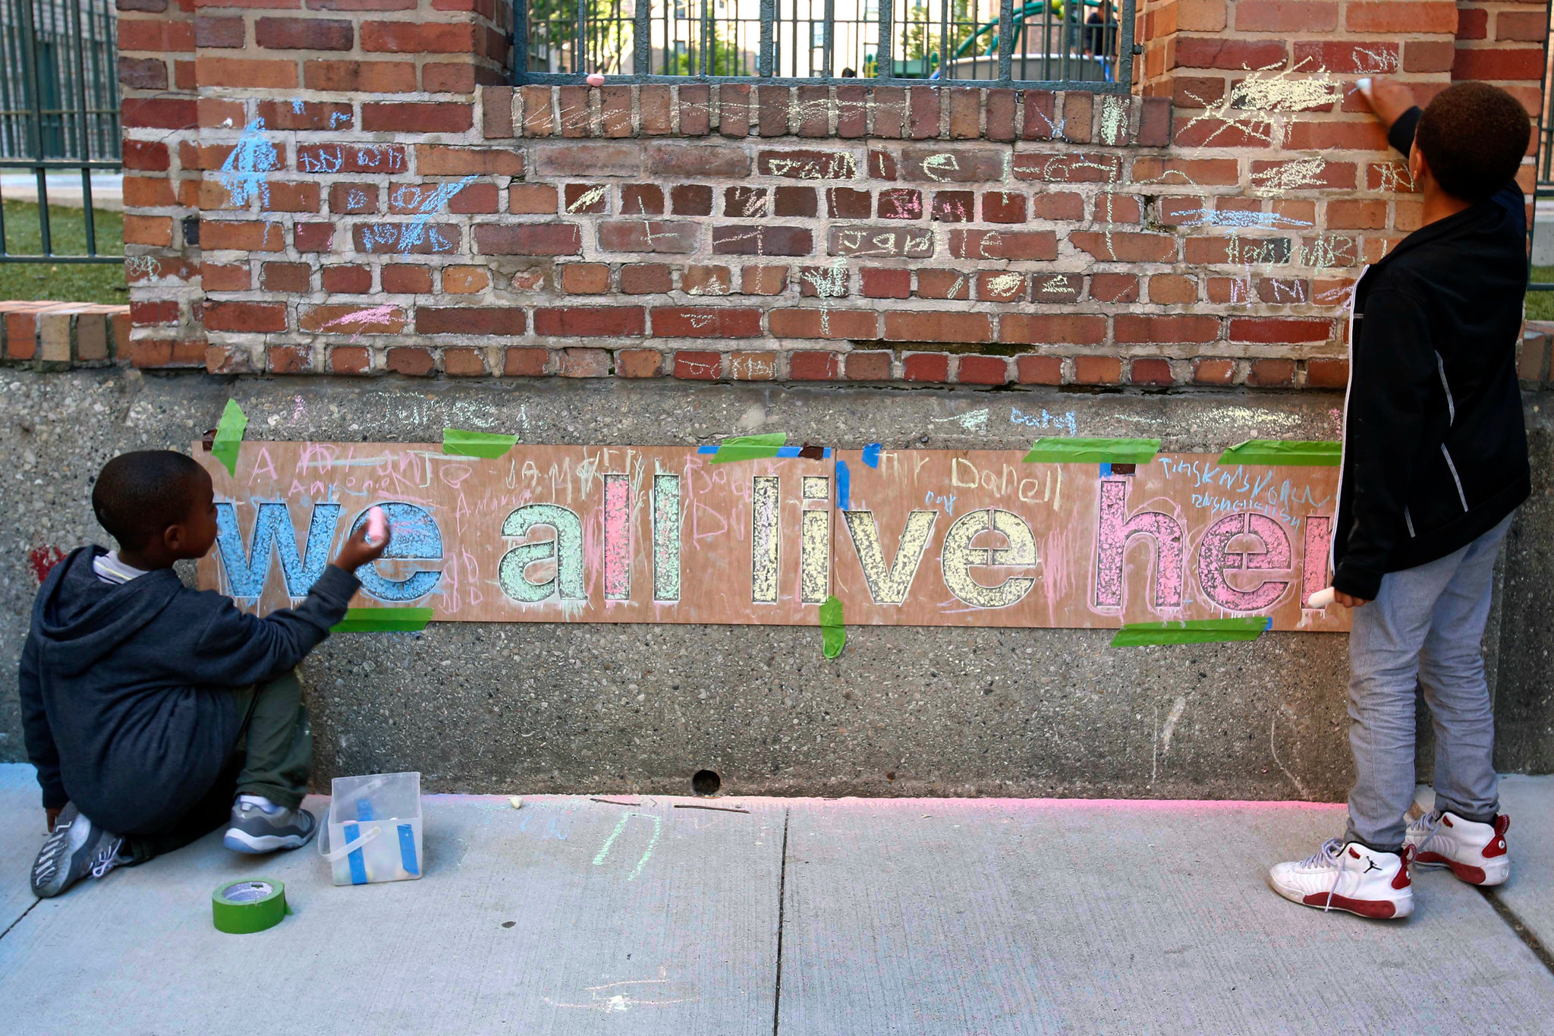
Theoretical Framework
Social Disorganization Theory
Presupposes structural characteristics explain variations in neighborhood crime
Alternative Perspective – Systemic Model – Emphasizes neighborhood process and change
Collective Efficacy – Indirect effect on variations in neighborhood crime
Social process embedded in social disorganization assumptions
“social cohesion among neighbors, combined with their willingness to intervene on behalf of the common good (Sampson et al, 1997, p. 918).”

Slide 3
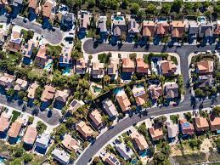
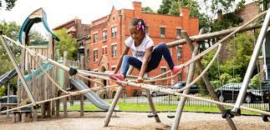
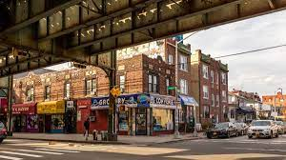
What IS a Neighborhood?
“…a social/spatial unit of social organization, and that it is larger than a household and smaller than a city… (Hunter, 1979)
Units nested within larger communities (Sampson et al, 2002)
Keyword: SPACE
What do YOU think your neighborhood is?

Slide 4
Social Media Dynamics
Characteristics of Social Media
Associated to both bridging and bonding social capital
Afford users with social capital components where they can increase potential resources and make action possible through a system embedded in “social cues”
Effective in strengthening and maintaining weak ties
The process is reciprocal since as weak ties are strengthened, trust is nurtured, and so is the motivation to communicate, exchange information, seek support, and even mobilize

Slide 5
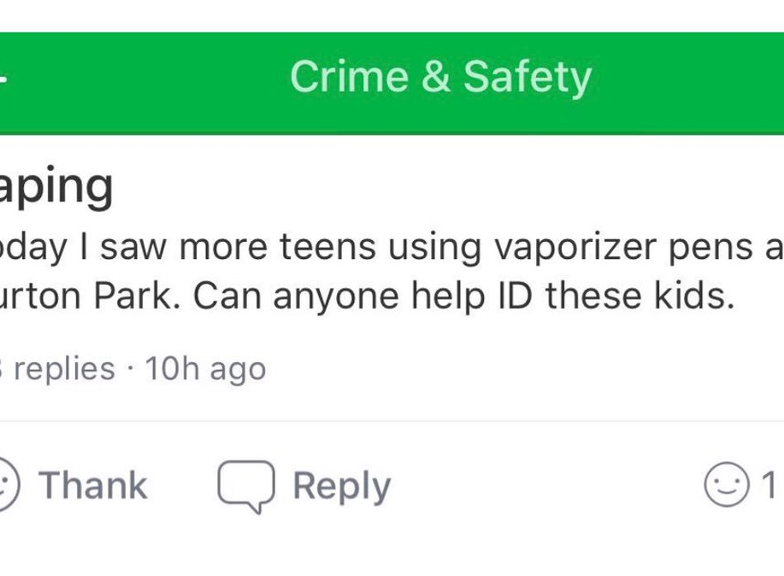
ONN Dynamics
What exactly is an ONN?
Restricted social media platforms designed to organize neighborhoods and connect neighbors online based on socio-spatially defined boundaries and identity verification
Distinct from other social media in its membership protocols and spatial delineation of neighborhoods
Delineated by the applications, the neighbors, or a combination of both
Exchange of neighborly information goes back to the 1990s
More than just Nextdoor

Slide 6
The Need to Connect….
Social Connectedness
Rooted in belonginess theory which states that humans have a pervasive need to belong and form social bonds
Develops through the life course but experiences and relations contributes to one’s sense of connectedness
Subjective belief on one’s relationship with others
Distinct from social capital
Online Social Connectedness
May be distinct from offline social connectedness yet moderated by it
Social awareness, social presence, and frequency of use influence online social connectedness

Slide 7
One Possible Model of Online Processes
Online Social Integration
Positive Outcomes
Online Social Connectedness
Online Collective Efficacy
Negative Outcomes
Online Social Ties

Slide 8
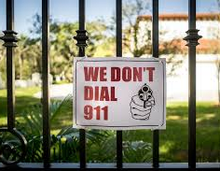
Possible Outcomes
Exclusiveness, Marginalization, Profiling, Vigilantism
Social capital theory
Disparate access to online access
Digital Redlining
Posts that push the boundaries and increases the fear of crime feedback loop
Offline Neighborhood Social Controls
Residents act on their online collective efficacy beliefs and are able to exercise informal or formal social controls and encourage others to do so as well

Slide 9
Considerations for Research
Need to deal with issues contextually specific to Internet Communication Technologies (ICT)
Beyond spatial delineation: Access, barriers, and resident perceptions of what is their neighborhood
Self-Selection and self-organization at multiple levels - Different and multiple methods of participation
Structural characteristics still matter.
Digital access and use could be considered a structural characteristic in this environment.
Consider how offline processes impact online neighborhood dynamics.

