Slide 1
Criminal Justice in the News TILTed: Tilting current events assignment for Criminal Justice courses
Dr. Jason Armstrong
Dr. Pamela Pitman Brown
Dr. Sarah Kuck
Notes:
This session will focus on a series of small teaching practices related to Transparency in Learning and Teaching. The strategies support student engagement in the social sciences.

Slide 2
TILT
TILT is Transparency in Learning & Teaching.
The goal is to make the learning process explicit and equitably accessible for all students.
The Three-Part Transparency Framework (Purpose/Task/Criteria) begins with having discussions about the work, and several aspects of the work PRIOR to actually doing the work. The remainder of the discussions between faculty/student are: covering the purpose of the work, the tasks involved in completion of the work, and the expected criteria of the final product.
Additionally, there are real world work samples in what each of the products should look like.
AND these are accessible to the students.
CJAG: Fall 2021
Notes:
This session will focus on a series of small teaching practices related to Transparency in Learning and Teaching. The strategies support student engagement in the social sciences.

Slide 3
Purpose: Criminal Justice in the News in CRJU 1101
Assignment Name: Criminal Justice in the News (CJiTN)
Skills: The purpose of this assignment is to gain an understanding of how criminal justice and criminology theories, themes, and concepts relate to the real world/work of criminologists and criminal justice professionals. The assignment will help you practice the following skills:
Identify core concepts in criminology and criminal justice
Illustrate how criminal justice and criminology concepts, themes, and theories introduced in the classroom have real world applicability
Engage in critical thinking to gain a better understanding of the society in which you live
Communicate criminological knowledge in the discipline in appropriate written form
Knowledge: This assignment will also help you to become familiar with the following important content knowledge in Criminal Justice:
Theoretical perspectives Constitutional Amendments Criminal Justice themes/concepts
Rational Choice theory 1st Amendment War on Drugs
Trait theory 2nd Amendment War on Terror
Social Structure theory 4th Amendment Victimization
Social Process theory 5th Amendment Ethics
Critical theory 6th Amendment Death penalty
Developmental theory 8th Amendment Recidivism
CJAG: Fall 2021
Notes:
This session will focus on a series of small teaching practices related to Transparency in Learning and Teaching. The strategies support student engagement in the social sciences.

Slide 4
The Task: Criminal Justice in the News in CRJU 1101
The Task:
Explanation of Activity: For each CJiTN assignment you will do the following:
Locate a current news article from a reputable online news source (such as the Associated Press, NPR, Washington Post, Time, Newsweek, etc.), concerning criminal justice themes/concepts. Suggestion: Go to “Google” and go to the “news” tab. Type in a theme, concept or even the title of the chapter that we are studying that week. Search for a current news article (within the last six months).Read the article and determine if it meets the current news article time frame of 6 months. Determine if the article has enough information on the theme/concept you chose.
Use the template provided to complete your two paragraph summary of the article, and then complete a third paragraph that links what the news article is saying back to your chosen theme/concept.
Make sure that you DO include the hyperlink where located in the template. THIS IS IMPORTANT!
Make sure that you DO include citations in your paper from your textbook. You may simply cite as follows: (Text, p. xxx). Insert the page number where you located information where the xxx is in the example.
Make sure that your article is within the 6 month time frame (count backward from the due date 6 months). If the due date is November 11th, and the article is written on February 7th, then the article is not within the six month time frame.
Check your grammar and spelling.
Do NOT directly copy the article word for word for your summary. Your summary is your words, not the author’s.
CJAG: Fall 2021
Notes:
This session will focus on a series of small teaching practices related to Transparency in Learning and Teaching. The strategies support student engagement in the social sciences.

Slide 5
Criteria: Criminal Justice in the News in CRJU 1101
Criteria:
The criteria for each CJiTN assignment is as follows:
You MUST use the template provided. The template is there to help you follow the instructions and gain the maximum points for the assignment. If you fail to use the template the project will be returned to you for a revision.
Each paragraph MUST contain at least five sentences. Last paragraph must contain in-text citations from your text.
You MUST include the hyperlink where located in the template. If you fail to insert the hyperlink, the project will be returned to you for a revision.
You MUST include citations in your paper from your textbook.
You MUST make sure that your article is within the 6 month time frame (count backward from the due date 6 months). If the article is not within a 6 month time frame, your assignment will be returned to you with a zero and you will be allowed 48 hours to redo the assignment.
Check your grammar and spelling count.
Do NOT directly copy the article word for word for your summary. Your summary is your words, not the author’s. If you directly copy the article (Plagiarism), then the assignment will be returned to you with a zero. You will be allowed 48 hours to redo the summary.
CJAG: Fall 2021
Notes:
FINISHING THIS IN THE MORNING!

Slide 6
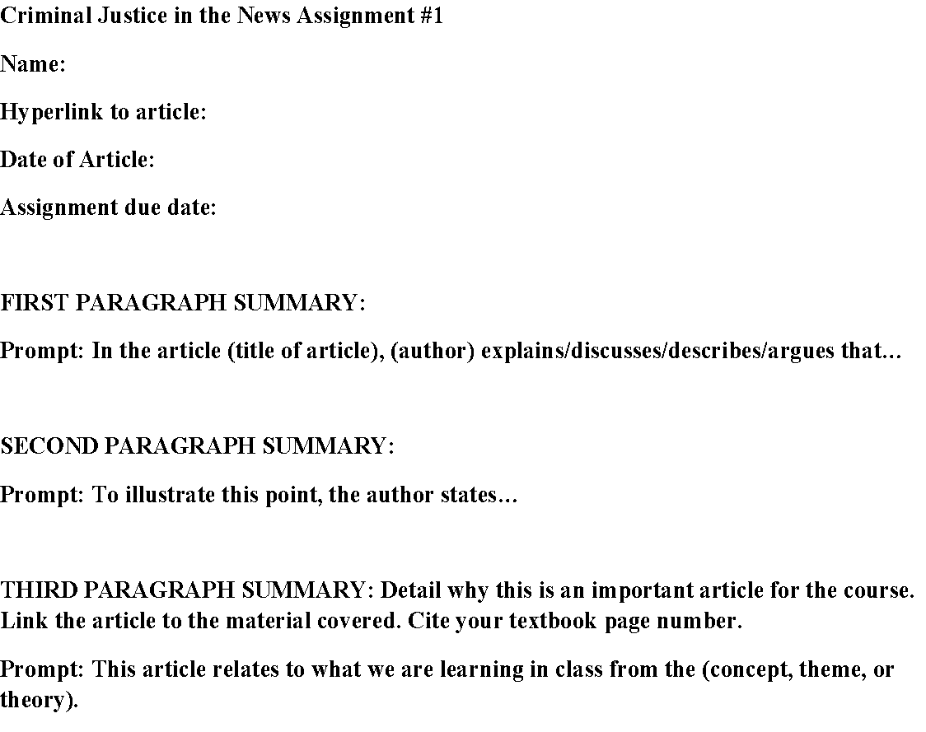
Criteria Examples:
Criminal Justice in the News (CJiTN)
Criteria Examples:
The criteria for each CJiTN assignment is as follows:
You MUST use the template provided. The template is there to help you follow the instructions and gain the maximum points for the assignment. If you fail to use the template the project will be returned to you for a revision.
CJAG: Fall 2021
Notes:
FINISHING THIS IN THE MORNING!

Slide 7
Criteria Examples:
Criminal Justice in the News (CJiTN)
Criteria Examples:
The criteria for each CJiTN assignment is as follows:
You MUST include the hyperlink where located in the template. If you fail to insert the hyperlink, the project will be returned to you for a revision.
CJAG: Fall 2021
Notes:
FINISHING THIS IN THE MORNING!

Slide 8
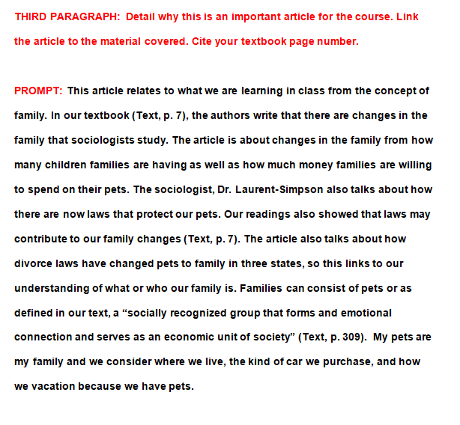
Criteria Examples:
Criminal Justice in the News (CJiTN)
Criteria Examples:
The criteria for each CJiTN assignment is as follows:
You MUST include citations in your paper from your textbook.
CJAG: Fall 2021
Notes:
FINISHING THIS IN THE MORNING!

Slide 9
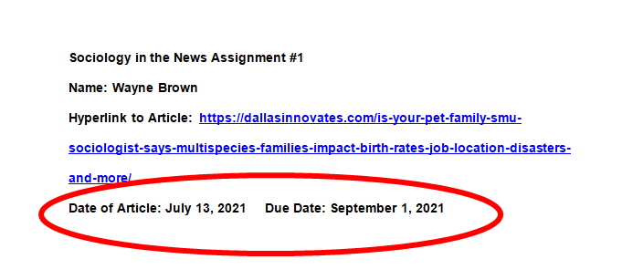
Criteria Examples:
Criminal Justice in the News (CJiTN)
Criteria Examples:
The criteria for each CJiTN assignment is as follows:
You MUST make sure that your article is within the 6 month time frame (count backward from the due date 6 months). If the article is not within a 6 month time frame, your assignment will be returned to you with a zero and you will be allowed 48 hours to redo the assignment.
CJAG: Fall 2021
Notes:
FINISHING THIS IN THE MORNING!

Slide 10
Course Options
Face-to-face: In addition to the assignment, you can have each student do an oral presentation throughout the semester.
Pre-selected and/or random
Online: This could be modified to become your weekly discussion assignment.
Hybrid: Can use either of the two above options to fit your particular course design
CJAG: Fall 2021
Notes:
This session will focus on a series of small teaching practices related to Transparency in Learning and Teaching. The strategies support student engagement in the social sciences.

Slide 11
Questions?
Dr. Jason Armstrong, Assistant Dean – College of Business, Education, & Professional Studies & Asst. Professor of Criminal Justice
229-500-2376
Jason.Armstrong@asurams.edu
Dr. Pamela Pitman Brown – Director, Center for Faculty Excellence & Associate Professor of Sociology
Pamela.brown@asurams.edu
229-500-2165
Dr. Sarah Kuck – Executive Director of Academics, eMajor & Professor of Political Science
Sarah.kuck@asurams.edu
229-500-2259
CJAG: Fall 2021

