Slide 2
BEYOND THE BOX
Inclusivity in education for Georgia

Slide 3
Introductions
Beyond the Box Founding Members
Abigail Cook
Patrick Rodriguez
Georgia State University
Kennesaw State University
Notes:
Each of us has fifteen seconds to introduce ourselves.

Slide 4
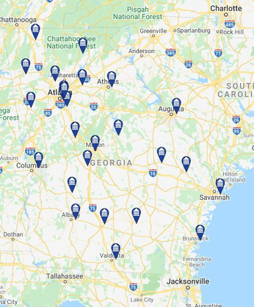
Research
Findings
Method: We filled out each application for all 26 USG schools, until we ran into the question that asked about criminal history conviction.
Some universities allow explanations, others don't.
2/3 students with criminal history will abandon the application
Where on the application do USG schools ask the criminal history question?
42%
Middle
All USG schools ask the criminal history question
27%
Beginning
Georgia has the highest incarcerated and supervised population in the WORLD.
31%
End

Slide 5
A Look at Georgia
01
02
03
04
Value
Problem
Solution
Action
Education
Justice
Georgia's recidivism rate is 50%
Annual costs for the system total to over $1 billion.
Education is fostering a poor environment for system impacted people.
Removing the criminal history question from college applications.
USG schools costs HALF as much per year as incarceration.
The recidivism rate among system impacted people with a Bachelor's degree is 5.6%
Collaborate
Conversate

Slide 6
Let's reimagine justice to be smart, humane, and economical.
www.beyondtheboxga.com

