Slide 1
Back the Blue Hurts Police
Tom Hochschild Jr.
Lorna Alvarez-Rivera
Valdosta State University

Slide 2
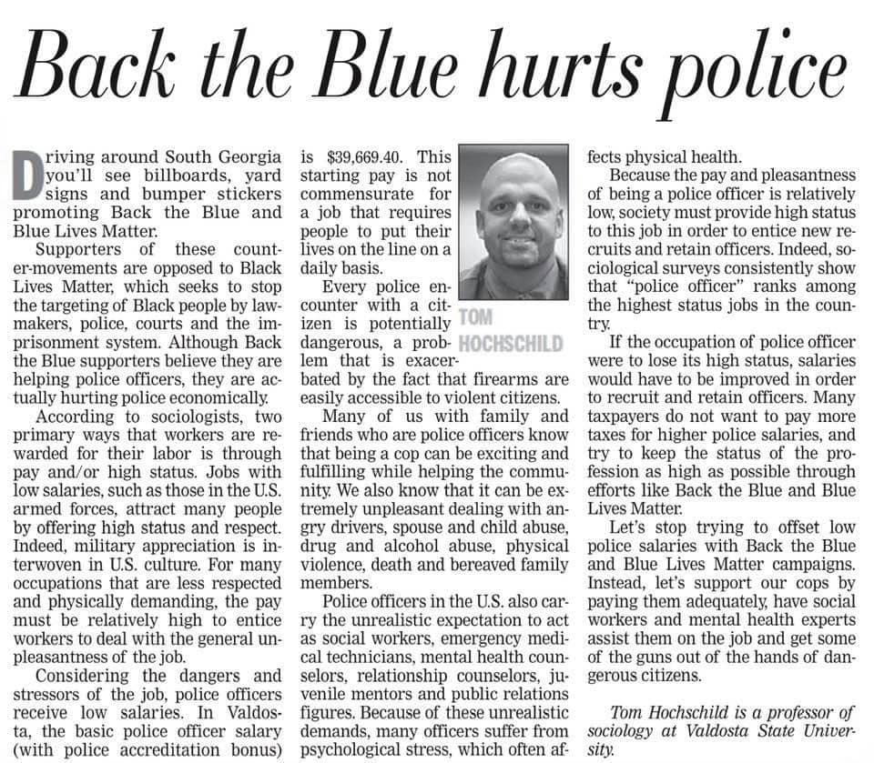

Slide 3
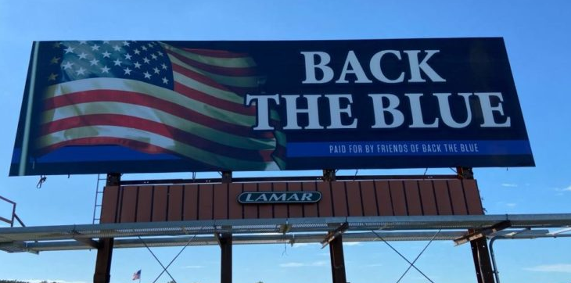
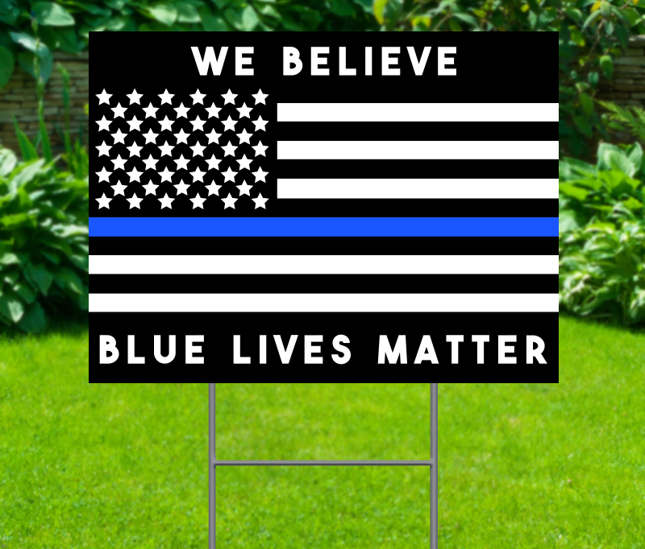

Slide 4
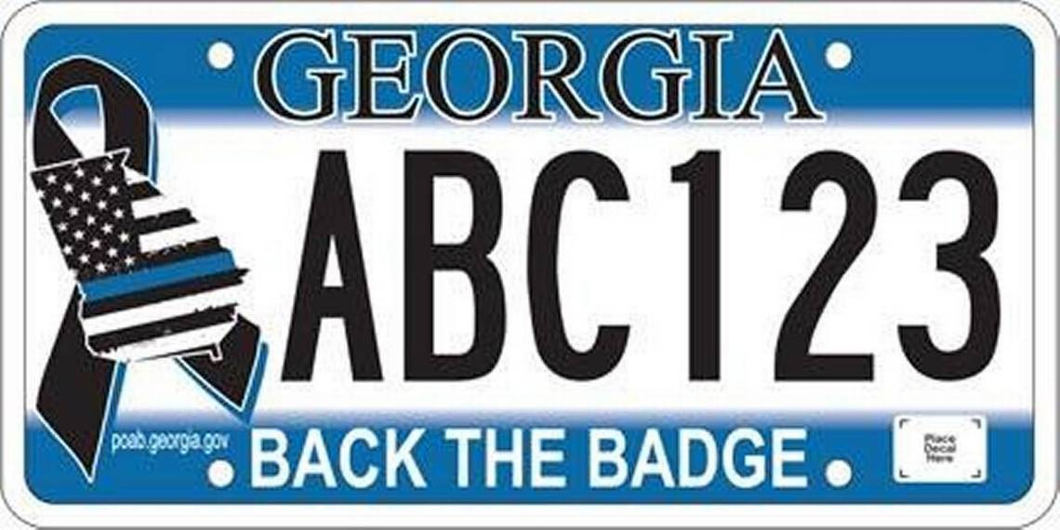

Slide 5
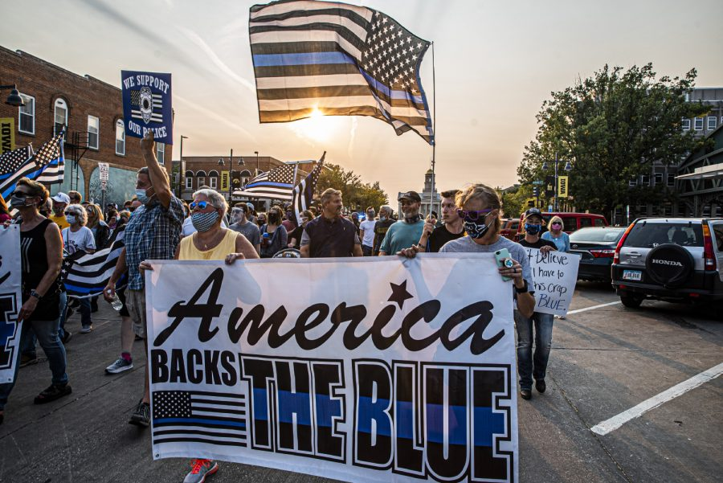
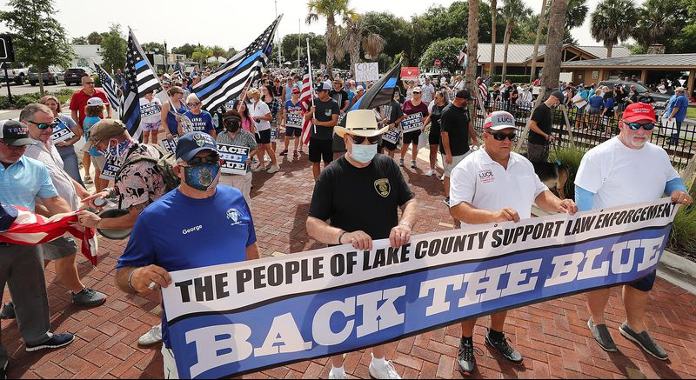
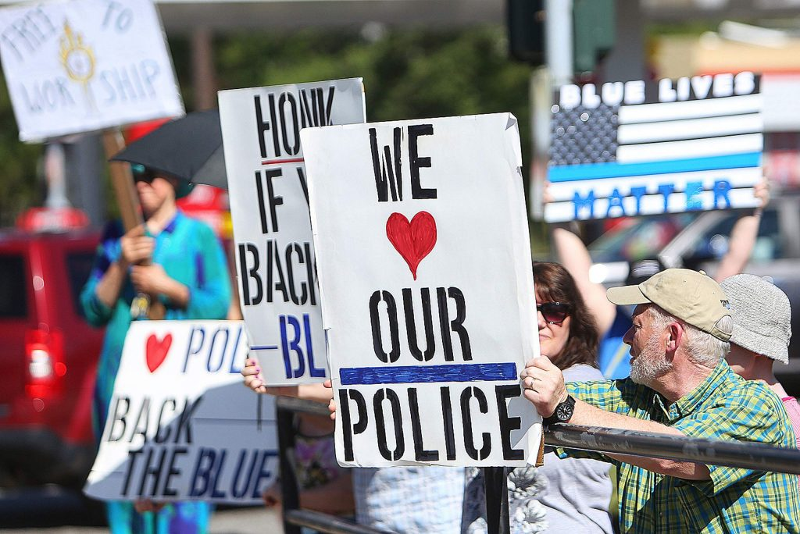
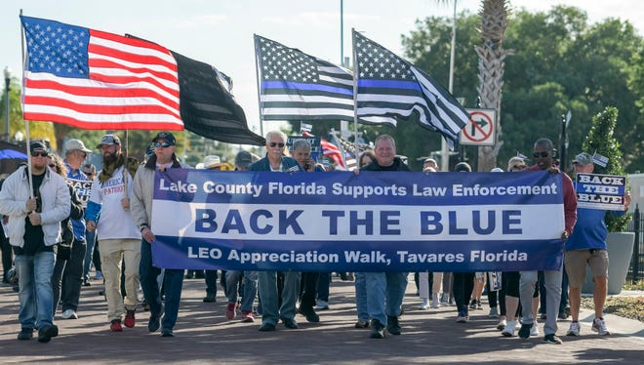

Slide 6
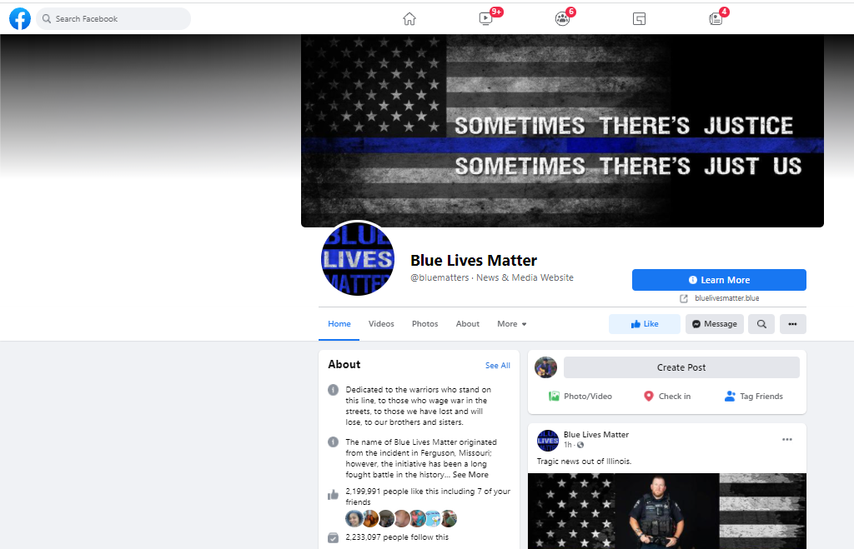
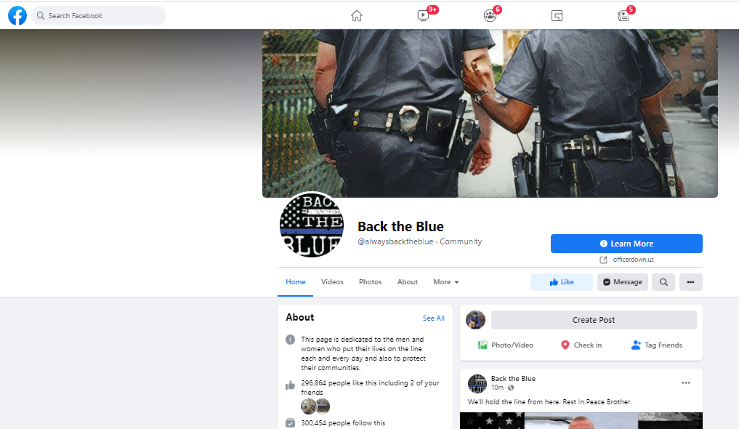
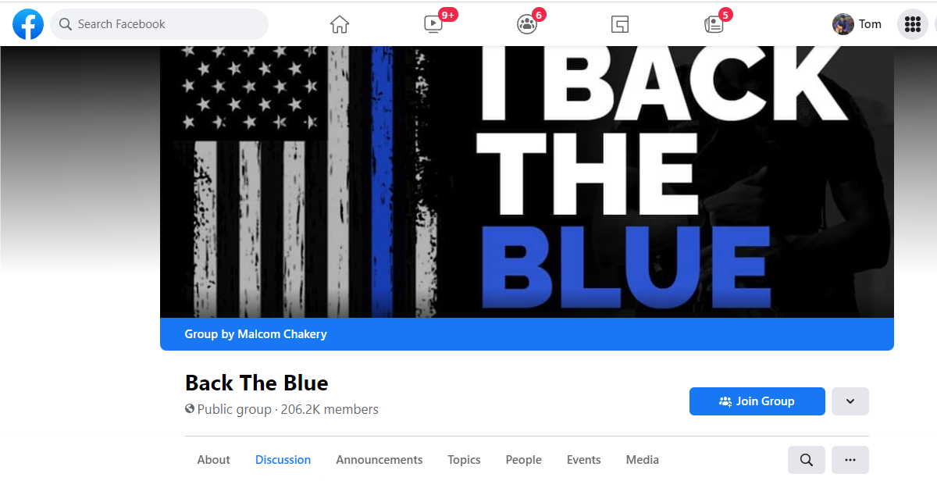

Slide 7
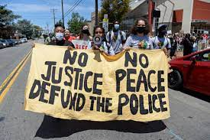
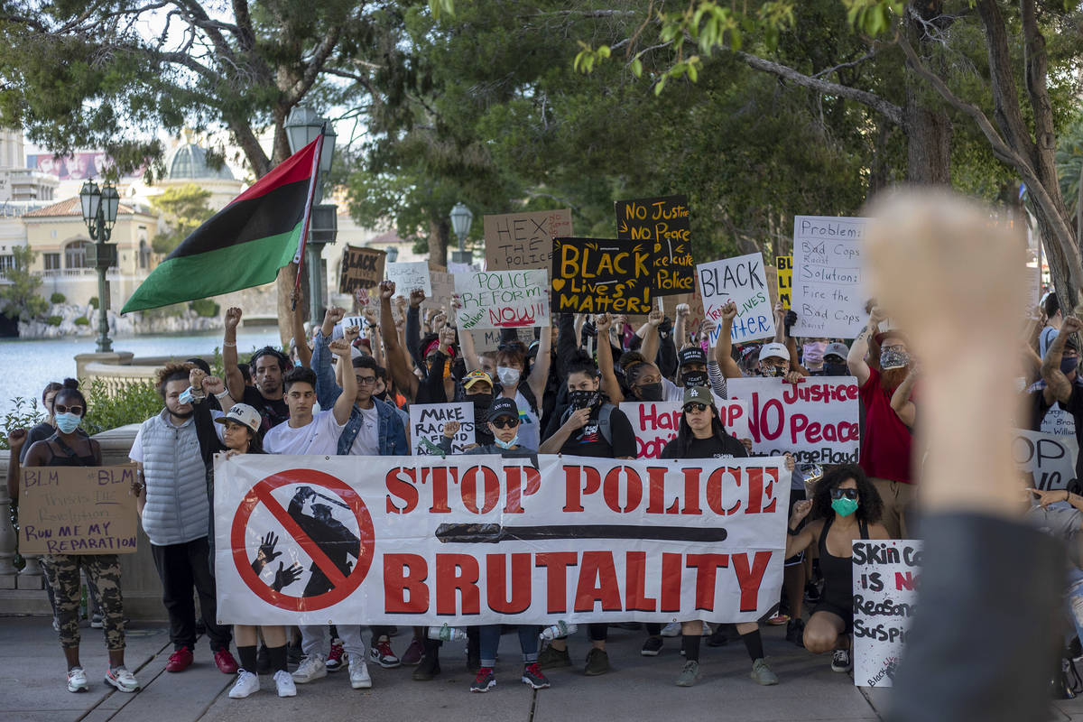
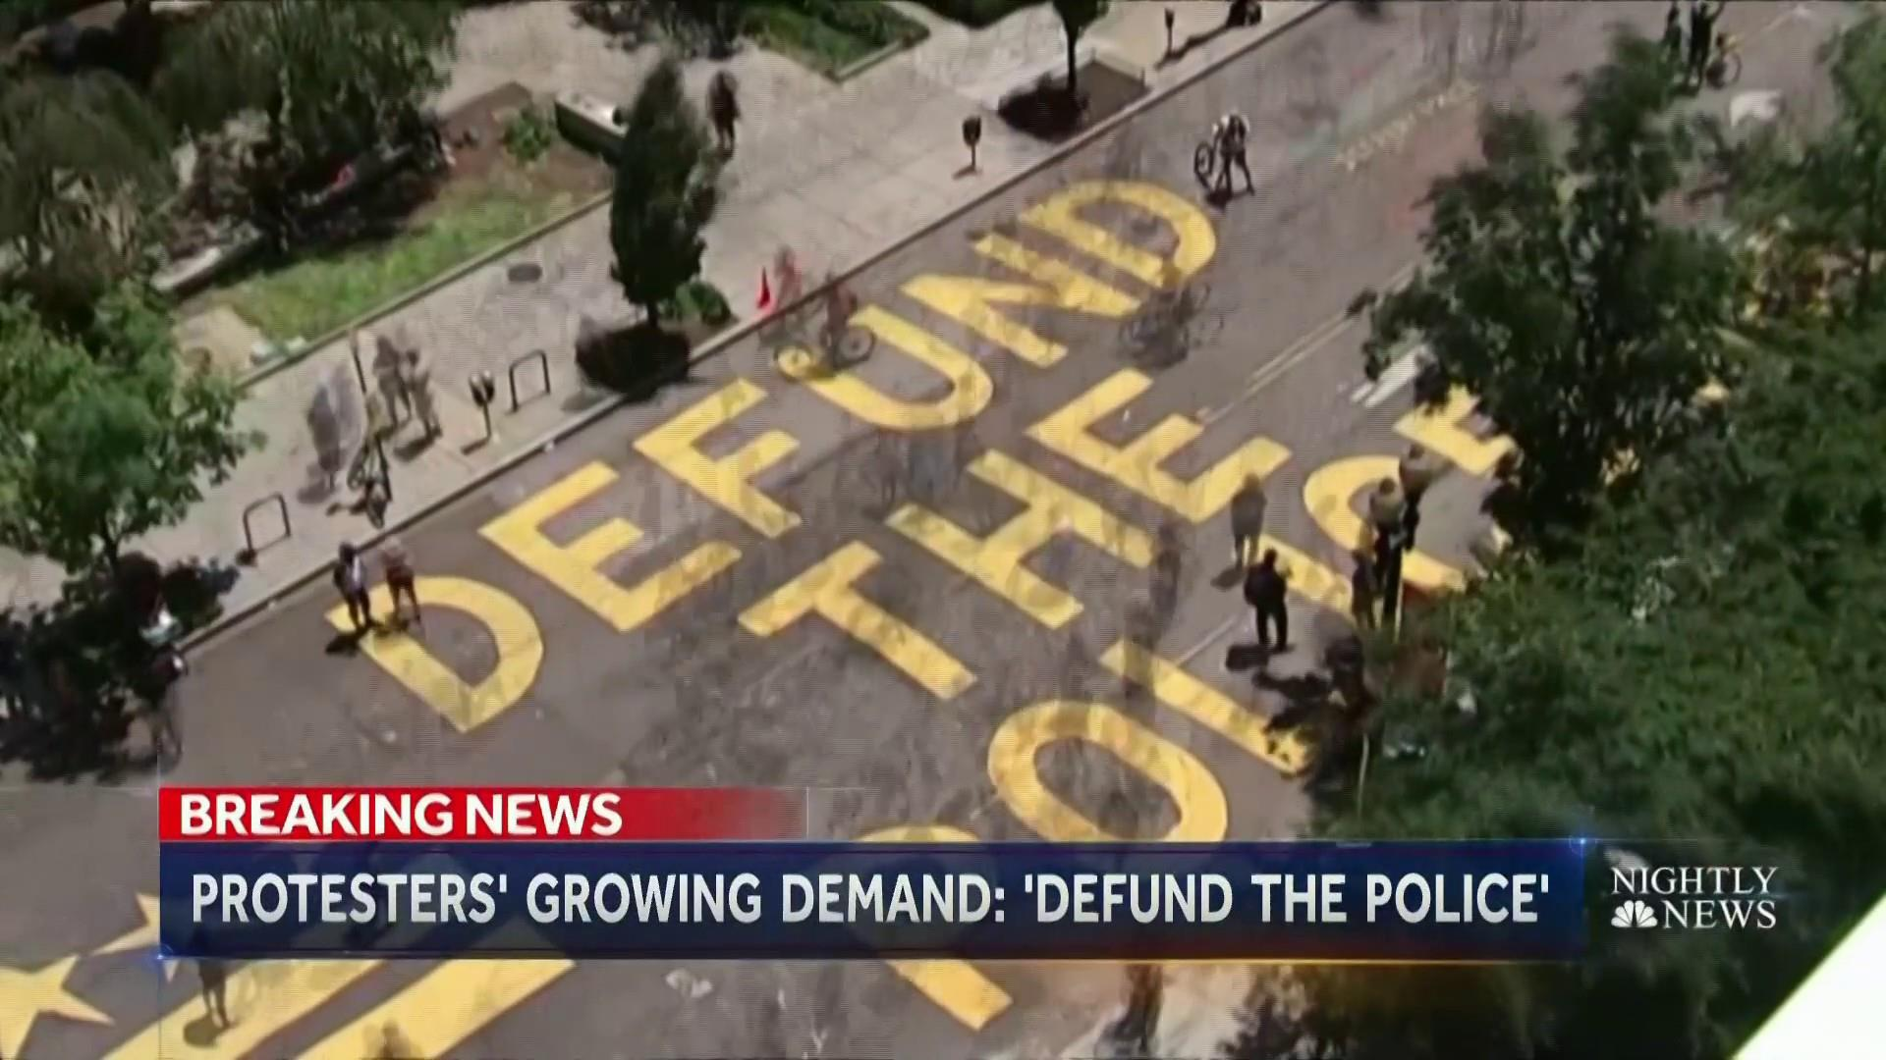
Black Lives Matter started July 2013
Blue Lives Matter started December 2014

Slide 8
Pleasant Occupation
Scarcity of Talent
Occupational Prestige (High Status)
High Salary

Slide 9
Professional Athlete
Pleasant Occupation
Scarcity of Talent
Occupational Prestige
High Salary
√
√
√
√

Slide 10
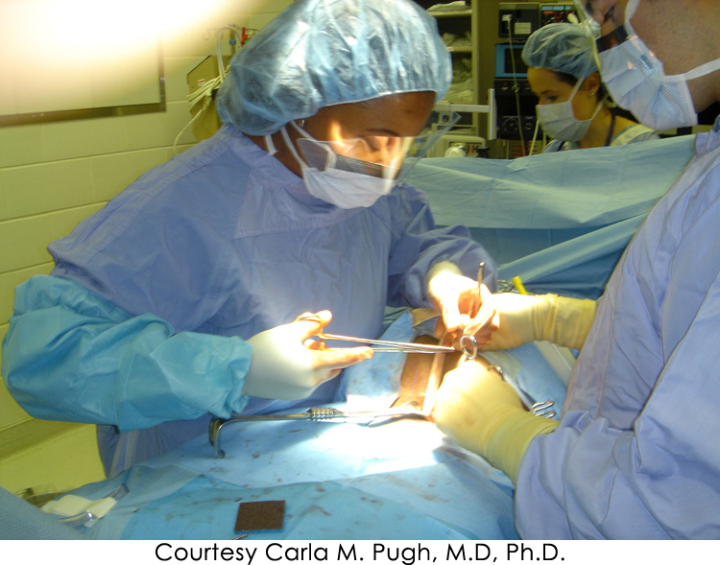
Medical Doctor
Pleasant Occupation
Scarcity of Talent
Occupational Prestige
High Salary
X
√
√
√

Slide 11
Military
Pleasant Occupation
Scarcity of Talent
Occupational Prestige
High Salary
X
X
√
X

Slide 12
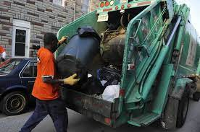
Garbage Collector
Pleasant Occupation
Scarcity of Talent
Occupational Prestige
High Salary
X
X
X
√

Slide 13
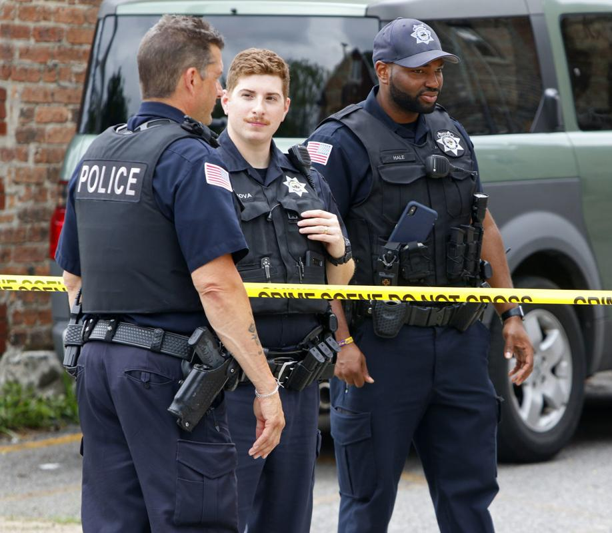
Police Officer
Pleasant Occupation
Scarcity of Talent
Occupational Prestige
High Salary
X
X
√
X

Slide 15
Police officers are expected to act as:
Social workers
Emergency medical technicians
Mental health counselors
Relationship counselors
Juvenile mentors
Public relations figures

Slide 16
In Valdosta, the basic police officer salary (with police accreditation bonus) is $39,669.40.

Slide 17
Research Questions
1) Did occupational prestige for police decline after the origination of the Black Lives Matter movement?
2) If occupational prestige has diminished, have police departments had to increase financial incentives to attract and retain police officers?

Slide 18
Back the Blue Hurts Police
Tom Hochschild Jr.
Lorna Alvarez-Rivera
Valdosta State University

