Slide 1
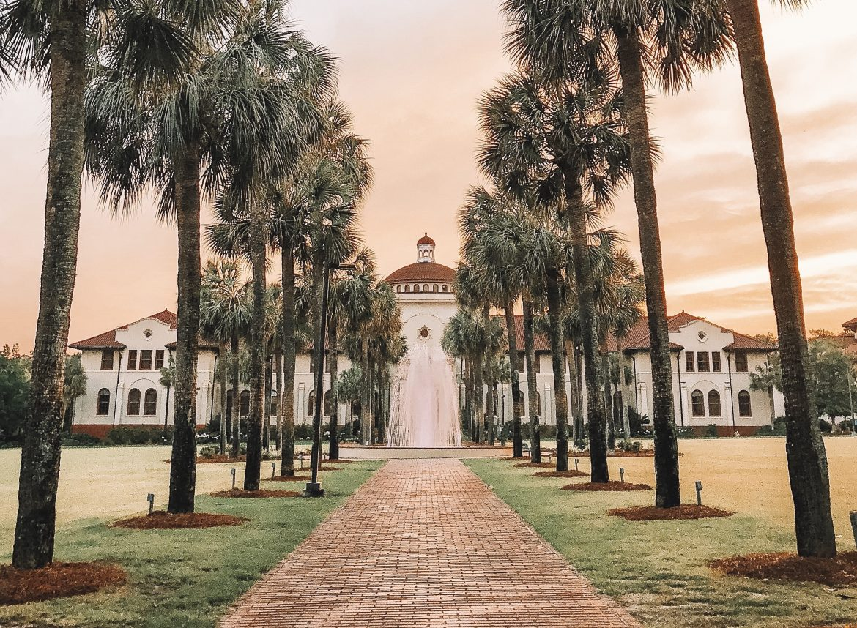
Greetings from Valdosta State University!

Slide 2
Presentation by Chris Cooke and R.K. Prine
A Brief Comparison of Ga Law Enforcement Agencies across three categories.
Commission on Accreditation for Law Enforcement Agencies, CALEA
Ga State Certified
Non-Certified

Slide 3
Two Part Methodology, 1 (N=65, 43% return rate)
Telephone Survey of Community Stakeholders Chamber of Commerce
Levels of Satisfaction on Overall Performance
Professionalism
Transparency including Use of Force Audits
Response to the Community
Race Relations including efforts to promote Diversity in the Depts.
Attempts to form Partnerships in the Community

Slide 4
Survey Results
There was a general level of support for Law Enforcement agencies across the board with values ranging from 3.5 to 4.9 on a traditional Likert Scale 1=lowest to 5=highest
However, on every category CALEA and GA State Certified agencies ranked higher, usually by a factor of 1. In other words a “letter grade” higher.

Slide 5
Methodology Part 2
Examination of UCR Crime Data over a 5 year period
This also included reporting rates across the agencies
40 CALEA Agencies
35 State Accredited
75 Non Accredited

Slide 6
Results
In 4/5 years CALEA and GA State had higher reporting rates to the UCR compared to non-certified agencies
In terms of Violent and Property Crime Rates non-certified agencies were slightly lower than CALEA and GA State Certified agencies for BOTH categories

Slide 7
A Note on Financial Costs to Obtain (CALEA)
1 to 24 employees $8,475.00
25 to 199 employees $11,450.00
200-999 employees $16,125.00
1000 or more employees $19,950.00

Slide 8
CALEA Annual Fees
1 to 24 employees $3,470.00
25 to 199 employees $4,065.00
200-999 employees $5,000.00
1000 or more employees $5,765.00

Slide 9
GA State Certification GA Association of Chiefs of Police
Cost Comparison to CALEA
$375 for certification
$375 annual renewal
CALEA Tier 1 has 181 Standards
Ga State has 129

Slide 10
Of the 45 CALEA Agencies in GA 40 are also Ga State Certified
Does anyone remember the Ferguson, MO Police Chief Jason Armstrong’s comparison to Certification with being in Compliance with a DOJ Consent Decree?
Ferguson, “The small Department with a big name, meeting accreditation standards is a 1, complying with a DOJ Consent Decree is a 10.”

Slide 11
In Conclusion
Get Vaccinated!
Get Certified! Just don’t promise your constituents lower crime rates will result!

