Slide 1
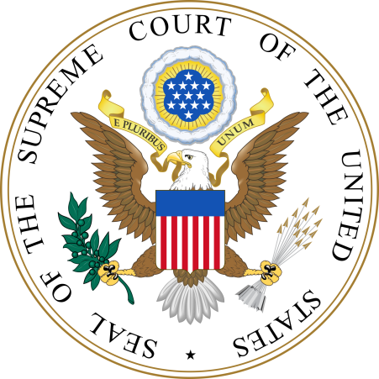
United States Supreme Court Criminal & Immigration Law Decisions of the 2019-2020 Term
Michael B. Shapiro, J.D. Clinical Assistant Professor of Criminal Justice Georgia State University and Peter Fenton, J.D. Faculty Emeritus Kennesaw State University

Slide 2
Hernandez v. Mesa, No. 17–1678 decided February 25, 2020 [Bivens claim] Alito majority, Thomas concurring, Ginsburg dissenting
Flying Fickle Finger of Fate Award Worst Decision of the Term, Part 1
Border Patrol Agent Mesa shot and killed Hernández, a 15-year-old Mexican while Mesa was standing on U.S. soil and Hernández was on Mexican soil, after having just run back across the border following entry onto U. S. territory. Hernández’s parents sued under Bivens v. Six Unknown Fed. Narcotics Agents, 403 U. S. 388, alleging that Mesa violated Hernández’s Fourth and Fifth Amendment rights. Held: Bivens’ holding does not extend to claims based on a cross-border shooting.

Slide 3
Kahler v. Kansas, No. 18–6135 decided March 23, 2020 [Insanity Defense] Kagan majority, Breyer dissenting
Flying Fickle Finger of Fate Award Worst Decision of the Term, Part 2
Under Kansas law a defendant may raise mental illness to show that he “lacked the culpable mental state required as an element of the offense charged,” however Kansas does not recognize any additional way that mental illness can produce an acquittal, and Kansas does not recognize a moral-incapacity defense. Held: Due process does not require Kansas to adopt an insanity test that turns on a defendant’s ability to recognize that his crime was morally wrong.

Slide 4
YOU HAVE A CASE OF WHAT?

Slide 5
Davis v. United States, No. 19–5421 decided March 23, 2020 [Plain Error Review] Per Curiam
Davis pled guilty to being a felon in possession of a firearm and possession of drugs with intent to distribute. He was sentenced to 4 years and 9 months to run consecutive to any sentence under pending state charges. Although Davis did not object at sentencing, he appealed, arguing that the sentence should be concurrent as part of the same course of conduct. The Fifth Circuit failed to conduct a plain-error review of this unpreserved argument. Judgement vacated for the Fifth Circuit’s practice of refusing to review.

Slide 6
Kansas v. Glover, No. 18-556 decided April 6, 2020 [Fourth Amendment, Reasonable Suspicion] Thomas majority, Kagan concurring, Sotomayor dissenting
A license plate check showed a vehicle owner’s driver’s license had been revoked. Assuming the owner was driving, which he was, the vehicle was stopped. The trial and Kansas Supreme Court found a Fourth Amendment violation for lack of reasonable suspicion of criminal activity, suppressing all evidence from the traffic stop. Held: An investigative traffic stop learning the registered owner’s driver’s license has been revoked is reasonable under the Fourth Amendment.

Slide 7
Kelly v. United States, et al., No. 18-1059 decided May 7, 2020 [Federal-Program Fraud and Wire Fraud] Kagan unanimous
Kelly, former New Jersey Governor Chris Christie’s Chief of Staff, and Port Authority officials closed off lanes to the George Washington Bridge as political retribution, using a cover story of a traffic study, which caused four days of gridlock. Kelly was convicted federal wire fraud, fraud on a federally funded program and conspiracy. Held: Because the scheme did not aim to obtain money or property, Kelly could not have violated the federal-program fraud or wire fraud laws.

Slide 8
Ramos v. Louisiana, No. 18-5924 decided April 20, 2020 [Unanimous Jury Verdict] Gorsuch majority, Sotomayor and Kavanaugh concurring, Alito dissenting
Only Louisiana and Oregon punish people based on 10-to-2 verdicts. Ramos was convicted in Louisiana by a 10-to-2 jury verdict and was sentenced to life without parole. He contests his conviction as an unconstitutional denial of the Sixth Amendment right to a jury trial. Held: The Sixth Amendment term “trial by an impartial jury” carries with it a requirement that a jury must reach a unanimous verdict in order to convict. If the jury trial right requires a unanimous verdict in federal court, it requires no less in state court.

Slide 9
Shular v. United States, No. 18–6662 decided February 26, 2020 [Armed Career Criminal Act] Ginsburg unanimous, Kavanaugh concurring
Shular pleaded guilty to being a felon in possession of a firearm and received a 15-year sentence, the mandatory minimum under ACCA, the District Court finding six prior Florida cocaine-related convictions as “serious drug offense[s]” triggering ACCA’s sentence enhancement. Held: Section 924(e)(2)(A)(ii)’s “serious drug offense” definition requires only that the state offense involve the conduct specified in the statute; it does not require that the state offense match certain generic offenses.

Slide 10
UPCOMING CASES
Borden v. United States (6th Circuit) whether the “use of force” clause in the Armed Career Criminal Act encompasses crimes with an intent requirement of mere recklessness?
Edwards v. Vannoy (5th Circuit) whether Ramos v. Louisiana, which held the U.S. Constitution requires states to obtain a unanimous verdict to convict a criminal defendant for a serious offense, applies retroactively to cases on federal collateral review?

Slide 11
UPCOMING CASES
Jones v. Mississippi (Supreme Court of Mississippi) whether under the 8th Amendment a sentencing authority must find that a juvenile is permanently incorrigible before it may impose a sentence of life without parole?
Pereida v. Barr (8th Circuit) whether a criminal conviction bars a noncitizen from applying for relief from removal when the record of conviction is ambiguous as to whether it corresponds to an offense listed in the Immigration and Nationality Act?

Slide 12
UPCOMING CASES
Torres v. Madrid (10th Circuit) whether an unsuccessful attempt to detain a suspect by use of physical force is a “seizure” within the meaning of the Fourth Amendment, or whether physical force must be successful in detaining a suspect to constitute a “seizure”?
Van Buren v. United States (11th Circuit) whether someone who is authorized to access information on a computer for certain purposes violates the Computer Fraud and Abuse Act if he or she accesses the same information for an unauthorized purpose?

Slide 13
QUESTIONS?
More detailed information about each of these cases, as well as others decided during the 2019-2020 term, is available in a Word formatted file on the CJAG website (cjag.us).
mshapiro5@gsu.edu and pfenton@kennesaw.edu

