Slide 1
The Ethical Implications of Pop Culture Humor: Laughing at Chief Wiggum
Kenneth Michael White, Ph.D., J.D.
Associate Professor, Political Science & Criminal Justice
Kennesaw State University
kwhite88@kennesaw.edu

Slide 2
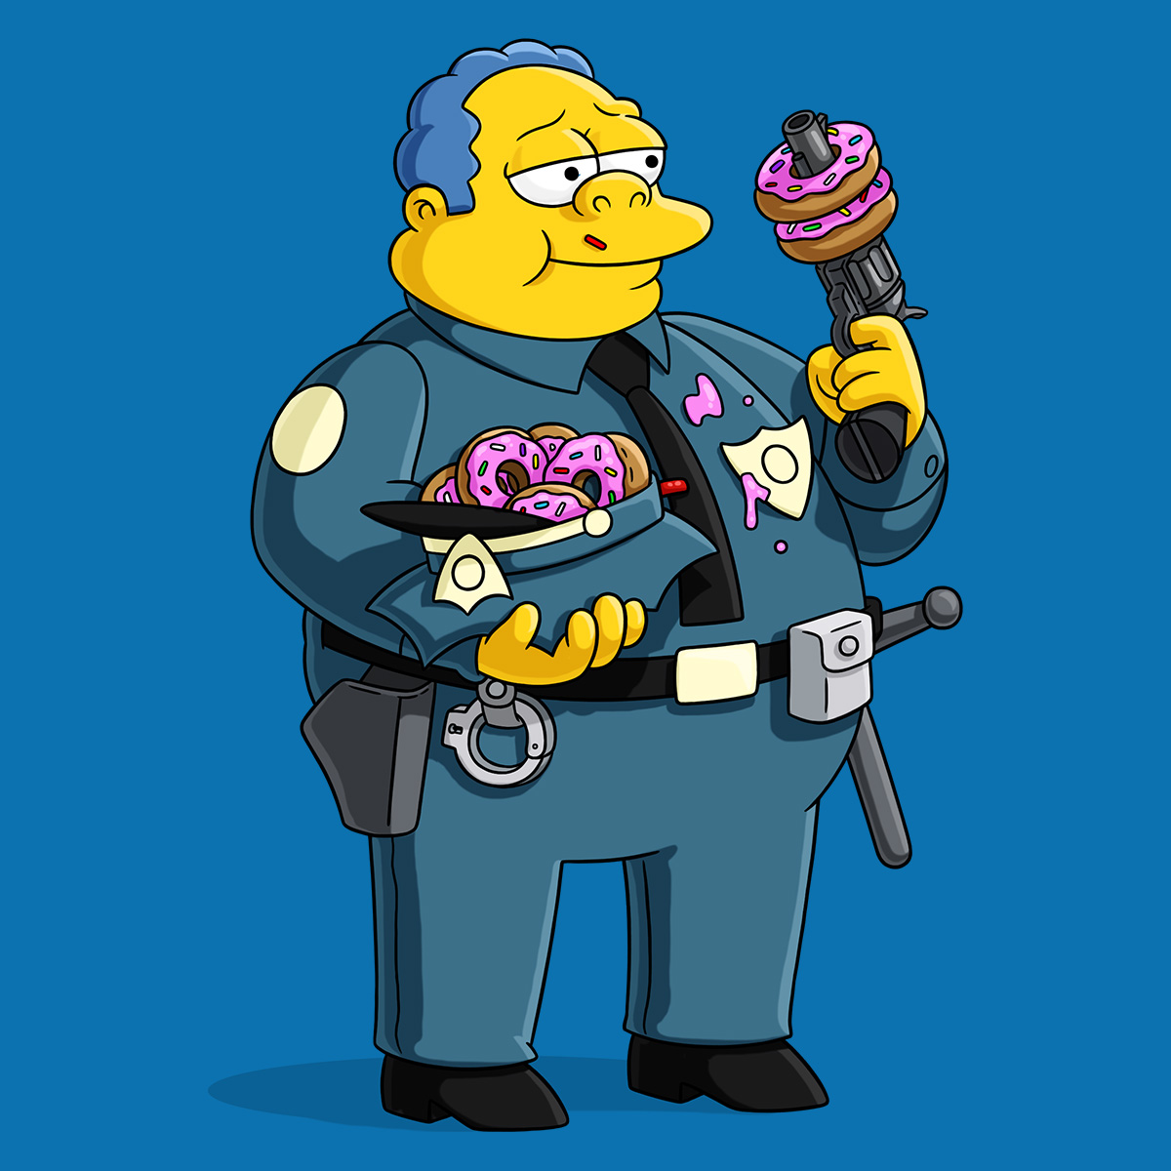
What’s This About?
Why study humor?
A classical political philosophy theory of humor: political vs. philosophical jokes
Why The Simpsons?
Laughing at Chief Wiggum
Selecting on the dependent variable: an example of laughable criminal justice behavior re medical marijuana prohibition
Path forward: Reform

Slide 3
Why study humor?
Humor within law enforcement affirms “group values, beliefs, and behaviors,” and allows for concerns to be raised that otherwise wouldn’t be; has the potential to help officers cope with tragedy (Progrebin and Poole 1998, 183-184).
Defined: “Humor is a state of affairs that is enjoyably incongruous” (Wright 1939, 7).
Shakespeare: “A jest’s prosperity lies in the ear of him that hears it, never in the tongue of him that makes it” (Love’s Labour’s Lost)
The realization of a difference between what ought to be and what happens in a joke is where the laugh occurs, as long as we are in the mood for it.

Slide 4
Two Kinds of Humor
Political humor (nomos): “The pleasures of the ludicrous originates in the sight of another’s misfortune” (Wright 1939, 6, referring to Plato’s observation that laugher is about “us” (the people laughing at someone) feeling superior to “them” (the victim of a joke).
Philosophical humor (physis): Cosmopolitan humor that does not attack a victim, but asks the audience to think (not feel superior) to get the joke.

Slide 5
Two Kinds of Humor: Examples
Political joke: “My first year as a cop was the greatest two years of my life” — Chief Wiggum
Philosophic joke: “Oh, Socrates, you’ve been unjustly condemned!” — Appollodorus
“Would you rather I had been justly condemned?” — Socrates

Slide 6
Why The Simpsons?
Art as a mirror that reflects society; we can study art to study the society (art is part of the shadows on Plato’s cave wall in the Republic)
Highly rated, Longest-running TV sitcom in America (1989—present)
Credited with creating an entire generation (Turner 2004)
Unites liberals and conservatives (Harvey Mansfield said it was the “best thing on television”)
“In Iraq, fighting stopped from 5-6 everyday so they could watch back-to-back episodes” (Reiss and Klickstein 2018, 178-179)

Slide 7
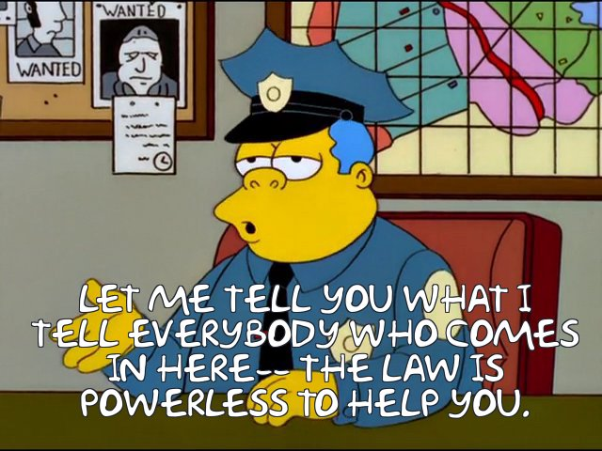
Chief Clancy Wiggum
Matt Groening (show’s creator): “I have a secret motto which is, ‘To entertain and subvert.’ If we can point out that teachers, political leaders, religious leaders, your parents, or your peers may be foolish, that’s a good lesson. Think for yourself.”
Mike Reiss (writer): “The fact that the police chief looks like a pig and talks like a gangster is our idea of deft social satire.”
Reiss: Police officers have told him “many times” that they think the show has “cops on staff” as writers, “because Chief Wiggum is so true to life.”

Slide 8
Chief Wiggum on Marijuana
Season 13, episode 16: Officer Wiggum’s police dog attacks high school Homer’s crotch (where he hid a joint given to him by Lenny and Carl).
Season 8, episode 20: Chief Wiggum breaks down the door of a series of homes, and then announces himself as the police; says, “if this one’s not the right house, I quit.” Wiggum’s new police dog finds the personal stash of marijuana on a blind man, Mr. Mitchell. Wiggum and other officers bring dates to the house for a party, and they sing a Bob Marley song as the credits roll.
Season 27, episode 9: Wiggum smokes a bong with Homer in Lisa’s room, and is caught by 15-year-old Bart. Wiggum: “Yeah, must be weird for ya.”

Slide 9
Connecting Marijuana Prohibition to the Story
“When jokes on The Simpsons become the news of the world—well, that’s just [messed] up” (Reiss and Klickstein 2018, 80).
This idea that reality could be like Wiggum reminded me of a previous case where DEA agents raided a medical marijuana collective in Santa Cruz, California, which was supported by the local authorities, including law enforcement. A local officer called the DEA agents “babies” for the way they acted. The September 5, 2002, federal raid on the Wo/Men’s Alliance for Medical Marijuana struck me as a laughable action by law enforcement (something Wiggum would do).
One patient described “five federal agents pointing assault rifles at my head…I am paralyzed and was on a respirator…Agents finally pushed aside the covers and saw that my legs weren’t quite right, but they still handcuffed me behind my back” (Goldston 2010, par 16).

Slide 10
Historical background: Marijuana prohibition began in the early 1900s on the basis of gross racial animus. It was considered medicine before it was outlawed.
When the voters passed the nation’s first medical marijuana law, then Attorney General of California, Dan Lungren, worked with federal law enforcement officials to ensure both state and federal officers were “on the same page.” Problem: The federal government did not recognize the existence of medical marijuana and was targeting doctors’ medical licenses if they recommended cannabis (a policy later struck down by an appellate court on free speech grounds).
Rather than implement the Compassionate Use Act uniformly, Lungren worked against it.
In 2005, San Diego County Supervisor Bill Horn (who is white) compared himself to Rosa Parks for refusing to issue medical marijuana ID cards as established by California law.
Despite the legalization of marijuana in 2020, there remains a racially disparate impact re who gets searched for marijuana offenses; “the bar for searching black and Hispanic drivers was still lower than that for white drivers post legalization” (Pierson, et al. 2020, 736).

Slide 11
Discussion
The conceit of this effort is two-fold. First, I want to introduce the idea that humor can be categorized as either political or philosophic. Second, I argue that any time the reality of criminal justice gets close to Wiggum’s laughable universe, then reform is needed.
Thus, the point on medical marijuana prohibition—A policy that started on the basis of express racism in 1937, and still shows evidence of a disparate impact today in 2020 means reform is needed. Past de jure racism + present de facto discrimination = Urgent need for reform.
Future research questions include what reform should look like specifically, whether Chief Wiggum has any impact on viewers’ attitudes towards law enforcement, and an analysis of the quantity of political vs. philosophic jokes that stem from Chief Wiggum.

Slide 12
Works Cited
Goldston, Linda. 2010. “Santa Cruz Medical Pot Collective Settles Lawsuit with Feds.” The Mercury News, January 22.
Pierson, Emma, et al. 2020. “A Large Scale Analysis of Racial Disparities in Police Stops Across the United States.” Nature Human Behavior 4: 736-745.
Progrebin, Mark R. and Eric D. Poole. 1998. “Humor in the Briefing Room” Journal of Contemporary Ethnography 17(2): 193-210.
Reiss, Mike and Mathew Klickstein. 2018. Springfield Confidential. HarperCollins.
Strauss, Leo. 1998. Xenophon’s Socrates. St. Augustine’s Press.
Turner, Chris. 2004. Planet Simpsons. De Capo.
Wright, Milton. 1939. What’s Funny—And Why. McGraw.

