Slide 1
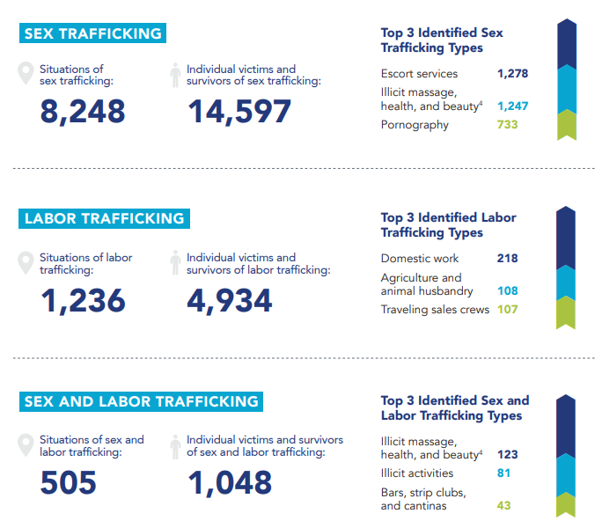
Cyber Human Trafficking
Colin Blankenship
Georgia Gwinnett College
Abstract: This poster presents data and recommendations about human trafficking and the role of cyber tools in the perpetrations of such act. Recommendations for addressing to combat human trafficking are presented.
How Cyber-Trafficking is Perpetrated
This Photo by Unknown Author is licensed under CC BY
Cyber Tools of Human Trafficking
The internet is singlehandedly the most important cyber tool for human traffickers.
Certain social media website can be used by traffickers to contact their victims and build trust
False advertisements can be placed on many websites which lure in victims.
Victims can be “traded” through certain websites
Computer cameras can be used to capture illicit images of victims. These images can then be distributed through the internet
Trafficker uses various websites and internet adds to lure victims with offers of a job, a romantic relationship, etc.
Victim is coerced to send revealing pictures or videos, or to meet the trafficker
The victim is forced to interact with predators online, or is sold outright
Recommendations
Inform people about NCMEC and ICAC
Closer monitoring of known and suspected trafficking websites
Teach transportation workers to notice the signs of human trafficking
Promote the sharing of information and resources across jurisdictions to combat human trafficking
Source: The Polaris Project (2019)
Sources
Van Dijk, J. & van der Heijden, P. G. M. (2016). On the potential of Multiple Systems Estimation for estimating the number of victims of human trafficking across the world. Retrieved September 15, 2020, from https://www.researchgate.net/profile/Peter_GM_Heijden/publi cation/305179429_On_the_potential_of_Multiple_Systems_Estim ation_for_estimating_the_number_of_victims_of_human_trafficki ng_across_the_world/links/5784109908ae37d3af6c15ae.pdf
Sykiotou, A. P. (2017). Cyber trafficking: recruiting victims of human trafficking through the net. Retrieved September 17, 2020, from http://crime-in-crisis.com/en/wp-content/uploads/2017/06/74- SYKIOTOU-KOURAKIS-FS_Final_Draft_26.4.17.pdf

